Slide 1

Open ETCS WP7 Toolchain Dev COURSE UI Plugin 4 Eclipse

Slide 2
Course OBJECTIVEs
General view of UI integration in Eclipse
How to declare UI Contributions
Practical Case

Slide 3
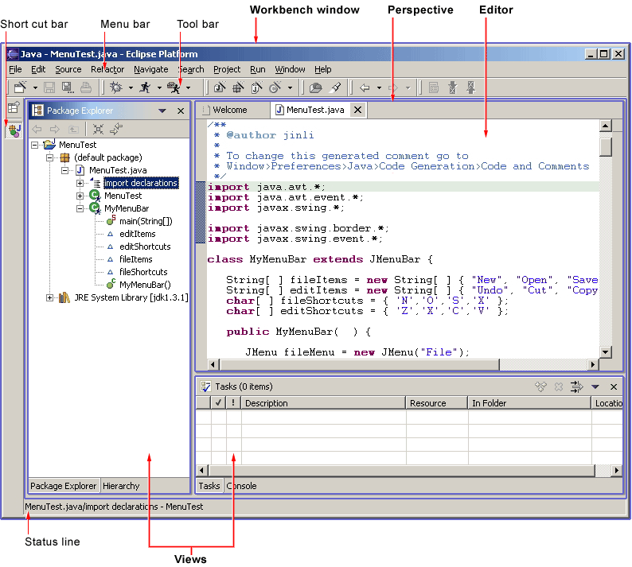
General views of UI in EClipse
Several options :
Ressources :
http://wiki.eclipse.org/User_Interface_Guidelines

Slide 4
Linking Plugin to the UI
Several Extension point to handle:
org.eclipse.ui.views
Declare Views
org.eclipse.ui.editors
Declare Editors (e.g. in the toolbar)
org.eclipse.ui.commands
Link a Behavior to an Id
org.eclipse.ui.menus
Contribute a command to a Menu (windows, popup, view, property)
org.eclipse.ui.handlers
Link Command to the Java Code
org.eclipse.ui.bindings
Key combination to launch commands
Ressource :
http://help.eclipse.org/luna/topic/org.eclipse.platform.doc.isv/guide/workbench_cmd.htm?cp=2_0_4_1

Slide 5
Links between Ui Elements
Eclipse Views
Plugin
Views
Plugin
Java Code
Plugin
Handlers
RefersTo
ContributeTo
Eclipse
Menus
Plugin
Menus
RefersTo
ContributeTo
Plugin
Icons
Eclipse
Editors
Plugin
Editors
Plugin
Commands
Use
Eclipse
KeyBinds
Plugin
KeyBinds
ContributeTo

Slide 6
How to declare Plugin UI
Good practice :
Make a specific UI plugin
E.g : org.openects.sysml2b.ui
Create commands with icons
To allows multiple way of interaction with the user in a coherent way
Limit your contribution to avoid UI pollution !
Limited to the needed perspective
Availlable only with correct selected Element / active view.
Use explicit namespace
Allow re-usability and maintainability.
Don't forget to add the core plugin to dependencies ….
Or the UI plugin loaded alone will probably crash ….

Slide 7
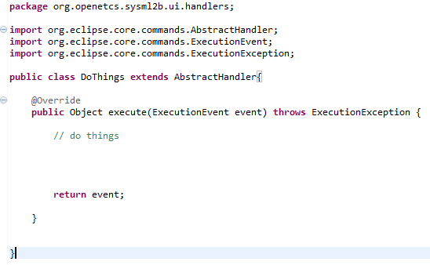
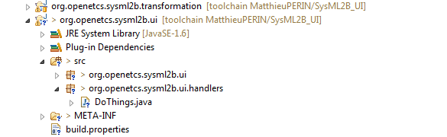
How to Code and handler
Add an handler package
Add a Class (an handlers)
Extends AbstractHandler
From org.eclipse.core.commands
Has an execute public method
An @override of the super class
Throws a ExecutionException if fails

Slide 8
What is an Handler For ?
Handler is the link between the UI and the Plugin Code.
Must Select, Recover and Validate Entry Data for the Code
Don’t forget to use the associated utils: org.eclipse.ui.handlers.HandlerUtil
Linked to a command: behavior in human point of view

Slide 9
Handler Example within Papyrus
Select an UMLElement in the Model Explorer View and give it to the Plugin Code:
Get the selected (Java) element
ISelection selection = HandlerUtil.getActiveWorkbenchWindow(event). getActivePage().getSelection();
Run several constitancy checks and modifiy the data
ISelection is not null
ISelection is an IStructuredSelection
Cast the ISelection in a IStructuredSelection
Get the EObject associated to the First Object of the IStructuredSelection (using Papyrus EMFHelper Class)
Check that the EObject is an UMLElement
Launch the Plugin Code with the UMLElement (finaly !)
Question: How I am sure that the selected Element is in the Model Explorer ? : use commands/menus configuration ☺

Slide 10
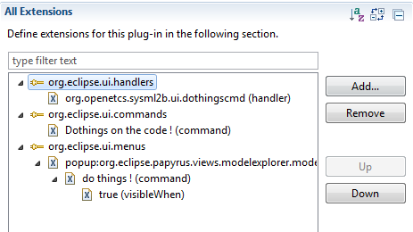
Link between Handlers, Commands and MENUS
Time to “play” with the UI extensions points !
RC stand for RightClick !
org.eclipse.ui.handlers
RC > New > handler
org.eclipse.ui.commands
RC > New > Command
org.eclipse.ui.menus
RC > New > MenuContribution
Select menuContribution then RC > New > Command
Select Command then RC > New > visibleWhen

Slide 11
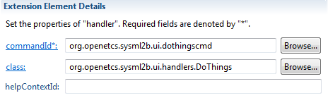
Configuring Handlers
Give the command name
Think about good naming convention !
Give the Class that Act
Must be an Handler sub type like AbstractHandler

Slide 12
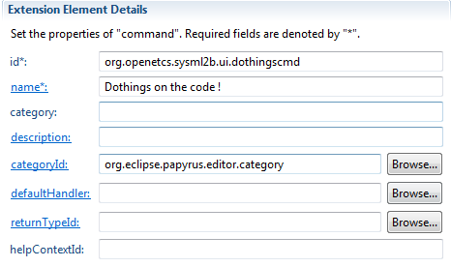
Configuring Commands
Set the command name
Think about good naming convention !
Give an human readable name
Category Id is used to limit Command accessibility to certain Editor, Like the papyrus editor linked to the Papyrus perspective Mandatory to avoid UI pollution !

Slide 13
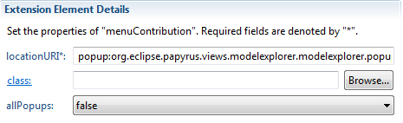
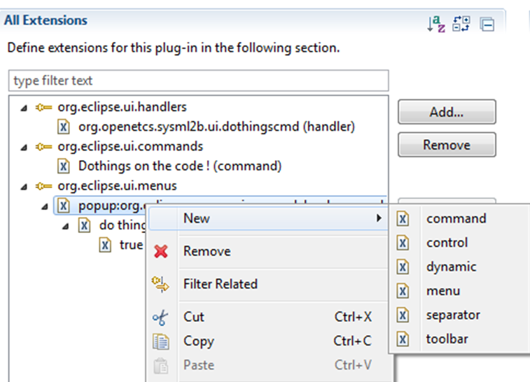
Configuring Menu
Set LocationURI
The “place” where the menuContribution will appear
Editor / view specific
Mandatory to avoid UI pollution !
Lots of possibilities after the first menu:
Command
(sub) menu
Separator
….
Here just add a command to start with !

Slide 14
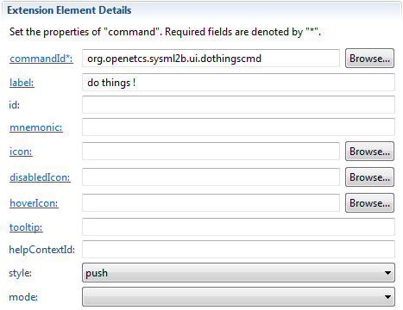
Configuring Menu Command
Give the command name
Give an human readable Label
Appears in the menu, so short please !
Lots of customization here:
Icons,
Hover icon,
Tooltip
Button style
… the more the better but optional !
Add a visibleWhen sub element

Slide 15
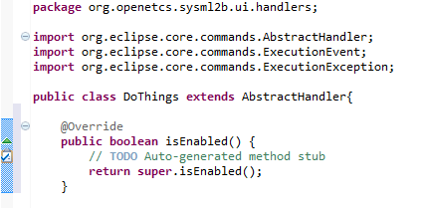
Configuring Menu Command VISIBLEWHEN attribute
Used to limit the availability (visibility) of the command
Extremely useful to limit bad typed input data for the code/UI Pollution
Set checkEnabled to true or false depending your test …
2 solutions : in the plugin.xml or in handler code within isEnabled method
<visibleWhen checkEnabled="false"> <with variable="selection"> <iterate ifEmpty="false" operator="and"> <adapt type="org.eclipse.core.resources.IFile"> <or> <test property="org.eclipse.core.resources.extension" value="uml"> </test> </or> </adapt> </iterate> </with> </visibleWhen>

Slide 16
Setting Command Name
Pay attention to the command name, really error prone and time consuming for debug !

Slide 17
Launch a runtime
To test your UI plugin.
Debug and have fun !
Reminder for Papyrus :
Menu id
Model explorer papyrus: popup:org.eclipse.papyrus.views.modelexplorer.modelexplorer.popup
diagram papyrus: popup:org.eclipse.gmf.runtime.diagram.ui.DiagramEditorContextMenu
Category
Model Explorer/generic diag: org.eclipse.papyrus.editor.category
Diagrams : org.eclipse.papyrus.uml.diagram.XXX
Ressources:
http://help.eclipse.org/luna/topic/org.eclipse.platform.doc.isv/guide/workbench_cmd.htm?cp=2_0_4_1

