Slide 1

Workpackage 4 Verification & Validation & Safety approach
Notes:
2 Parts- Presentation:
General Verification & Validation Part (me)
Part on Model Based Testing by Professor Jan Peleska from University of Bremen
Set out to do?
What are the challenges we face in V&V?

Slide 2
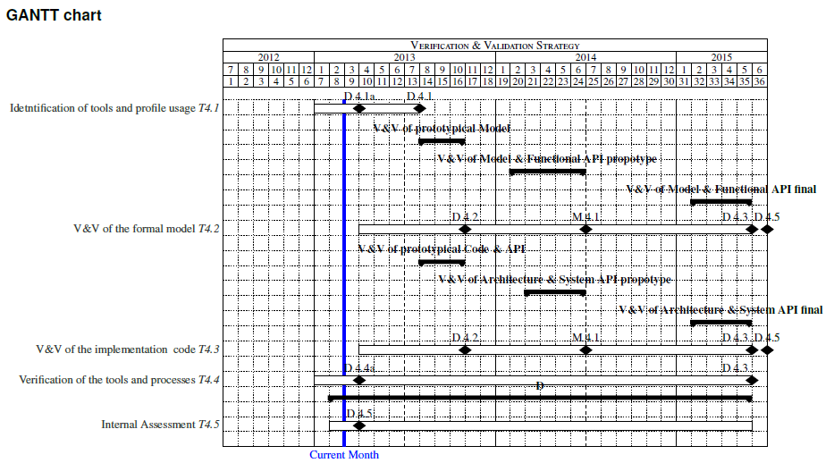


Verification and Validation Activities Artifacts Triggered SCRUM-Verificarion and Validation Level
3 Verification and Validation Level:
Safety case is based on EN 50126 & 50129
Always looks at the system at all
Parts of Safety Case
Part 1: Definition of System
Part 2: Quality Management Report
Part 3: Safety Management Report
Part 4: Technical Safety Report
Part 5: Related Safety Cases
Part 6: Conclusion
Define testing interfaces of openETCS being foreseen by the API
Notes:
Marc: Why do we choose a model?
V&V report and Assessment report as result of each phase
➔ What did we achieve?

Slide 3
WP4 Progress
July 2013
Verification and Validation Plan
August 2013:
Goal: full artifacts traceability, meta-formats
September 2013:
Goal: test and proof coverage
October 2013:
V&V Report on Preliminary Model
July 2013
Aug.
2013
Sept. 2013
Oct. 2013
Nov. 2013
July 2013:
Decision on Preliminary Model to evaluate
August 2013:
Start of V&V
level 1
October 2013:
Goal: Complete VnV level 1 process
Q4 2013
First Internal Assessment Report
Notes:
Marc

Slide 4
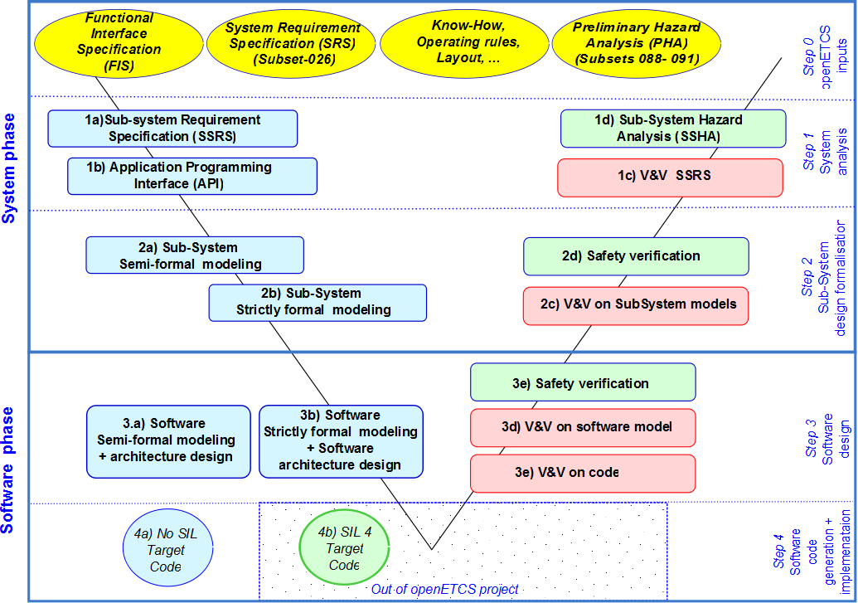
Verification and Validation Inside openETCS
Notes:
Jan

Slide 5
Verification and Validation Inside openETCS
Tools for management of requirements
tool for automizes requirements coverage
Tools for SSRS: Data dictionary, management of requirements
Tool for Hazard Log/ Safety Evaluation
modelling tools for architecture
proofing framework
System modelling tool
testmodel
testgenerator
testsuite
tools for code analysis
Software model
Code generator
message based tests
Notes:
M/J

Slide 6
Principles for artifacts integration (1st VnV level)
Qualification for generated artifacts
Using the same artifact as input – clearly defined interface
Having integrable outputs
Advantage: Not more effort on artifacts
one artifact
Tool 1
Tool 2
one artifact
Notes:
M

Slide 7
Principles for artifacts integration (1st VnV level)
Qualification for generated artifacts
Message Based Tests (Subset-026 chapter 7 & 8 transferability)
➔ Tests can contribute to Validation
one artifact
Tool 1
Tool 2
Test-DB
Testsuite(s)
Notes:
M/J

Slide 8
Gaps in primary model
Top Level: Completing SSRS according to a first set of functions that can feed validation
Is needed for Verification!
Selection of toolchain
Selection of stable builds (all tool chain)
Code generator in the toolchain is needed
If there is no open source code generator, code generated by closed source will be taken for VnV level 1
Notes:
M J J

Slide 9
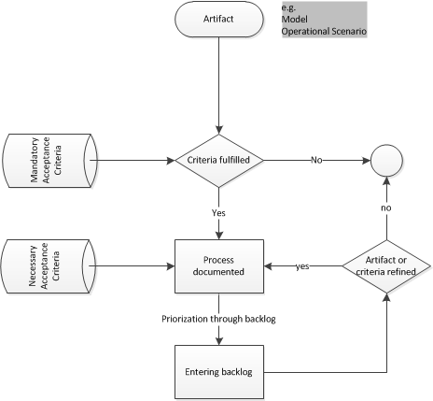
Artifacts decision process
Mandatory criteria
- Model in baseline 3 exists
- Existing interfaces to other VnV tools
- Modularity (D2.6-02-078.1)
Necessary criteria
- Model completeness
- Evaluation from state of the art
- Integration
Notes:
M

Slide 10
Results WP7 Tool-Benchmark
 |  |  | Weight | GOPRR | ERTMSFormalSpecs | SysML with papyrus | SysML with EA | SCADE | EventB | Classical | System | Petri | GNATprove | Semi-Formal | Formal
3.1 Main usage of the approach | for which phases do you recommend the approach |  | 1 | 18 | 0 | 9 | 10 | 18 | 9 | 18 | 15 | 12 | 18 | 1 | 1
0 | for which type of activities do you recommend the approach |  | 0,1 | 27 | 42 | 39 | 40 | 52 | 50 | 42 | 36 | 47 | 39 | 1 | 1
3.2 Language | Which are the main characteristics of the language |  | 1 | 35 | 54 | 52 | 49 | 56 | 42 | 41 | 46 | 0 | 45 | 1 | 1
0 | capabilities of the language |  | 1 | 57 | 65 | 62 | 74 | 81 | 63 | 73 | 74 | 87 | 81 | 1 | 1
3.3 System Analysis | how the approach can be involved for the sub-system requirement specification |  | 1 | 62 | 53 | 58 | 72 | 59 | 69 | 57 | 0 | 63 | 33 | 1 | 1
3.4.1 Semi-formal model | Concerning semi-formal model, how the WP2 requirements are covered ? |  | 1 | 0 | 94 | 69 | 87 | 0 | 91 | 74 | 68 | 81 | 79 | 1 | 0
0 | Concerning safety properties management, how the WP2 requirements are covered ? |  | 1 | 0 | 39 | 24 | 35 | 0 | 55 | 54 | 48 | 63 | 50 | 1 | 0
0 | Does the language allow to formalize (D2.6-02-069): |  | 1 | 0 | 56 | 33 | 51 | 0 | 51 | 56 | 62 | 54 | 57 | 1 | 0
3.4.2 Strictly formal model | Concerning strictly formal model, how the WP2 requirements are covered ? |  | 1 | 54 | 0 | 0 | 68 | 86 | 87 | 90 | 0 | 86 | 80 | 0 | 1
0 | Does the language allow to formalize (D2.6-02-070): |  | 1 | 45 | 0 | 0 | 47 | 61 | 50 | 56 | 0 | 54 | 57 | 0 | 1
3.5.1 Functional design | How the approach allows to produce a functional software model of the on-board unit ? |  | 0,5 | 35 | 0 | 31 | 45 | 39 | 0 | 45 | 37 | 42 | 37 | 0 | 1
3.5.2 SSIL4 design | How the approach allows to produce in safety a software model ? |  | 0 | 35 | 0 | 34 | 67 | 72 | 0 | 72 | 41 | 69 | 58 | 0 | 1
0 | Which criteria for software architecture are covered by the methodology (see EN50128 table A.3) : |  | 0 | 60 | 0 | 33 | 36 | 37 | 0 | 48 | 52 | 44 | 75 | 0 | 1
3.6 Software code generation | Which criteria for software design and implementation are covered by the methodology (see EN50128 table A.4) : |  | 1 | 45 | 0 | 23 | 44 | 52 | 0 | 54 | 39 | 42 | 48 | 0 | 1
3.7 Main usage of the tool | Which task are covered by the tool ? |  | 1 | 33 | 32 | 16 | 34 | 54 | 48 | 50 | 40 | 45 | 45 | 1 | 1
3.8 Use of the tool | 0 |  | 1 | 54 | 96 | 104 | 93 | 103 | 107 | 92 | 104 | 74 | 110 | 1 | 1
3.9 Certifiability | This section discusses how the tool can be classified according EN50128 requirements (D2.6-02-085). |  | 1 | 21 | 27 | 23 | 28 | 57 | 35 | 53 | 24 | 51 | 43 | 1 | 1
 |  |  | Sum | 581 | 558 | 610 | 880 | 827 | 757 | 975 | 686 | 914 | 955
 |  |  | Weight Sum | 444 | 520 | 492 | 719 | 652 | 712 | 795 | 542 | 738 | 768
 |  |  | Semi Formal | 283 | 520 | 454 | 537 | 433 | 575 | 572 | 485 | 535 | 565
 |  |  | Formal | 444 | 331 | 366 | 546 | 652 | 515 | 611 | 364 | 540 | 582
Notes:
J

Slide 11
Expectations to WP7
To develop the VnV Process:
Support for consistency of process
Does the process work?
Support for tool functionality
Which tasks are supported by the tools?
Support for tool integration is needed
Do the tools integrate?
Support for artifacts
Do the artifacts trace?
Notes:
J

Slide 12
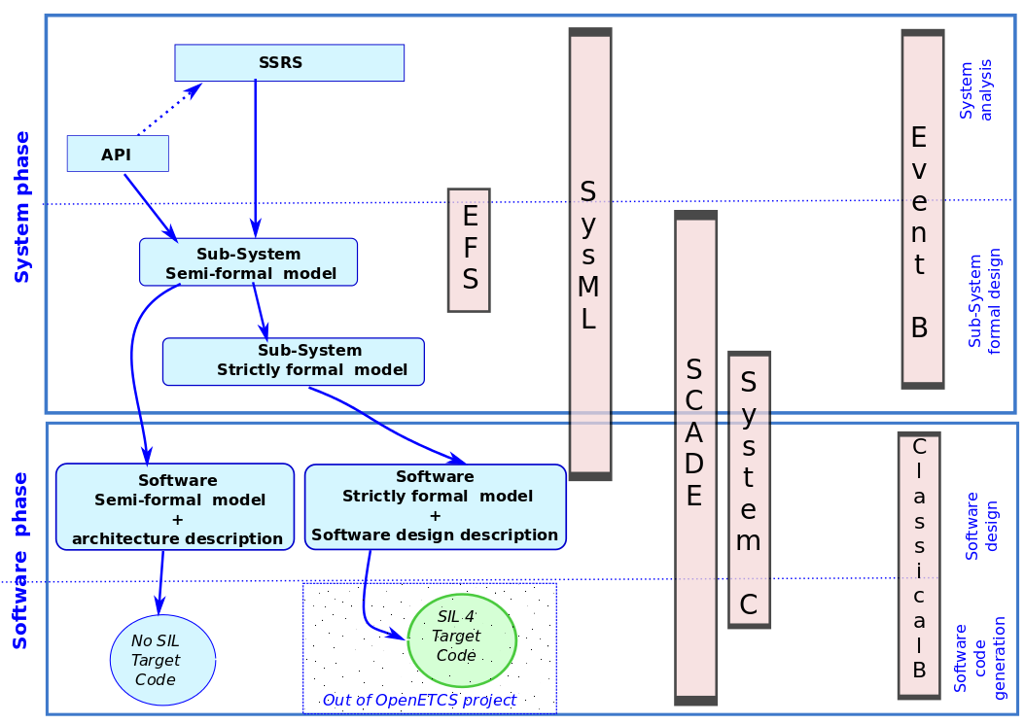
Model Transformation Possible
Backup or
VnV artifact?
Artifacts as input
for VnV level 1
VnV l1 transfor-mation
Transformation/
constraints
proof
Notes:
J M

Slide 13
Primary Model for VnV level 1
SysML/papyrus (High level model)
SCADE (Low level model & Code)
Justification:
SysML:
agreed on as primary tools for modelling (WP7- Workshop 4.7.2013)
SCADE:
Best available formal tool and code generation according to WP7 benchmark
Notes:
J M

Slide 14
Thank you for your attention!
For further regular information, please subscribe to the Verification & Validation group: wp4+subscribe@openetcs.org
Marc Behrens Deutsches Zentrum für Luft- und Raumfahrt e.V. Marc.Behrens@DLR.de Tel: +49 (0) 531 295 3451
Notes:
Thanks to all WP4 TL and participants

Slide 15
Question round
Back

