Slide 1
BLACKJACK
♠ Pouria Momayyezi ♦
♥ Axel Reman ♣

Slide 2
Description of the game
Aim of the game
Beat the dealer without getting a hand-total over 21 points
Betting
How to play
Highest hand wins.
Closer to 21, higher likelihood of beating the dealer.
Exceeding 21 point-total = LOSS
If dealer gets the same value as you, dealer wins.
Card values
2-10 = Face value
Dressed cards = 10
Ace is worth 1 or 11.
Notes:
Title of the project + Student name o Description of the game o Challenges you faced
o Ideas about possible future improvements of your game/code o Highlights

Slide 3
PLAY
♥♠♦♣

Slide 4
Challenges with the project
Entering while-loops and exiting under the right conditions
Having many conditions and changing something without knock-on effects
Sharing the code back and forth and keeping track of the latest version
Coding over eachothers’ shouldes; holding back when exploring the other’s ideas.
Commenting the code
Notes:
Title of the project + Student name o Description of the game o Challenges you faced
o Ideas about possible future improvements of your game/code o Highlights

Slide 5
Future improvements
Betting
Insurance
Double up
Splitting
More players
More decks in the stack of cards
Dynamic gameboard

Slide 6
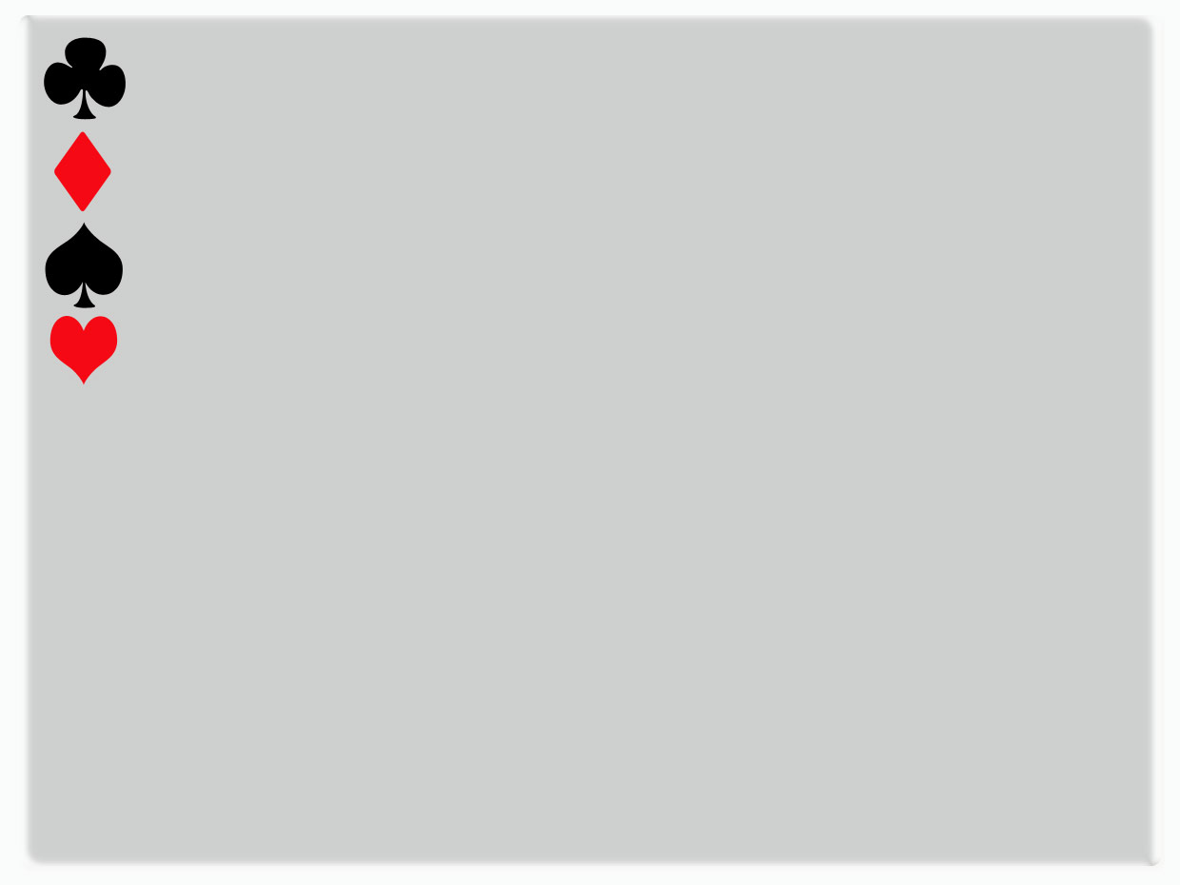
Highlights
Nice to put our newly aqcuired skills to work and be able to build something functional
Going back to a problem after having slept on it

