Slide 1
Transfer optimizations on partitioned communication
Axel Schneewind

Slide 2
MPI-4.1: Nonblocking Communication Operations
Progress. A call to MPI_WAIT that completes a receive will eventually terminate and return if a matching send has been started , unless the send is satisfied by another receive.
In particular, if the matching send is nonblocking, then the receive should complete even if
no call is executed by the sender to complete the send. Similarly, a call to MPI_WAIT that
completes a send will eventually return if a matching receive has been started, unless the
receive is satisfied by another send, and even if no call is executed to complete the receive.

Slide 3
MPI-4.1: Nonblocking Communication Operations
Order. Nonblocking communication operations are ordered according to the execution
order of the calls that initiate the communication.
The nonovertaking requirement of Section 3.5 is extended to nonblocking communication, with this definition of order being used.

Slide 4
MPI-4.1: Partitioned Communication
Rationale. Partitioned communication is designed to provide opportunities for MPI implementations to optimize data transfers. MPI is free to choose how many transfers to do within a partitioned communication send independent of how many partitions are reported as ready to MPI through MPI_PREADY calls.
Aggregation of partitions is permitted but not required.
Ordering of partitions is permitted but not required.
A naive implementation can simply wait for the entire message buffer to be marked ready before any transfer(s) occur and could wait until the completion function is called on a request before transferring data.
However, this modality of communication gives MPI implementations far more flexibility in data movement than nonpartitioned
communications. (End of rationale.)

Slide 5
State of implementations - OpenMPI
Progress
No software progress threads
Offloading to hardware
Partitions are mapped to a partitioned send request, started by Pready()
No guarantee that transfer occurs on Pready()

Slide 6
State of implementations - MPICH
A single transfer is initiated after all Pready()-calls have been made
No early-bird-gain or overlap with computation

Slide 7
Goals
Measure effective bandwidth depending on message size
Do different MPI-implementations perform optimizations (aggregation, reordering) on partitioned transfers?
Is it possible to trigger early progress using completion tests?
Do OpenMPIs Point-to-point Messaging Layer (PML) – components make use of hardware offloading?

Slide 8
Benchmarking scheme
// initialization
for i in 0...num_iterations:
MPI_Barrier(); // synchronization
s_i = MPI_Wtime();
MPI_Start(&request);
for p in 0...partition_count in some order:
perform some MPI operation to send/receive partition p
MPI_Wait(&request, &status);
e_i = MPI_Wtime();
// cleanup

Slide 9
Benchmarks
Mode | initialization | ready | completion
 |  | MPI_Send
 | MPI_Send_init | MPI_Start | MPI_Waitall
 |  | MPI_Isend | MPI_Waitall
 | MPI_Psend_init | MPI_Pready | MPI_Wait
 | MPI_Psend_init | MPI_Pready | MPI_Wait | MPI_Request_get_status
 | MPI_Win_create | MPI_lock MPI_Put MPI_unlock
 | MPI_Win_create | MPI_lock Mpi_Put MPI_unlock

Slide 10
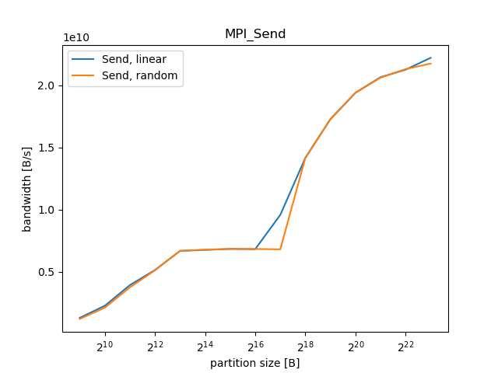
OpenMPI: Send->Recv

Slide 11
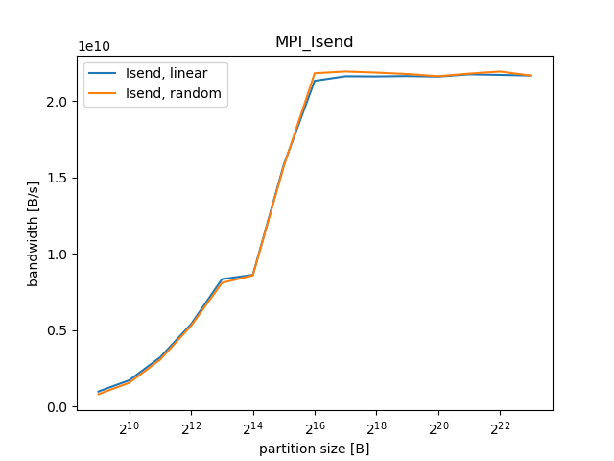
OpenMPI: ISend->IRecv

Slide 12
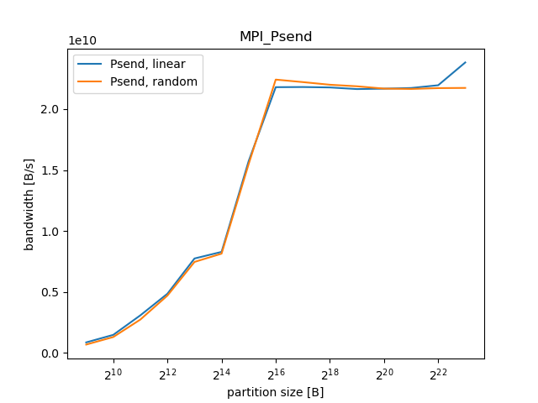
OpenMPI: Psend

Slide 13
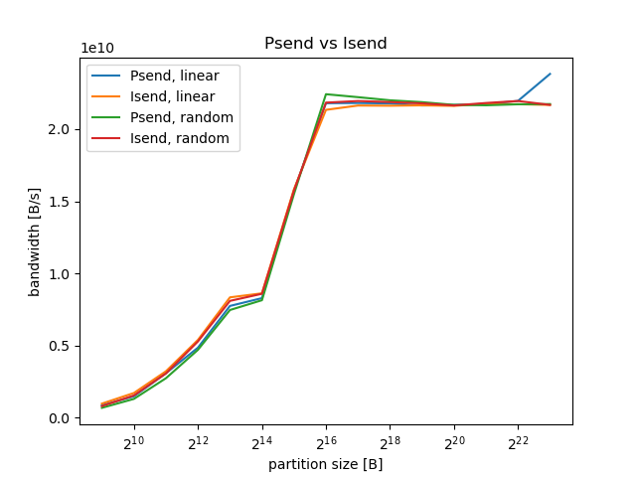
OpenMPI: Psend vs Isend

Slide 14
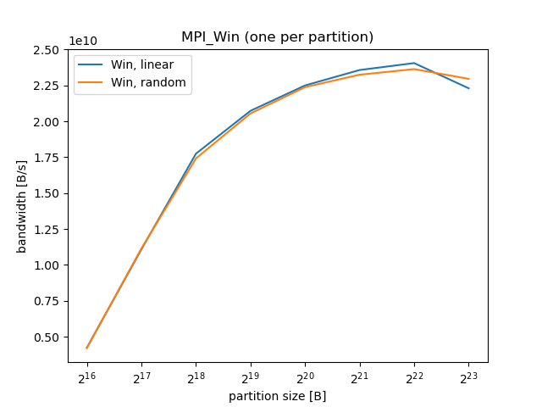
OpenMPI: MPI_Win per partition

Slide 15
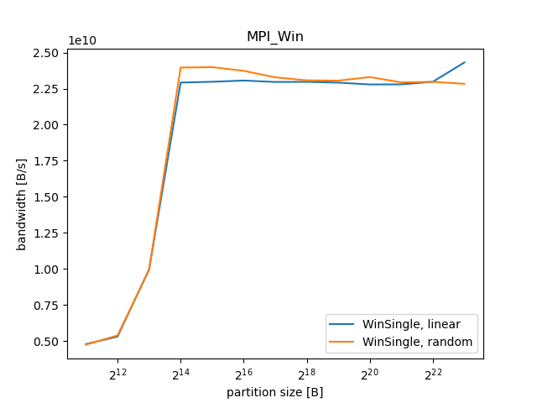
OpenMPI: MPI_Win for entire buffer

Slide 16
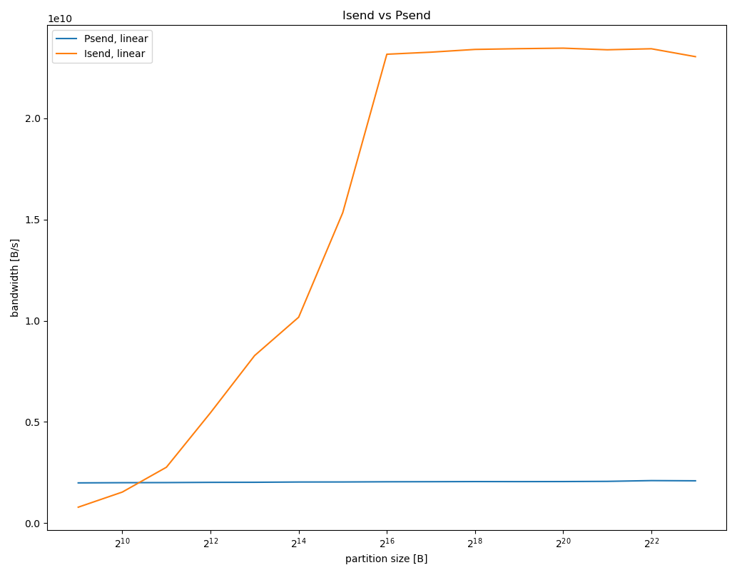
Results: Psend on MPICH-4.1.2

Slide 17
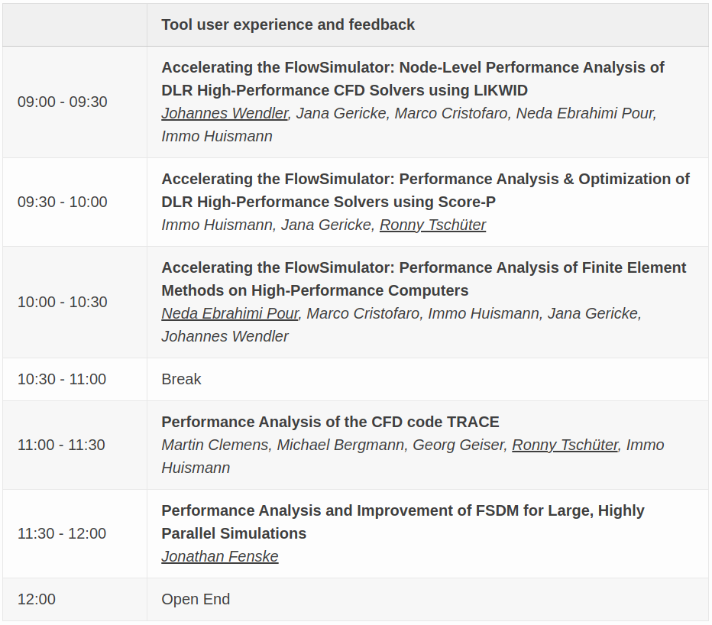
Program Day 2:

Slide 18
IPTW 2023
Thanks for participating!
International Parallel Tools Workshop, 5./6. October 2023

