Slide 1
Transfer optimizations on MPI partitioned communication
Axel Schneewind

Slide 2
Outline
MPI partitioned communication
Introduction
MPI-4.1 standard
Optimization opportunities
Current implementations in OpenMPI and MPICH
Benchmarks
Psend vs Persistent Send (single-/multithreaded)
Psend, Isend with completion tests
Psend vs RDMA

Slide 3
Motivation: Hybrid Programming
Rank 0
Rank 1
buffer
?
buffer
p0
p1
p2
p3
p0
p1
p2
p3
T0
T1
T2
T3
T0
T1
T2
T3
Notes:
Motivation:
buffers worked on by multiple threads (pthreads, GPU-threads)
Options for transfer:
single transfer after entire computation -> potentially long waiting time between data being ready and sent
Transfer per rank via Send/Isend/RDMA/... -> contention over resources (network interface) -> locking required
Solution: partititioned communication

Slide 4
MPI: Partitioned Communication Operations
MPI_Psend_init
MPI_Start
MPI_Pready
MPI_Pready
MPI_Pready
MPI_Wait/MPI_Test
MPI_Request_free
Notes:
General sequence of operations on partitioned communication
-> similar to persistent send
-> only MPI_Pready may be called concurrently

Slide 5
MPI-4.1: Nonblocking Communication Operations
Order (3.5). Messages are nonovertaking: If a sender sends two messages in succession to the
same destination, and both match the same receive, then this operation cannot receive the
second message if the first one is still pending. [analogously for receive operations]
Order (3.7.4). Nonblocking communication operations are ordered according to the execution
order of the calls that initiate the communication.
Notes:
Important properties of nonblocking communication operations
Nonblocking communication operations are ordered according to the execution
order of the calls that initiate the communication.
The nonovertaking requirement of Section 3.5 is extended to nonblocking communication, with this definition of order being used.
This requirement is not imposed on transfers of partitions

Slide 6
MPI-4.1: Nonblocking Communication Operations
Progress (3.7.4). A call to MPI_WAIT that completes a receive will eventually terminate and return if a matching send has been started, unless the send is satisfied by another receive.
In particular, if the matching send is nonblocking, then the receive should complete even if
no call is executed by the sender to complete the send.
Notes:
Progress:
Transfers have to be done before MPI_Wait returns or MPI_Test returns flag=true
Transfer has to terminate eventually
No requirement on when exactly transfers occur (MPI_Pready is not required to make progress)
Progress rule also applies to non-destructive testing (MPI_Request_get_status(), MPI_Parrived()) -> could potentially be used to trigger progress earlier
A call to MPI_WAIT that completes a receive will eventually terminate and return if a matching send has been started, unless the send is satisfied by another receive.
In particular, if the matching send is nonblocking, then the receive should complete even if
no call is executed by the sender to complete the send. Similarly, a call to MPI_WAIT that
completes a send will eventually return if a matching receive has been started, unless the
receive is satisfied by another send, and even if no call is executed to complete the receive.

Slide 7
MPI-4.1: Partitioned Communication
Rationale. Partitioned communication is designed to provide opportunities for MPI implementations to optimize data transfers.
MPI is free to choose how many transfers to do within a partitioned communication send independent of how many partitions are reported as ready to MPI through MPI_PREADY calls.
Aggregation of partitions is permitted but not required.
Ordering of partitions is permitted but not required.
A naive implementation can simply wait for the entire message buffer to be marked ready before any transfer(s) occur and could wait until the completion function is called on a request before transferring data. However, this modality of communication gives MPI implementations far more flexibility in data movement than nonpartitioned communications. (End of rationale.)
Notes:
TODO: shorten
Standard names possible optimizations that implementations may perform:
Aggregation
Reordering
Selecting internal message size different to counts given to Psend/recvInit()
Implementation may decide when to perform transfers

Slide 8
Possible optimizations – Reduce locking overhead
Notes:
TODO
Transfers per thread might require synchronization of accesses to network interface
Psend: only mark partitions as ready when calling Pready and handle transfer somewhere else (e.g. main thread)

Slide 9
Possible optimizations – Early-bird effect
Notes:
TODO: insert graphic
Idea:
Starting transfer as soon as first partition is ready overlaps computation and communication,
Reduces total time from start of computation to end of communication, especially if duration between first and last partition becoming ready is large

Slide 10
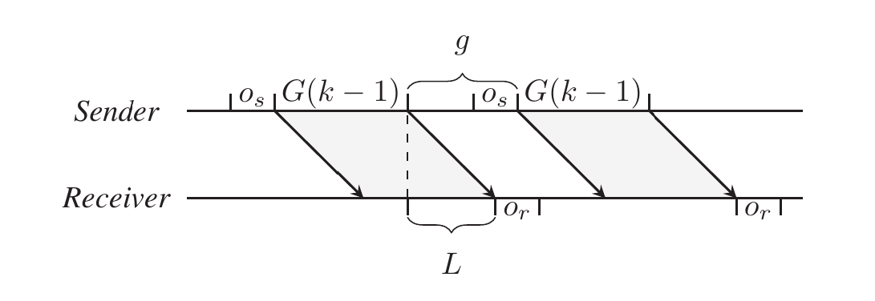
Possible optimizations – Message aggregation
Y. H. Temuçin, S. Levy, W. Schonbein, R. E. Grant and A. Afsahi, "A Dynamic Network-Native MPI Partitioned Aggregation Over InfiniBand Verbs,"
https://doi.org/10.1109/CLUSTER52292.2023.00029
Notes:
LogG model:
(communication latency (L), overhead(o), bandwidth (G), gap (g))
There is some duration g between consecutive messages, where earlier transfer does not increase effective bandwidth
Implementations may wait before sending after Pready calls without reducing effective bandwidth

Slide 11
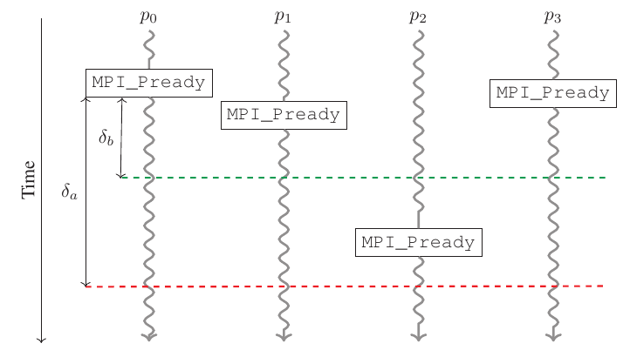
Possible optimizations – Message aggregation
Y. H. Temuçin, S. Levy, W. Schonbein, R. E. Grant and A. Afsahi, "A Dynamic Network-Native MPI Partitioned Aggregation Over InfiniBand Verbs,"
https://doi.org/10.1109/CLUSTER52292.2023.00029
Notes:
How transfer could work:
Send message after each Pready
Wait for last Pready and send entire buffer
Potentially better: after p0, wait for some delta and send both p0,p1, then p3, then p2
Only 3 messages transferred

Slide 12
Current implementations: OpenMPI/5.0.2
MPI_Psend_init
p0
p1
...
pm
progress engine
MPI_Start
isend_init
isend_init
isend_init
MPI_Pready
flag[0] = ready
MPI_Pready
flag[1]=ready
MPI_Pready
flag[m]=ready
progress():
for some p with flag[p]=ready:
start(request[p])
MPI_Wait/MPI_Test
MPI_Request_free
Notes:
TODO: highlight that operations are per partition, not thread, add progress engine
OpenMPI maps transfers to isend calls:
MPI_Start initializes request for each partition
MPI_Pready marks partition as ready, progress engine starts and tests request
MPI_Wait calls progress engine until all transfers done

Slide 13
Current implementations: MPICH/4.2.0
MPI_Psend_init
p0
p1
...
pm
MPI_Start
counter = p
isend_init
isend_init
MPI_Pready
counter-- ;
MPI_Pready
counter--;
counter--;
start
MPI_Pready
MPI_Wait/MPI_Test
wait
MPI_Request_free
Notes:
MPICH maps all partitions to one single transfer:
Counter initialized with partition count in MPI_Start
Pready decrements counter
When counter == 0: start transfer

Slide 14
Goals
Measure effective bandwidth depending on message size and quantify performance benefits
Is it possible to trigger early progress using completion tests?

Slide 15
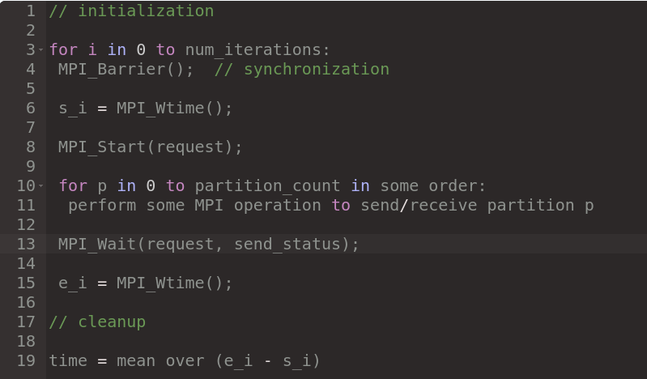
Benchmarking scheme
Notes:
TODO: Pseudocode schöner anzeigen
// initialization
for i in 0...num_iterations:
MPI_Barrier(); // synchronization
s_i = MPI_Wtime();
MPI_Start(&request);
for p in 0...partition_count in some order:
perform some MPI operation to send/receive partition p
MPI_Wait(&request, &result->send_status);
e_i = MPI_Wtime();
// cleanup

Slide 16
Benchmarks
Mechanism | Initialization | Partition ready | Completion | Freeing
Send | - | MPI_Send (p) | - | -
SendPersistent | MPI_Send_init (p) | MPI_Start (p) | MPI_Waitall | MPI_Request_free (p)
Isend | - | MPI_Isend (p) | MPI_Waitall | MPI_Request_free (p)
Psend | MPI_Psend_init | MPI_Pready (p) | MPI_Wait | -
Win | MPI_Win_create | MPI_lock MPI_Put(p) MPI_unlock | - | MPI_Win_free
operations marked with (p) are performed for each partition

Slide 17
Experimental setup
2 nodes on HAWK with one mpi process each
Bandwidth:
Fixed buffer size of 8MiB, partition sizes between 512B and 8MiB
Partitions marked ready in left-to-right or randomized order
Multithreading with OpenMP
Notes:
TODO: exact maximum bandwidth for Infiniband

Slide 18
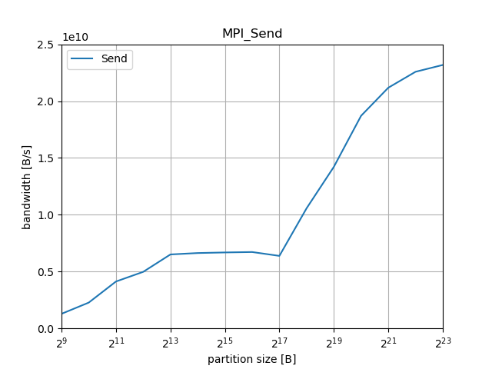
Baseline: Send->Recv

Slide 19
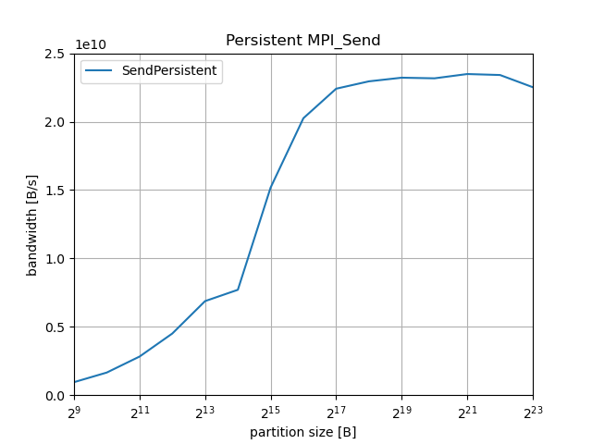
Baseline: Persistent Send
Notes:
Speedup compared to Send/Recv, as transfer and initialization of next transfer can happen concurrently

Slide 20
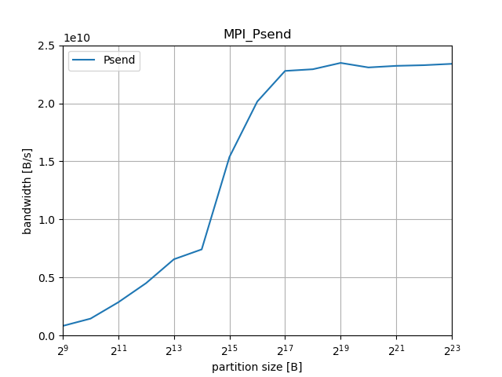
Results: Psend
Notes:
Similar to Isend/Irecv or persistent Send

Slide 21
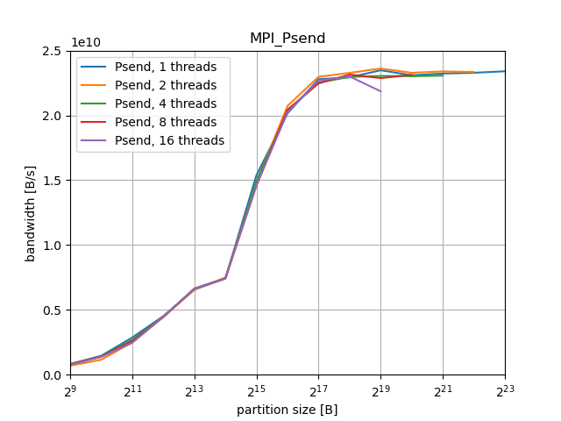
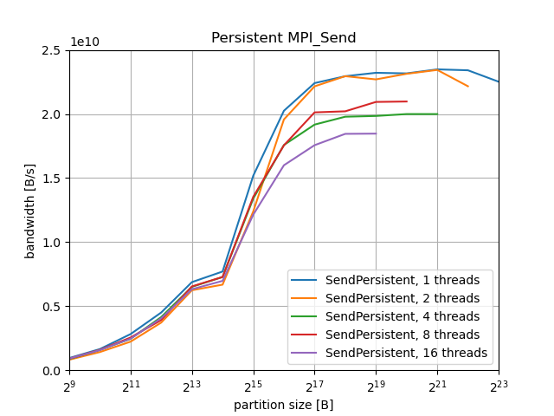
Results: Persistent Send vs Psend (multithreaded)
Notes:
Bandwidth differs by ~10% for higher partition sizes, possibly due to no required synchronization on Pready calls

Slide 22
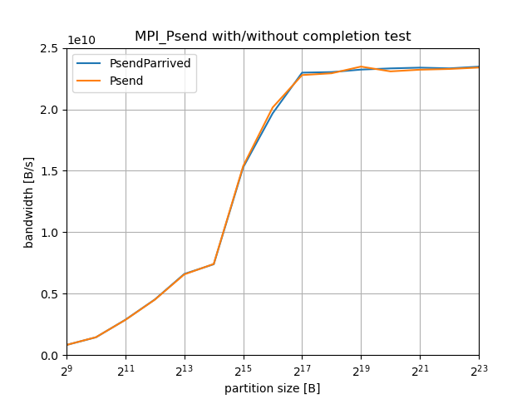
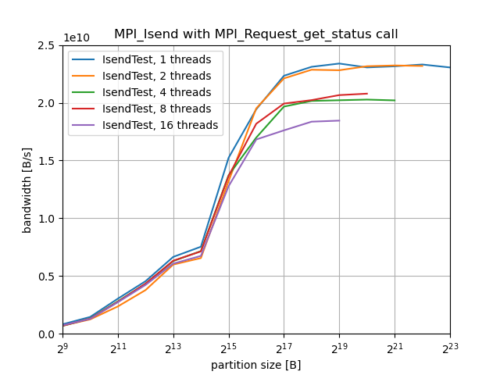
Results: Completion testing
Notes:
TODO: compare isend with/without on fixed thread count
Bandwidth differs by ~10% for higher partition sizes, possibly due to no required synchronization on Pready calls

Slide 23
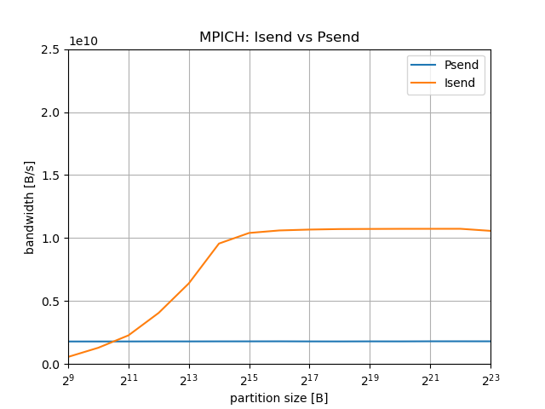
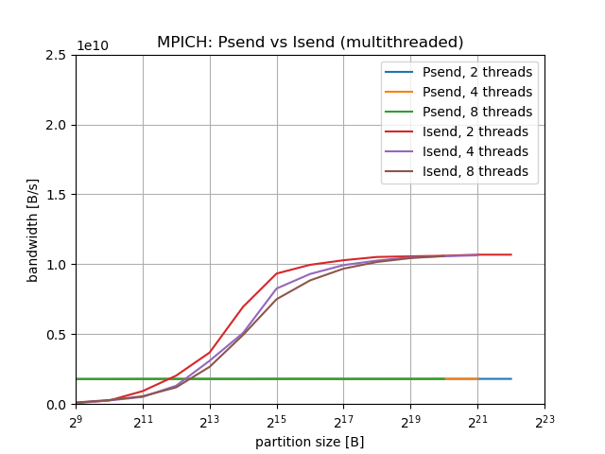
Results: Psend on MPICH-4.1.2

Slide 24
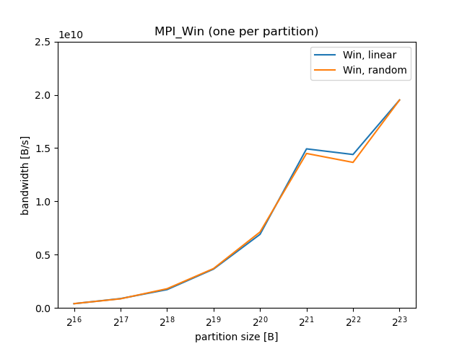
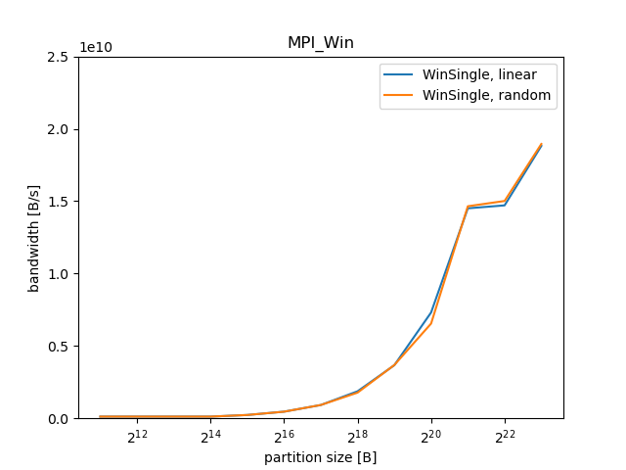
Results: MPI_Win
Notes:
TODO update, include multithreaded case, compare to Psend

Slide 25
Conclusion
OpenMPI
Partitioned Communication has similar performance as persistent Send when single-threaded
Partitioned Communication provides higher performance when using multiple threads
However, no further optimizations such as message aggregation
Partitioned Communication in MPICH currently provides lower performance than other mechanisms

Slide 26
Thanks for your attention!

Slide 27
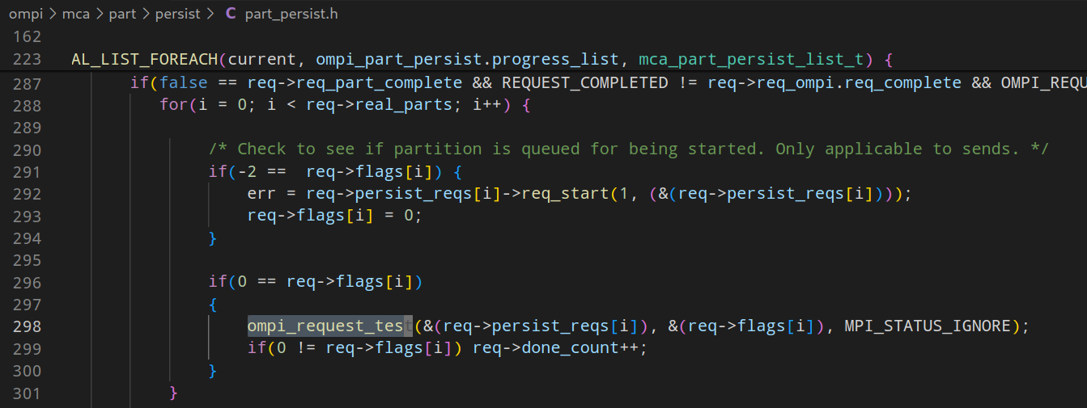
Appendix – OpenMPI progress

Slide 28
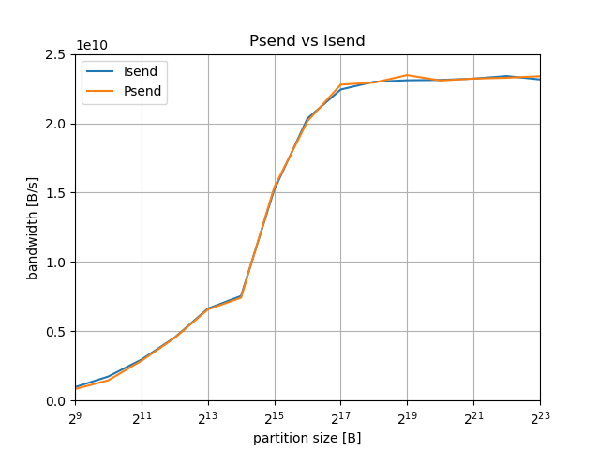
Appendix: Isend vs Psend

Slide 29

Appendix - Isend
Notes:
Speedup compared to Send/Recv, as transfer and initialization of next transfer can happen concurrently

Slide 30
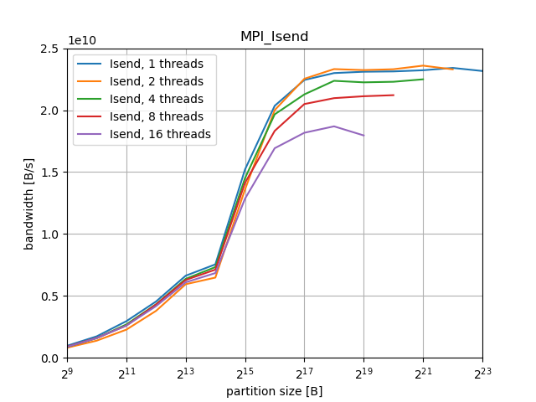
Appendix: Isend vs Psend (multithreaded)
Notes:
Bandwidth differs by ~10% for higher partition sizes, possibly due to no required synchronization on Pready calls

