Slide 1
Transfer optimizations on partitioned communications
Axel Schneewind

Slide 2
Outline
MPI partitioned communication
Optimization opportunities
Current implementations in OpenMPI and MPICH
Benchmarks
Psend vs Isend (single-/multithreaded)
Psend, Isend with completion tests
Psend vs RDMA
Notes:
Introduced in MPI 4.0
Use case

Slide 3
MPI: Hybrid Programming
Rank 0
Rank 1
buffer
buffer
p0
p1
p2
p3
p0
p1
p2
p3
T0
T1
T2
T3
T0
T1
T2
T3
Notes:
Introduced in MPI 4.0
Use case

Slide 4
MPI: Partitioned Communication Operations
MPI_Psend_init
MPI_Start
MPI_Pready
MPI_Pready
MPI_Pready
MPI_Wait/MPI_Test
MPI_Request_free

Slide 5
MPI-4.1: Nonblocking Communication Operations
Order (3.5). Messages are nonovertaking: If a sender sends two messages in succession to the
same destination, and both match the same receive, then this operation cannot receive the
second message if the first one is still pending. [analogously for receive operations]
Order (3.7.4). Nonblocking communication operations are ordered according to the execution
order of the calls that initiate the communication.
Notes:
Nonblocking communication operations are ordered according to the execution
order of the calls that initiate the communication.
The nonovertaking requirement of Section 3.5 is extended to nonblocking communication, with this definition of order being used.
This requirement is not imposed on transfers of partitions

Slide 6
MPI-4.1: Nonblocking Communication Operations
Progress (3.7.4). A call to MPI_WAIT that completes a receive will eventually terminate and return if a matching send has been started, unless the send is satisfied by another receive.
In particular, if the matching send is nonblocking, then the receive should complete even if
no call is executed by the sender to complete the send.
Notes:
A call to MPI_WAIT that completes a receive will eventually terminate and return if a matching send has been started, unless the send is satisfied by another receive.
In particular, if the matching send is nonblocking, then the receive should complete even if
no call is executed by the sender to complete the send. Similarly, a call to MPI_WAIT that
completes a send will eventually return if a matching receive has been started, unless the
receive is satisfied by another send, and even if no call is executed to complete the receive.

Slide 7
MPI-4.1: Partitioned Communication
Rationale. Partitioned communication is designed to provide opportunities for MPI implementations to optimize data transfers. MPI is free to choose how many transfers to do within a partitioned communication send independent of how many partitions are reported as ready to MPI through MPI_PREADY calls.
Aggregation of partitions is permitted but not required.
Ordering of partitions is permitted but not required.
A naive implementation can simply wait for the entire message buffer to be marked ready before any transfer(s) occur and could wait until the completion function is called on a request before transferring data.
However, this modality of communication gives MPI implementations far more flexibility in data movement than nonpartitioned communications. (End of rationale.)

Slide 8
Possible optimizations – Less locking overhead

Slide 9
Possible optimizations – Early-bird effect

Slide 10
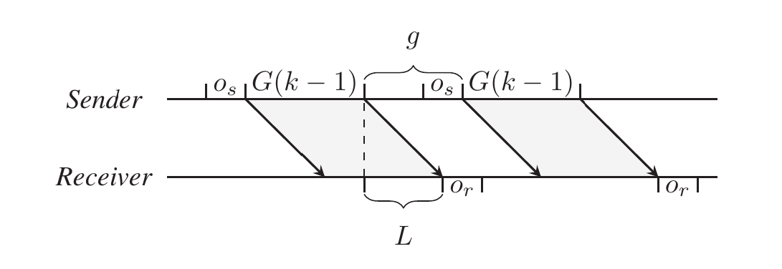
Possible optimizations – Message aggregation
Y. H. Temuçin, S. Levy, W. Schonbein, R. E. Grant and A. Afsahi, "A Dynamic Network-Native MPI Partitioned Aggregation Over InfiniBand Verbs,"
https://doi.org/10.1109/CLUSTER52292.2023.00029

Slide 11
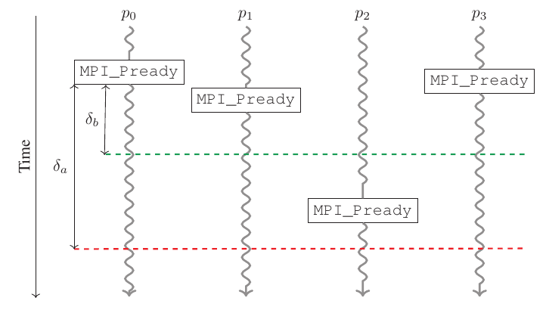
Possible optimizations – Message aggregation
Y. H. Temuçin, S. Levy, W. Schonbein, R. E. Grant and A. Afsahi, "A Dynamic Network-Native MPI Partitioned Aggregation Over InfiniBand Verbs,"
https://doi.org/10.1109/CLUSTER52292.2023.00029

Slide 12
Current implementations: OpenMPI/5.0.2
MPI_Psend_init
MPI_Start
isend_init
isend_init
isend_init
MPI_Pready
start, test
MPI_Pready
start, test
MPI_Pready
start, test
MPI_Wait/MPI_Test
opal_progress
opal_progress
opal_progress
MPI_Request_free

Slide 13
Current implementations: MPICH/4.2.0
MPI_Psend_init
MPI_Start
counter = p
isend_init
isend_init
MPI_Pready
counter-- ;
MPI_Pready
counter--;
counter--;
start
MPI_Pready
MPI_Wait/MPI_Test
wait
MPI_Request_free

Slide 14
Goals
Measure effective bandwidth depending on message size
Do different MPI-implementations perform optimizations (aggregation, reordering) on partitioned transfers?
Is it possible to trigger early progress using completion tests?
Do OpenMPIs Point-to-point Messaging Layer (PML) – components make use of hardware offloading?

Slide 15
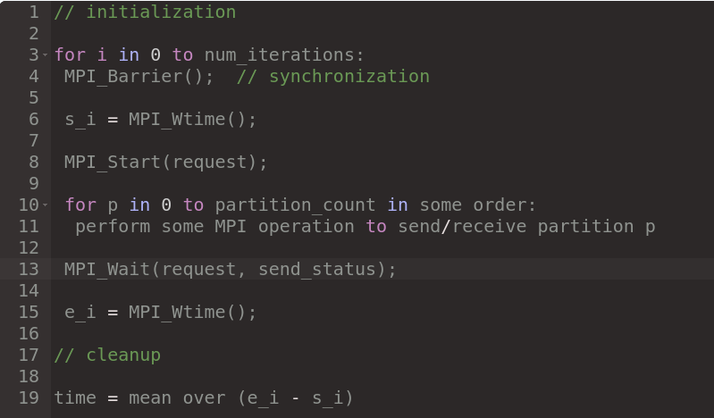
Benchmarking scheme
Notes:
Pseudocode
// initialization
for i in 0...num_iterations:
MPI_Barrier(); // synchronization
s_i = MPI_Wtime();
MPI_Start(&request);
for p in 0...partition_count in some order:
perform some MPI operation to send/receive partition p
MPI_Wait(&request, &result->send_status);
e_i = MPI_Wtime();
// cleanup

Slide 16
Experimental setup
2 nodes on HAWK with one mpi process each
Bandwidth:
Fixed buffer size of 8MiB, partition sizes between 512B and 8MiB
Partitions marked ready in left-to-right or randomized order
Multithreading with OpenMP

Slide 17
Benchmarks
MPI_Send() -> MPI_Recv()
MPI_Isend() -> MPI_Irecv()
MPI_Isend(), MPI_Test() -> MPI_Irecv()
MPI_Psend()
MPI_Psend(), MPI_Request_get_status()
MPI_Psend(), additional thread calling MPI_Request_get_status()
Multiple threads calling MPI_Psend()
MPI_Win, MPI_Put() for each partition
MPI_Win for each partition

Slide 18
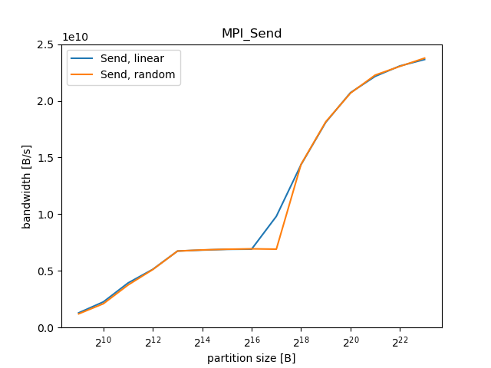
Results: Send->Recv

Slide 19
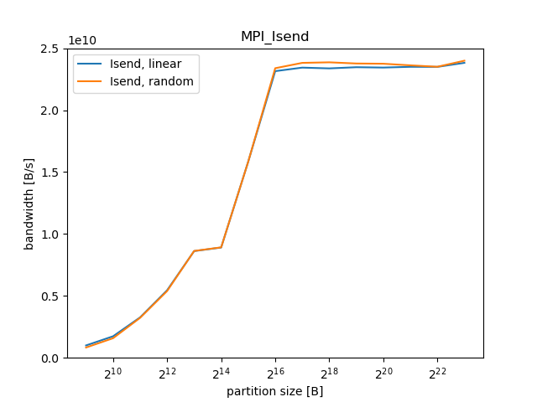
Results: ISend->IRecv

Slide 20
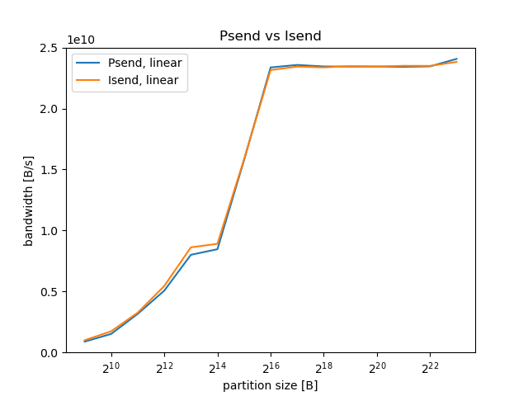
Results: Isend vs Psend

Slide 21
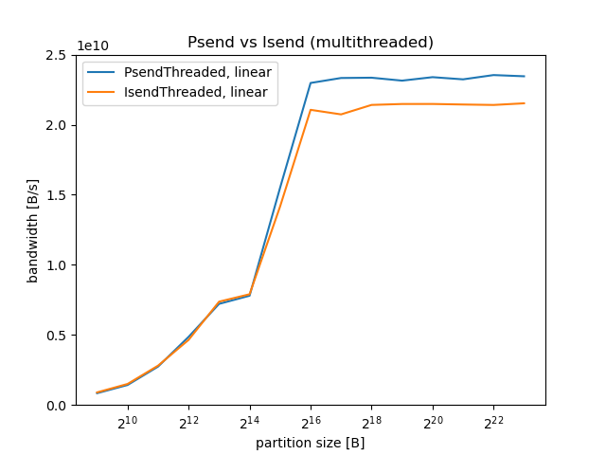
Results: Isend vs Psend (8 threads)

Slide 22
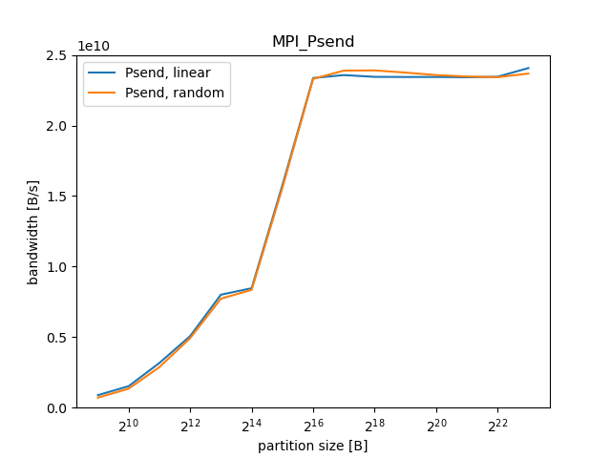
Results: Psend

Slide 23
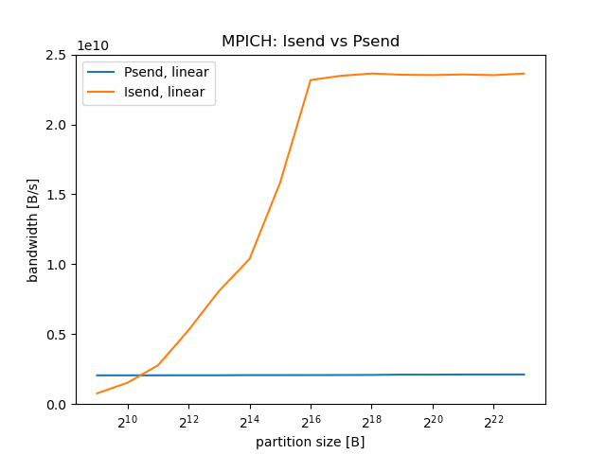
Results: Psend on MPICH-4.1.2

Slide 24
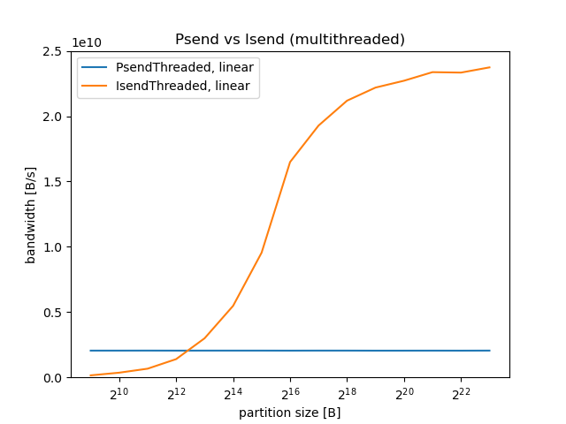
Results: Psend on MPICH-4.1.2 (8 threads)

Slide 25
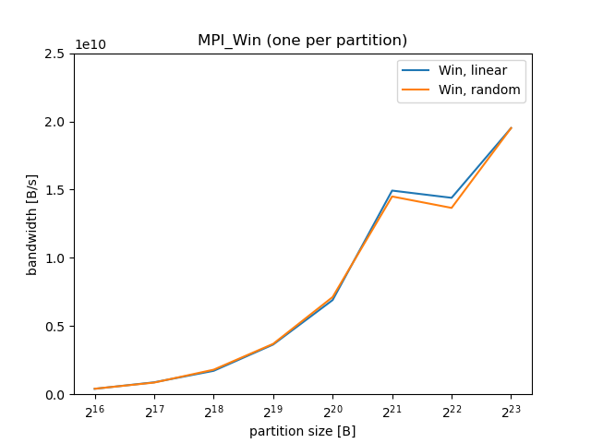
Results: MPI_Win per partition

Slide 26
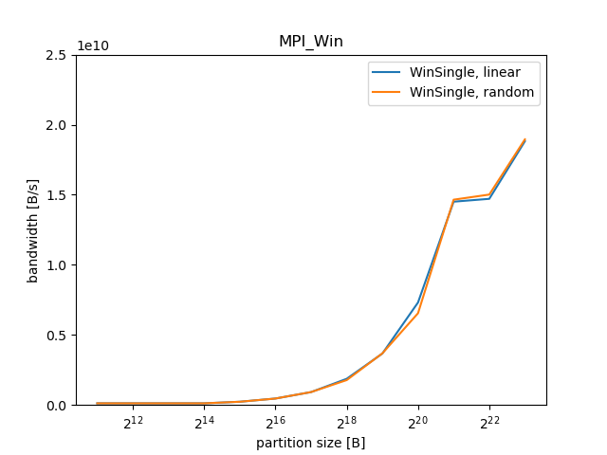
Results: MPI_Win for entire buffer, MPI_Put per partition

Slide 27
Conclusion
Partitioned Communication in OpenMPI provides higher performance when using multiple threads
However, no further optimizations such as message aggregation
Partitioned Communication in MPICH currently provides lower performance than other mechanisms

Slide 28
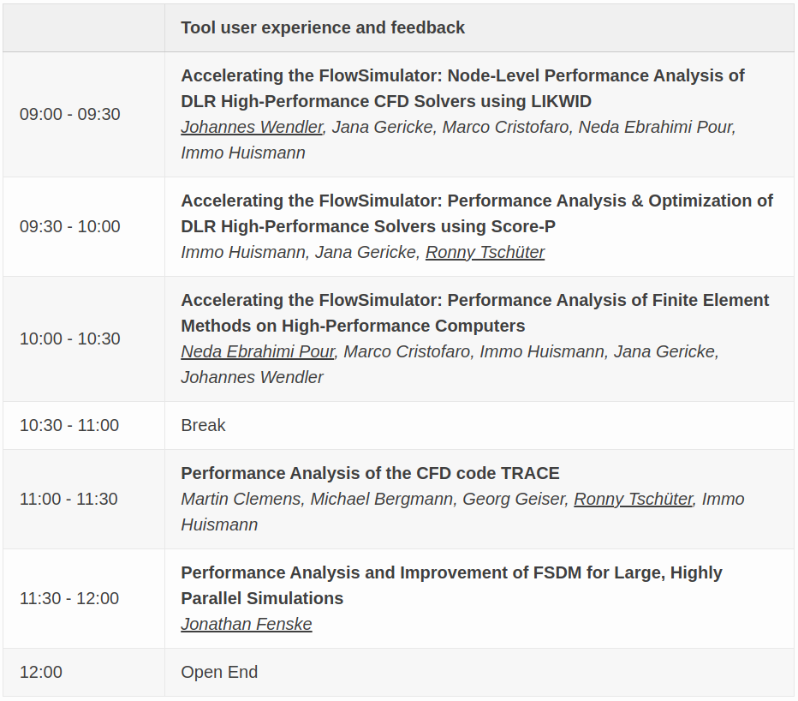
Program Day 2:

Slide 29
IPTW 2023
Thanks for participating!
International Parallel Tools Workshop, 5./6. October 2023

