Slide 1
IPTW 2023
IPTW 2023
International Parallel Tools Workshop, 5./6. October 2023

Slide 2
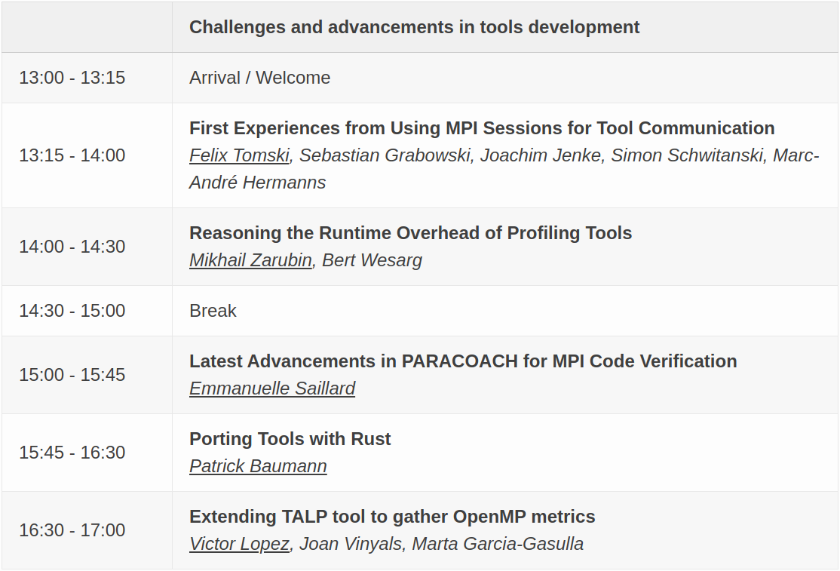
Program Day 1:

Slide 3
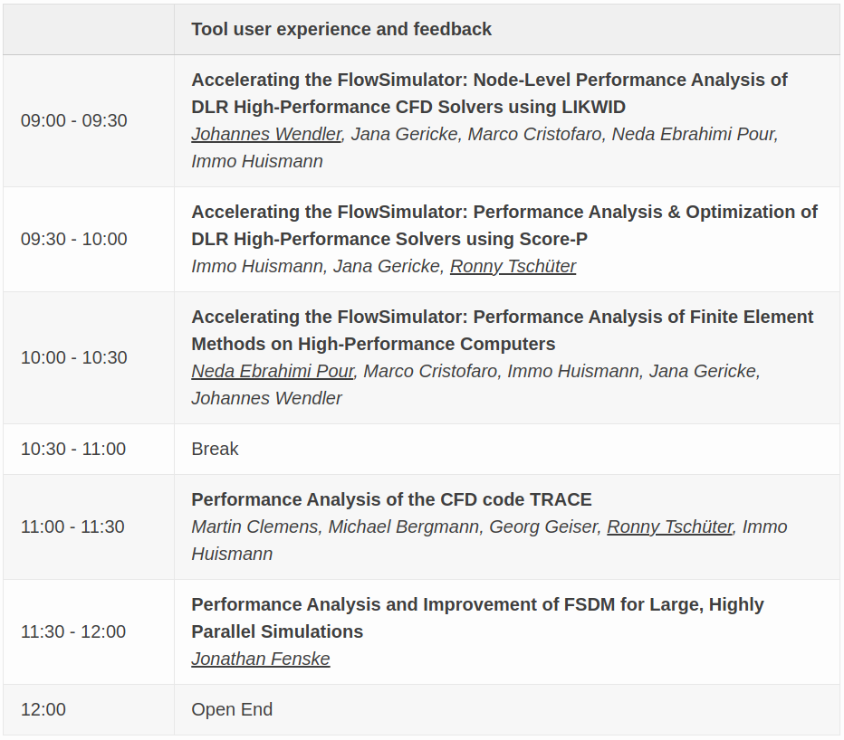
Program Day 2:

Slide 4
IPTW 2023
Thanks for participating!
International Parallel Tools Workshop, 5./6. October 2023

