Slide 1
Simulation of CT metal artefacts
Alexander Winkler
Clinical project final presentation
Advisors: | Dipl.-Inf. Philipp Stefan, Dipl.-Inf. PatrickWucherer, Pascal Fallavollita, Ph.D.

Slide 2
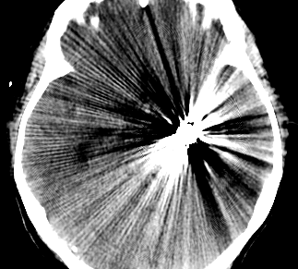
Examples of metal artefacts in CT
The human body usually does not contain any metal objects
many medical implants are composed of metal
Artificial hip bones
dental fillings
Pacemakers
intramedullary rods
Screws
Needles
Trocars
etc.
artefacts usually consist of dark stripes between metal objects with light, pinstriped lines covering the surrounding tissue

Slide 3
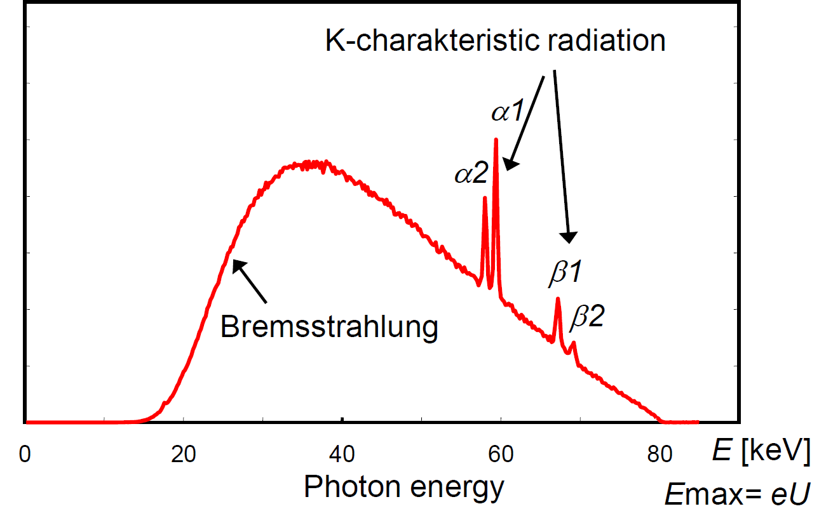
Fundamentals of X-Ray physics
Generation of X-Ray radiation
to generate X-Ray radiation an X-Ray tube is used
consists of a cathode and a rotating (tungsten) anode
electrons from the cathode hit
the anode
Bremsstrahlung
Characteristic emission lines
Both effects together result in
the total emission spectrum
of the X-Ray source
Notes:
Bremsstrahlung: fast electrons are decelerated by the Coulomb fields of the atoms in the anode material
characteristic emission lines: direct interaction of the fast electrons with the inner shell electrons of the anodematerial

Slide 4
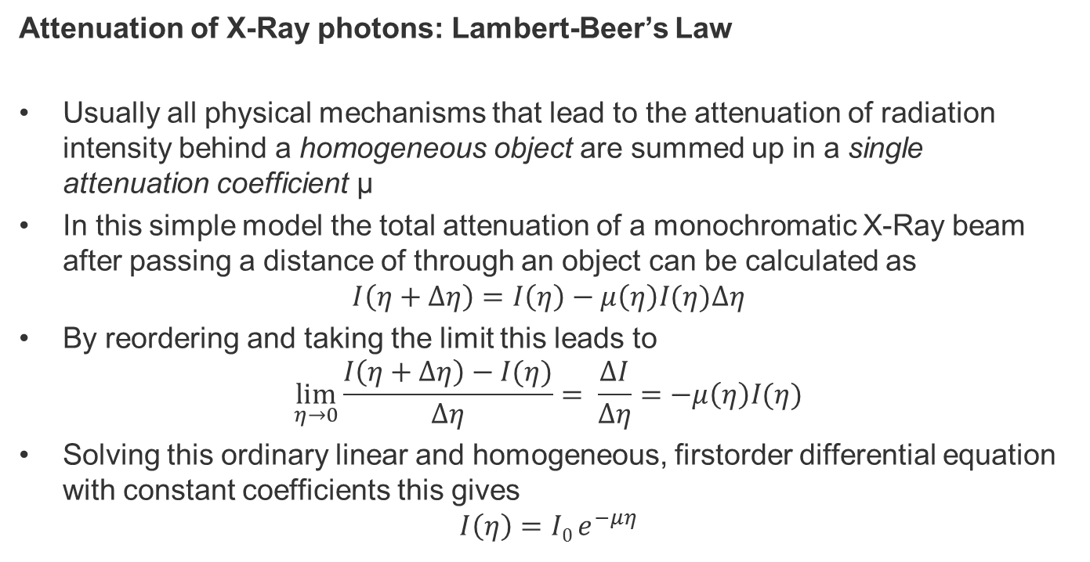
Fundamentals of X-Ray physics
Attenuation of X-Ray photons: Lambert-Beer’s Law
Usually all physical mechanisms that lead to the attenuation of radiation intensity behind a homogeneous object are summed up in a single attenuation coefficient µ
In this simple model the total attenuation of a monochromatic X-Ray beam after passing a distance of through an object can be calculated as
$$I\left(η+Δη\right)=I\left(η\right)−μ\left(η\right)I(η)Δη$$
By reordering and taking the limit this leads to
$$\lim_{η→0}{\frac{I\left(η+Δη\right)−I(η)}{Δη}= \frac{ΔI}{Δη}=−μ\left(η\right)I(η)}$$
Solving this ordinary linear and homogeneous, firstorder differential equation with constant coefficients this gives
$$I\left(η\right)=I0 e^{−μη}$$

Slide 5
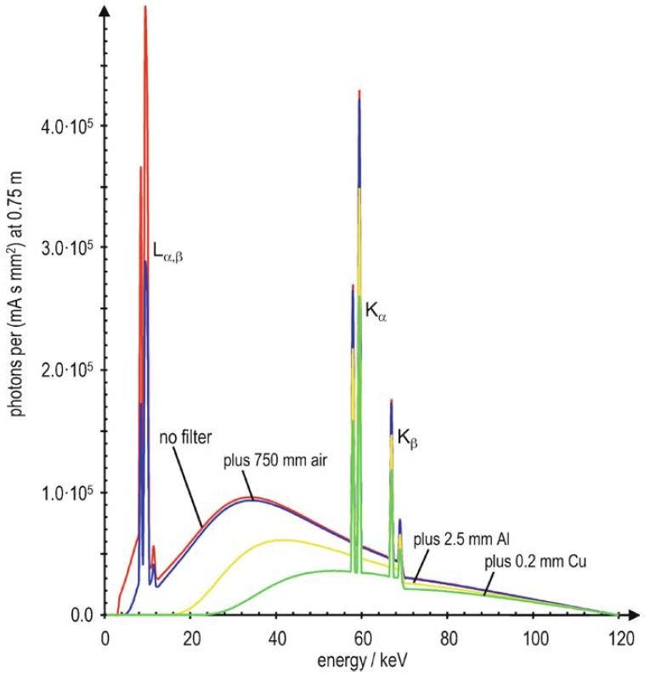
Fundamentals of X-Ray physics
Beam hardening
Colloquially, X-ray is known to have the property of effectively penetrating material.
But radiation attenuation is not only dependent on path length
but is a function of the specific, wavelength-dependent interaction between X-ray and the material concerned.
Lambert-Beer’s Law is a simplification
it does not take beam hardening into account

Slide 6
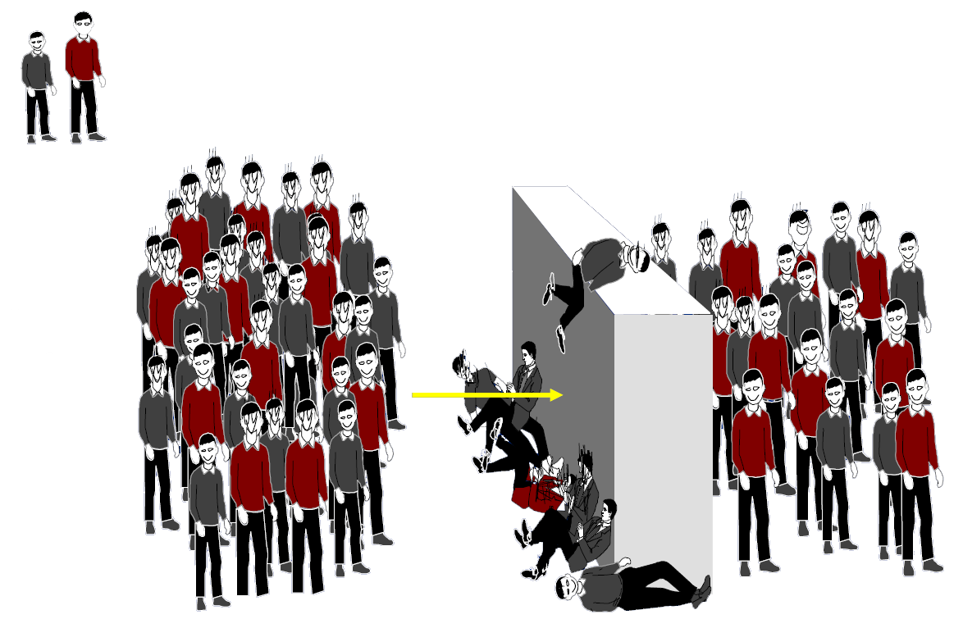
Fundamentals of X-Ray physics
Low
energy
Beam hardening
Colloquially, X-ray is known to have the property of effectively penetrating material.
But radiation attenuation is not only dependent on path length
but is a function of the specific, wavelength-dependent interaction between X-ray and the material concerned.
Lambert-Beer’s Law is a simplification
it does not take beam hardening into account
High
energy
Ratio 40/24
Ratio 20/18

Slide 7
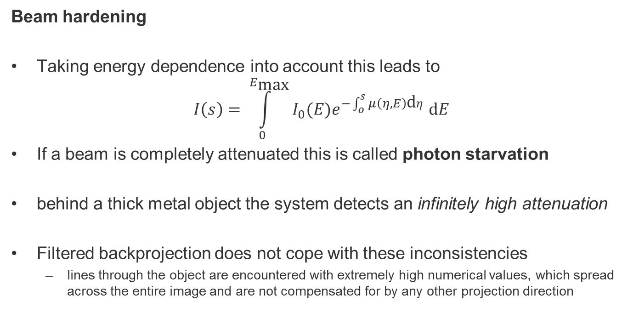
Fundamentals of X-Ray physics
Beam hardening
Taking energy dependence into account this leads to
$$I\left(s\right)= \int_{0}^{E_{\text{max}}}{I_{0}(E)e^{−\int_{o}^{s}{μ\left(η,E\right)\text{d}η}}}\text{d}E$$
If a beam is completely attenuated this is called photon starvation
behind a thick metal object the system detects an infinitely high attenuation
Filtered backprojection does not cope with these inconsistencies
lines through the object are encountered with extremely high numerical values, which spread across the entire image and are not compensated for by any other projection direction

Slide 8
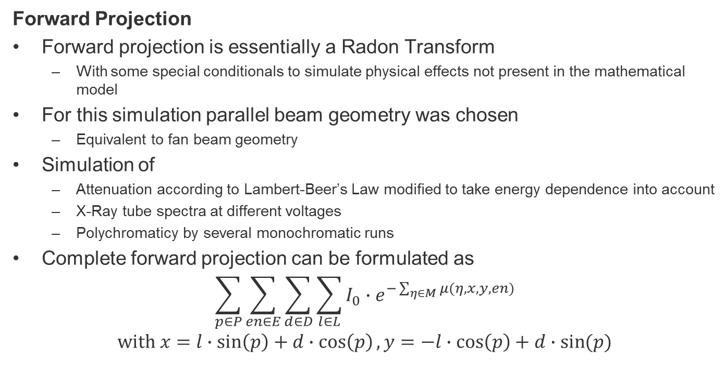
Simulation of CT
Forward Projection
Forward projection is essentially a Radon Transform
With some special conditionals to simulate physical effects not present in the mathematical model
For this simulation parallel beam geometry was chosen
Equivalent to fan beam geometry
Simulation of
Attenuation according to Lambert-Beer’s Law modified to take energy dependence into account
X-Ray tube spectra at different voltages
Polychromaticy by several monochromatic runs
Complete forward projection can be formulated as
$$\sum_{p∈P}{\sum_{en∈E}{\sum_{d∈D}{\sum_{l∈L}{I_{0}∙e^{−\sum_{η∈M}{μ(η,x,y,en)}}}}}}$$
$$\text{with} x=l∙\sin\left(p\right)+d∙\cos\left(p\right), y=−l∙\cos\left(p\right)+d∙\sin{(p)}$$

Slide 9
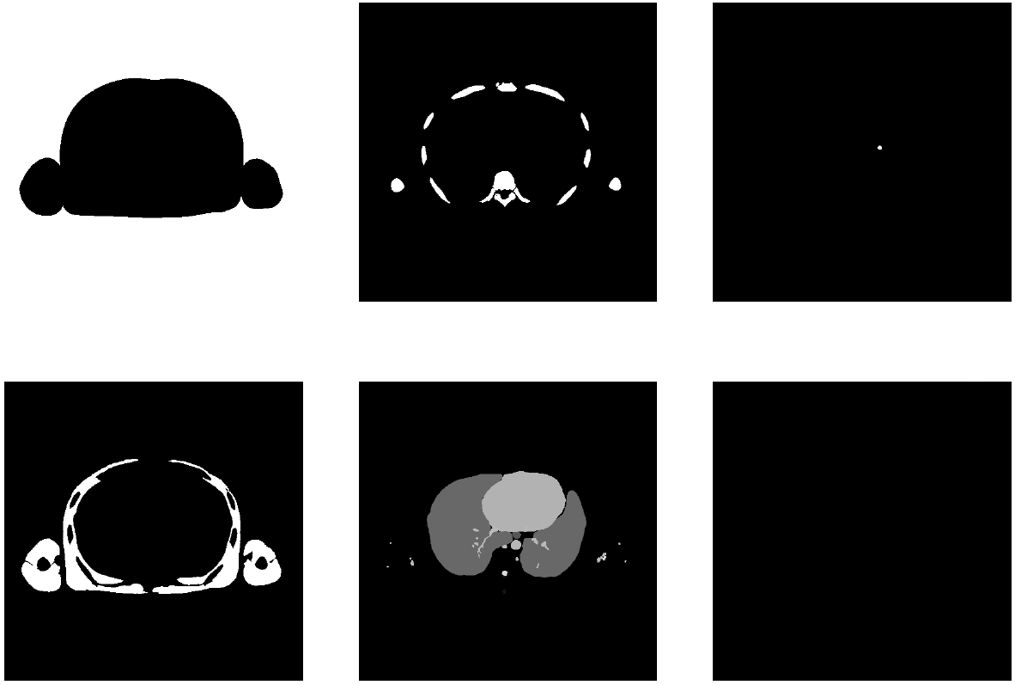
Simulation of CT
Segmented CT slice

Slide 10
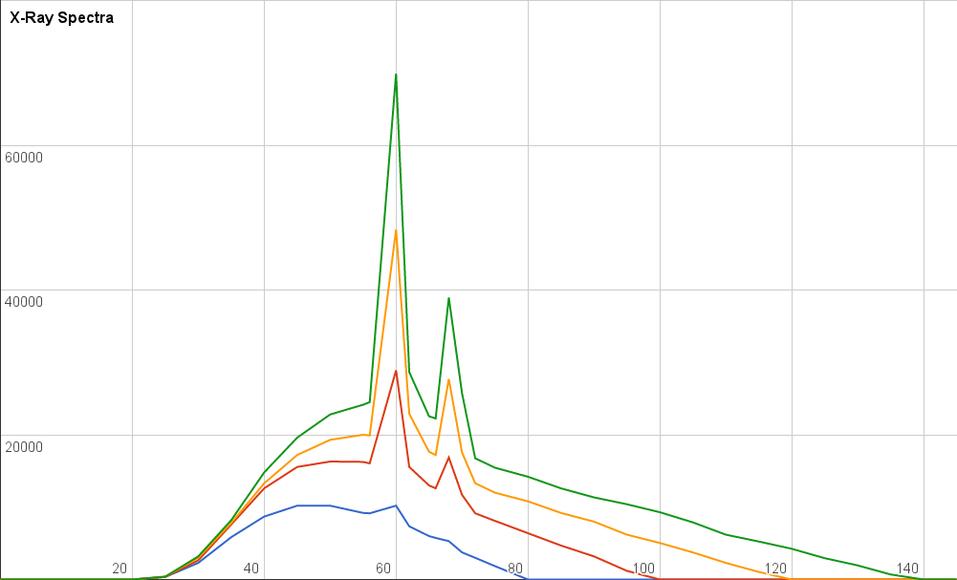
Simulation of CT
Lookup tables for X-Ray spectra
Sampled from:
J. Anthony Seibert. X-ray imaging physics for nuclear medicine technologists. part 1:
Basic principles of x-ray production. J. Nucl. Med. Technol., 32 no. 3,:139–147, 2004.

Slide 11
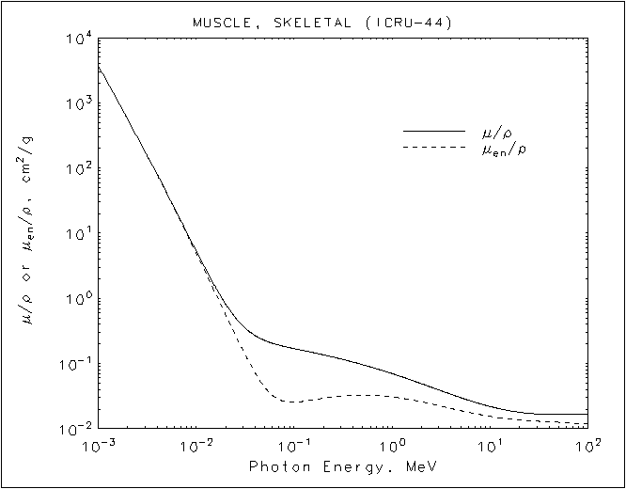
Simulation of CT
Lookup tables for attenuation coefficients
Tables by:
S. M. Seltzer J. H. Hubbell. Tables of x-ray mass attenuation coefficients and mass
energy-absorption coefficients from 1 kev to 20 mev for elements z = 1 to 92 and 48
additional substances of dosimetric interest, May 1996.

Slide 12
Simulation of CT
Configuration file
pathToSlice=slices/Segmentation2
pathToOutputReconstruction=outData.pgm
pathToOutputSinogram=simulatedSinogram.pgm
pathToXRaySpectra=Data/XRaySpectra
minEnergy=20
maxEnergy=140
energyLevels=8
numberOfProjectionAngles=64
numberOfThreads=4
tubeEnergy=140
detectorThreshold=100
attenuationMultiplicator=10

Slide 13
Simulation of CT
Miscellaneous parts of the simulator
Out paradigm was not to rely on any third party libraries
So some more code had to be implemented…
Own logger (inspired by loggers like log4j)
Different loglevels: ALL > TRACE > DEBUG > INFO > WARN > ERR > FATAL > OFF
Heavily relies on macros to guarantee no major impact on performance
Outputs loglevel, source code file, function, line and message. In “verbose mode”
Can also write output to file
Image reading and writing
portable graymap format .pgm (Portable Anymap or Netpbm format)
One of the easiest image formats
Super short header followed by color values in ASCII separated by whitespaces

Slide 14
Results
Images take long to compute (5-60 minutes on my laptop)
CPU speed and number of threads/cores is the limiting factor
Computation speed is direct proportional to
Number of projections
Number of energy levels
Computation speed is indirect proportional to the number of threads
We think that simulation of the CT would be a good candidate for the calculation on the graphics card
All rays from all projections can be run in parallel, no dependencies on each other
Current simulator is written in C, a port to CUDA-C should be possible with reasonable amount of work

Slide 15
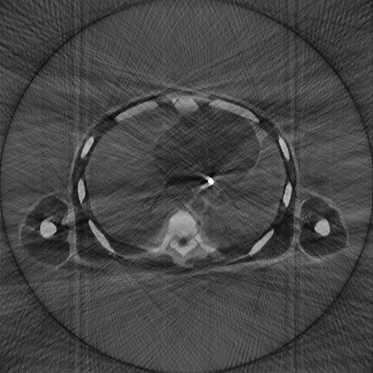
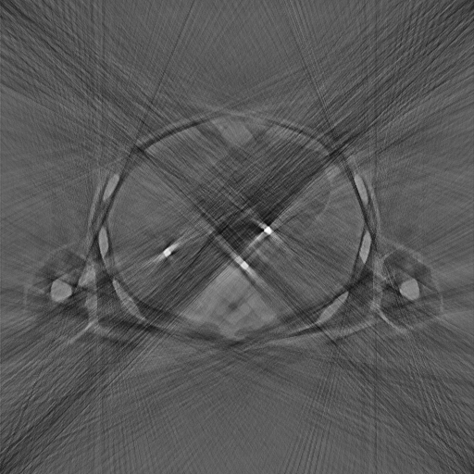
Results

Slide 16
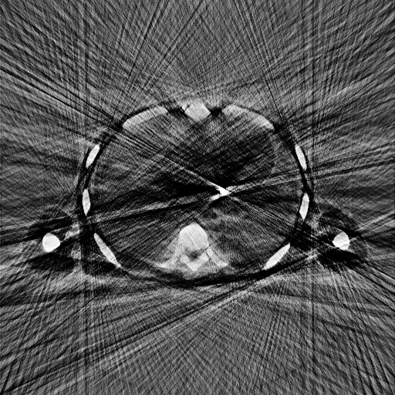
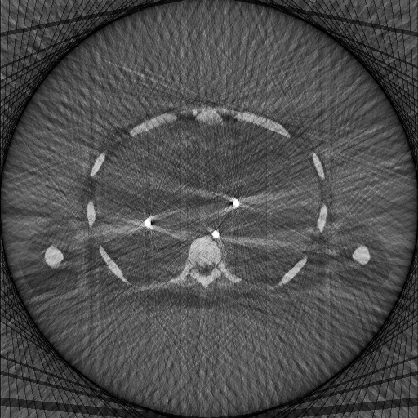
Results

Slide 17
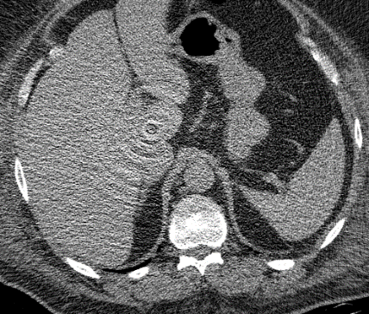
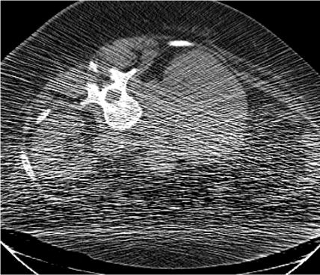
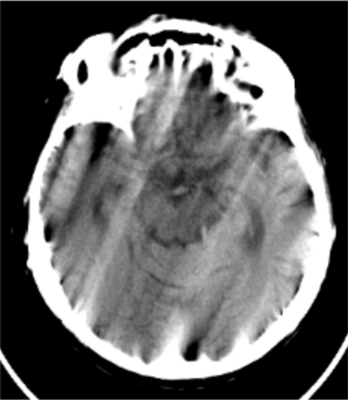
Future Work
More easily implementable CT artefacts
Ring artefacts
Caused by miscalibrated detector
Multiply/Add intensity value by random numbers at the end of the ray
Poisson Noise
Caused by discrete particle nature of light at low X-Ray doses
Modify relative photon count at the start of the ray
Motion artefacts
Caused by the patient moving during the scan
Merge sinograms from two or more simulation runs

Slide 18

Notes:
Metal artefacts not easily simulated alone but required a full CT simulator.
Metal artefacts as the epitome of beam hardening
physical model mainly based on Lambert-Beer’s Law
Poisson noise, Ring artefacts or motion artefacts -> future
Port to CUDA-C possible

