Slide 1
Simulation of CT metal artefacts
Alexander Winkler
Clinical project final presentation
Advisors: | Dipl.-Inf. Philipp Stefan, Dipl.-Inf. PatrickWucherer, Pascal Fallavollita, Ph.D.
Notes:
Desired-view based system

Slide 2
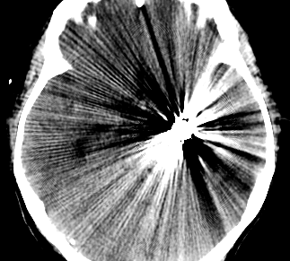
Examples of metal artefacts in CT
The human body usually does not contain any metal objects
many medical implants are composed of metal
Artificial hip bones
dental fillings
Pacemakers
intramedullary rods
Screws
Needles
Trocars
etc.
artefacts usually consist of dark stripes between metal objects with light, pinstriped lines covering the surrounding tissue

Slide 3
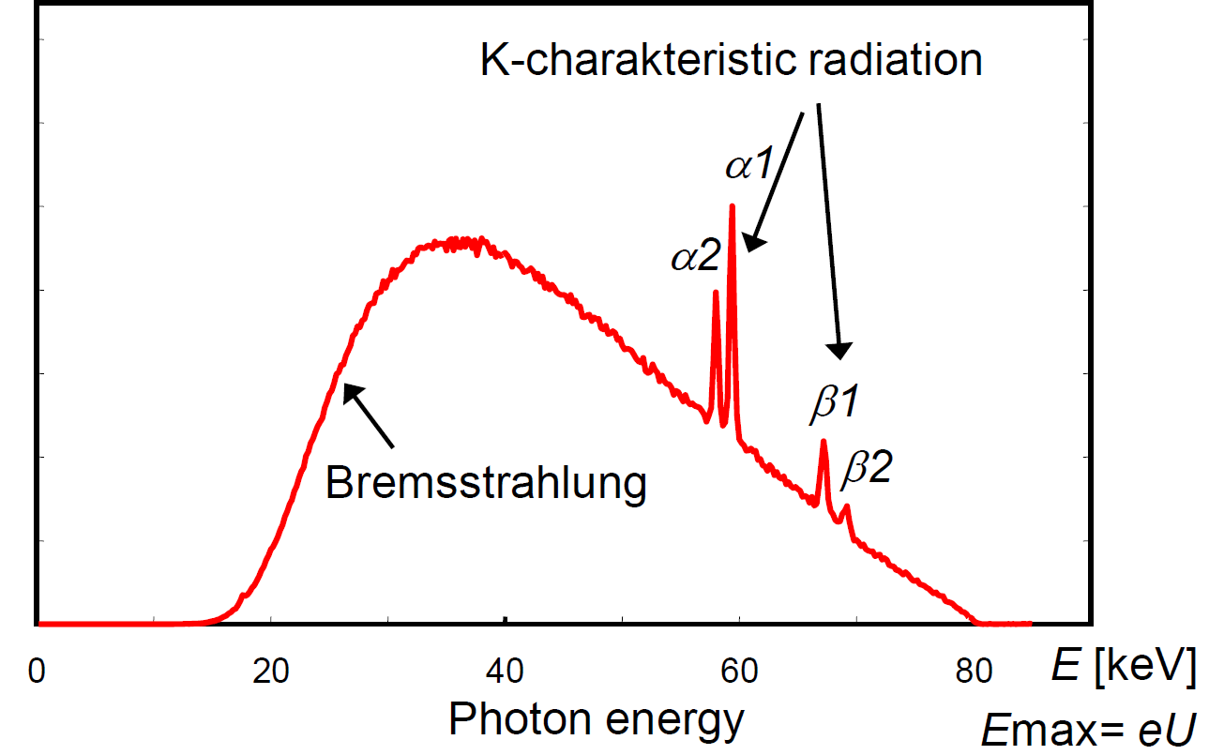
Fundamentals of X-Ray physics
Generation of X-Ray radiation
to generate X-Ray radiation an X-Ray tube is used
Consisting of a cathode and a rotating tungsten anode
electrons from the cathode hit
the anode
Bremsstrahlung
Characteristic X-Rays
Both effects together result in
the total emission spectrum
of the X-Ray source

Slide 4
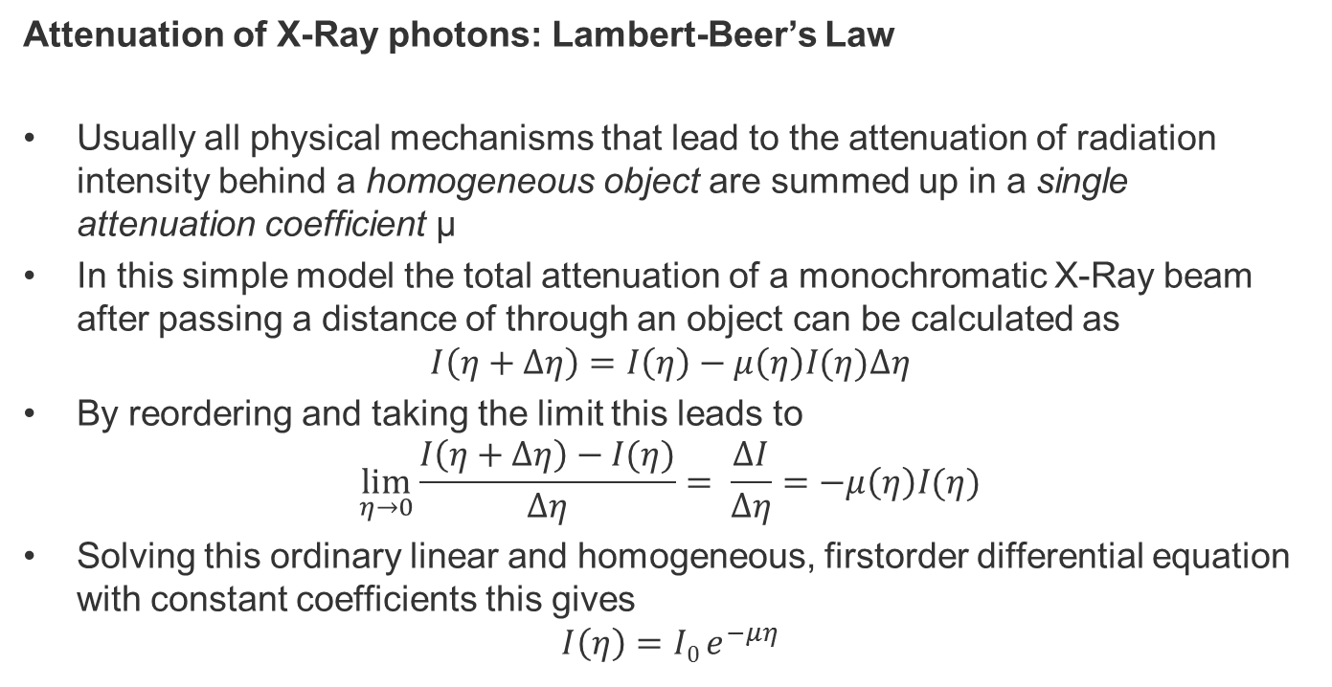
Fundamentals of X-Ray physics
Attenuation of X-Ray photons: Lambert-Beer’s Law
Usually all physical mechanisms that lead to the attenuation of radiation intensity behind a homogeneous object are summed up in a single attenuation coefficient µ
In this simple model the total attenuation of a monochromatic X-Ray beam after passing a distance of through an object can be calculated as
$$I\left(η+Δη\right)=I\left(η\right)−μ\left(η\right)I(η)Δη$$
By reordering and taking the limit this leads to
$$\lim_{η→0}{\frac{I\left(η+Δη\right)−I(η)}{Δη}= \frac{ΔI}{Δη}=−μ\left(η\right)I(η)}$$
Solving this ordinary linear and homogeneous, firstorder differential equation with constant coefficients this gives
$$I\left(η\right)=I0 e^{−μη}$$

Slide 5
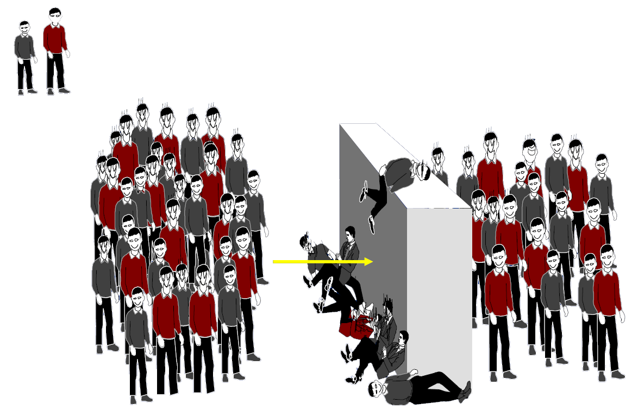
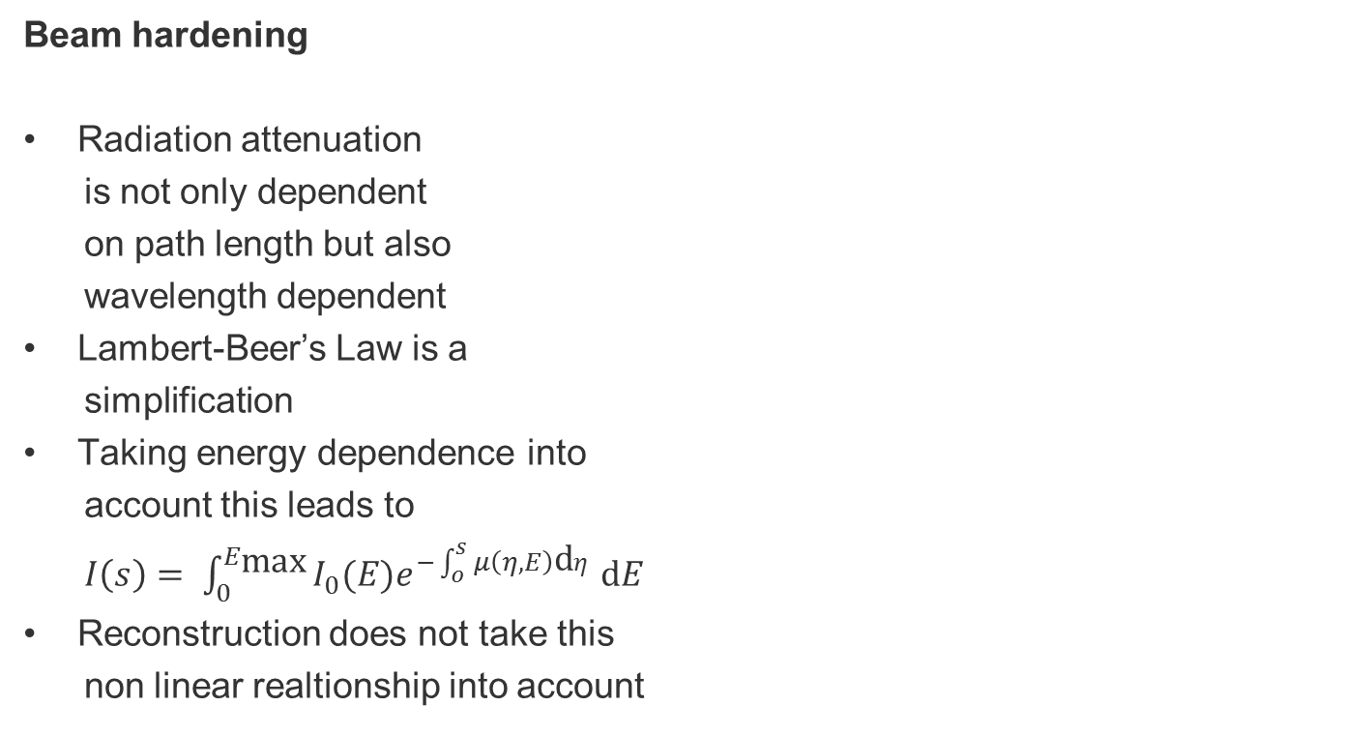
Fundamentals of X-Ray physics
Beam hardening
Radiation attenuation
is not only dependent
on path length but also
wavelength dependent
Lambert-Beer’s Law is a
simplification
Taking energy dependence into
account this leads to
$I\left(s\right)= \int_{0}^{E_{\text{max}}}{I_{0}(E)e^{−\int_{o}^{s}{μ\left(η,E\right)\text{d}η}}}\text{d}E$
Reconstruction does not take this
non linear realtionship into account
Low
energy
High
energy
Ratio 40/24
Ratio 20/18

Slide 6
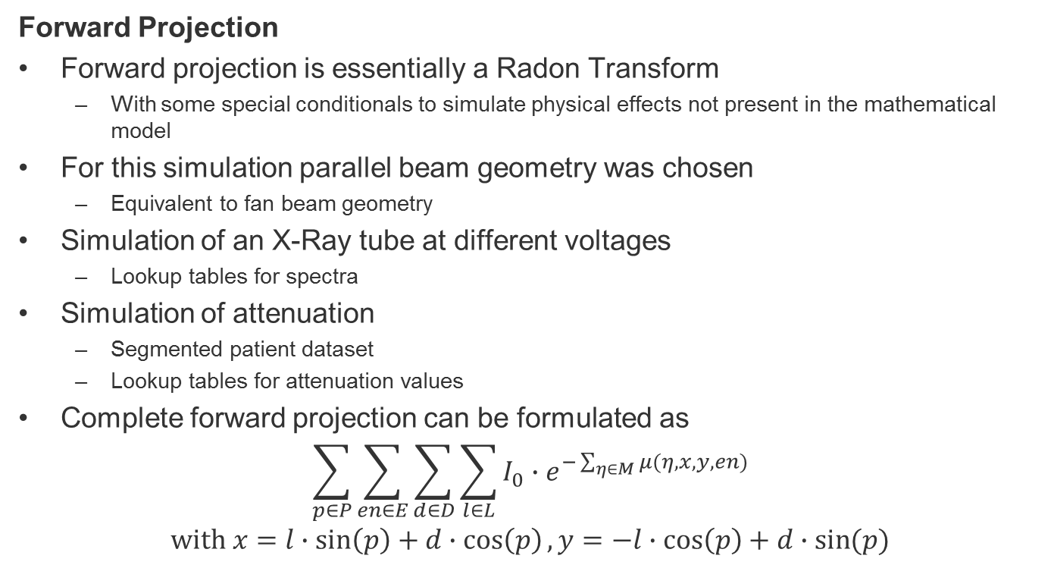
Simulation of CT
Forward Projection
Forward projection is essentially a Radon Transform
With some special conditionals to simulate physical effects not present in the mathematical model
For this simulation parallel beam geometry was chosen
Equivalent to fan beam geometry
Simulation of an X-Ray tube at different voltages
Lookup tables for spectra
Simulation of attenuation
Segmented patient dataset
Lookup tables for attenuation values
Complete forward projection can be formulated as
$$\sum_{p∈P}{\sum_{en∈E}{\sum_{d∈D}{\sum_{l∈L}{I_{0}∙e^{−\sum_{η∈M}{μ(η,x,y,en)}}}}}}$$
$$\text{with} x=l∙\sin\left(p\right)+d∙\cos\left(p\right), y=−l∙\cos\left(p\right)+d∙\sin{(p)}$$

Slide 7
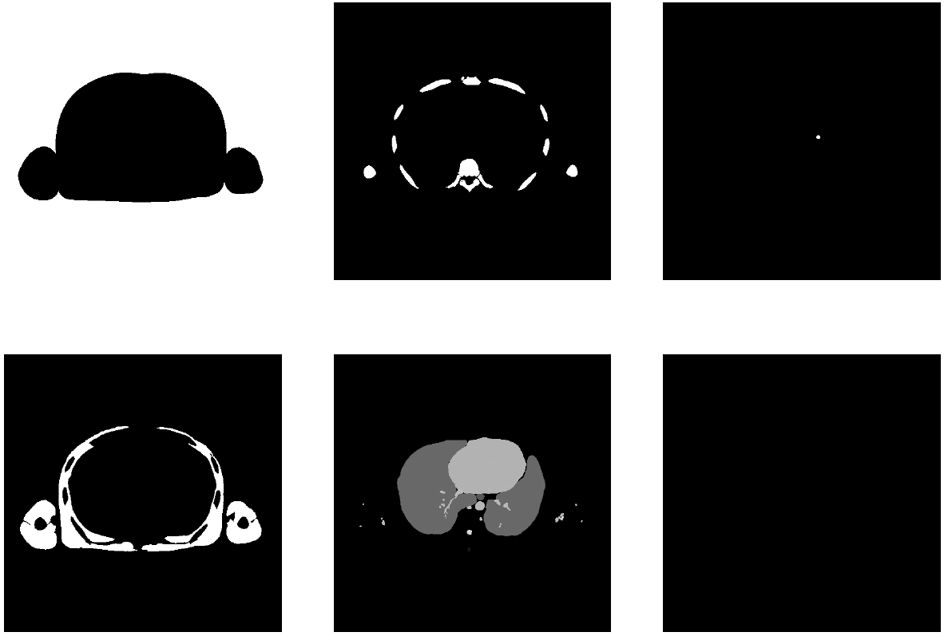
Simulation of CT
Segmented CT slice

Slide 8
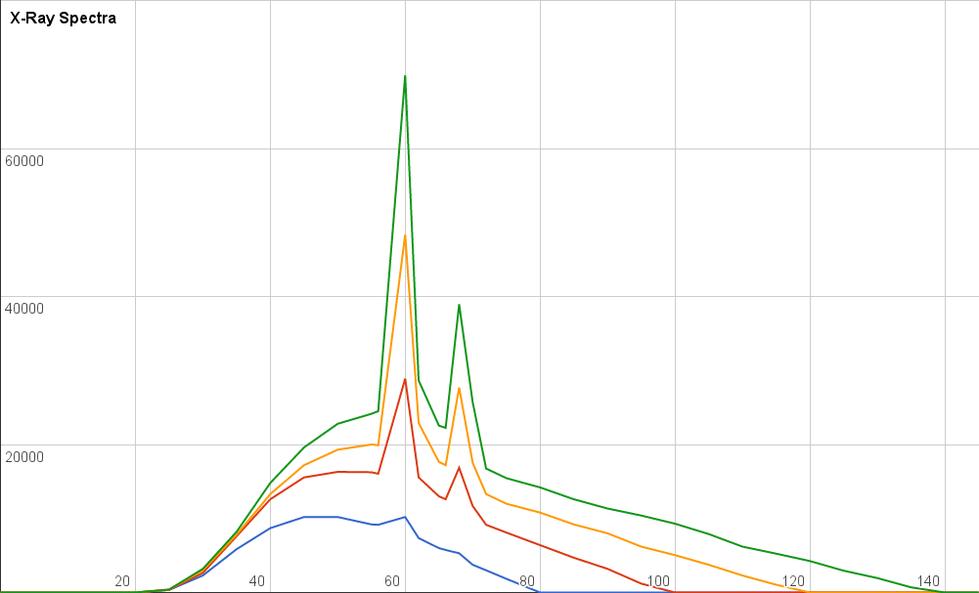
Simulation of CT
X-Ray spectra

Slide 9
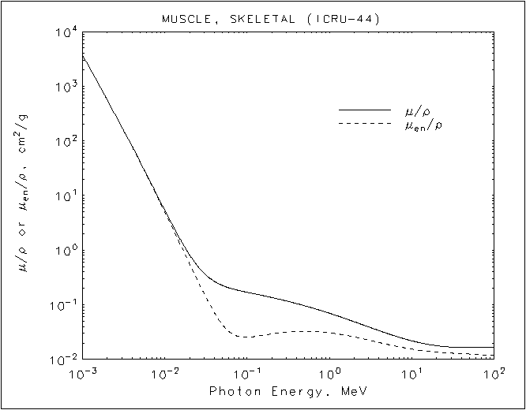
Simulation of CT
Attenuation coefficients

Slide 10
Simulation of CT
Configuration file
pathToSlice=slices/Segmentation2
pathToOutputReconstruction=outData.pgm
pathToOutputSinogram=simulatedSinogram.pgm
pathToXRaySpectra=Data/XRaySpectra
minEnergy=20
maxEnergy=140
energyLevels=8
numberOfProjectionAngles=64
numberOfThreads=4
tubeEnergy=140
detectorThreshold=100
attenuationMultiplicator=10

Slide 11
Simulation of CT
Miscellaneous parts of the simulator
Own logger (inspired by loggers like log4j)
Different loglevels: ALL > TRACE > DEBUG > INFO > WARN > ERR > FATAL > OFF
Heavily relies on macros to guarantee no major impact on performance
Outputs loglevel, source code file, function, line and message. In “verbose mode”
Can also write output to file
Image reading and writing
portable graymap format .pgm (Portable Anymap or Netpbm format)
One of the easiest image formats
Super short header followed by color values in ASCII separated by whitespaces

Slide 12
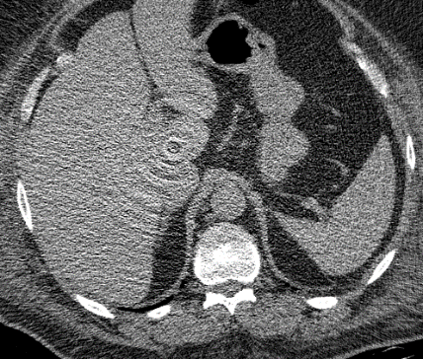
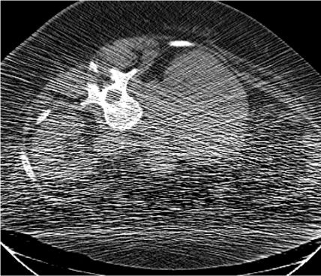
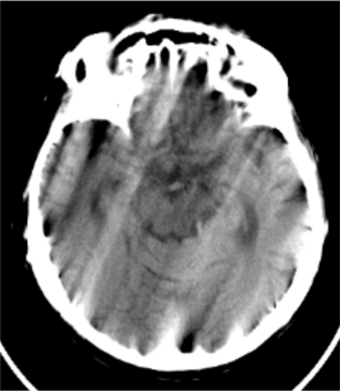
Simulation of CT
More easily implementable CT artefacts
Ring artefacts
Caused by miscalibrated detector
Multiply/Add intensity value by random numbers at the end of the ray
Poisson Noise
Caused by discrete particle nature of light at low X-Ray doses
Modify relative photon count at the start of the ray
Motion artefacts
Caused by the patient moving during the scan
Merge sinograms from two or more simulation runs

Slide 13
Results
Images take long to compute (5-60 minutes on my laptop)
CPU speed and number of threads/cores is the limiting factor
Computation speed is direct proportional to
Number of projections
Number of energy levels
Computation speed is indirect proportional to the number of threads
We think that simulation of the CT would be a good candidate for the calculation on the graphics card
All rays from all projections can be run in parallel, no dependencies on each other
Current simulator is written in C, a port to CUDA-C should be possible in reasonable time

Slide 14
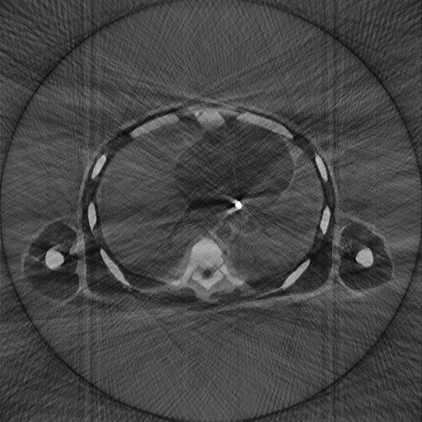
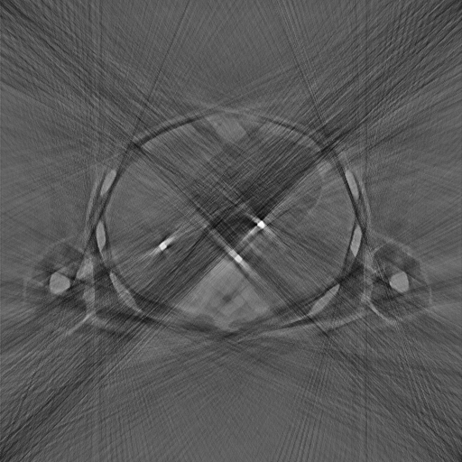
Results

Slide 15
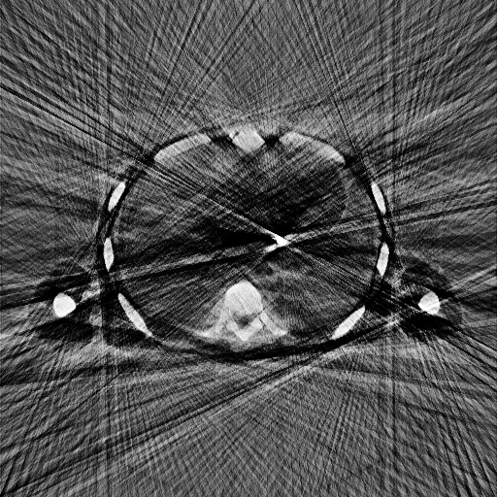
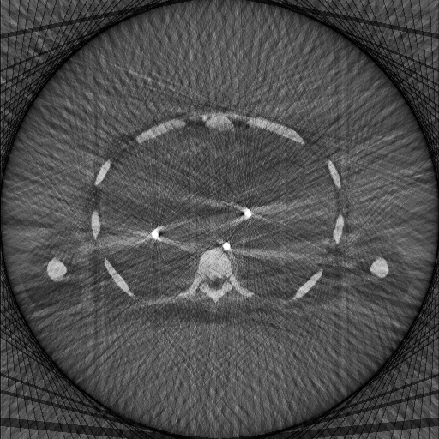
Results

Slide 16

Notes:
Metal artefacts not easily simulated alone but required a full CT simulator.
Metal artefacts as the epitome of beam hardening
physical model mainly based on Lambert-Beer’s Law
Poisson noise, Ring artefacts or motion artefacts -> future
Port to CUDA-C possible

