Slide 1

OnChainBunnies
Do you hop on the chain with us?

Slide 2
What is the blockchain??

Slide 3

a node
A computer
Store data
Who has how many coins?
Who has which NFT?

Slide 4

Principle behind the blockchain

Slide 5
Principle behind the blockchain
How many ETH has Ann-Julie?

Slide 6
Principe achter de blockchain
I want to sell my NFT to Maxim.

Slide 7

Proof Of Work
8
5 + 3 = ?
I want to sell my NFT to Maxim.

Slide 8
Let’s try it out!!

Slide 9
There are 7 girls in the 2nd grade. There are 2 more boys than girls. How many children are in the 2nd grade?

Slide 10
There are 23 children in the 3rd grade. They will receive a math notebook, a language notebook, a French notebook and a KO notebook from their teacher at the beginning of the school year. How many notebooks will the teacher hand out in total?

Slide 11
The 23 students want to make a cup of fruit salad as a teenage snack. With 1 apple, 1 pear, 1 orange and 1 banana, they can make 4 cups of fruit salad. How many pears do they need for everyone to have 1 cup of fruit salad?

Slide 12
NFTs? What is that?

Slide 13

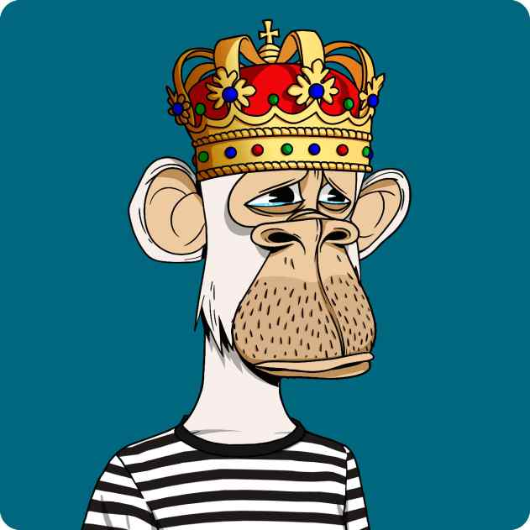
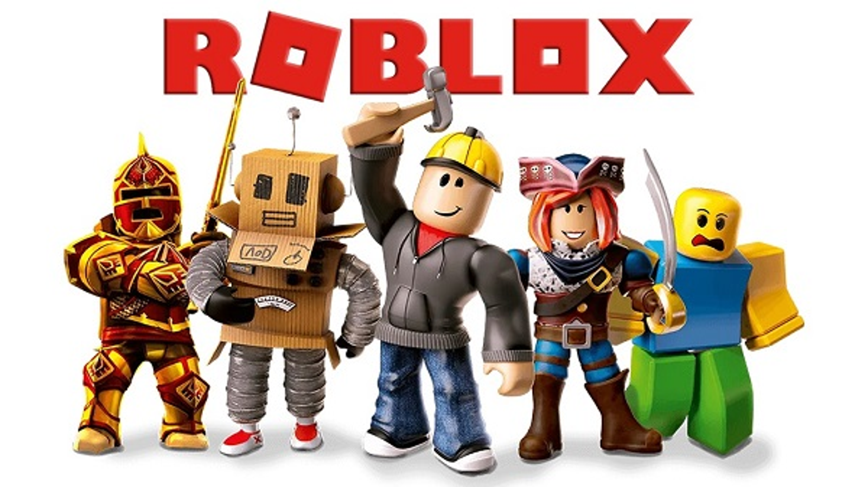
What are NFTs?
Roblox
Non Fungible Token
Exists out of 3 things:
The image
The metadata
Prove that it is yours

Slide 14




An NFT collection
Lots of items in the same category
Traits
Compare with pokemoncards

Slide 15
OnChainBunnies

Slide 16
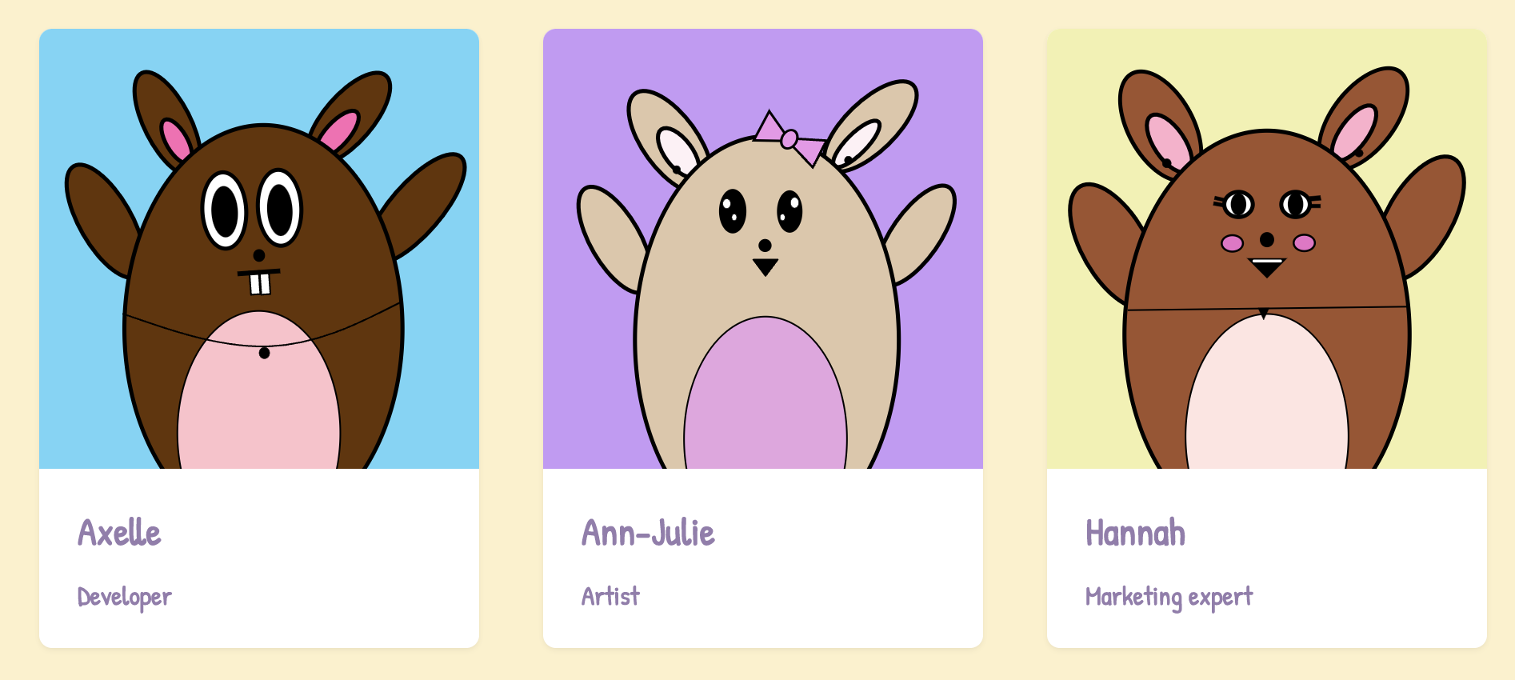
TEAM

Slide 17
OnChainBunnies
5000 NFTs
30 June mint date
Website: onchainbunnies.io
Merch:
Caps
Stickers
T-shirts

Slide 18
OnChainBunnies
8 different traits:
Cap
Eyebrows
Wizzard
Glasses
Bracelet
Whiskers
Tie
Purse

Slide 19
What is so special about OnChainBunnies?

Slide 20
OnChainBunnies
Beste artist: Ann-Julie
Images are on the blockchain
Can not be hacked
Randomly generated

Slide 21
What is a wallet?

Slide 22

What is a wallet?
Digital wallet
NFTs
Cryptocoins
Strong security:
Password = 12 words

