Slide 1

>one-liners # 3 Packages to Boost Productivity # SatRday JHB 2019-04-06 # Oscar Baruffa
<5min

Slide 2


*Thanks!

Slide 3
Installation
> install.packages(“beepr”)
> install.packages(“DataExplorer”) #note Caps
> install.packages(“tidylog”)

Slide 4
Beepr
> beep(1)
> beep(4)
Sound plays!
Great to include @ end of long-running scripts

Slide 5
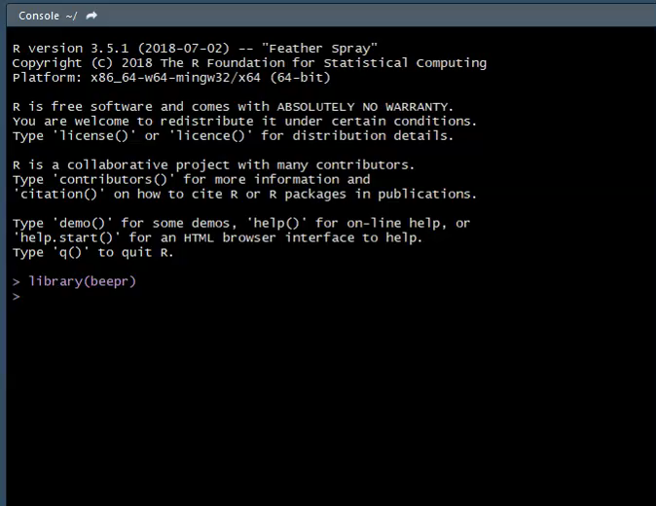

Slide 6
DataExplorer
> create_report(french_train_delays)

Slide 7
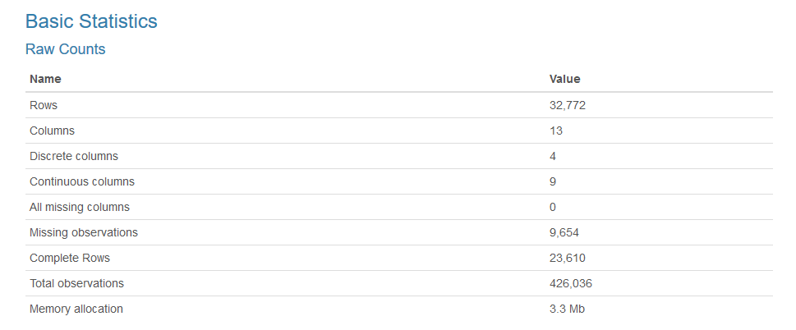

Slide 8
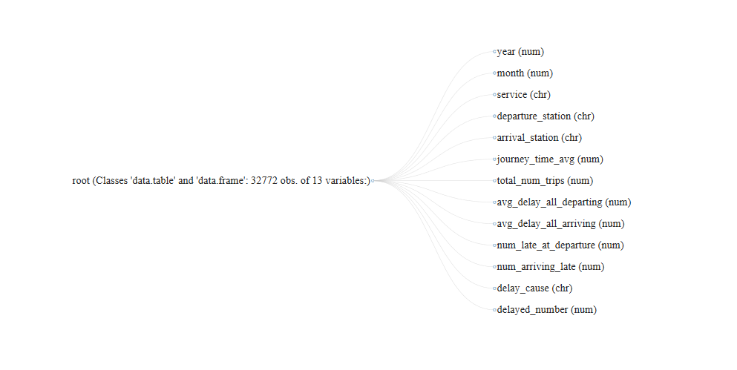

Slide 9
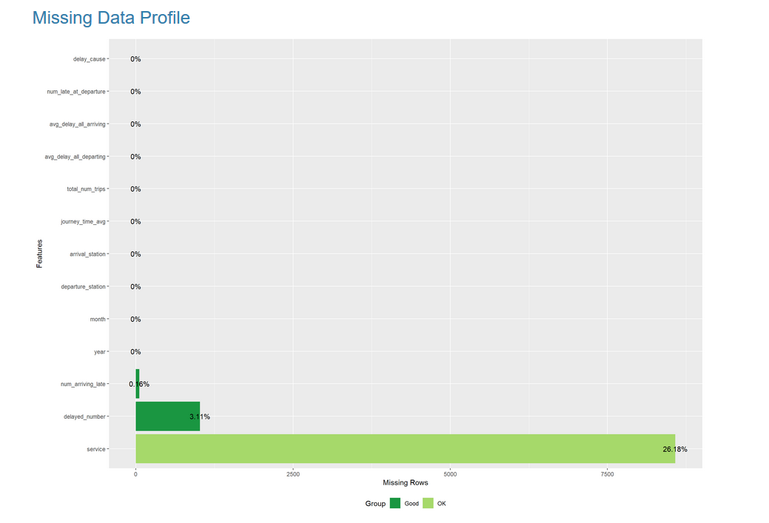

Slide 10
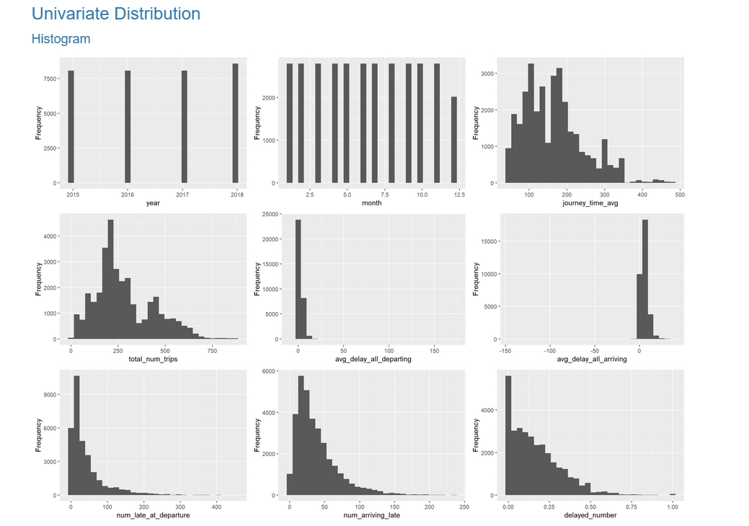

Slide 11

Tidylog
fam_games <- board_games %>%
filter(min_age <= 5) %>% filter(max_playtime <= 30) %>%
filter(users_rated >= 300)
filter: removed 9605 out of 10532 rows (91%)
filter: removed 342 out of 927 rows (37%)
filter: removed 486 out of 585 rows (83%)

Slide 12
Installation
> install.packages(“beepr”)
> install.packages(“DataExplorer”) #note Caps
> install.packages(“tidylog”)

Slide 13
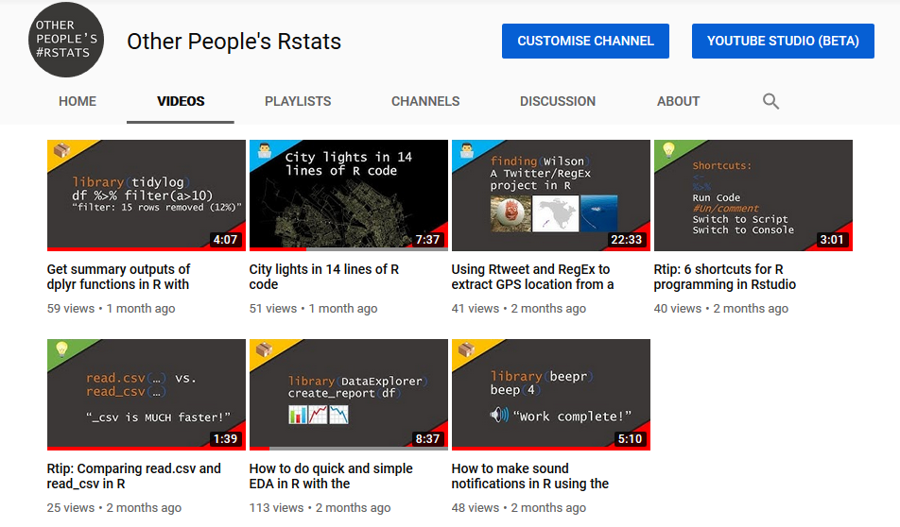

Slide 14

Get in touch
> oscarbaruffa.com
> twitter: @oscar_b123
> Youtube: “Other People’s Rstats”
Thanks to EmojiOne for use of emoji :)

