Slide 1
From Pythonista to Rtist
Diana Pholo
Predictive Insights

Slide 2
Introduction

Slide 3
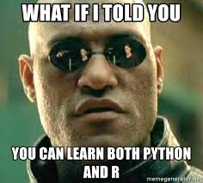
Python or R
Notes:
Digital world is full of data
Businesses hiring data scientists + investing in business intelligence tools
But still a gap
Because data science fails if no sharing

Slide 4
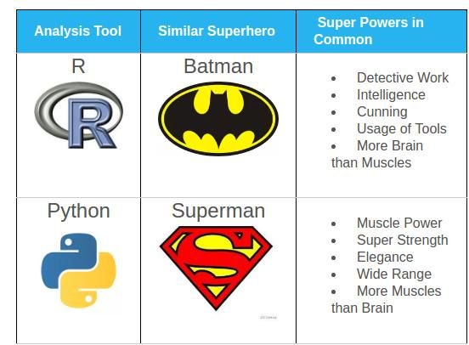
Which one is better?

Slide 5
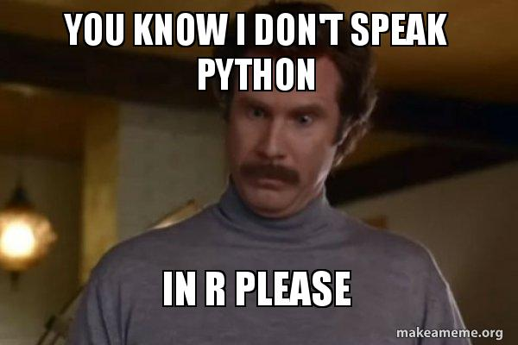
But...

Slide 6
My initial struggles

Slide 7
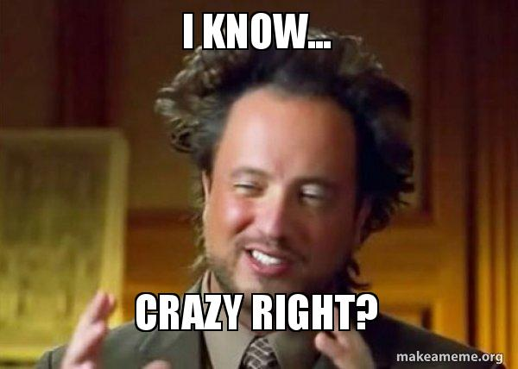
str() has nothing to do with strings!
Notes:
Data obtained from Harambee
NGO promoting youth employment
Partner with GVT, businesses and young people

Slide 8

Indices start at 1...
Notes:
Data obtained from Harambee
NGO promoting youth employment
Partner with GVT, businesses and young people

Slide 9
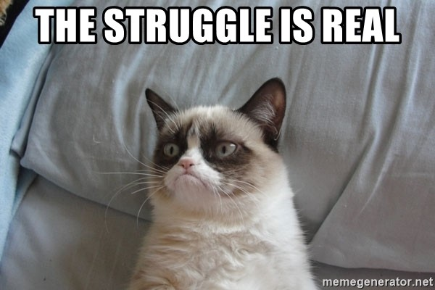
Forget about loops
Notes:
Data obtained from Harambee
NGO promoting youth employment
Partner with GVT, businesses and young people

Slide 10
How did I get started?

Slide 11
Quick Start
Choose an IDE. RStudio!
Learn R Syntax
enough to understand Stack Overflow code
Understand some important R packages
tidyverse, lubridate, ggplot, caret
Go through Data Analysis Workflow using R
Importing Data → Data Manipulation → Data Visualization → ML modeling

Slide 12
The. End.

