Slide 1
Productionalizing R code using Databricks
Michael Johnson
@MikeJohnsonZA

Slide 2

What we will talk about
Data science lifecycle
Spark and R
Databricks

Slide 3
Data science lifecycle

Slide 4
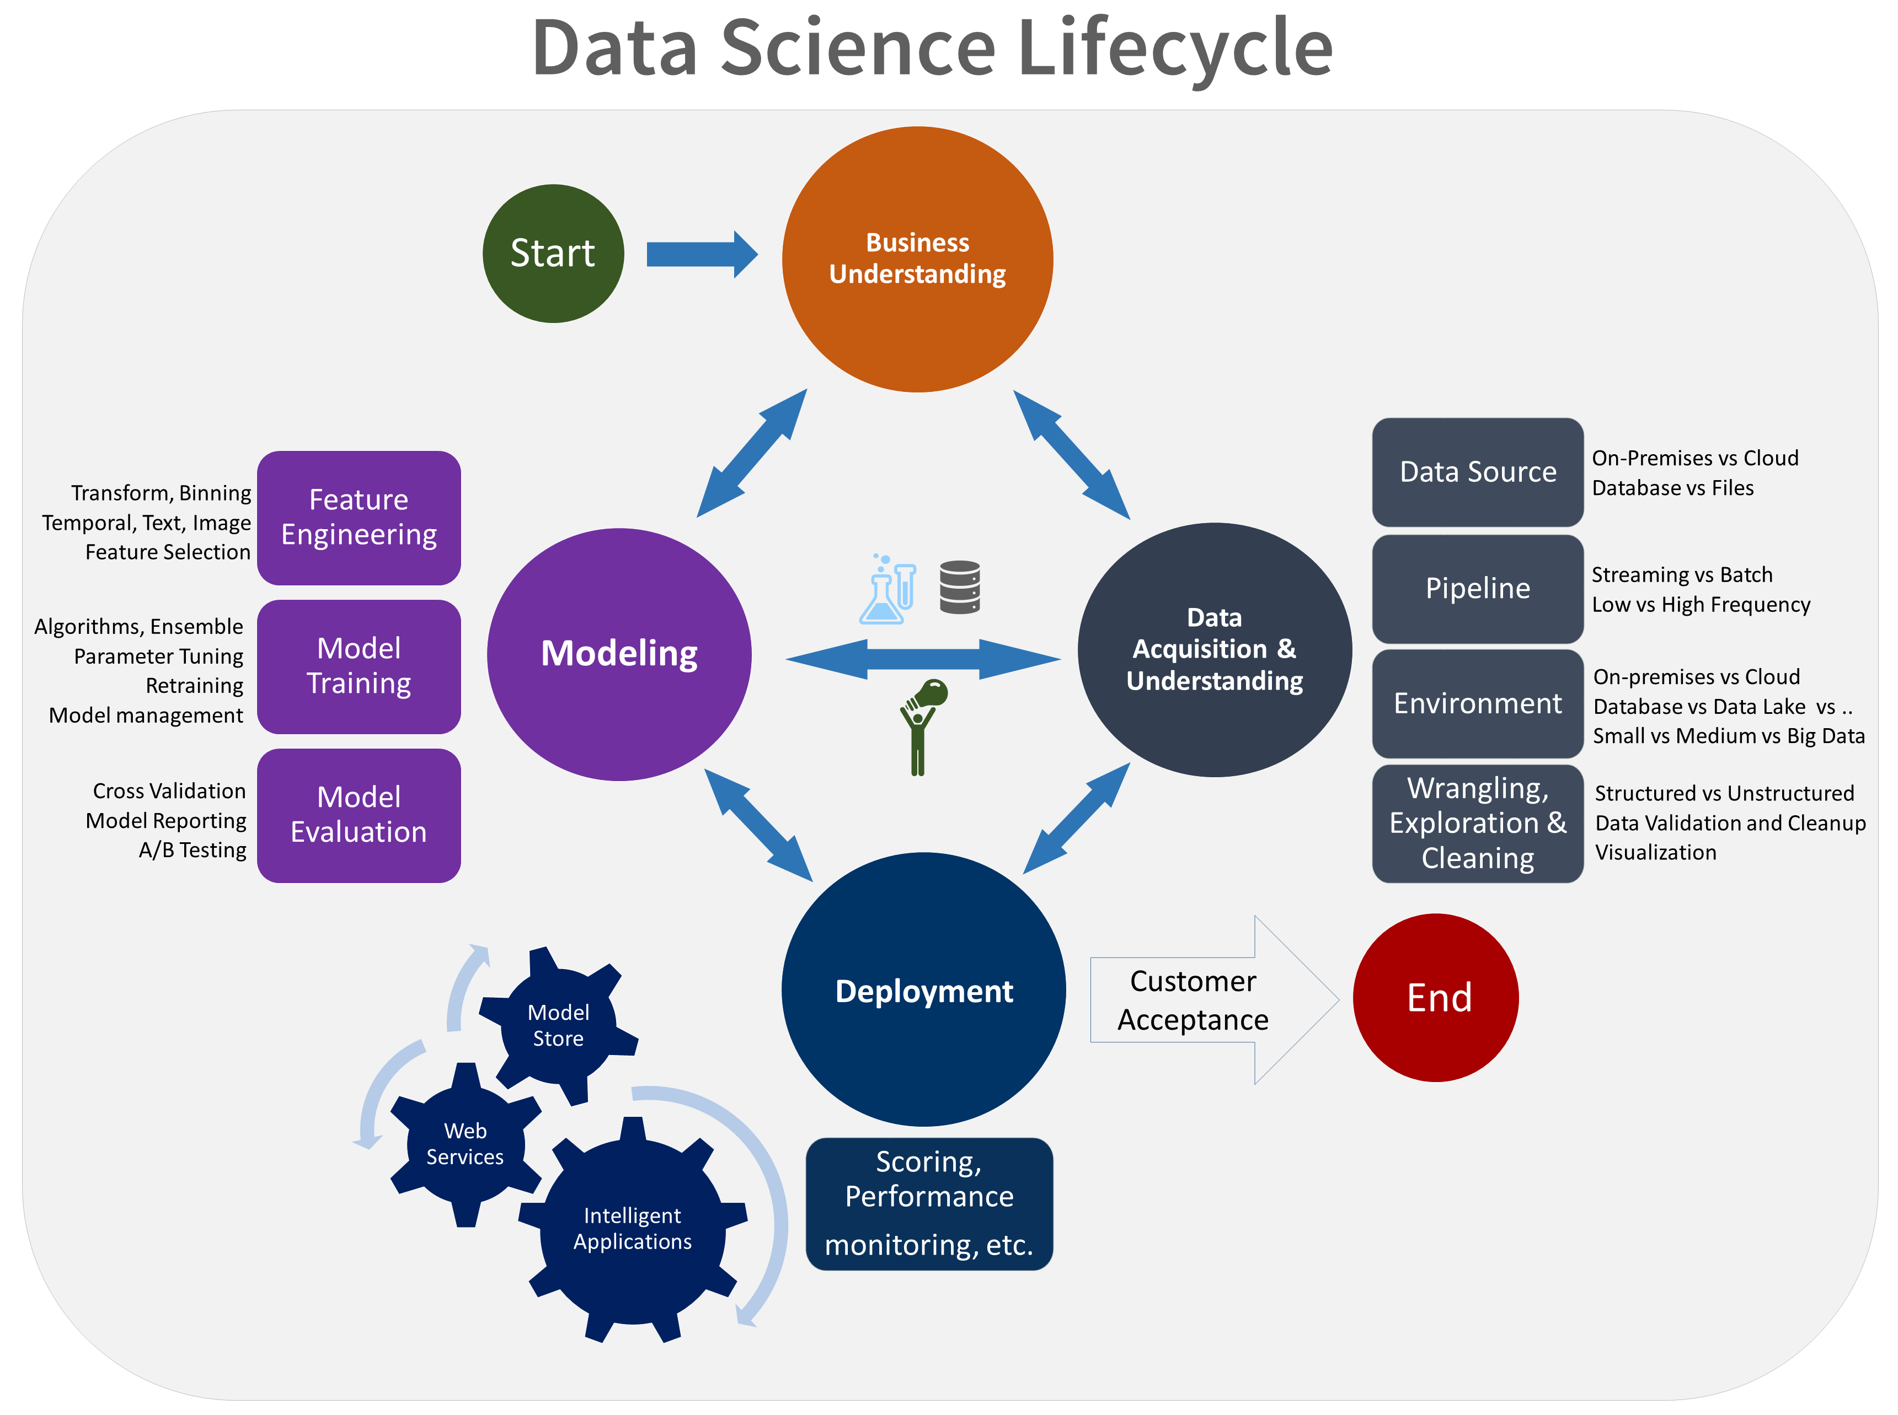

Slide 5

Apache Spark

Slide 6




MapReduce
Spark
2004
2012
2003
2006
2013
Google File System (GFS)
Apache Hadoop Project
Databricks
Predecessor to HDFS
History of Azure Databricks

Slide 7




DataFrames API / SQL
Streaming
Graph
Machine Learning

Slide 8
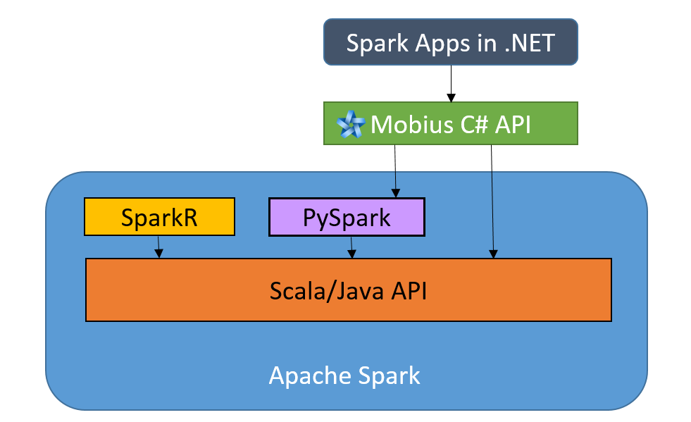

Slide 9
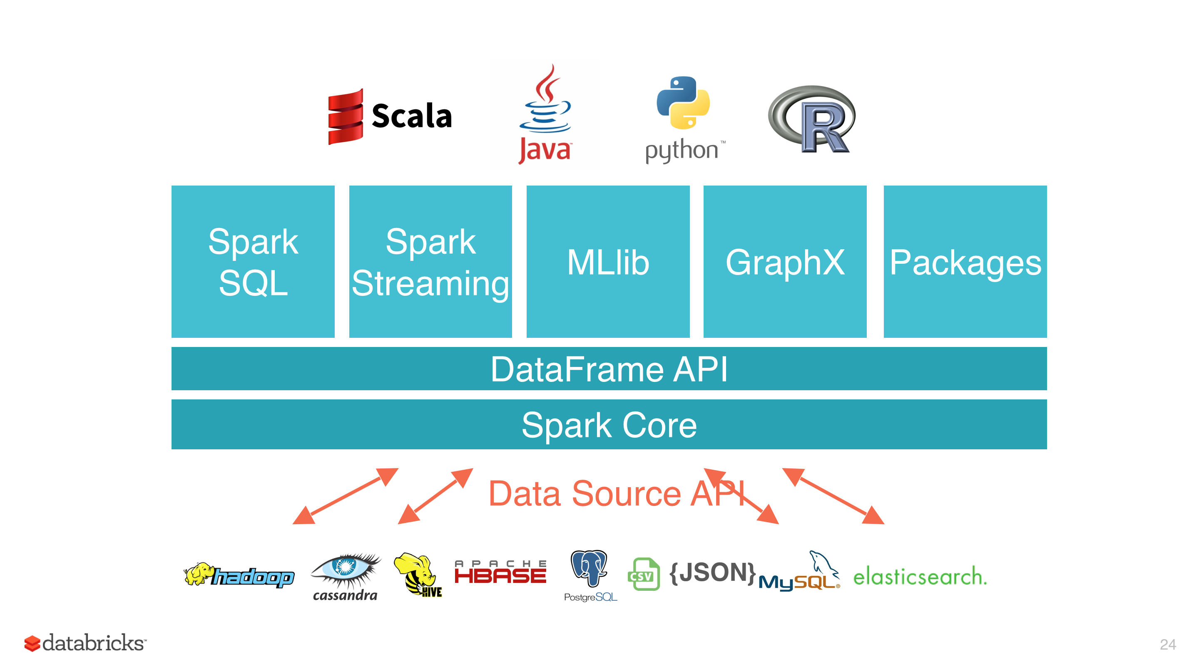

Slide 10
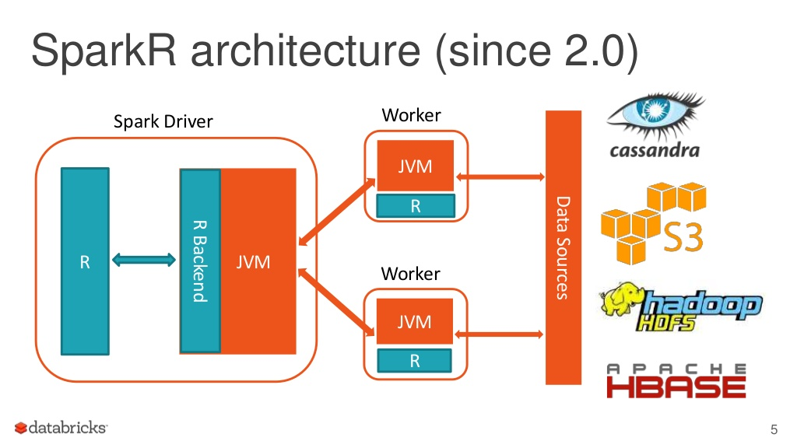

Slide 11
Data bricks

Slide 12


Environments

