Slide 1

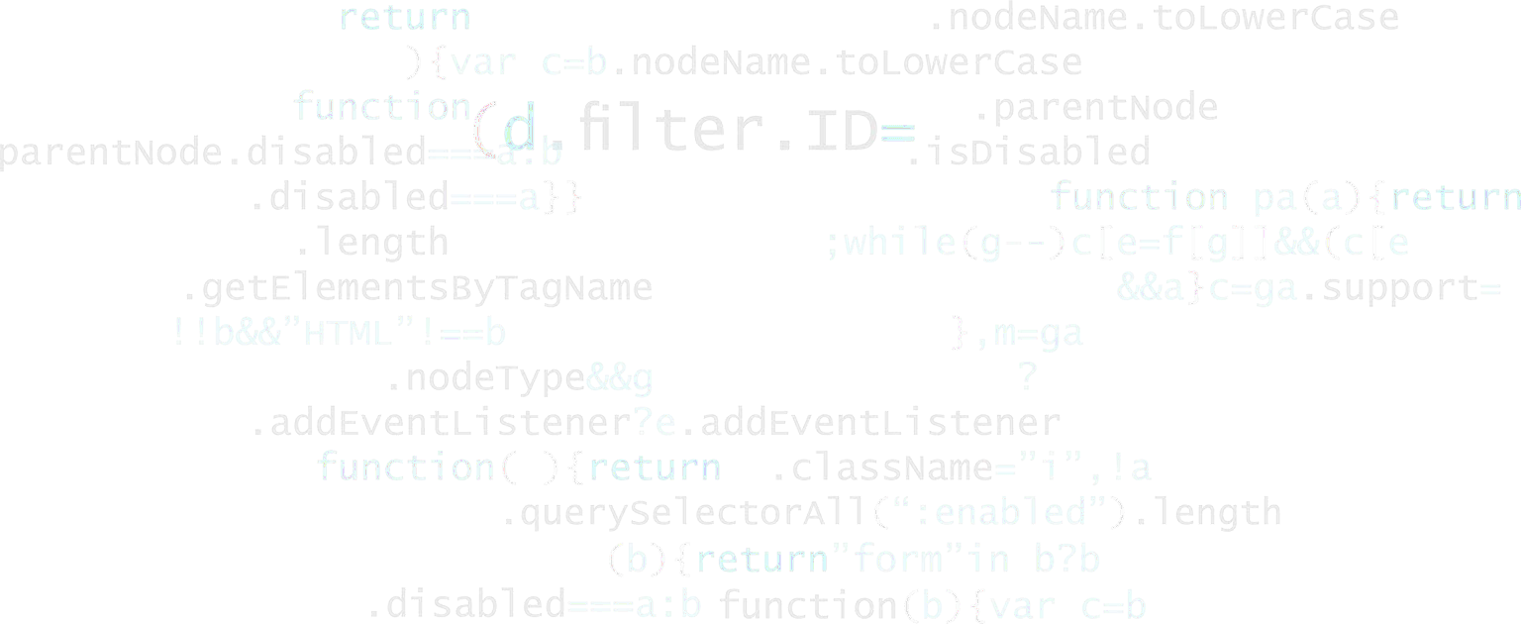


Consistency Checking for Transactional Databases
Senior Engineer @ Tencent Database (TDSQL)
Yuxing Chen
Notes:
Hello, everyone, my name is Yuxing Chen, a research engineer at Tencent database, I will share you with the topic of consistency checking for transactional databases.

Slide 2


Content
Background
Motivation
Solution
Summary
Notes:
Today I will cover the topic though background and motivation, and then introduce two current solutions and give a brief summary at the end.

Slide 3
Background

Slide 4










TDSQL
Tencent Enterprise Distributed Database
Serve more than 500K enterprise customers
Applications cover billions of users
Notes:
For those of you who don’t know Tencent Database (also called TDSQL), we are Tencent Enterprise level distributed database systems. Databases are the key and fundamental software for many applications. TDSQL proposed and implemented many innovative techniques, such as multi-level consistency, HTAP mixed engines, serverless high elastics, high availability. TDSQL serves more than half million enterprise customers such as banks, securities companies, and government companies. And our database applications cover billions of users.

Slide 5




TDSQL
Tencent Enterprise Distributed Database
Serve more than 500K enterprise customers
Applications cover billions of users
Financial
Social Network
Entertainment
Video
Notes:
Our database have been applied to many applications, ranging from financial, social network, entertainment gaming, and to online video. These are the top applications that have been widely using all overall the country.

Slide 6
TDSQL Products
OLTP
OLAP
Enterprise MySQL(CDB)
TDSQL-C
TDSQL
TDSQL-A
MySQL Compatible
Enhanced with enterprise-level features
Cloud native
Shared storage
MySQL and PG compatible
Shared nothing
MySQL compatible
Shared nothing
MPP + Column store
Oracle Compatible
Notes:
So, we have developed several product lines to fit different application scenarios. Mostly, we focus on OLTP at the beginning, recently, we also published TDSQL-A to fully and better support OLAP.
So we do care not only the performance but also the consistency or the correctness of databases. Some part of my job is to research the consistency of our products, as we have a lot of financial or banking customers, which have higher standards for database transactions.
And today, I am gonna talk about it from the perspective of isolation levels.

Slide 7
Background
 | P0:Dirty Write | P1:Dirty Read | P2:Non-repeatable Read | P3:Phantom
Read Uncommitted | Not Possible | Possible | Possible | Possible
Read Committed | Not Possible | Not Possible | Possible | Possible
Repeatable Read | Not Possible | Not Possible | Not Possible | Possible
Serializable | Not Possible | Not Possible | Not Possible | Not Possible
Isolation levels vs.
Data anomalies
The stronger the levels, the less the anomalies
Anomaly occurrences by ANSI SQL
Notes:
Most of our knowledge are the four standard isolation levels and the prohibited anomalies at each levels. We know the stronger the levels, the less the anomalies. At serializable level, theoretically, it did not allow any anomalies.

Slide 8
Background
 | P0:Dirty Write | P1:Dirty Read | P4C:Cursor Lost Update | P4:Lost Update | P2:Non-repeatable Read | P3:Phantom | A5A: Read Skew | A5B: Write Skew
Read Uncommitted | Not Possible | Possible | Possible | Possible | Possible | Possible | Possible | Possible
Read Committed | Not Possible | Not Possible | Possible | Possible | Possible | Possible | Possible | Possible
Cursor Stability | Not Possible | Not Possible | Not Possible | Possible | Possible | Possible | Possible | Possible
Repeatable Read | Not Possible | Not Possible | Not Possible | Not Possible | Not Possible | Possible | Not Possible | Not Possible
Snapshot Isolation | Not Possible | Not Possible | Not Possible | Not Possible | Not Possible | Not Possible | Possible | Possible
Serializable | Not Possible | Not Possible | Not Possible | Not Possible | Not Possible | Not Possible | Not Possible | Not Possible
More isolation levels and anomalies
Reference: Hal Berenson, Philip A. Bernstein, Jim Gray, Jim Melton, Elizabeth J. O'Neil, Patrick E. O'Neil: A Critique of ANSI SQL Isolation Levels. SIGMOD Conference 1995: 1-10
Notes:
However, the four standard anomalies are only tiny portions. We are aware of more forms of anomalies. Also, we see more isolation levels are defined. And there existed new relationship between new anomalies and new isolation levels.
New users to database may be confused to those new names of isolation levels or newly reported anomalies. It is not trivial to understand both new and old isolation or anomalies.

Slide 9
Motivation

Slide 10
Motivation
Non traditional isolation levels
MongoDB： Snapshot Isolation level
DB2: Cursor Stability level
TiDB：Optimistic level
Databricks：WriteSerializable level
SQL Server：Read Committed Snapshot Isolation level
Notes:
So, How can we better understand the isolation levels. We actually have a couple more examples of new isolation level names. It is not easy to directly understand these levels. For example, by the name of optimistic level from TiDB or Write Serializable from Databricks, it is hard to tell what anomalies to be expected and to be avoided.

Slide 11
Motivation
User:
1 Selection of a level for application, understanding of a new level:
want to know expected and unexpected anomalies in advance
2 Databases may not meet the level they claim or may not perform the same
Oracle claimed Serializable support but existing Write Skew
PostgreSQL does not allow Phantom but allow Write Skew at RR level
SQL Server does not allow Write Skew but allow Phantom at RR level
Notes:
But why do we need to understand these levels. From user perspective, they would like to know the possible anomalies in advance to best fit into the application scenarios, and sometimes the databases may not meet the level as they claimed. For example, Oracle claimed serializable support but existing Write Skew, Some databases may not perform the same with the same level, for example, PostgreSQL does not allow Phantom but allow Write Skew at Repeatable Read level, however, SQL Server perform the opposite, does not allow Write Skew but allow Phantom.

Slide 12
Motivation
Vendors:
1 Iteration developing yet regression test may be incomplete
PostgreSQL exists Write Skew from v9.1 to v12.3
2 How do we verify a newly developed database
Design flaw, program bugs, other optimization may yield unexpected anomalies.
Notes:
From the vendor perspective, they are iterating developing version, however, the regression test or verification are not complete. We see that PostgreSQL exists Write Skew from v9.1 to v12.3 for around 8 years
And a lot of newly developed database are ready to be published, but they still need a quality check or verification before it published to customers.

Slide 13
Solutions
Notes:
I will introduce two current solutions for isolation level checking.

Slide 14
Current solutions
Jepsen/Elle
Pros:
1. Isolation verification
2. Efficient checking
Cons：
1. Random test and sometimes hard to construct SQL test cases
2. No range queries, can not distinguish RR and SER levels
Reference: Peter Alvaro, Kyle Kingsbury: Elle: Inferring Isolation Anomalies from Experimental Observations. Proc. VLDB Endow. 14(3): 268-280 (2020)
Notes:
The first is Called Elle, it uses specific workload to stress the system for isolation level verification. Its workloads are specially designed for read-write dependencies. So by its test, it can be efficient to test the systems. However, it is still random read write operations, so sometimes it is really hard to reproduce or construct specific explainable test cases. And it does not consider range queries, so it can not distinguish between Repeatable Read and Serializable levels.

Slide 15
Current solutions
Cobra
Pros：
1. test K-V serializability
2. can catch the workload throughput
Cons：
1. Random test and sometimes hard to construct SQL test cases
2. No range queries, can not distinguish RR and SER levels
Reference: Cheng Tan, Changgeng Zhao, Shuai Mu, Michael Walfish: Cobra: Making Transactional Key-Value Stores Verifiably Serializable. OSDI 2020: 63-80
Notes:
The second solution is called Cobra, which test the serializability of K-V store. It can test the real application’s result and claim to be possible to catch the real-world workload throughput
Still, it is not easily to analyze the violations, and predicate anomalies with range queries can not be verified.

Slide 16
Summary

Slide 17
Summary
TDSQL cares about the correctness of the databases.
Current tools of isolation verification still
Lack reproducibility and understandability
Lack predicate anomaly verifications
Notes:
So, at TDSQL, we do care much about the correctness of the databases. The current solutions help us to effectively and efficiently understand our product behaviors. We can verify and guarantee the isolation levels we claim. But I think the currents checking solutions are still not perfect.
I think they sometimes still hard to reproduce the violations or hard to understand the violation. And I think the predicate anomaly verifications are still under research.

Slide 18
Thanks
Yuxing Chen
axingguchen@tencent.com

Slide 19
Reference：
Atul Adya, Barbara Liskov, Patrick E. O'Neil: Generalized Isolation Level Definitions. ICDE 2000: 67-78
Peter Alvaro, Kyle Kingsbury: Elle: Inferring Isolation Anomalies from Experimental Observations. Proc. VLDB Endow. 14(3): 268-280 (2020)
Cheng Tan, Changgeng Zhao, Shuai Mu, Michael Walfish: Cobra: Making Transactional Key-Value Stores Verifiably Serializable. OSDI 2020: 63-80
腾讯云数据库开源技术沙龙

