Slide 1




Efficient Query Rewrite Rule Discovery via
Standardized Enumeration and Learning-to-Rank
Yuan Zhang, Yuxing Chen, Yuekun Yu, Jinbin Huang, Rui Mao,
Anqun Pan, Lixiong Zheng, Jianbin Qin

Slide 2
Contents
Background & Motivation
Limitations of SOTA
Contribution
Preliminaries
Key Idea 1 – Standardized Templates
Key Idea 2 – RTP Deduplicator
Key Idea 3 – Learning-to-Rank
Experiments
Conclusion

Slide 3
Backgroud & Motivation
Real-world queries are complex:
Most production queries contain 5–8+ nodes (PostgreSQL, web apps).
Auto-generated SQL (ORM, AI tools) produces redundant joins/subqueries.
Manual rules are incomplete and unsustainable.
Existing optimizers leave many queries unoptimized.
title.id=1
Inner Join
Predicate pushdown rewriting
Inner Join
id=1
title
movie_info
title
movie_info
Runtime: 17952.84 ms
The runtime difference is 40,000 times!
Runtime: 0.45 ms

Slide 4
Limitations of SOTA (WeTune[1])
Brute-force enumeration of plan templates + constraints
4-node rules: 4,320 CPU hours (~9 days), >90% redundant, >50% trivial
5-node rules: ~6 months on 64-CPU machine
6+ node rules: Infeasible (decades)
Cannot handle real workloads (most queries >4 nodes)
No effective prioritization → rule base clogged with low-value rules
Rule validator duration: 133h 33m 38s
96.7%
Total time for 4-node rule enumeration:137h 59m 28s
[1] Wang, Zhaoguo, et al. "WeTune: Automatic Discovery and Verification of Query Rewrite Rules." Proceedings of the 2022 International Conference on Management of Data. 2022..

Slide 5
Contribution
Query rewriting is essential for database performance, yet automated rule discovery remains challenging due to exponential search spaces, massive redundancy (>90%), and poor scalability beyond 4-node plans.
SLER (Standardized Enumeration + Learning-to-Rank) is the first scalable system that discovers >1 million empirically validated rewrite rules — the largest rule library to date.
Supports complex templates up to channel-level depth (previously infeasible).

Slide 6
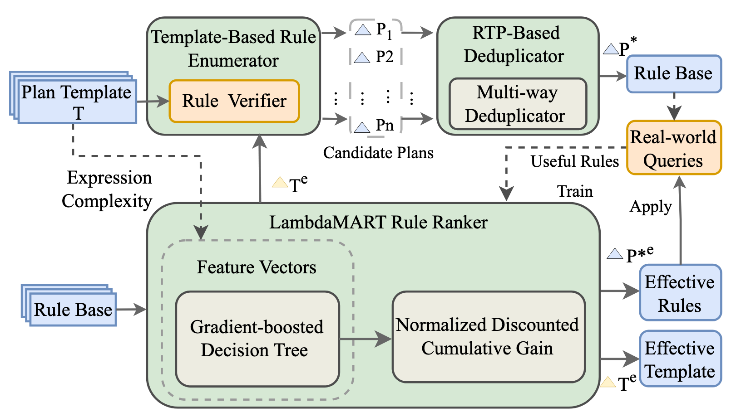
SLER Overview
Standardized Template Enumerator – drastically reduces search space
RTP-based Deduplicator – eliminates redundancy at template-pair level
LambdaMART Rule Ranker – learning-to-rank for high-value rules + pre-filtering
Notes:
图都汉化，表自己做。

Slide 7
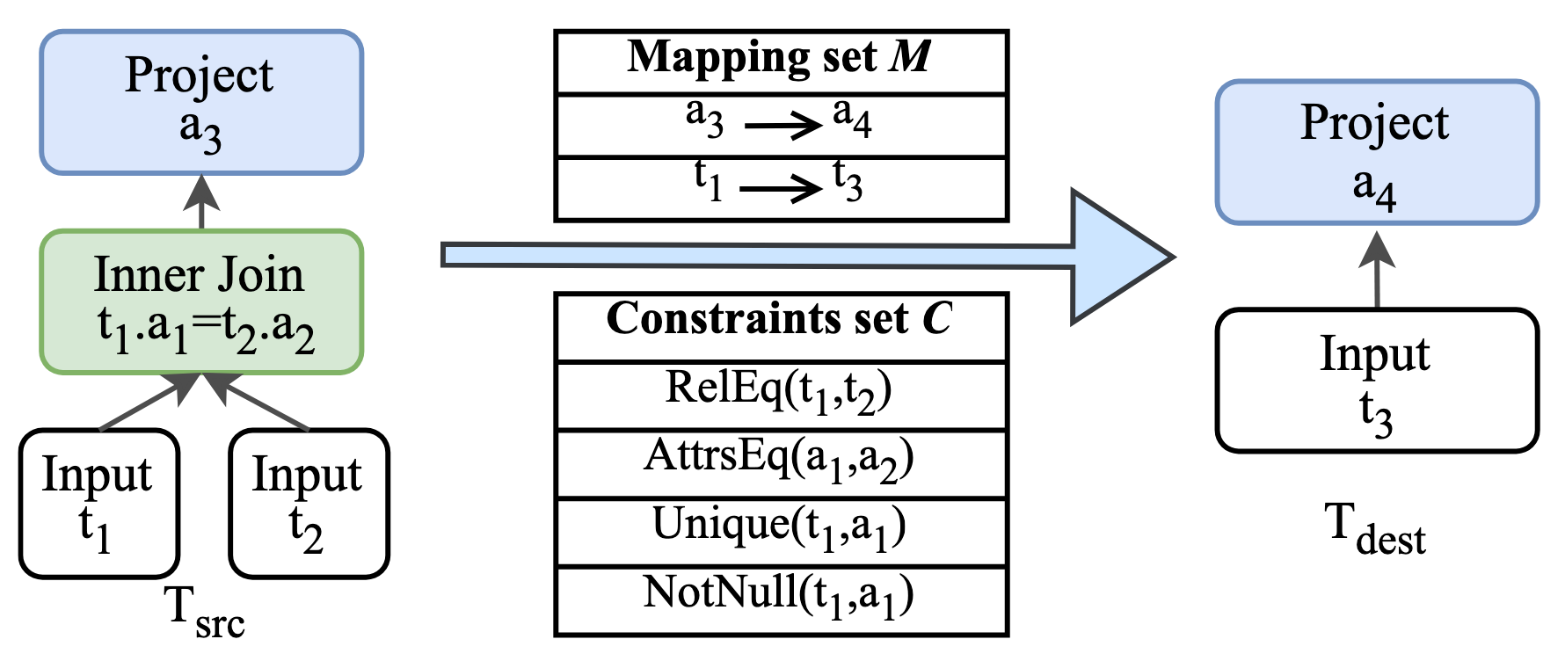
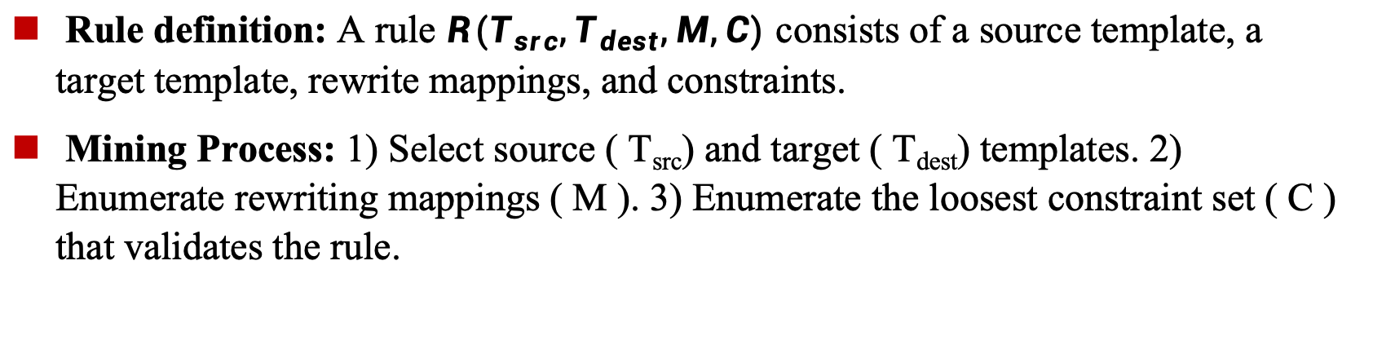
Key Idea 1 – Standardized Templates
Rule definition: A rule $R(T_{src},T_{dest},M,C)$ consists of a source template, a target template, rewrite mappings, and constraints.
Mining Process: 1) Select source ( T_{src}) and target ( T_{dest}) templates. 2) Enumerate rewriting mappings ( M ). 3) Enumerate the loosest constraint set ( C ) that validates the rule.
Notes:
图都汉化，表自己做。

Slide 8
Preliminaries – Query Plan Operators
A query plan template T is a directed tree where each node is a relational algebra operator.
Supported Operators (same as WeTune)
Operator | Semantics
Input(R) | Input relation R (table or subquery)
Project(a) | Project attributes in list a
Filter(p,a) | Keep tuples satisfying predicate p on attributes a
InnerJoin(R_{l}.a_{l},R_{r}.a_{r} ) | Inner join on R_{l}.a_{l}=R_{r}.a_{r}
LeftJoin / RightJoin | Left / Right outer join (symmetric)
InSub(R_{l}.a_{l},R_{r}.a_{r} ) | Semi-join: keep rows from Rl where value exists in Rr
Distinct(a) | Project a and remove duplicates
Notes:
图都汉化，表自己做。

Slide 9
Constraints
C is minimal (most relaxed possible): removing any single constraint breaks equivalence
Constraint Types (used in C )
Constraint | Meaning
RelEq(R₁,R₂ ) | Relations R₁ and R₂ contain identical tuples
AttrsEq(a₁,a₂ ) | Attribute lists are identical
PredEq(p₁,p₂) | Predicates are logically equivalent
SubAttr(a₁,a₂) | Every attribute in a₁ also appears in a₂
RefAttr(R₁.a₁,R₂.a₂ ) | All values in R₁.a₁exist in R₂.a₂
Unique(R,a) | Values in R on attribute a are unique
NotNull(R,a) | No NULL values in R.a
Notes:
图都汉化，表自己做。

Slide 10
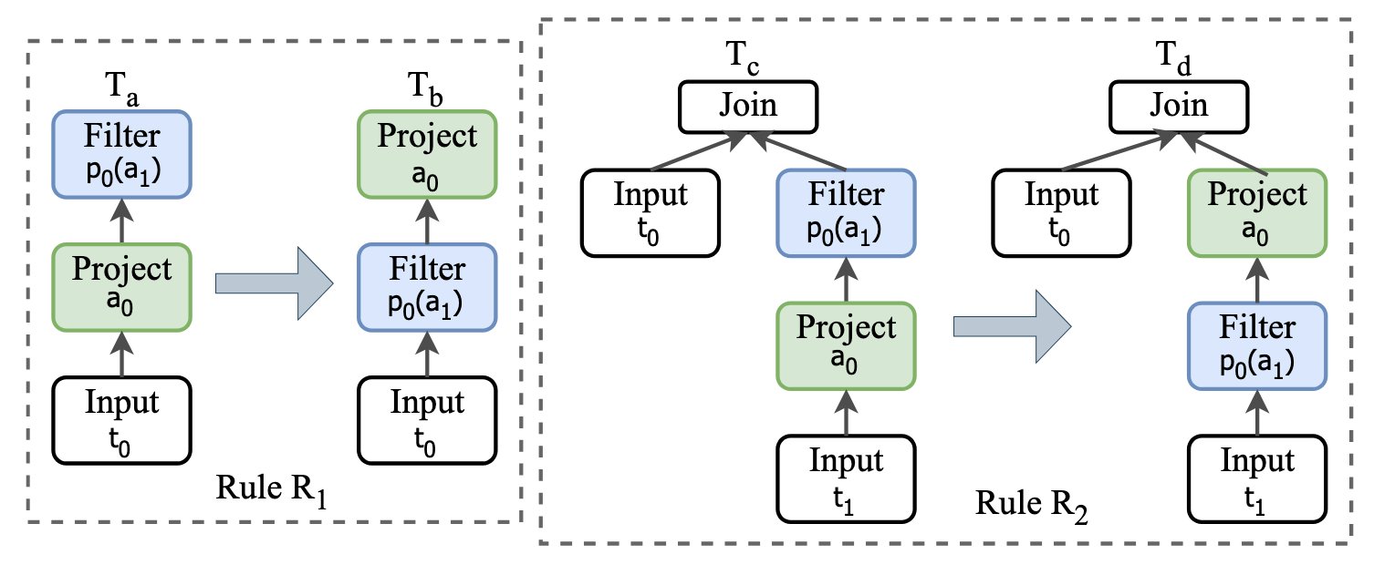
Key Idea 1 – Standardized Templates
Observation: Many rules differ only in trivial operator ordering (Project/Filter/Distinct swaps) or redundant operators.
Standardized Rule : Empty constraint set + only two transformations:
Swap two adjacent operators
Remove one operator
Priority order : Project > Distinct > Filter
Property: Any non-standardized rule is provably redundant if a standardized rule exists.
Notes:
图都汉化，表自己做。

Slide 11
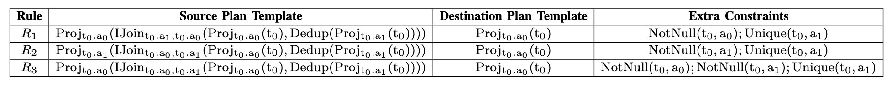
Key Idea 2 – RTP Deduplicator
Traditional deduplication: O(n²) nested loops → >20 days for 4-node rules.
RTP Algorithm
Per template pair (T_{src}, T_{dest})
Incremental redundancy check during enumeration
Uses optimizer to test whether adding a rule changes optimization result
Multi-way subsumption + subset partitioning (Compared to R₃, both R₁ and R₂ are redundant rules.)
Guaranteed correctness (proven in paper).
Notes:
多路归并后算法复杂度为O(nlogn)，且资源利用率提高
我们可以简单证明这一点。假设有规则集合$S$与$S′$，且$S′$是$S$的子集。若某规则$R$在$S′$中是冗余的，可得
$$∀q Rewrite\left(S′,q\right)=Rewrite(S^{′}−\left\{R\right\},q)$$
对于任意查询$q$，使用规则集合$S$进行优化时，分为两种情况
（2）查询$q$在优化过程中使用到了规则$R$。那么，存在某查询计划中间结果$q_{R}$，在查询时使用规则$R$重写为${q′}_{R}$，即
$$q_{R}\underset{→}{R}{q′}_{R}$$
在这种情况下，由公式可知，必定存在另一条优化路径，使得
$$q_{R}\underset{→}{R_{1}}…\underset{→}{R_{m}}{q′}_{R}$$
其中，该优化路径用到的规则集合$\{R_{1},…,$ $R_{m}\}⊆S −\left\{R\right\}$。可得
$$Rewrite\left(S,q\right)=Rewrite(S−\left\{R\right\},q)$$
在枚举输出的规则中，包含大量重复的规则。这是复杂的映射与约束枚举造成的，在具体规则生成前难以去除冗余。
（2）去冗余操作会带来一定的内存开销。以模板对为单位的去冗余可以控制内存，避免影响枚举算法性能。
（3）枚举时过滤冗余规则，可以中断后续对约束的进一步枚举，减少校验器调度次数。

Slide 12
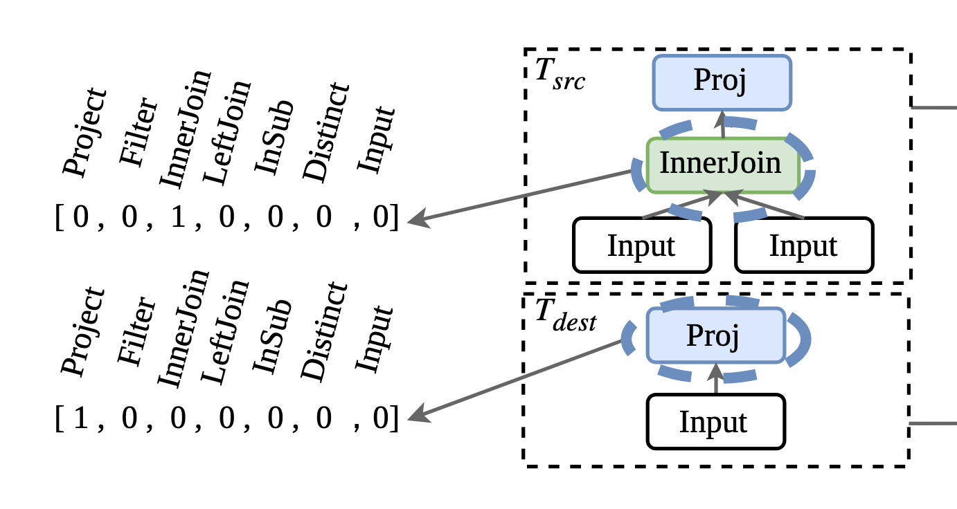
Key Idea 3 – Learning-to-Rank
Problem: Proof length (Z3 assertions) is unreliable (NP=coNP open problem).
Solution: Train LambdaMART (gradient-boosted trees) on real query workload (>11k SQL queries).
Features:
Tree distance & structural similarity
Expression complexity
Operator types
Emcoding each node of the tree using one-Hot encoding

Slide 13
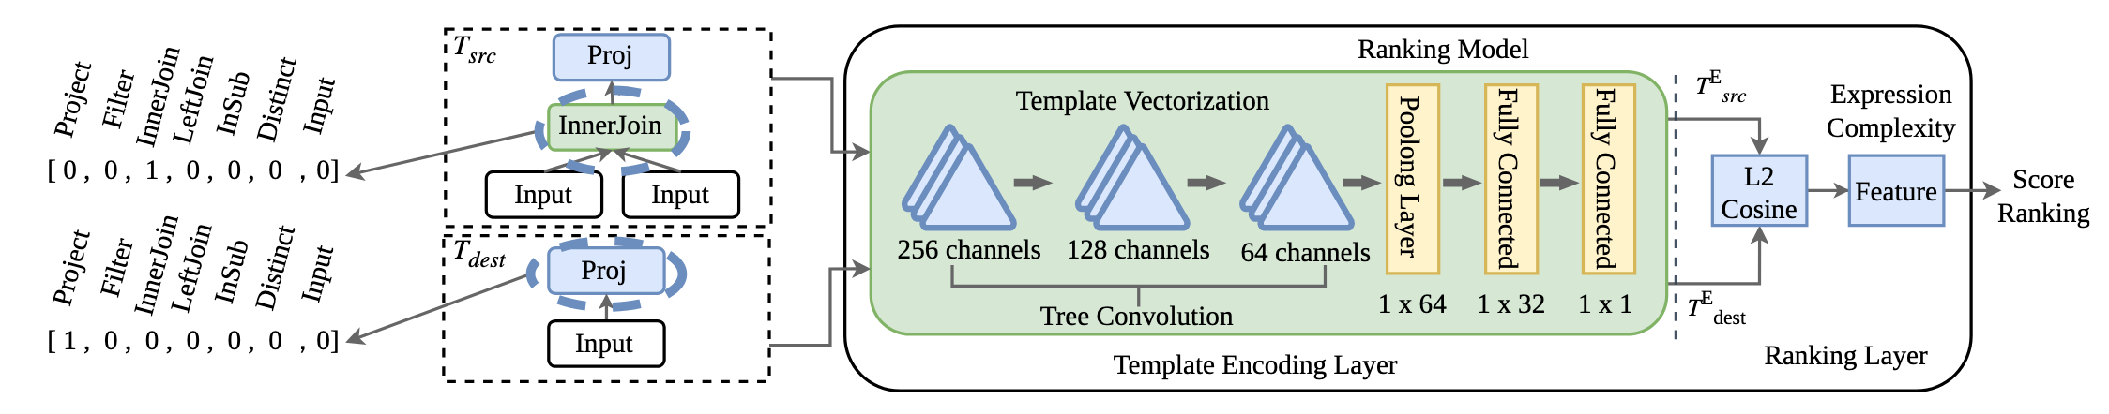
Key Idea 3 – Learning-to-Rank
The Figure below illustrates the architecture of rule effectiveness ranking.
The vectorized tree is passed through three layers of tree convolution.
After the last layer of tree convolution, the tree structure is flattened into a single vector.
The source template and target template tree(T_{src},T_{dest})output a fixed vector (V_{src},V_{dest}).

Slide 14
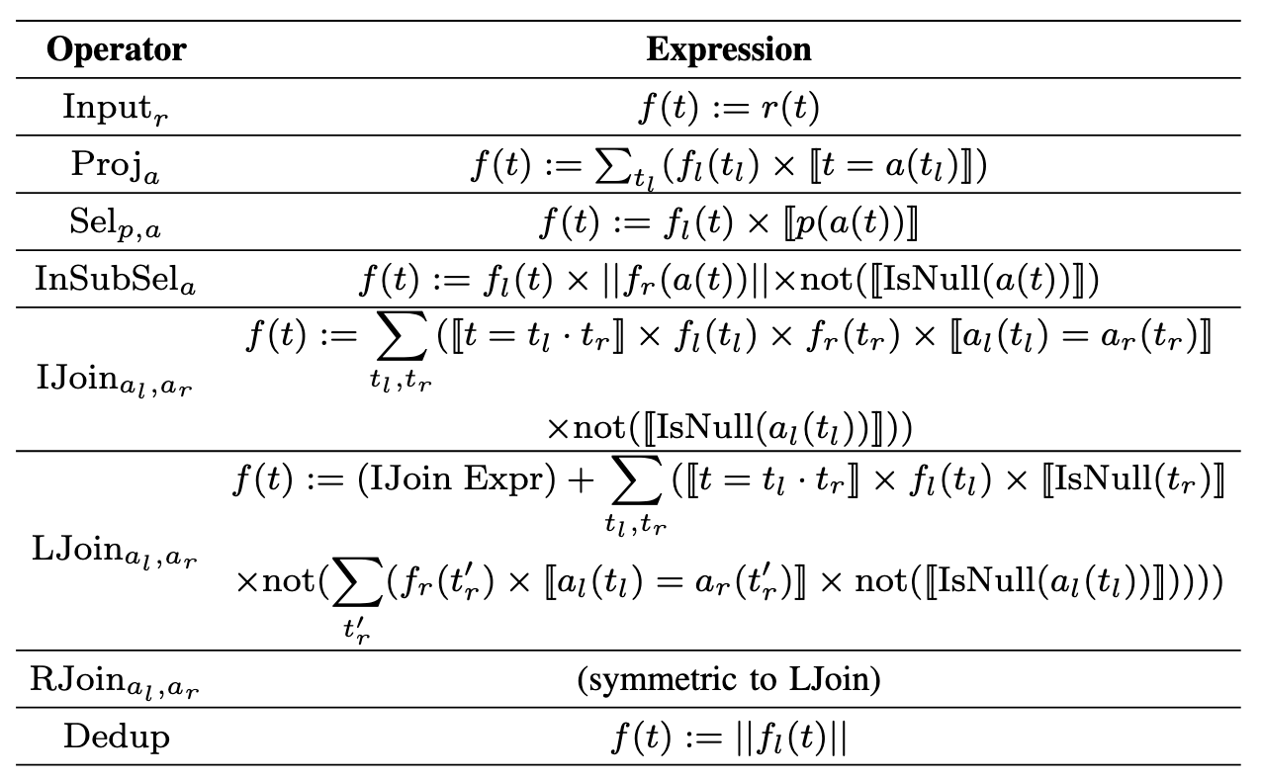
LambdaMART – Quantitative Features
We transformed the operators into expression form and extracted nine quantitative features from them to train the LambdaMART sorter:
 | Feature | Description
1 | L2 Distance | Euclidean distance between V_{src} and V_{dest}
2 | Cosine Similarity | Cosine similarity between the two vectors
3 | expr_length | String length of the expression
4 | sum_count | Count of ∑ operators
5 | times_count | Count of × operators
6 | neg_count | Count of ¬ operators
7 | bracket_count | Number of [ ] bracket pairs
8 | var_count | Number of variables (t, r, f, a)
9 | complexity | Total operator count

Slide 15
Dual Role of LambdaMART Ranker
The LambdaMART learning-to-rank model serves two complementary purposes in SLER:
Phase | Role | How it Works | Key Benefit
During Enumeration (Pre-filtering) | Template-pair pre-filter | Rank all possible template pairs → select only top-k most promising pairs | Enables scalable rule discovery for complex templates (n ≥ 7 nodes) Reduces enumeration time dramatically while retaining high-value rules
After Enumeration (Final ranking) | Rule effectiveness ranking | Score every generated rule using the 9 quantitative features → sort in descending order | Optimizes Precision@n Guarantees the top-n rules are the most effective for real-world query performance. Sort all rules.

Slide 16
Evaluation Setup
Datasets / Query Statistics:Total workload: 11,518 unique SQL queries
8,518 queries from WeTune : collected from 15 open-source applications (e.g., Discourse, Redmine)
3,000 commercial queries from YashanDB :intricate relational patterns from real financial systems(kept private due to proprietary restrictions)
End-to-end performance evaluation:
Deployed on SQL Server 2019
Populated with 10M+ rows (Discourse dataset)
Baselines
WeTune (SOTA automated rule discovery)
No-rewrite baseline

Slide 17
Evaluation Setup
Metrics for Evaluation:
Enumeration Efficiency & Scalability
Total enumeration time and CPU hours
Reduction in Z3 verification calls and overall verification complexity
Scalability to complex templates (n ≥ 7 nodes)
Rule Quality
Number of effective (non-redundant, high-value) rules discovered
Coverage of real-world complex query patterns unreachable by prior work
End-to-End Optimizer Performance
Query execution runtime on SQL Server 2019
Plan quality (number of rewrite steps required, plan simplicity)
Latency reduction percentage compared with WeTune and no-rewrite baseline

Slide 18
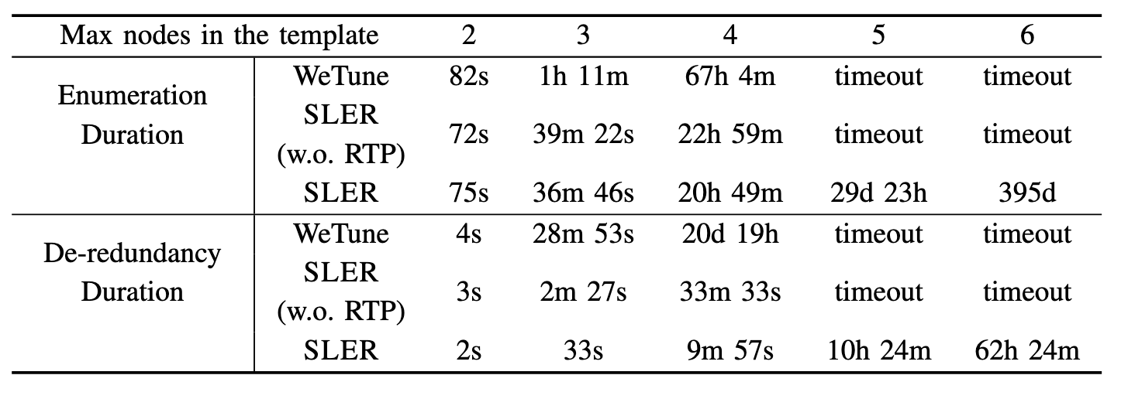
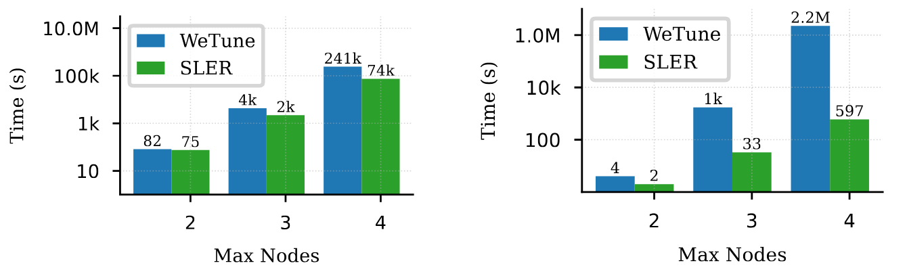
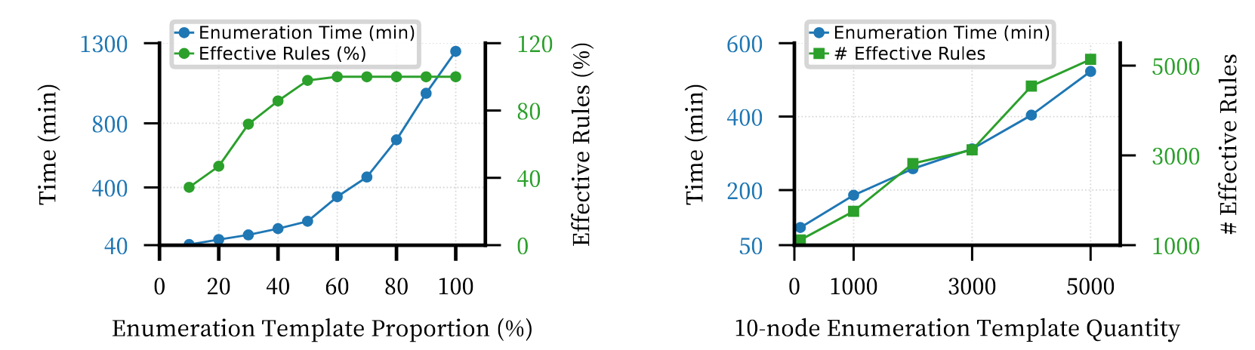
Main Results – Efficiency

Slide 19
Main Results – Efficiency
Standardized enumeration + RTP: up to 90% reduction in verification time
Full 4-node rule discovery: dramatically faster than WeTune
7+ node templates now feasible via ranker pre-filtering
Example: 10-node templates → 5,127 effective rules discovered in 523 minutes

Slide 20
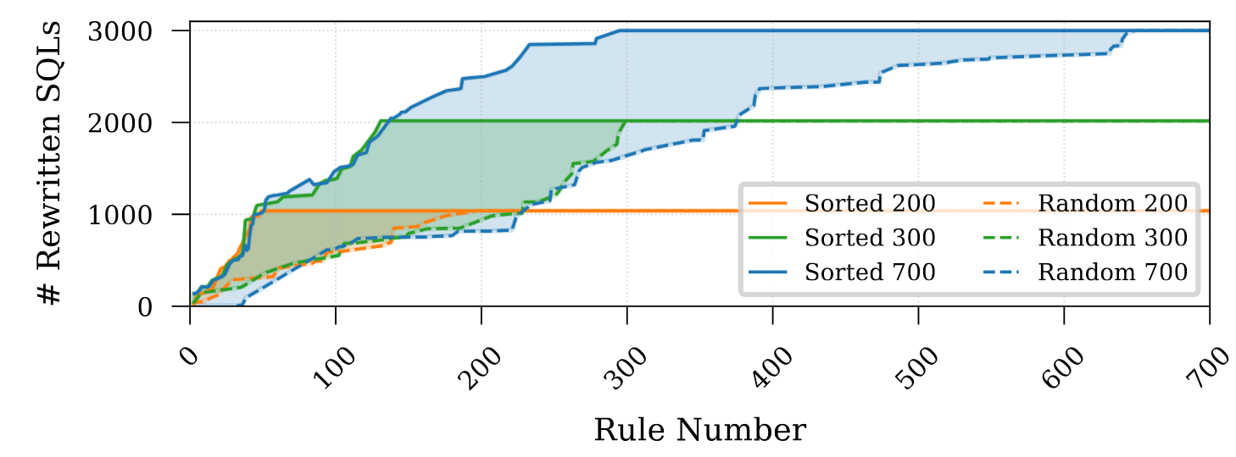
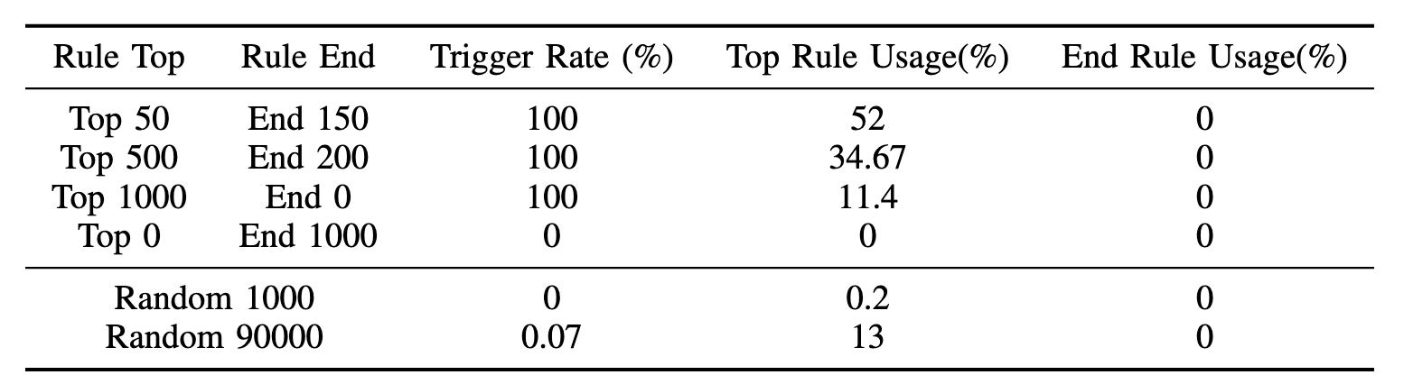
Rule Quality

Slide 21
Rule Quality
As the number of rules increases, the ranked rule set consistently optimizes significantly more queries than the random or bottom-ranked sets.
LambdaMART ranking delivers clear gains in rewrite efficiency and query performance.

Slide 22
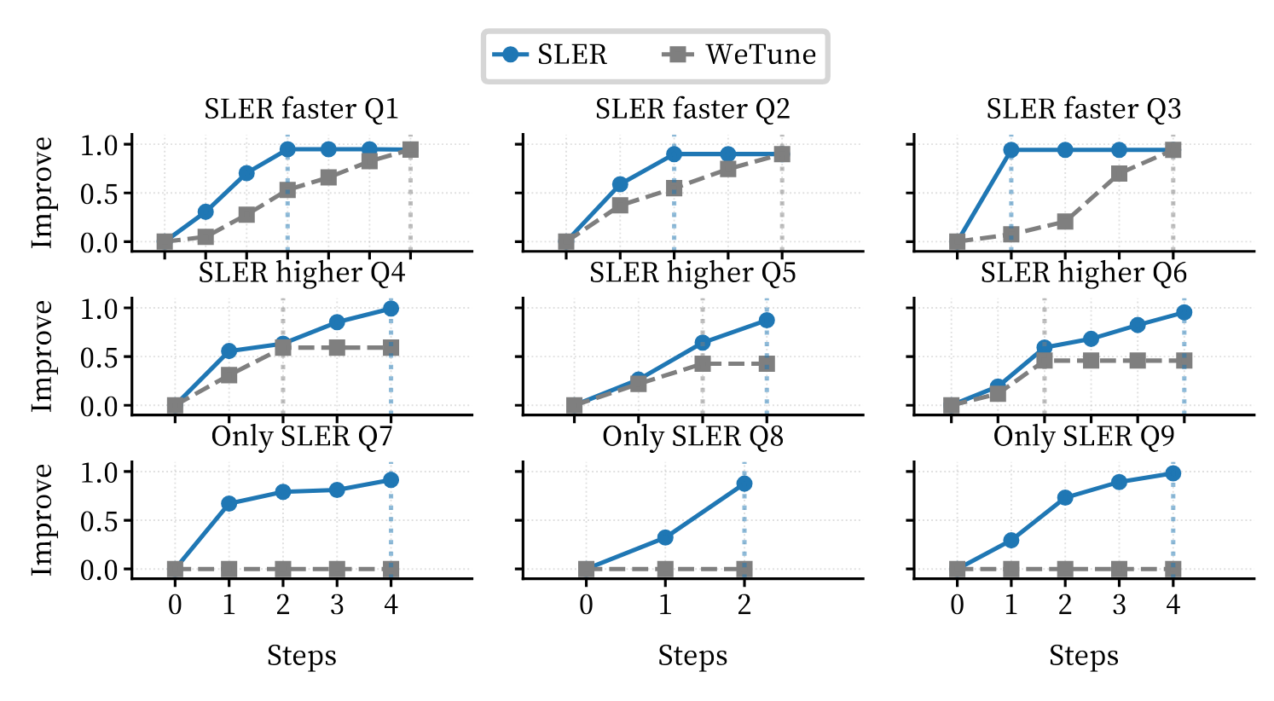
Main Results – Effectiveness
Query optimization on real workloads:
SLER reaches ideal plans in single step vs. WeTune’s 3–4 steps
Latency reduction: 41.8%–73.2% (vs. WeTune 18.5%–41.8%) in deep-optimization scenarios
Three typical win scenarios (Q1–Q9 ):
convergence acceleration
breakthrough depth
unique optimizations

Slide 23
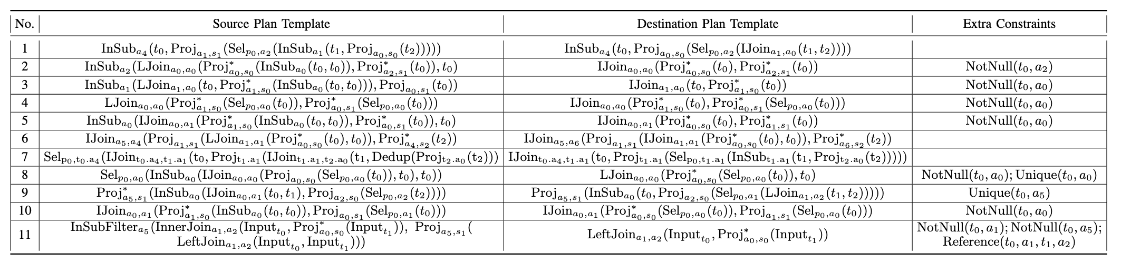
Example Rules & Impact
SLER discovers rules that:
Eliminate unnecessary joins/subqueries
Push filters/projects optimally
Handle multi-level redundancy

Slide 24
Conclusion
SLER solves the long-standing scalability crisis in automated rewrite-rule discovery.
First system to produce >1M high-quality rules covering complex real-world queries.
Template standardization + RTP + LambdaMART ranking = general, extensible framework.
Opens the door to next-generation optimizers powered by massive, adaptive rule spaces.
Future Work
Support more operators/constraints
Workload-specific rule subset selection
Integration into production DBMS

Slide 25
Thanks
Thank You!
Thanks
Thanks
Q & A
SZU

