Slide 1



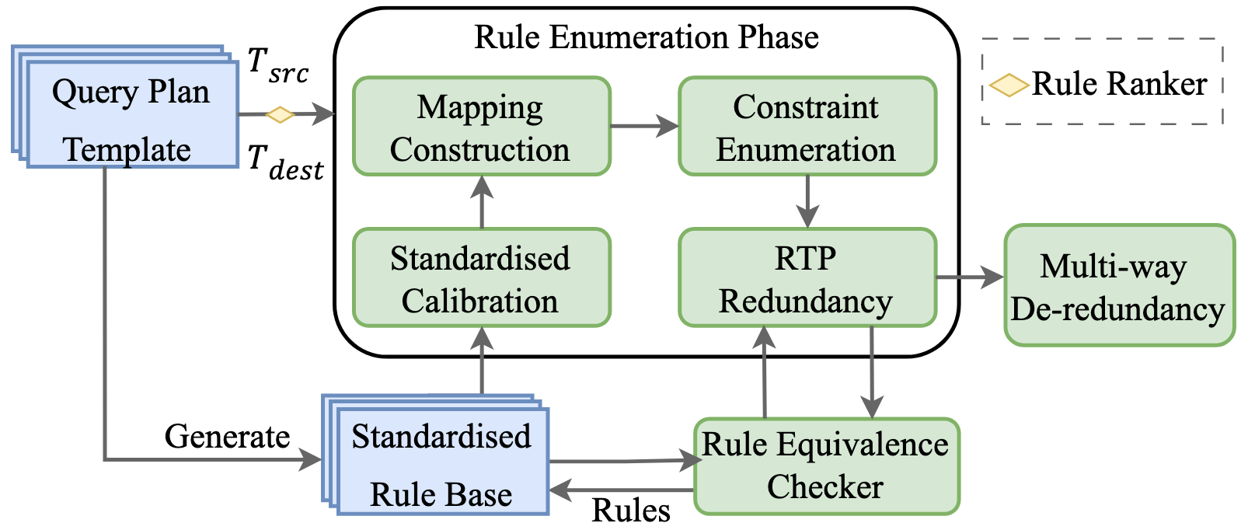
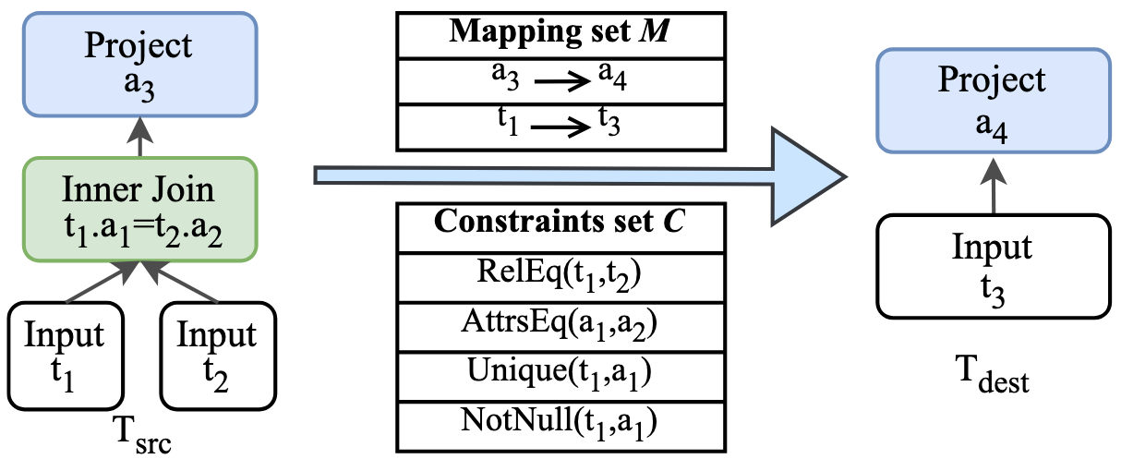
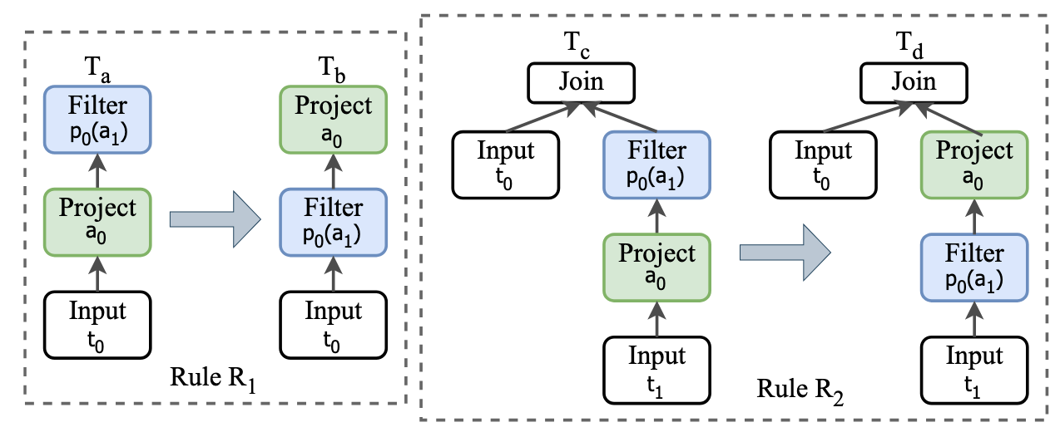
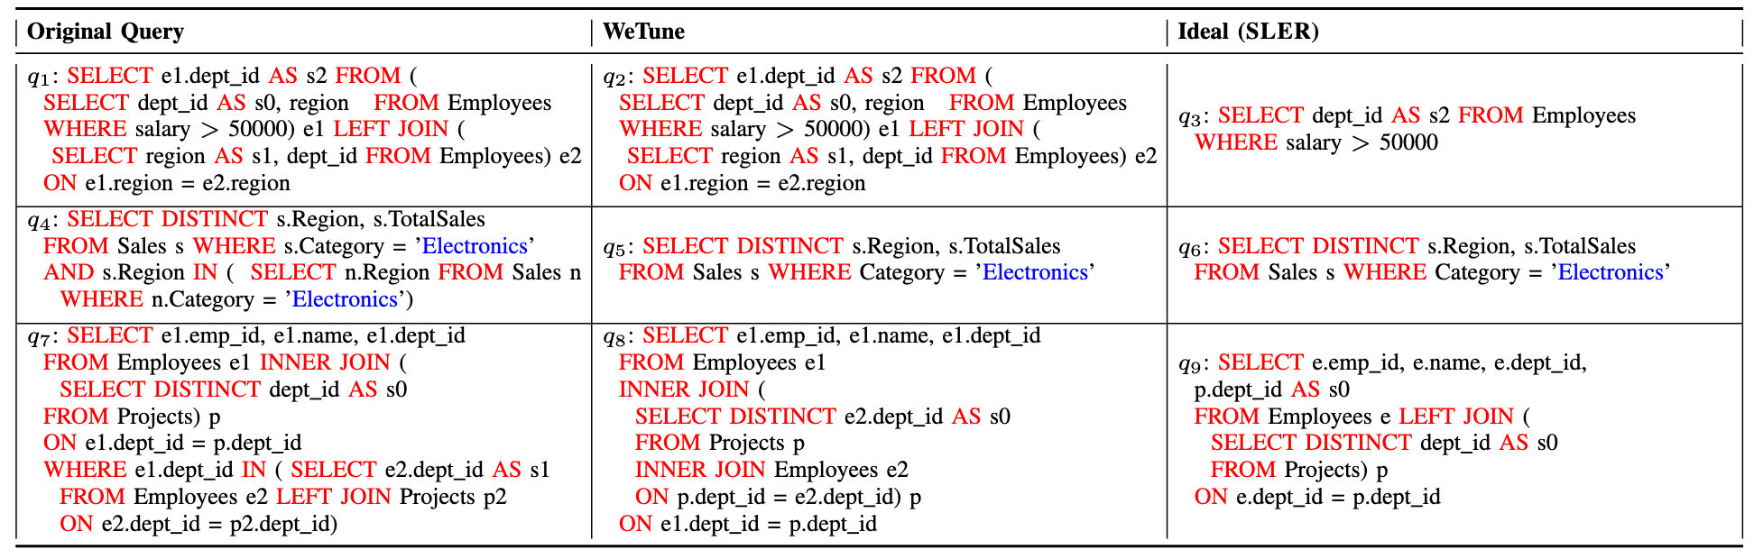
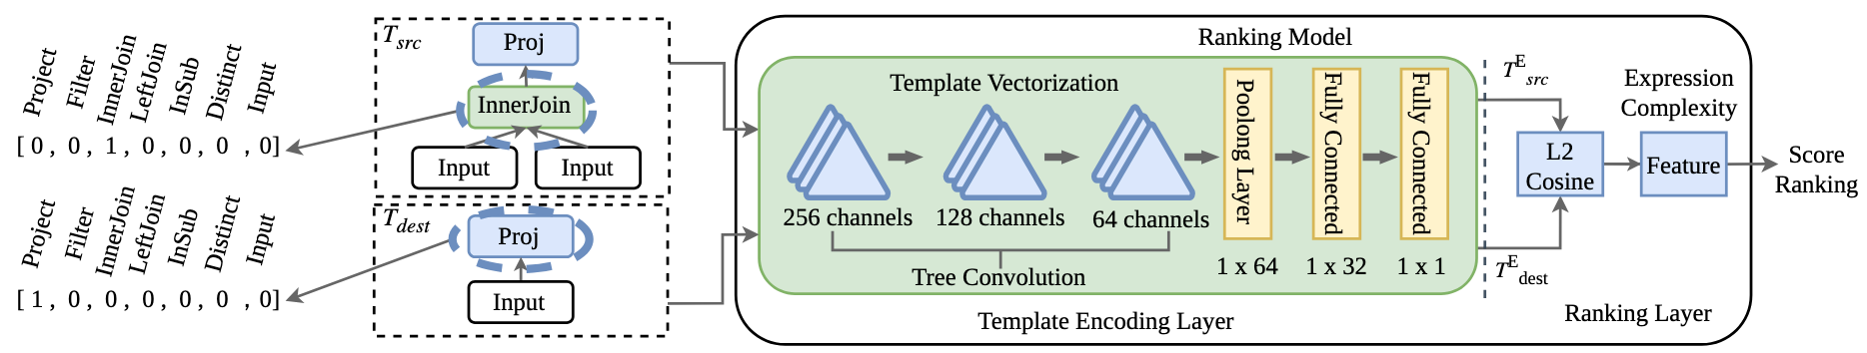


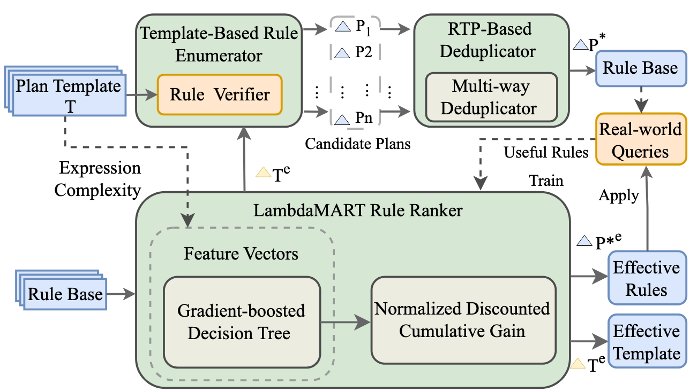
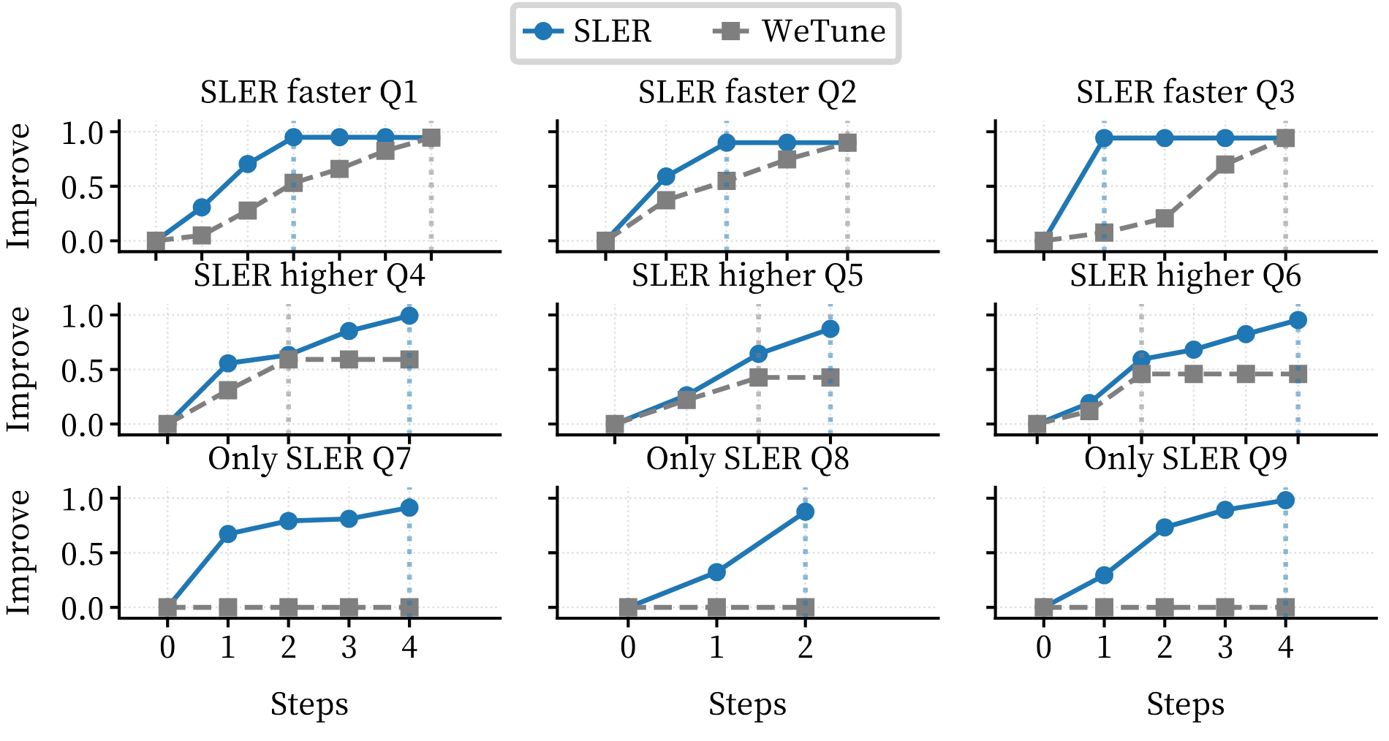
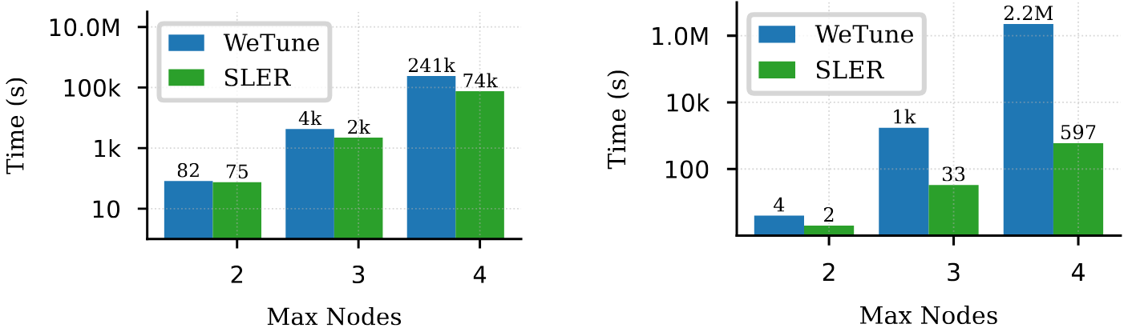
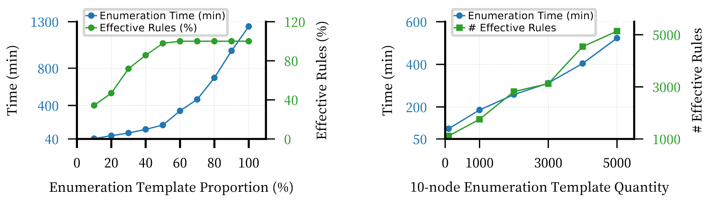
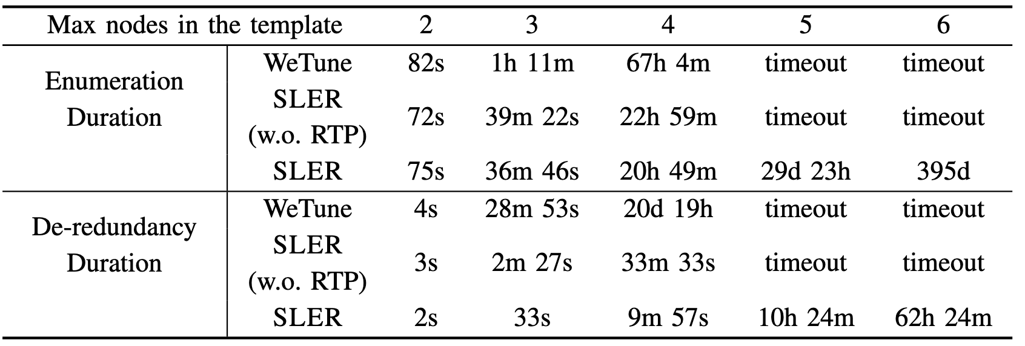
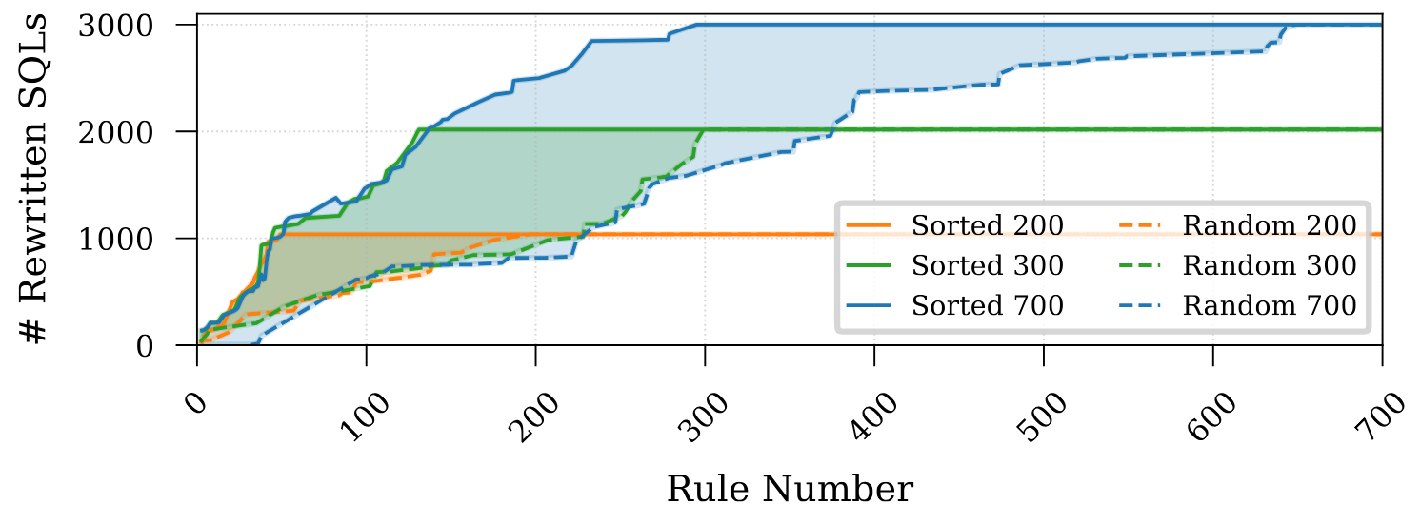
Efficient Query Rewrite Rule Discovery
via Standardized Enumeration and Learning-to-Rank
Yuan Zhang¹ Yuxing Chen^{†2} Yuekun Yu¹ Jinbin Huang¹ Rui Mao¹ Anqun Pan^{†2} Lixiong Zheng^{†2} Jianbin Qin¹
¹ Shenzhen Institute of Computing Science, Shenzhen University ²Tencent Inc.
What is Query Rewrite Rule?
Background: Query rewriting is a cornerstone of query optimization. While manual rule creation is slow, automated discovery tools (e.g., WeTune) have emerged.
E. Standardized Enumeration & RTP
title.id=1
Predicate pushdown rewriting
Inner Join
Inner Join
id=1
title
movie_info
The runtime difference is 40,000 times!
title
movie_info
Runtime: 17952.84 ms
Runtime: 0.45 ms
Why Query Rewrite Rule Discovery ?
Motivation:
Complexity Wall: Production systems require rules with 5-10 nodes, but search spaces grow exponentially.
Severe Redundancy: Over 90% of auto-generated rules are trivial, redundant, or structural isomers.
Efficiency Gap: Existing tools (e.g., WeTune) fail beyond 4 nodes, making complex optimizations infeasible.
Core Goal: To build a scalable system that discovers high-impact, complex rewrite rules for large-scale query plans.
Eliminating Structural Redundancy Operator Removal Operator Permutation | The RTP Algorithm Logical Equivalence Pruning Efficient Deduplication
F. Learning-to-Rank (LTR)
Approach: Treats rule discovery as a ranking problem to prioritize "promising" template pairs.
3
Pre-filtering (Discovery Phase) Ranks and selects Top-k promising template pairs. | Final Ranking (Optimization) Scores and sorts validated rules by predicted performance gains.
System Overview: SLER
Standardized Template Enumerator
RTP-Based Deduplicator
Learning-to-Rank (LTR) Ranker
G. Experiments
Datasets. 11,518 real-world SQL queries (GitHub Apps & YashanDB).
Baselines: WeTune (State-of-the-art automated rule discovery tool).
Optimization Speed
Efficiency
Scalability
Efficiency evaluation in enumeration and de-redundancy
Contribution
Large-Scale Rule Base
Building the largest rewritten rule base to date, containing over 1 million non-redundant and empirically validated rules.
Standardized Enumeration
Eliminates structural isomers and identity operators via a canonical framework.
LTR-Guided Discovery
Utilizing LambdaMART to prioritize high-value template pairs.
High-Performance Discovery and Practical Functionality
Achieving up to 87% faster runtime compared to state-of-the-art tools and identifying new, complex rule categories.
Assess SLER's ranker via cumulative rewritten SQLs with added rules

