Slide 1


IndeXY: A Framework for Constructing Indexes Larger than Memory
Chen Zhong
Xingsheng Zhao, Song Jiang
Qingqing Zhou, Yuxing Chen,
Kuang He, Anqun Pan

Slide 2
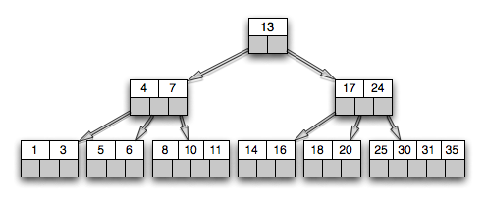
Insufficient Memory for Large Indexes
Indexes are one of the most performance-critical component in a DB.
Keep them all in the memory?
Usually too large:
For example, about 55% of the memory is occupied by the indexes in H-Store.
Often not necessary:
Not all parts of an index are accessed at a time.
An apparent solution:
Use the disk as the memory extension
A large index spans memory and disk
Notes:
2
TB of memory

Slide 3
State-of-the-art Practices - A Co-design approach
In-memory databases:
migrate a selected subset of tuples out of the memory
E.g., Siberia and Anti-Caching.
migrate only subset of tuples, instead of index.
customized to database systems
E.g., respectively, Microsoft Hekaton and H-Store.
On-disk databases:
cache the indexes in the memory
optimize the buffer cache management
For example, LeanStore uses pointer swizzling
use the common paged index structure for memory and disk
Not customized to the devices’ different characterizations.
Notes:
3
TB of memory

Slide 4
IndeXY: a Framework for Extensible Indexes
Support integration of in-memory index (Index X) and on-disk index (Index Y).
Each can be independently selected
Each was designed for its target device.
Provide a virtual-memory-like infrastructure at the key-value granularity.
The index becomes ‘swappable’
Automate the process of maintaining a designated index memory limit by selecting keys for unloading to the disk.
Notes:
4
IndeXY, a framework supporting development of extensible indexes across the memory and disk.
it allows a selected existing in-memory index (Index X) and a selected existing on-disk index (Index Y) to be integrated into one index structure

Slide 5
The Design Challenges
How to minimize the changes to the existing Indexes X and Y?
No structural change to their data structures.
No logic change to the access algorithms.
How to efficiently track access hotness?
Access unit is small (individual keys).
Both time and space overhead needs to be considered.
How to generate high-performance write requests to Index Y?
Sequential writes are friendly to disk performance.
Both temporal and spatial locality needs to be considered.
Notes:
5

Slide 6
The Big Picture
Index X
DRAM
Transfer Layer
DISK
Index Y
The framework’s major features are integrated into Index X.
Notes:
6
Why is pre-cleaning necessary? “Therefore, it is important for this unloading process to be completed as quickly as possible so that the lock can be
released quickly and the index size can be quickly reduced. However, this can be a challenging task. The index grows because of continuously inserted new keys. It leads to dirty data in the index and accordingly a slowdown of the unloading process due to writing of the dirty data to the disk.

Slide 7
The Big Picture
Index X
DRAM
Transfer Layer
DISK
Index Y
The framework’s major features are integrated into Index X.
Notes:
7
Why is pre-cleaning necessary? “Therefore, it is important for this unloading process to be completed as quickly as possible so that the lock can be
released quickly and the index size can be quickly reduced. However, this can be a challenging task. The index grows because of continuously inserted new keys. It leads to dirty data in the index and accordingly a slowdown of the unloading process due to writing of the dirty data to the disk.

Slide 8
The Big Picture
Subtree Pre-cleaning
Index X
DRAM
Transfer Layer
DISK
Index Y
Not actively dirty sub-trees will be cleaned.
a background pre-cleaning process
prepare for later quick space reclamation.
Notes:
8
Why is pre-cleaning necessary? “Therefore, it is important for this unloading process to be completed as quickly as possible so that the lock can be
released quickly and the index size can be quickly reduced. However, this can be a challenging task. The index grows because of continuously inserted new keys. It leads to dirty data in the index and accordingly a slowdown of the unloading process due to writing of the dirty data to the disk.

Slide 9
The Big Picture
Subtree Release
Index X
Mount point
DRAM
Transfer Layer
DISK
Index Y
Large and cold subtrees will be selected for release.
space reclamation to keep the index size below its memory limit.
Notes:
9
Why is pre-cleaning necessary? “Therefore, it is important for this unloading process to be completed as quickly as possible so that the lock can be
released quickly and the index size can be quickly reduced. However, this can be a challenging task. The index grows because of continuously inserted new keys. It leads to dirty data in the index and accordingly a slowdown of the unloading process due to writing of the dirty data to the disk.

Slide 10
The Big Picture
Index X
DRAM
Transfer Layer
DISK
Index Y
New writes to Index X also go to a write-ahead-log for recovery.
A thin transfer layer between Indexes X and Y is set up.
A write buffer to form sequences of disk writes
A read cache to act as a small block cache.
Notes:
10
Why is pre-cleaning necessary? “Therefore, it is important for this unloading process to be completed as quickly as possible so that the lock can be
released quickly and the index size can be quickly reduced. However, this can be a challenging task. The index grows because of continuously inserted new keys. It leads to dirty data in the index and accordingly a slowdown of the unloading process due to writing of the dirty data to the disk.

Slide 11
Pre-cleaning Sub-trees
D: Dirty Node
C: Candidate Node
Under
Intensive Writes
New
write
Sub-tree
Search
New
write
D = 0
C = 0
D = 1
C = 0
D = 0
C = 1
D = 1
C = 1
Sub-tree
Search
Transfer Layer
Sub-tree
Search
The subtree found!
Search for a sub-tree for pre-cleaning on a linked list of inner nodes
Use a two-bit algorithm to detect subtrees that:
have been written before
currently not under intensive writes.
Notes:
11

Slide 12
Sub-tree Release
A
😞
😞
G
😊
Low density
B
I
B
C
D
E
F
A
F
F
D
Index Limit Size
Index Limit Size
Index Limit Size
G
H
I
Target Size
D
Target Size
Target Size
C
C
H
E
E
Initially
Replace/Sorted
by density
When Index X size approaches its limit, memory release thread is triggered.
Access density of a subtree = # of accesses / the subtree size
Efficiently track the density (see the paper)
Density-based subtree ranking algorithm to find a subtree for release:
The subtree is not frequently accessed; and
The subtree is large.
Notes:
12
A new concept: access density of a subtree rooted at an inner node is the ratio between the number of searches that have crossed the node and the number of keys in the subtree (on the Index X).
This density takes both the loss (miss penalty) and benefit (space reclamation)

Slide 13
Performance Evaluation
The workloads
Micro-benchmarks
YCSB
TPC-C
Experiment setup
Intel Xeon Platinum 8255C CPU processors
128 GB DRAM, 512 GB SAMSUNG MZ7LH480 SSD
The system
Systems | Index X | Index Y
B+ – B+ | B+ Index | B+ Index
ART – B+ | ART Index | B+ Index
ART – LSM | ART Index | LSM-tree Index
RocksDB | RocksDB buffer | LSM-tree Index
* Use LeanStore as a representative of B+ tree design
Notes:
13
The workloads
Micro-benchmarks (4 query threads, memory limit = 5 GB)
YCSB (4 query threads, memory limit = 5 GB)
TPC-C (memory limit = 30 GB)
we experimentally evaluate the benefits brought by the framework. In the experiments, we choose two alternatives for Index X. One is B+ tree. And the other is the ART index [10], an adaptive radix tree that has been well recognized and used for efficient indexing in the main memory [11]–[14]. We also choose two alternatives for Index Y. One is the B+ tree for the disk, and the other is LSM tree [15]. The LSM tree is designed to optimize the insert operations on the block device by always sequentially writing a large file containing sorted key-value pairs

Slide 14
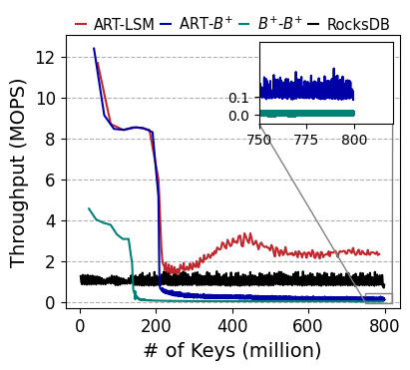
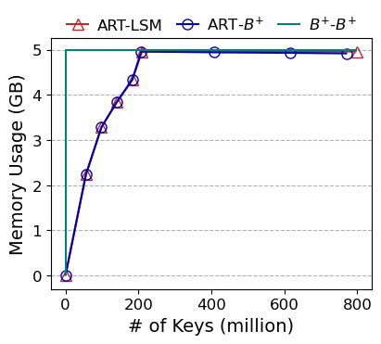
Write Performance (memory limit = 5GB)
Insert 800 million unique random key-value 16B pairs (12GB working set).
B+ tree (Index X) quickly consumes all memory.
ART tree store KVs, instead of blocks.
Choose the right Index X (ART tree) for high perf
Notes:
14

Slide 15
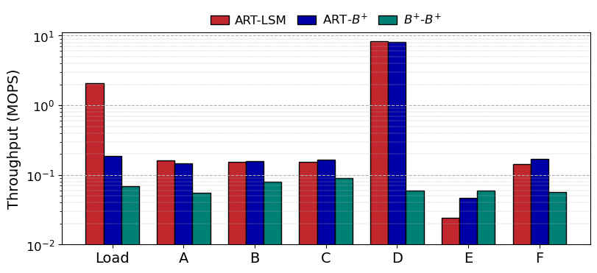
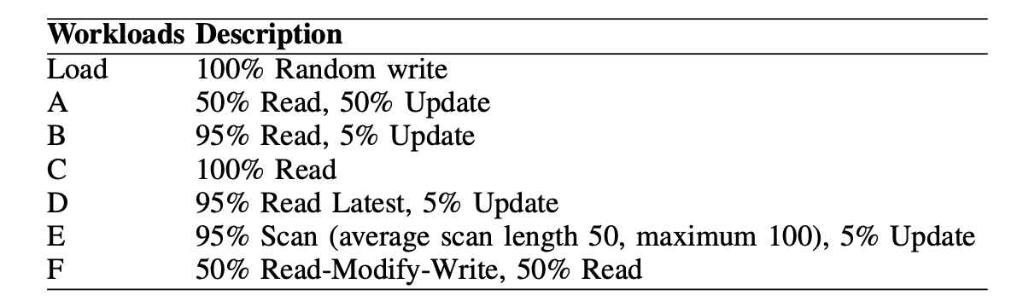
The YCSB Benchmark (memory limit = 5 GB)
ART tree is fast for in-memory writes
LSM tree is fast for random disk writes
Notes:
15
Most deep learning trainings are using the gradient decent optimization method to find the global optimal weights. It is a mini-batch-based approach, meaning it divides the training data into small batches, i.e. five images.
And each batch adjusts the weights directions by a little. The whole training is an iterative procedure. It loops through the whole training set tens to hundreds of times.
GPU becomes a the dominant computing device to accelerate the training process.
However, to solve industry level problems, a single GPU is not feasible as it may take hundreds or thousands of computing hours with a single machine. Therefore...

Slide 16
The YCSB Benchmark (memory limit = 5 GB)
B+-B+ doesn’t use right index for each index
Notes:
16
Most deep learning trainings are using the gradient decent optimization method to find the global optimal weights. It is a mini-batch-based approach, meaning it divides the training data into small batches, i.e. five images.
And each batch adjusts the weights directions by a little. The whole training is an iterative procedure. It loops through the whole training set tens to hundreds of times.
GPU becomes a the dominant computing device to accelerate the training process.
However, to solve industry level problems, a single GPU is not feasible as it may take hundreds or thousands of computing hours with a single machine. Therefore...

Slide 17
The YCSB Benchmark (memory limit = 5 GB)
LSM tree is not a right choice of Index Y for scans
Notes:
17
Most deep learning trainings are using the gradient decent optimization method to find the global optimal weights. It is a mini-batch-based approach, meaning it divides the training data into small batches, i.e. five images.
And each batch adjusts the weights directions by a little. The whole training is an iterative procedure. It loops through the whole training set tens to hundreds of times.
GPU becomes a the dominant computing device to accelerate the training process.
However, to solve industry level problems, a single GPU is not feasible as it may take hundreds or thousands of computing hours with a single machine. Therefore...

Slide 18
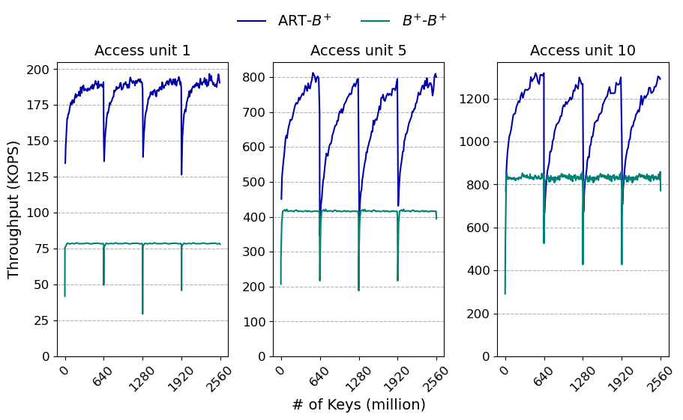
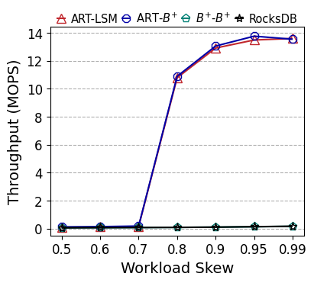
Read Performance (Micro-benchmark)
Read throughput with
Various Zipfian distributions
Lookup performance with shifting workload
Index adapt the workload shift by choosing right subtree to release
Memory enough to cache the read data
Notes:
18
However, to solve industry level problems, a single GPU is not feasible as it may take hundreds or thousands of computing hours with a single machine. Therefore...

Slide 19
A Summary
IndeXY is a framework for a decoupled deployment of indexes in the memory and on the disk.
IndeXY provides highly efficient supports for migrating index subsets between memory and disk.
With the ease of selection and integration of two indexes, IndeXY makes quick development of high-performance extensible indexes possible.

Slide 20
Backup Slides

Slide 21
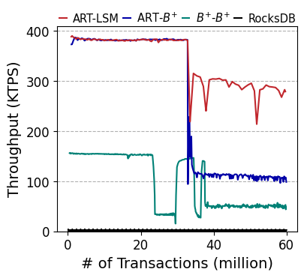
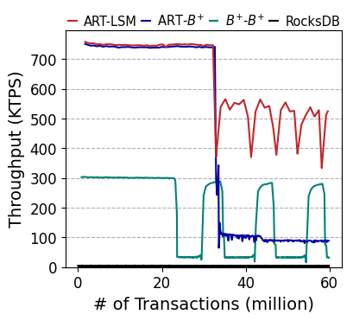
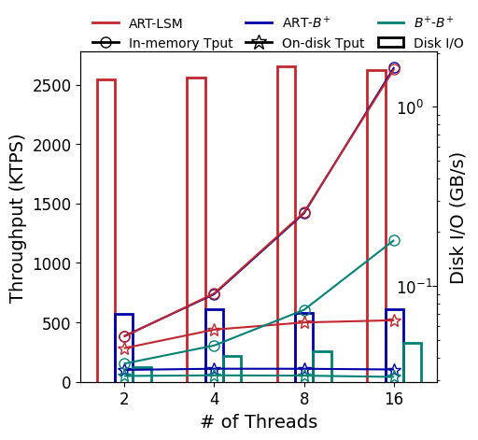
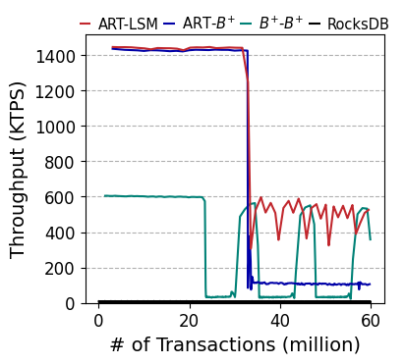
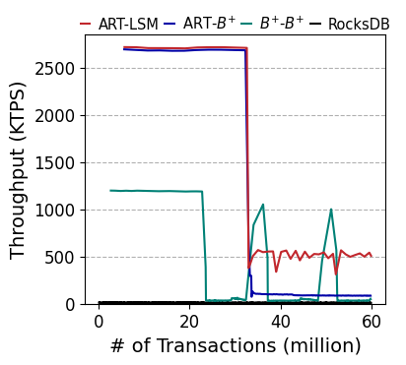
TPC-C benchmark
100 warehouse (~ 10GB)
New Order and Payment transactions are enabled (90%)
2 thread
4 thread
8 thread
16 thread
Notes:
21

Slide 22
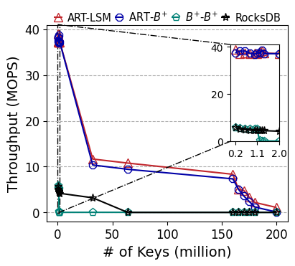
Read Performance (Micro-benchmark)
Read throughput with
Various Zipfian distributions
Read throughput with
different working set sizes
Notes:
22
Most deep learning trainings are using the gradient decent optimization method to find the global optimal weights. It is a mini-batch-based approach, meaning it divides the training data into small batches, i.e. five images.
And each batch adjusts the weights directions by a little. The whole training is an iterative procedure. It loops through the whole training set tens to hundreds of times.
GPU becomes a the dominant computing device to accelerate the training process.
However, to solve industry level problems, a single GPU is not feasible as it may take hundreds or thousands of computing hours with a single machine. Therefore...

Slide 23
Read Performance (Micro-benchmark)
Read throughput with
different working set sizes
Read throughput with
Various Zipfian distributions
Lookup performance with shifting workload
Notes:
23
However, to solve industry level problems, a single GPU is not feasible as it may take hundreds or thousands of computing hours with a single machine. Therefore...

