Slide 1
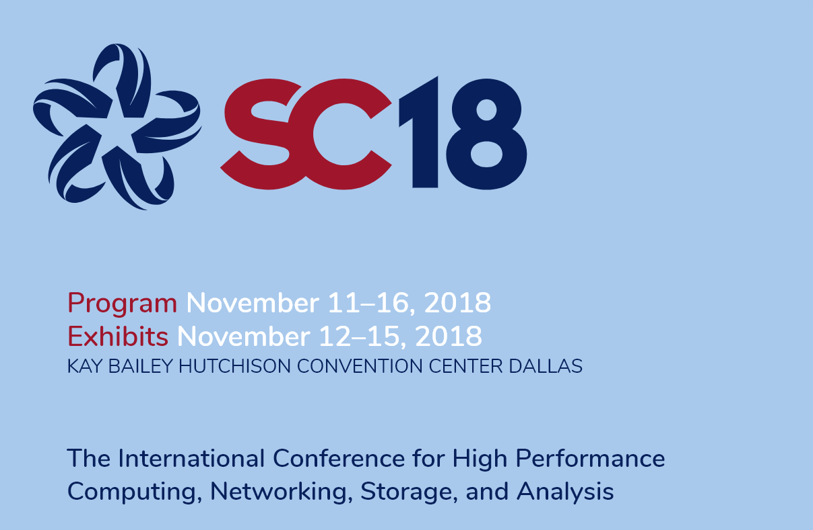
For more info:
chris.watkins@csiro.au

