Slide 1
Lecture 1
Distributed Systems

Slide 2
Lecture Outline
Concept of Parallel Computing
Introduction to Distributed System
  Definition and History
  DS Model
  DS Strengths and Weaknesses
  DS Challenges
Performance Measurements
Distributed Systems Lecture 1

Slide 3
Parallel Computing
Little sequential processing involved in human mind
Parallelism in Nature
  Traffic and crowd movements
  Weather, ocean currents, tectonic plates
  Industrial processes, assembly lines, chemical plants, building projects
Universe, essentially a parallel computer
Distributed Systems Lecture 1

Slide 4
On Sequential Computing
Essence of Sequential Processing
  Architectural design for execute-stored-programs - Von Neumann model
  Earlier models with fixed programs
  Movie reel, musical box, clockwork
  Simplicity in Programming, linear time-scale driven
How fast can a sequential computer go?
  Faster clock
  Speed of light and energy disposal
How to by-pass the universal barriers?
  Will it open a pathway to extreme programming for strategic apps where speed matters, answering big questions, discovering more?
Distributed Systems Lecture 1

Slide 5
Application Areas
Big Data
Mission critical applications: Weather, decision support, urgent action
Scientific and Engineering: Cars, buildings, oil exploration, medical image recognition
Simulation and Modeling: Strategic responses, policy design, disaster modeling, climate projections
Entertainment
  OC’ing
Distributed Systems Lecture 1

Slide 6
What is Parallel Computing?
It is steps further beyond OC’ing
  Tweaking versus building a purpose specific system
Requires learning a new way of programming to by-pass universal limits
Understand the computer architecture and re-designing it to support this new way
New way is controlling computers where time and concurrency are added to linear time-scale programming
The computers collectively and cooperatively function in a model termed as the distributed systems
Requires formal understanding of the distributed systems
Distributed Systems Lecture 1

Slide 7
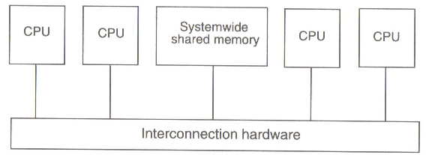
DS Introduction
Computer architectures consisting of interconnected multiple processors are basically of two types –
Tightly coupled systems
  Single system wide primary memory (address space) shared by all the processors
Distributed Systems Lecture 1

Slide 8
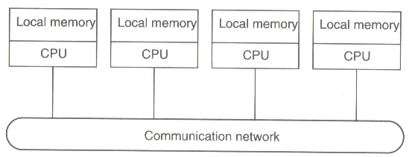
DS Introduction
Loosely coupled systems
  Processors do not share memory
  Each processor has its own local memory
Distributed Systems Lecture 1

Slide 9
Definition of Distributed Systems
“A distributed system is a collection of independent computers that appears to its users as a single coherent system.”
The definition has several important aspects
  Autonomous components
  Users (whether people or program) think they are dealing with a single system
A distributed system is a system in which components located at networked computers communicate and coordinate their actions only by passing messages.
Distributed Systems Lecture 1

Slide 10
Evolution of Distribution System
Two advances as the reason for spread of distributed systems
  1. Powerful micro-processor:
    • 8-bit, 16-bit, 32-bit, 64-bit
    • x86 family, 68k family, CRAY, SPARC, dual core, multi-core
    • Clock rate: up to 4Ghz
  2. Computer network:
  Local Area Network (LAN), Wide Area Network (WAN), MAN, Wireless Network type: Ethernet, Token-bus, Token-ring, Fiber Distributed Data Interface (FDDI), Asynchronous Transfer Mode (ATM), Fast-Ethernet, Gigabit Ethernet, Fiber Channel, Wavelength-Division Multiplex (WDM)
  Transfer rate: 64 kbps up to 1Tbps
Distributed Systems Lecture 1

Slide 11
Distributed computing system models
Various models are used for building distributed computing systems.
These models can be broadly classified into five categories-
  Minicomputer model
  Workstation model
  Workstation-server model
  Processor-pool model
  Hybrid model
Distributed Systems Lecture 1

Slide 12
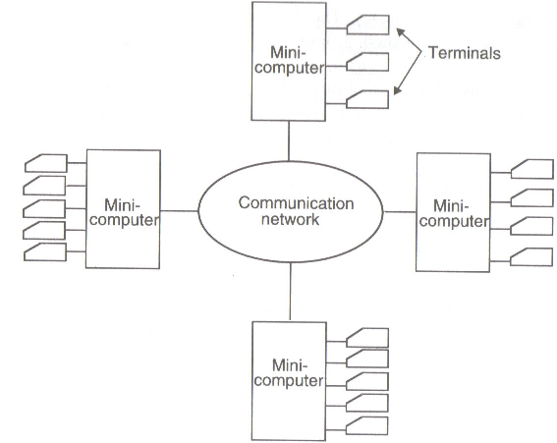
Distributed computing system models
1. Minicomputer model:
  simple extension of centralized time-sharing systems
  few minicomputers interconnected by communication network
  each minicomputer has multiple users simultaneously logged on to it
  this model may be used when when resource sharing with remote users is desired
  Example: the early ARPAnet
Distributed Systems Lecture 1

Slide 13
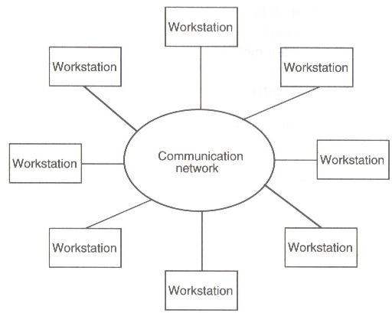
Distributed computing system models
2. Workstation model:
  several workstations interconnected by communication network
  basic idea is to share processor power
  user logs onto home workstation and submits jobs for execution, system might transfer one or more processed to other workstations
  issues must be resolved –
    how to find an idle workstation
    how to transfer
    what happens to a remote process
  Examples- Sprite system, Xerox PARC
Distributed Systems Lecture 1

Slide 14
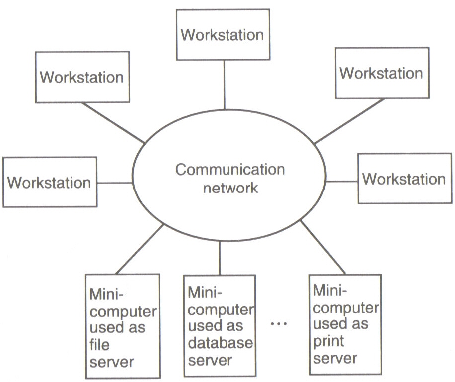
Distributed computing system models
3. Workstation-server model
It consists of a few minicomputers and several workstations (diskless or diskful)
Minicomputers are used for providing services
For higher reliability and better scalability multiple servers may be used for a purpose.
Compare this model with workstation model .
Example- The V-System
Distributed Systems Lecture 1

Slide 15
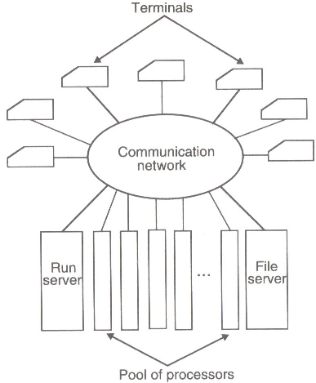
Distributed computing system models
4. Processor-pool model
Base observation –
sometimes user neesd NO computing power, other times needs very large amount of computing power BUT for a short period of time
Run server manages and allocates the processors to different users
No concept of a home machine, i.e., a user does not log onto a particular machine but to the system as a whole.
Offers better utilization of processing power compared to other models.
Example: Amoeba, Plan9, Cambridge DCS.
Distributed Systems Lecture 1

Slide 16
Distributed computing system models
5. Hybrid Model
To combine the advantages of both workstation-server model and processor-pool model a hybrid model may be used
It is based on the workstation-server model but with addition of a pool of processors
Expensive!!
Distributed Systems Lecture 1

Slide 17
Distribution Model
There are several distribution models for accessing distributed resources and executing distributed applications as follows.
File Model - Resources are modeled as files. Remote resources are accessible simply by accessing files.
Remote Procedure Call Model - Resource accesses are modeled as function calls. Remote resources can be accessed by calling functions.
Distributed Object Model - Resources are modeled as objects which are a set of data and functions to be performed on the data. Remote resources are accessible simply by accessing an object.
Distributed Systems Lecture 1

Slide 18
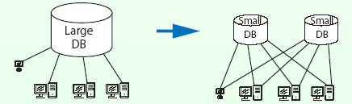
Advantages of Distributed Systems
Economics: Microprocessors offer a better price / performance than mainframes.
Speed: A distributed system may have more total computing power than a mainframe. E.g. one large database may be split into many small databases. In that way, we may improve response time.
Inherent distribution: Some application like banking, inventory systems involve spatially separated machines.
Distributed Systems Lecture 1

Slide 19
Advantages of Distributed Systems
Reliability: If 5% of the machines FAIL, the system as a whole can still survive with some degradation of performance.
Incremental growth: Computing power can be added in small increments
Sharing: Allow many users access to a common database and peripherals.
Communication: Make human-to-human communication easier.
Effective Resource Utilization: Spread the workload over the available machines in the most cost effective way.
Distributed Systems Lecture 1

Slide 20
Disadvantages of Distributed Systems
Software: It is harder to develop distributed software than centralized one.
Networking: The network can saturate or cause other problems.
Security: Easy access also applies to secret data.
Distributed Systems Lecture 1

Slide 21
Characteristics of Distributed Systems
Heterogeneity - Within a distributed system, we have variety in networks, computer hardware, operating systems, programming languages, etc.
Openness - New services are added to distributed systems. To do that, specifications of components, or at least the interfaces to the components, must be published.
Transparency - One distributed system looks like a single computer by concealing distribution.
Performance - One of the objectives of distributed systems is achieving high performance out of cheap computers.
Distributed Systems Lecture 1

Slide 22
Challenges in Distributed Systems
Scalability - A distributed system may include thousands of computers. Whether the system works is the question in that large scale.
Failure Handling - One distributed system is composed of many components. That results in high probability of having failure in the system.
Security - Because many stake-holders are involved in a distributed system, the interaction must be authenticated, the data must be concealed from unauthorized users, and so on.
Concurrency - Many programs run simultaneously in a system and they share resources. They should not interfere with each other
Distributed Systems Lecture 1

Slide 23
Heterogeneity
A distributed system is composed of a heterogeneous collection of computers
Heterogeneity arises in the following areas-
  networks: Even if the same Internet protocol is used to communicate, the performance parameters may widely vary within the inter-network.
  computer hardware: Internal representation of data is different for different processors.
  operating systems: The interface for exchanging messages is different from one operating system to another.
  programming languages: Characters and data structures are represented differently by different programming languages.
  implementations by different developers: Unless common standards are observed, different implementations cannot communicate.
Distributed Systems Lecture 1

Slide 24
Openness
Openness means disclosing information: the usage of services provided by remote computers in particular.
Open systems are easier to extend and reuse.
By making services open, servers can be used by various clients.
The clients which use services provided by other servers can extend the services and again provide services to other clients.
The openness of distributed systems lets us add new services and increase availability of services to different clients.
DRAWBACK?
Distributed Systems Lecture 1

Slide 25
Transparency
Transparency means hiding something.
Transparency is an important issue to realize the single system image which makes systems as easy to use as a single processor system. E.g. WWW we can access whatever information by clicking links without knowing whereabouts of the host.
Classification of Transparency
Access transparency: Data and resources can be used in a consistent way.
Location transparency: A user cannot tell where resources are located.
Migration transparency: Resources can move at will without changing their names.
Distributed Systems Lecture 1

Slide 26
Classification of Transparency
Replication transparency: A user cannot tell how many copies exist.
Concurrency transparency: Multiple users can share resources automatically.
Failure transparency: A user does not notice resource failure.
Performance transparency: Systems are reconfigured to improve performance as loads vary.
Scaling transparency: Systems can expand in size without changing the system structure and the application programs.
Distributed Systems Lecture 1

Slide 27
Performance
Fine-grained parallelism: Small programs are executed in parallel.
  Large number of messages.
  Communication overhead decreases the performance gain with parallel processing.
Coarse-grained parallelism:
  Long compute-bound programs executed in parallel.
  Communication overhead is less in this case.
Distributed Systems Lecture 1

Slide 28
Scalability
Scalability is the issue whether a distributed system works and the performance increases when more computers are added to the system.
The followings are potential bottle-necks in very large distributed systems
  Centralized components: A single mail server for all users.
  Centralized tables: A single on-line telephone book.
  Centralized algorithms: Routing based on complete information.
Use decentralized algorithms for scalability:
  No machine has complete information about the system state.
  Machines make decisions based only on local information.
  Failure of one machine does not completely invalidate the algorithm.
Distributed Systems Lecture 1

Slide 29
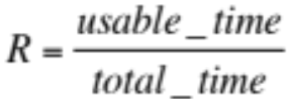
Reliability
We have high probability to have faulty components in a distributed system because the system includes large number of components.
On the other hand, it is theoretically possible to build a distributed system such that if a machine goes down, the other machine takes over the job.
Reliability has several aspects.
  Availability: The fraction of time that the system is available. It can be expressed by the following equation-
  Fault tolerance: Distributed systems can hide failures from the users.
Distributed Systems Lecture 1

Slide 30
Performance
Maximum aggregate performance of the system can be measured in terms of Maximum aggregate floating-point operations.
P = N*C*F*R
Where P performance in flops, N number of nodes, C number of CPUs, F floating point ops per clock period - FLOP, R clock rate.
The similar measures with MOP/MIP.
Distributed Systems Lecture 1

Slide 31
Scalability
It is computed as
S = T(1) / T(N)
Where T(1) is the wall clock time for a program to run on a single processor.
T(N) is the runtime over N processors.
A scalability figure close to N means the program scales well.
Scalability metric helps estimate the optimal number of processors for an application.
Distributed Systems Lecture 1

Slide 32
Utilization
It is calculated as,
U = S(N)/N
Values close to unity or 100% are ideally sought.
Distributed Systems Lecture 1

Slide 33
Summation
What is a Distributed System?
  “A distributed system is a collection of independent computers that appears to its users as a single coherent system.”
Models of Distributed System?
  Minicomputer model
  Workstation model
  Workstation-server model
  Processor-pool model
  Hybrid model
What are the Strengths and Weaknesses of a Distributed System?
  S: Reliability, Incremental growth, Resource sharing
  W: Programming, Reliance on network, Security
Important characteristics of of a Distributed System?
  Heterogeneity, Openness, Transparency
Performance Metrics?
Distributed Systems Lecture 1

