Slide 1
HUM_cleaned
Total enrollment in Fall 2025: 3788
Total enrollment in Fall 2021: 3384
Difference (2025 - 2021): 404
Total number of classes: 2633
Social Sciences _Cleaned
Total enrollment in Fall 2025: 3853
Total enrollment in Fall 2021: 3588
Difference (2025 - 2021): 265
Total number of classes: 1271
Business_cleanedfinal
Total enrollment in Fall 2025: 1717.0
Total enrollment in Fall 2021: 658.0
Difference (2025 - 2021): 1059.0
Total number of classes: 314
Natural Sciences
Total enrollment in Fall 2025: 6602.0
Total enrollment in Fall 2021: 5249.0
Difference (2025 - 2021): 1353.0
Total number of classes: 1840
EN_Cleaned
Total enrollment in Fall 2025: 5276.0
Total enrollment in Fall 2021: 3928.0
Difference (2025 - 2021): 1348.0
Total number of classes: 1738

Slide 2
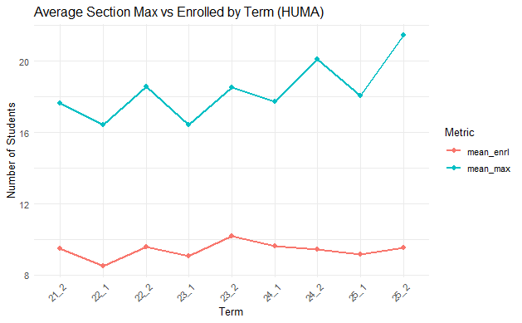

Slide 3
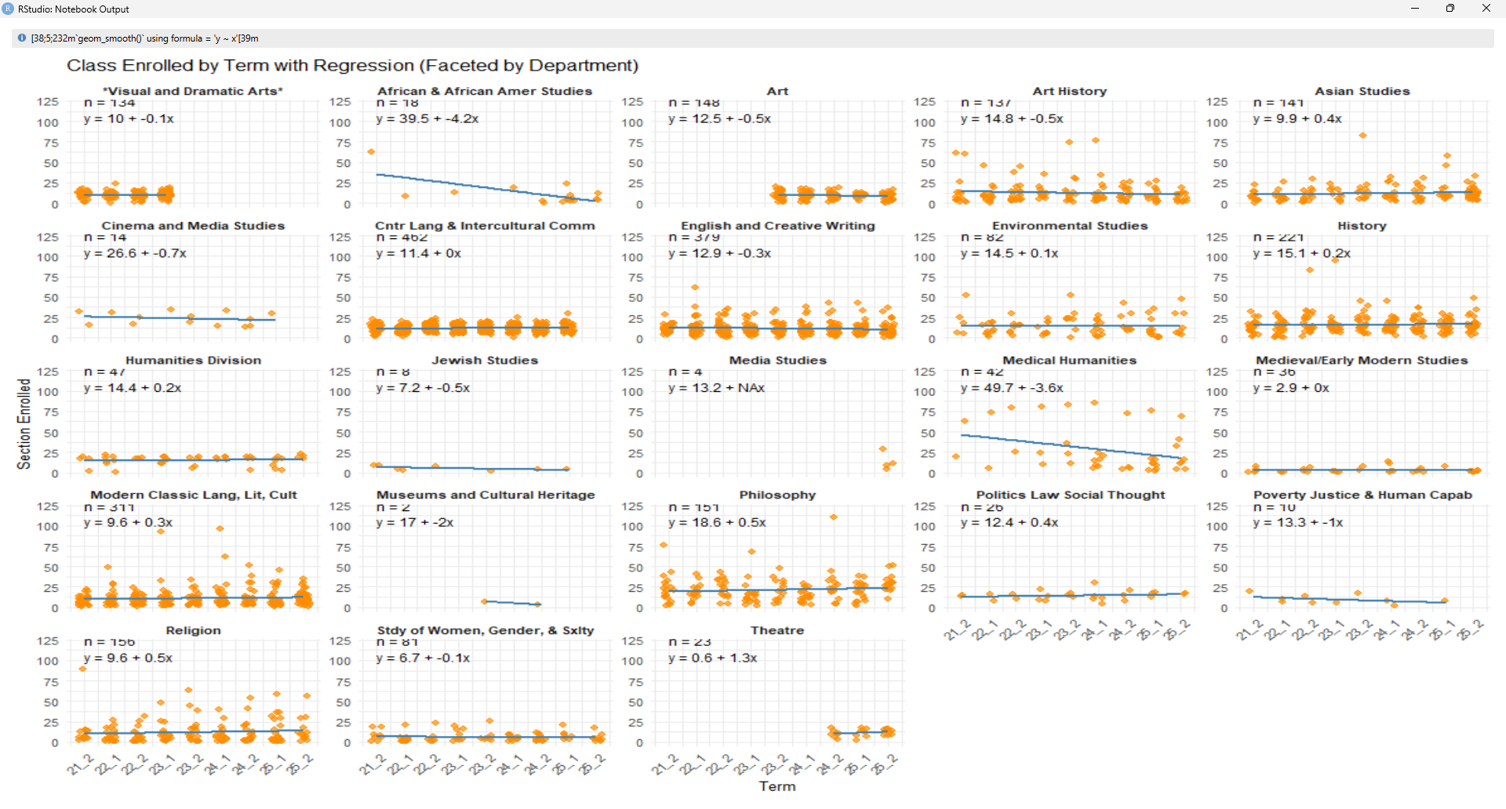
THIS IS ONE OF THE MOST IMPORTANT SLIDES
# NOTES: English has been combined into English and Creative Writing
# Modern and Classical Lit & Culture has been combined into Modern Classic Lang, Lit, Cult"
# Visual and Dramatic Arts is combined into simply Art, Theater is kept as is.

Slide 4
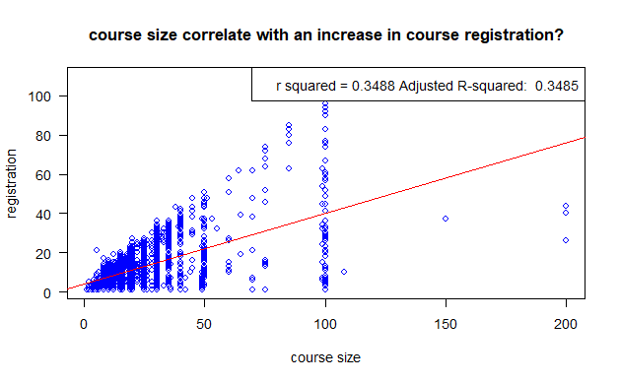
> course_linreg$coefficients
(Intercept) x
4.1978139 0.3580797
y = 4.198 + 0.35x. p-value: < 2.2e-16.

Slide 5
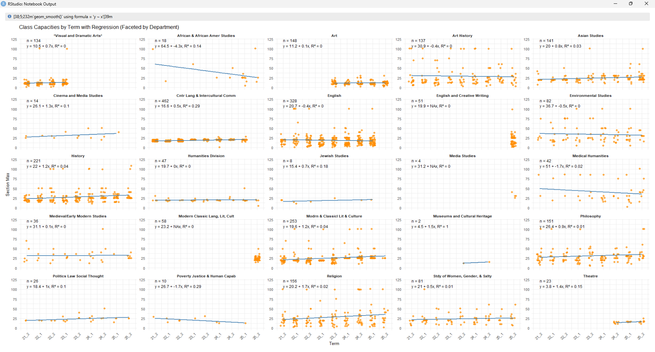

Slide 6
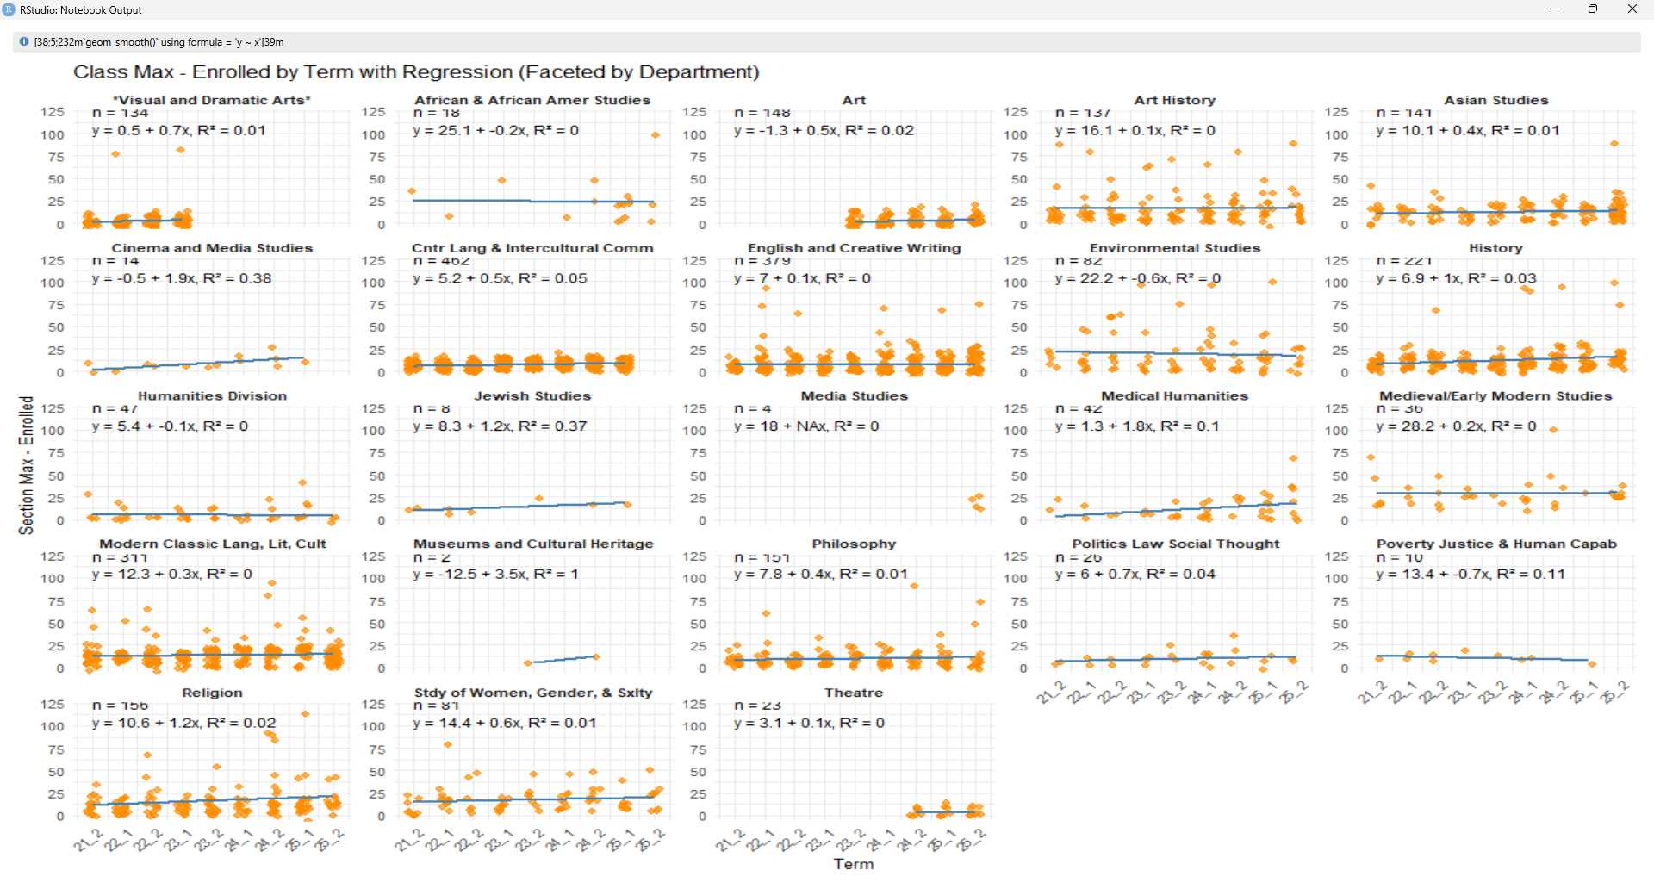

Slide 7
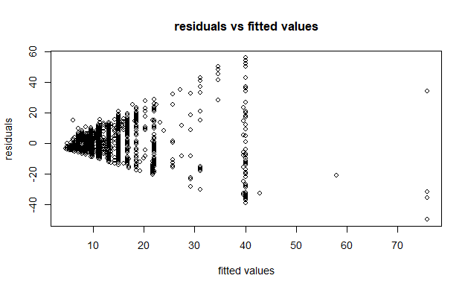
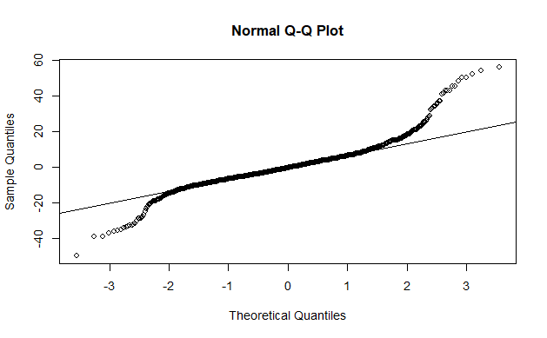

Slide 8


Slide 9
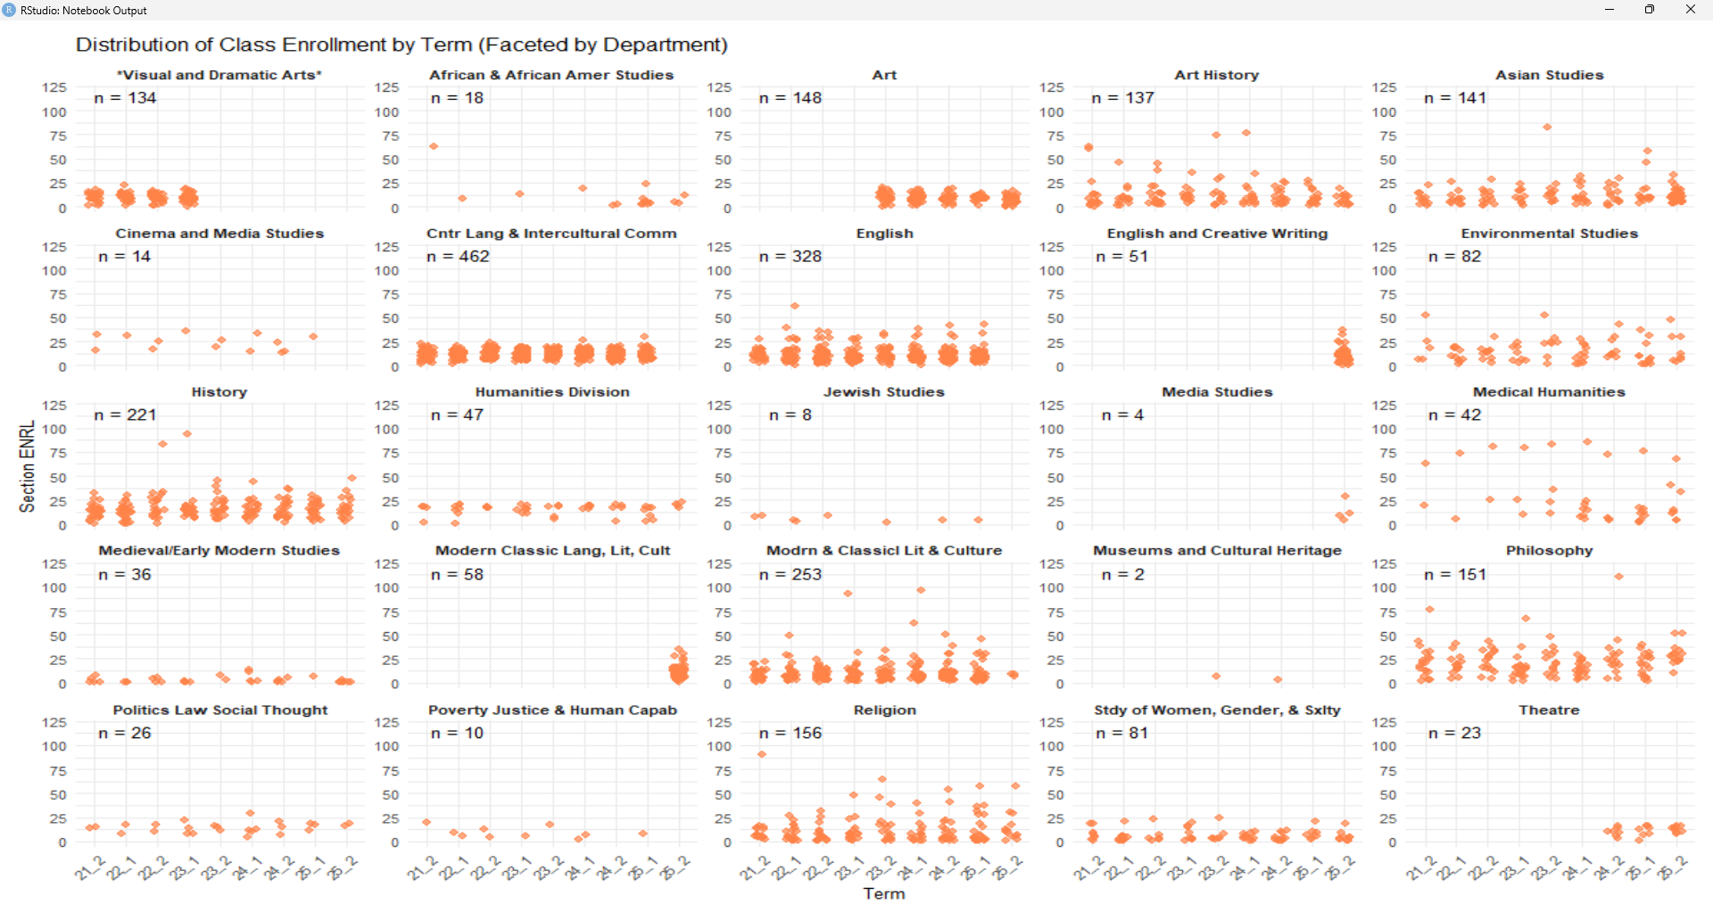

Slide 10
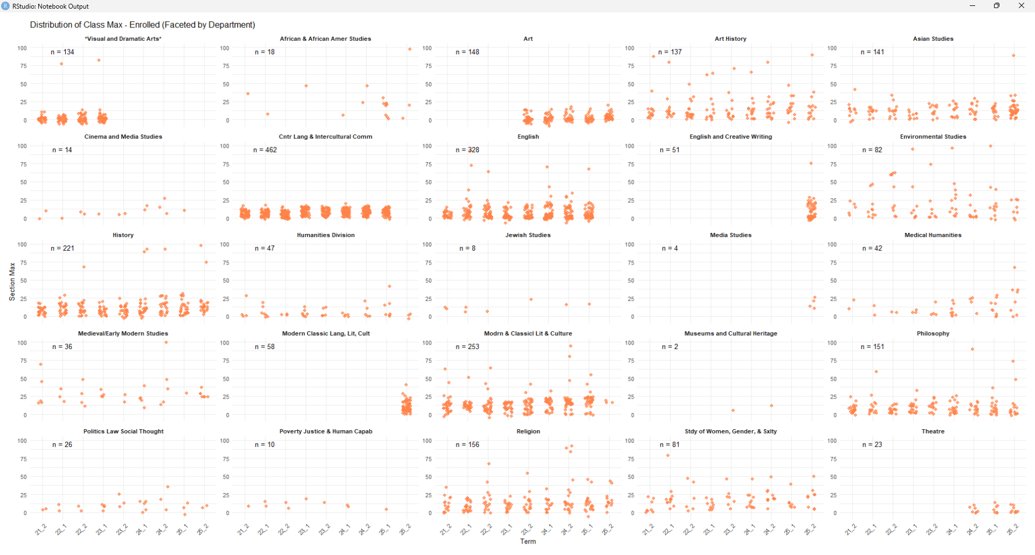

Slide 11
