Slide 1
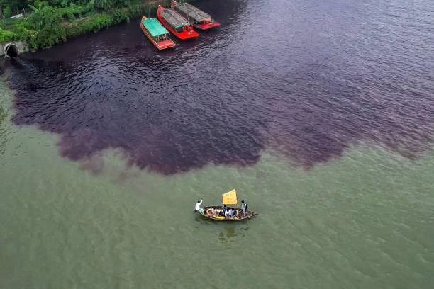
Causes and Effects
of
Industrial Pollution

Slide 2
INDUSTRIAL POLLUTION
Cause
Discharge of Untreated Wastewater
Presence of Toxic Chemicals and Heavy Metals
Inadequate Effluent Treatment Plants (ETPs)
Weak Enforcement and Monitoring
Unplanned Industrialization and Urbanization

Slide 3
INDUSTRIAL POLLUTION
Effects
On Human Health
Waterborne diseases
Skin diseases and long-term illnesses
On the Environment and Ecosystems
Death of Rivers and Aquatic Life
Contamination of Soil and Groundwater
Loss of Biodiversity
On the Economy and Livelihoods
Loss of agricultural productivity
Impact on fisheries
Increased healthcare costs

