Slide 1
ENERGY EFFICIENCY Refreshing beverages factory “juguitos”
Suicide Squad
PROJECTO 1

Slide 2
PROBLEM STATEMENT 1
The beverages factory “Juguitos” has a production Schedule that is active 24/7, 365 days a year.
For this project we will analise data from the first 6 months of the year.
The factory has 4 production lanes, we will attempt to explain how does the volumen produced impacts the energy intake of each lane.

Slide 3
PROBLEM STATEMENT 2
To supply each production lane with the amount of refrigeration and air compressors needed to produce, the factory has:
12 compressorss:
6 air compressors
2 big AC (mas de 200 HP)
4 small AC (60 HP)
4 Ammonia compressors 250 HP (refrigeration)
2 reciprocating compressors 200 HP (displacement/movement)
These compressors feed the 4 production lanes.
The purpose is to determine which combination of compressors presents the lowest energy intake.

Slide 4
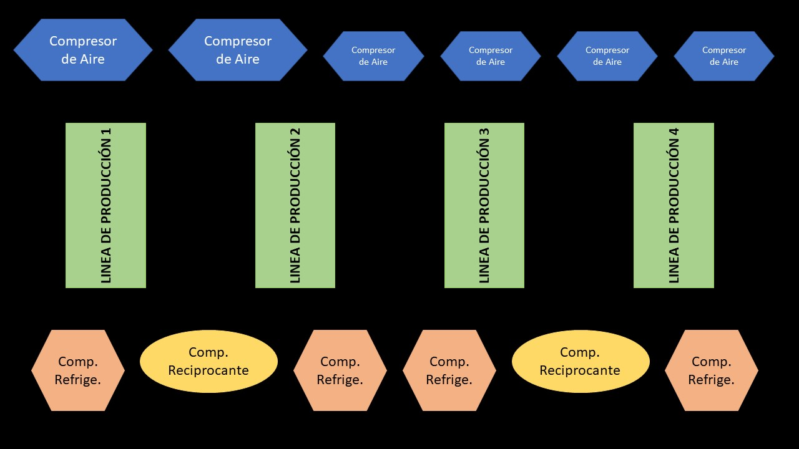
Factory diagram

Slide 5
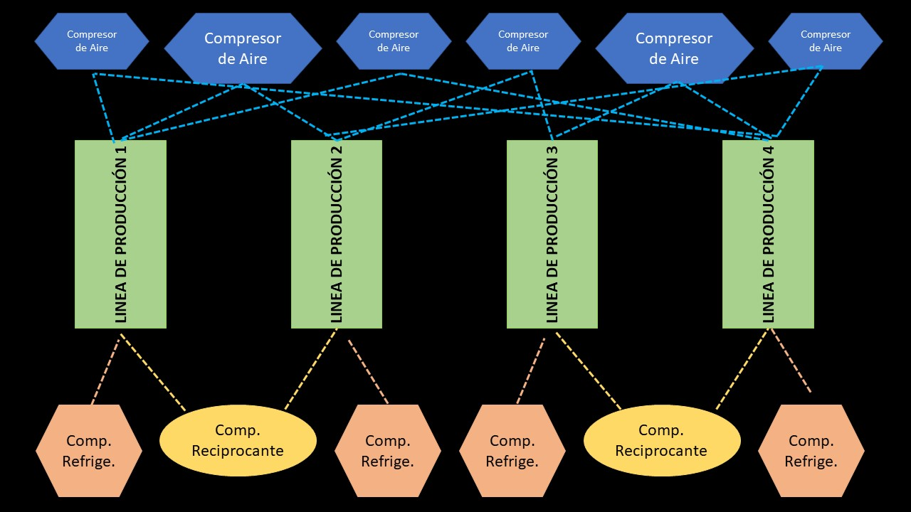
There are over 5,700 combinations in which te compressors may be connected to all 4 production lanes.

