Slide 1
CSE 5523: HW2+3

Slide 2
Outline
You are to implement:
Linear logistic regression
Pocket algorithm (improved perceptron)
Linear soft-margin SVM
Linear Naïve Bayes
Linear Gaussian discriminative analysis
Nonlinear Naïve Bayes
Nonlinear Gaussian discriminative analysis

Slide 3
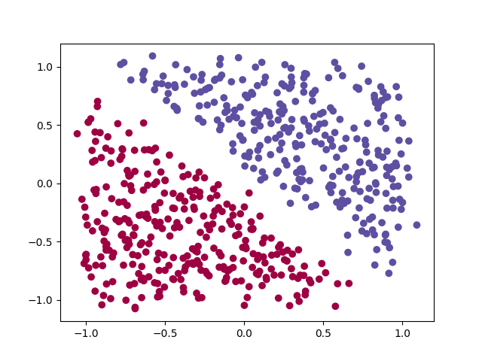
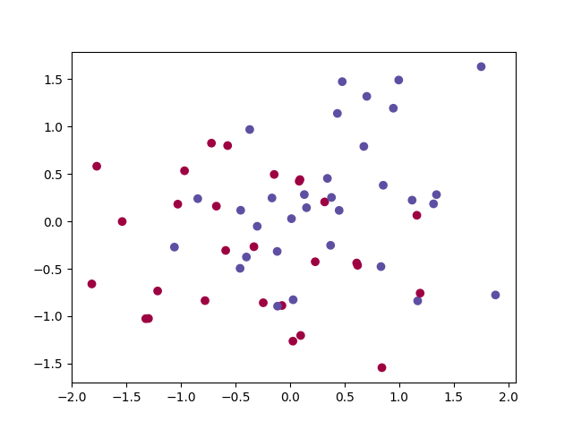
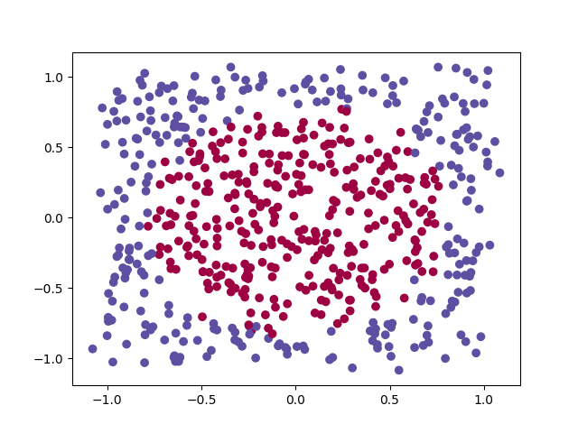
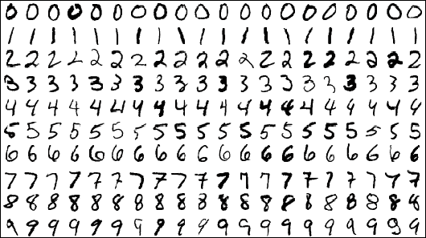

Data
Four data source
2D linear
2D noisy linear
2D quadratic (circle)
MNIST (<5 vs. >=5)
$X∈ℝ^{D×N}$:
A column as an instance
$Y∈{\left\{+1,−1\right\}}^{N×1}$

Slide 4
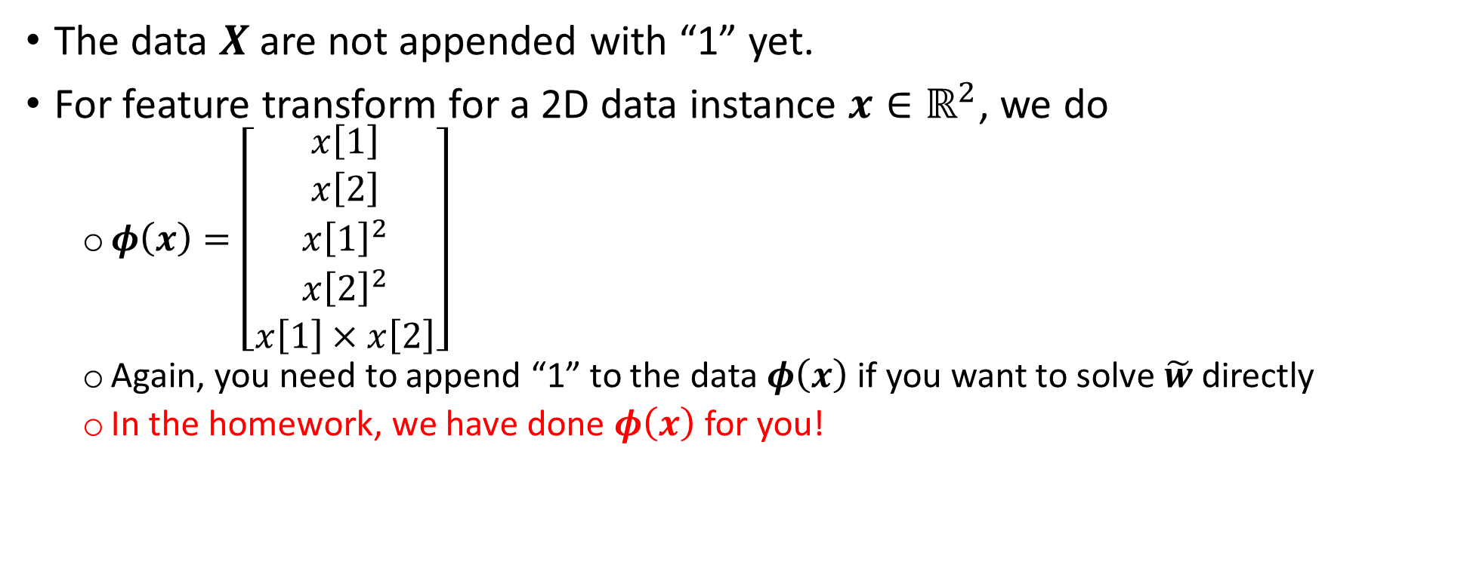
Data
The data $X$are not appended with “1” yet.
For feature transform for a 2D data instance $x∈ℝ^{2}$, we do
$φ\left(x\right)=\left[\begin{matrix}x\left[1\right] \\ x\left[2\right] \\ \begin{aligned}{x\left[1\right]}^{2} \\ {x\left[2\right]}^{2} \\ x\left[1\right]×x\left[2\right]\end{aligned}\end{matrix}\right]$
Again, you need to append “1” to the data $φ\left(x\right)$ if you want to solve $\tilde{w}$ directly
In the homework, we have done $φ\left(x\right)$ for you!

Slide 5

Accuracy
Data = ${\left\{ \left(x_{i}, y_{i}∈\left\{+1,−1\right\}\right) \right\}}_{i=1}^{N}$
Accuracy = $\frac{1}{N}\sum_{i=1}^{N}{1[{{\hat{y}}_{i}==y}_{i}]}$, where ${\hat{y}}_{i}$ is the prediction based on $x_{i}$

Slide 6
Logistic regression

Slide 7
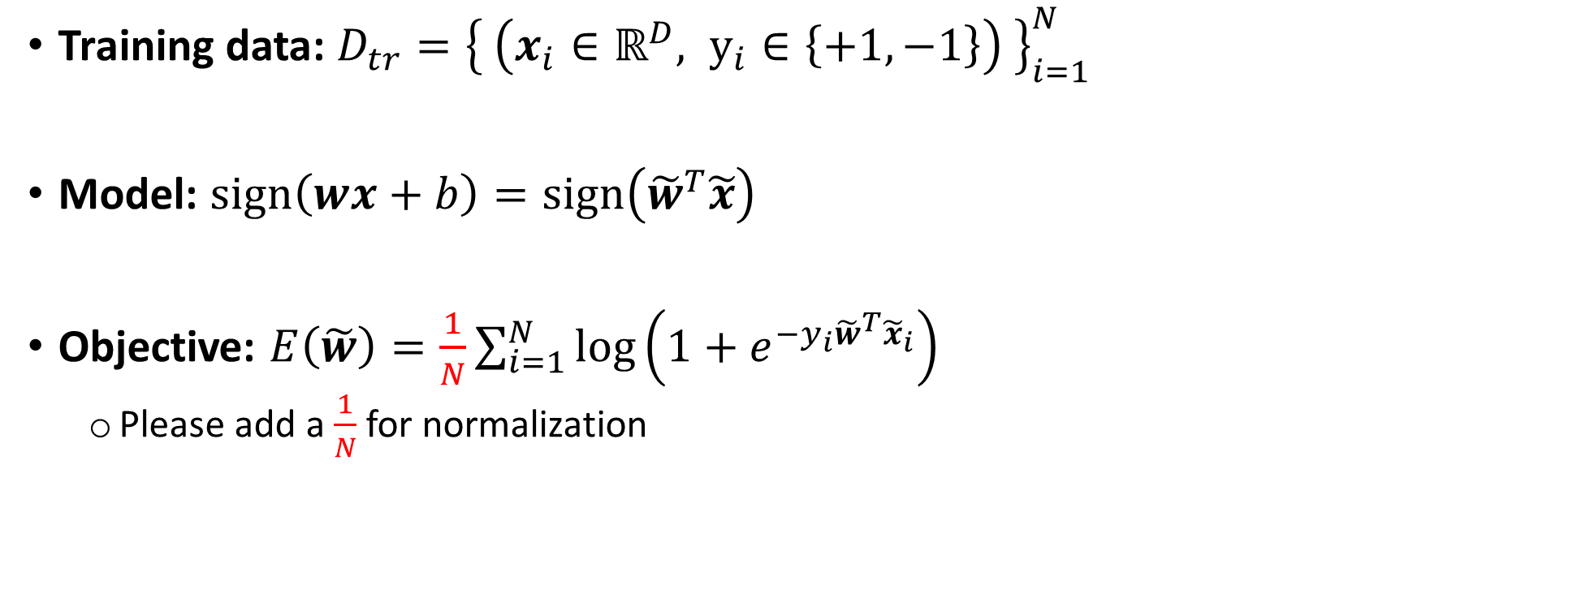
Logistic regression
Training data: $D_{tr}={\left\{ \left(x_{i}∈ℝ^{D}, y_{i}∈\left\{+1, −1\right\}\right) \right\}}_{i=1}^{N}$
Model: $sign\left(wx+b\right)=sign\left({\tilde{w}}^{T}\tilde{x}\right)$
Objective: $E\left(\tilde{w}\right)=\frac{1}{N}\sum_{i=1}^{N}{\log\left(1+e^{−y_{i}{\tilde{w}}^{T}{\tilde{x}}_{i}}\right)}$
Please add a $\frac{1}{N}$ for normalization

Slide 8

Gradient descent (GD) for logistic regression
Initialize$\tilde{w}$
For $t=1:T$
$\tilde{w}←\tilde{w}−η∇_{\tilde{w}}E(\tilde{w})$ ; $E(\tilde{w})$: the loss function you want to minimize!
No need to stop earlier
Note:
If $E\left(\tilde{w}\right)=\frac{1}{N}\sum_{n}{e_{n}\left(\tilde{w}\right)}$; for example, $e_{n}\left(\tilde{w}\right)$ is the loss on the i-th example
$∇_{\tilde{w}}E\left(\tilde{w}\right)=\frac{1}{N}\sum_{n}{∇_{\tilde{w}}e_{n}\left(\tilde{w}\right)}$

Slide 9


Gradient descent (GD) for logistic regression
$e_{n}\left(\tilde{w}\right)=\log\left(1+e^{−y_{n}{\tilde{w}}^{T}{\tilde{x}}_{n}}\right)$ for $y_{i}∈\left\{+1, −1\right\}$
$$∇_{\tilde{w}}e_{n}\left(\tilde{w}\right)=\frac{1}{1+e^{−y_{n}{\tilde{w}}^{T}{\tilde{x}}_{n}}}×∇_{\tilde{w}}\left(1+e^{−y_{n}{\tilde{w}}^{T}{\tilde{x}}_{n}}\right)$$
$$=\frac{1}{1+e^{−y_{n}{\tilde{w}}^{T}{\tilde{x}}_{n}}}×\left(−y_{n}{\tilde{x}}_{n}\right)×e^{−y_{n}{\tilde{w}}^{T}{\tilde{x}}_{n}}$$
$$=ρ\left(y_{n}{\tilde{w}}^{T}\tilde{x}\right)×\left(−y_{n}{\tilde{x}}_{n}\right)×e^{−y_{n}{\tilde{w}}^{T}{\tilde{x}}_{n}}$$
$$=ρ\left(y_{n}{\tilde{w}}^{T}\tilde{x}\right)×\left(−y_{n}{\tilde{x}}_{n}\right)×\frac{1−ρ\left(y_{n}{\tilde{w}}^{T}\tilde{x}\right)}{ρ\left(y_{n}{\tilde{w}}^{T}\tilde{x}\right)}$$
$$=−y_{n}\left(1−ρ\left(y_{n}{\tilde{w}}^{T}\tilde{x}\right)\right)\left({\tilde{x}}_{n}\right)$$

Slide 10
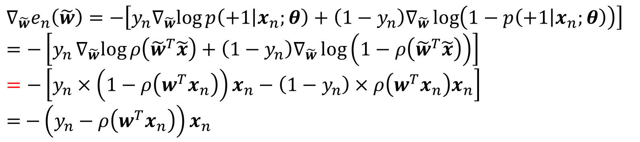

Gradient descent (GD) for logistic regression
$e_{n}\left(\tilde{w}\right)=−\left[y_{n}log{p\left(+1 | x_{n};θ\right)}+\left(1−y_{n}\right)\log\left(1−p\left(+1 | x_{n};θ\right)\right)\right]$ for $y_{i}∈\left\{+1, 0\right\}$
$$∇_{\tilde{w}}e_{n}\left(\tilde{w}\right)=−\left[y_{n}∇_{\tilde{w}}log{p\left(+1 | x_{n};θ\right)}+\left(1−y_{n}\right)∇_{\tilde{w}}\log\left(1−p\left(+1 | x_{n};θ\right)\right)\right]$$
$$=−\left[y_{n}∇_{\tilde{w}}log{ρ\left({\tilde{w}}^{T}\tilde{x}\right)}+\left(1−y_{n}\right)∇_{\tilde{w}}\log\left(1−ρ\left({\tilde{w}}^{T}\tilde{x}\right)\right)\right]$$
$$=−\left[y_{n}×\left(1−ρ\left(w^{T}x_{n}\right)\right)x_{n}−\left(1−y_{n}\right)×ρ\left(w^{T}x_{n}\right)x_{n}\right]$$
$=$ $−\left(y_{n}−ρ\left(w^{T}x_{n}\right)\right)x_{n}$

Slide 11
Pocket algorithm

Slide 12

Pocket algorithm
Training data: $D_{tr}={\left\{ \left(x_{i}∈ℝ^{D}, y_{i}∈\left\{+1, −1\right\}\right) \right\}}_{i=1}^{N}$
Model: $sign\left(wx+b\right)=sign\left({\tilde{w}}^{T}\tilde{x}\right)$

Slide 13

Pocket algorithm
Initialize $\tilde{w}$and ${\tilde{w}}^{best}$
For $t=1:T$
Loop for all training examples ${\tilde{x}}_{n}$ (random order!)
Predict ${\hat{y}}_{n}=sign\left({\tilde{w}}^{T}{\tilde{x}}_{n}\right)$
If ${\hat{y}}_{n}≠y_{n}$
Update: $\tilde{w}←\tilde{w}+η(y_{n}{\tilde{x}}_{n})$
Evaluate $\tilde{w}$ on the “training data” and calculate the training accuracy
If training accuracy by $\tilde{w}$ is “higher” than the training accuracy by ${\tilde{w}}^{best}$
${\tilde{w}}^{best}$ $←\tilde{w}$
Output ${\tilde{w}}^{best}$

Slide 14
Soft-margin SVM algorithm

Slide 15
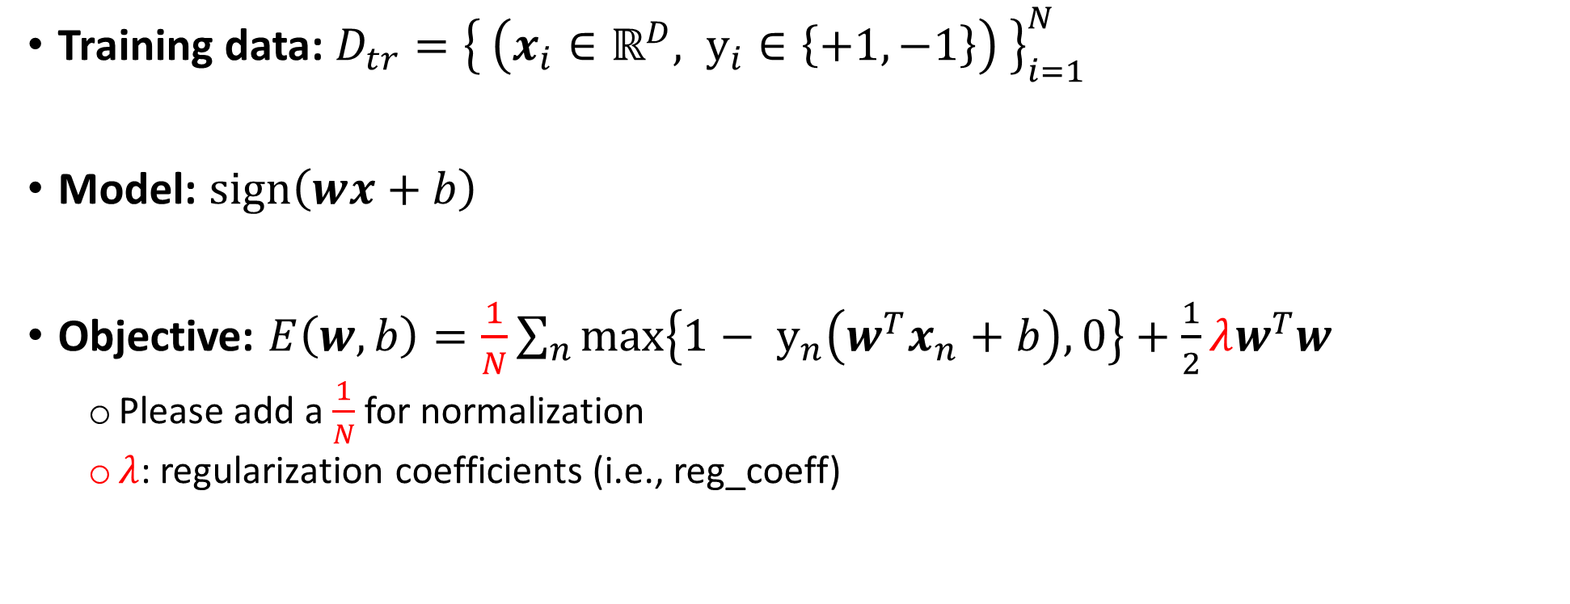
Soft-margin SVM
Training data: $D_{tr}={\left\{ \left(x_{i}∈ℝ^{D}, y_{i}∈\left\{+1, −1\right\}\right) \right\}}_{i=1}^{N}$
Model: $sign\left(wx+b\right)$
Objective: $E\left(w, b\right)=\frac{1}{N}\sum_{n}{max\left\{1− y_{n}\left(w^{T}x_{n}+b\right), 0\right\}}+\frac{1}{2}λw^{T}w$
Please add a $\frac{1}{N}$ for normalization
$λ$: regularization coefficients (i.e., reg_coeff)

Slide 16

Gradient descent (GD) for soft-margin SVM
Initialize$\tilde{w}$
For $t=1:T$
$\tilde{w}←\tilde{w}−η∇_{\tilde{w}}E(\tilde{w})$ ; $E(\tilde{w})$: the loss function you want to minimize!
No need to stop earlier
Note:
If $E\left(w,b\right)=\frac{1}{N}\sum_{n}{e_{n}\left(w,b\right)}+\frac{1}{2}λw^{T}w$
$∇_{w}E\left(w,b\right)=\frac{1}{N}\sum_{n}{∇_{w}e_{n}\left(w,b\right)+λw}$
$∇_{b}E\left(w,b\right)=\frac{1}{N}\sum_{n}{∇_{b}e_{n}\left(w,b\right)}$

Slide 17

Gradient descent (GD) for soft-margin SVM
$∇_{w}e_{n}\left(w,b\right)=\left\{\begin{aligned}−y_{n}x_{n}, if y_{n}\left(w^{T}x_{n}+b\right)<1 \\ 0, othewise\end{aligned}\right.$
$∇_{b}e_{n}\left(w,b\right)=\left\{\begin{aligned}−y_{n}, if y_{n}\left(w^{T}x_{n}+b\right)<1 \\ 0, othewise\end{aligned}\right.$

Slide 18
Naïve Bayes

Slide 19
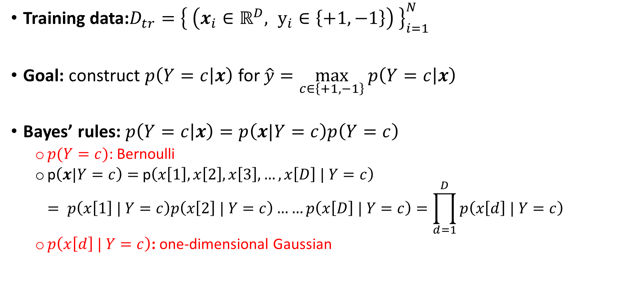
Naïve Bayes
Training data:$D_{tr}={\left\{ \left(x_{i}∈ℝ^{D}, y_{i}∈\left\{+1, −1\right\}\right) \right\}}_{i=1}^{N}$
Goal: construct $p\left(Y=c | x\right)$ for $\hat{y}=\max_{c∈\left\{+1, −1\right\}}{p\left(Y=c | x\right)}$
Bayes’ rules: $p\left(Y=c | x\right)=p\left(x|Y=c\right)p\left(Y=c\right)$
$p(Y=c)$: Bernoulli
p$\left(x|Y=c\right)=$ p$\left(x\left[1\right],x\left[2\right],x\left[3\right], …,x\left[D\right] | Y=c\right)$ $= p\left(x\left[1\right] | Y=c\right)p\left(x\left[2\right] | Y=c\right)……p\left(x\left[D\right] | Y=c\right)=\prod_{d=1}^{D}{p\left(x\left[d\right] | Y=c\right)}$
$p\left(x\left[d\right] | Y=c\right)$: one-dimensional Gaussian

Slide 20

Nonlinear Naïve Bayes
$p\left(x\left[d\right] | Y=+1\right)$ and $p\left(x\left[d\right] | Y=+1\right)$ have their own standard deviations $σ_{d,+1}$ and $σ_{d,−1}$
See slides 11 or 12 for how to compute them
You can represent ${[σ_{1,+1},σ_{2,+1}, ……,σ_{N,+1}]}^{T}$as a vector

Slide 21
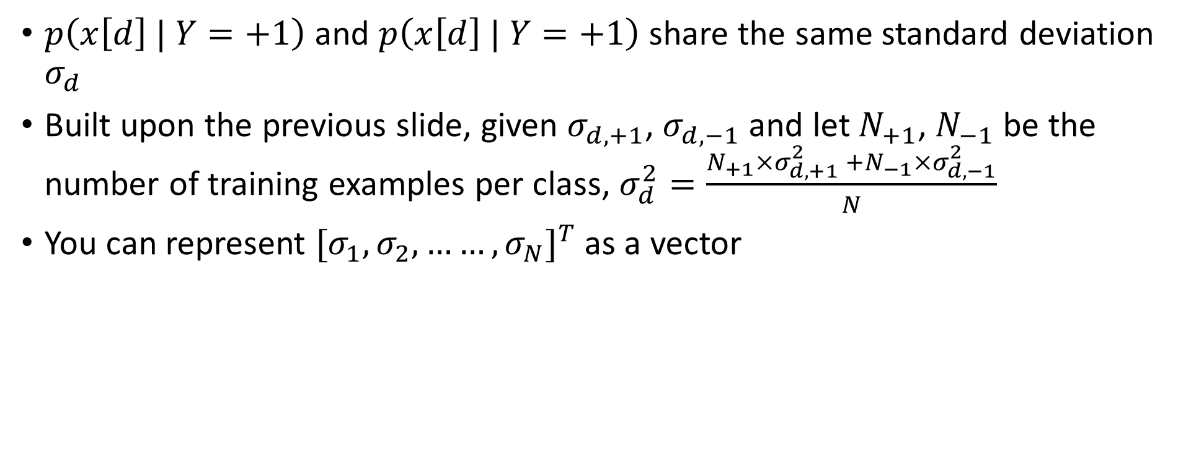
Linear Naïve Bayes
$p\left(x\left[d\right] | Y=+1\right)$ and $p\left(x\left[d\right] | Y=+1\right)$ share the same standard deviation $σ_{d}$
Built upon the previous slide, given $σ_{d,+1}$, $σ_{d,−1}$ and let $N_{+1}$, $N_{−1}$ be the number of training examples per class, $σ_{d}^{2}=\frac{N_{+1}×σ_{d,+1}^{2} +N_{−1}×σ_{d,−1}^{2}}{N}$
You can represent ${[σ_{1},σ_{2}, ……,σ_{N}]}^{T}$as a vector

Slide 22

Prediction (please do “log” to prevent overflow)
$$\max_{c∈\left\{+1, −1\right\}}{p\left(Y=c | x\right)}=\max_{c∈\left\{+1, −1\right\}}{p\left(x|Y=c\right)p\left(Y=c\right)}$$
$$=\max_{c∈\left\{+1, −1\right\}}p\left(x|Y=c\right)\prod_{d=1}^{D}{p\left(x\left[d\right] | Y=c\right)}$$
$$=\max_{c∈\left\{+1, −1\right\}}\log{p\left(x|Y=c\right)}+\sum_{d=1}^{D}{\log{p\left(x\left[d\right] | Y=c\right)}}$$

Slide 23
Gaussian discriminant analysis

Slide 24
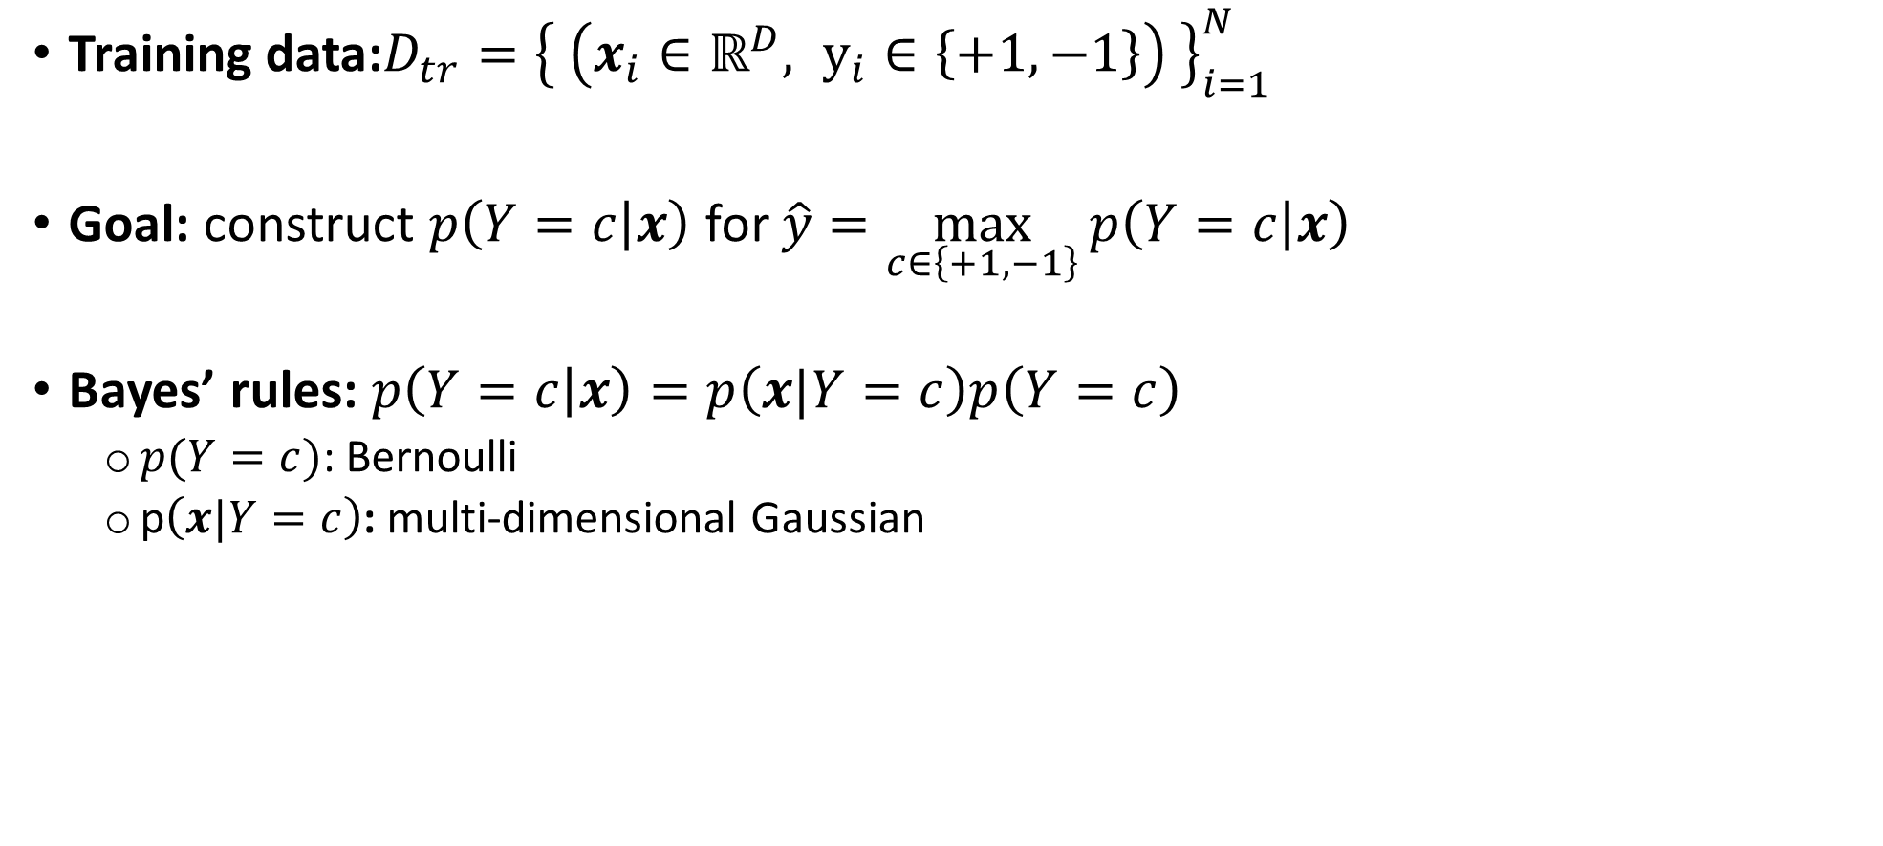
GDA
Training data:$D_{tr}={\left\{ \left(x_{i}∈ℝ^{D}, y_{i}∈\left\{+1, −1\right\}\right) \right\}}_{i=1}^{N}$
Goal: construct $p\left(Y=c | x\right)$ for $\hat{y}=\max_{c∈\left\{+1, −1\right\}}{p\left(Y=c | x\right)}$
Bayes’ rules: $p\left(Y=c | x\right)=p\left(x|Y=c\right)p\left(Y=c\right)$
$p(Y=c)$: Bernoulli
p$\left(x|Y=c\right)$: multi-dimensional Gaussian

Slide 25

Nonlinear GDA
$p\left(x| Y=+1\right)$ and $p\left(x| Y=+1\right)$ have their own covariance matrices $Σ_{+1},Σ_{−1}$
See slides 10, 11 for how to compute them
See also your homework # 2

Slide 26
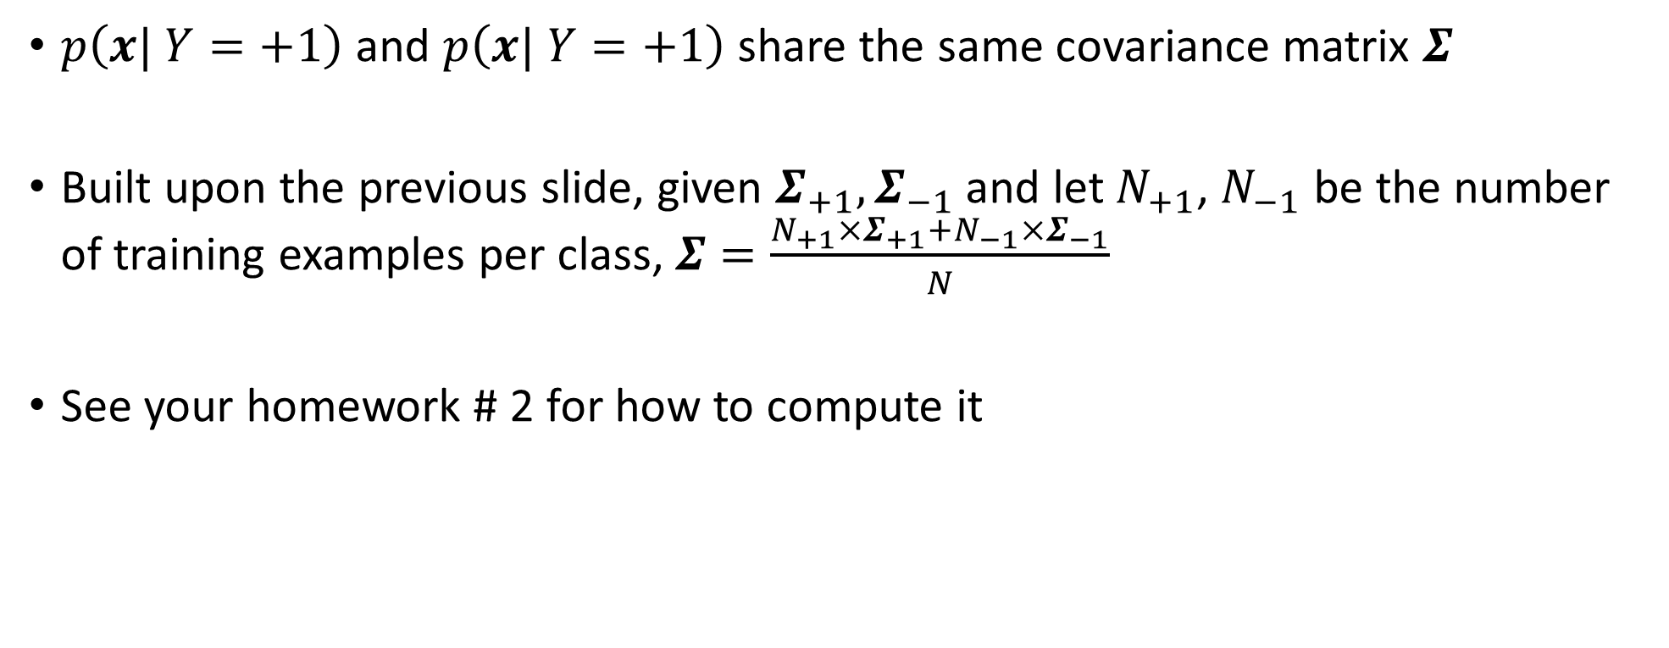
Linear GDA
$p\left(x| Y=+1\right)$ and $p\left(x| Y=+1\right)$ share the same covariance matrix $Σ$
Built upon the previous slide, given $Σ_{+1},Σ_{−1}$ and let $N_{+1}$, $N_{−1}$ be the number of training examples per class, $Σ=\frac{N_{+1}×Σ_{+1}+N_{−1}×Σ_{−1}}{N}$
See your homework # 2 for how to compute it

Slide 27

Prediction (please do “log” to prevent overflow)
$$\max_{c∈\left\{+1, −1\right\}}{p\left(Y=c | x\right)}=\max_{c∈\left\{+1, −1\right\}}{p\left(x|Y=c\right)p\left(Y=c\right)}$$
$$=\max_{c∈\left\{+1, −1\right\}}\log{p\left(x|Y=c\right)}+\log{p\left(x|Y=c\right)}$$

