Slide 1
Electropolymerization of Aniline
Nikolas Vitaliti s223455

Slide 2
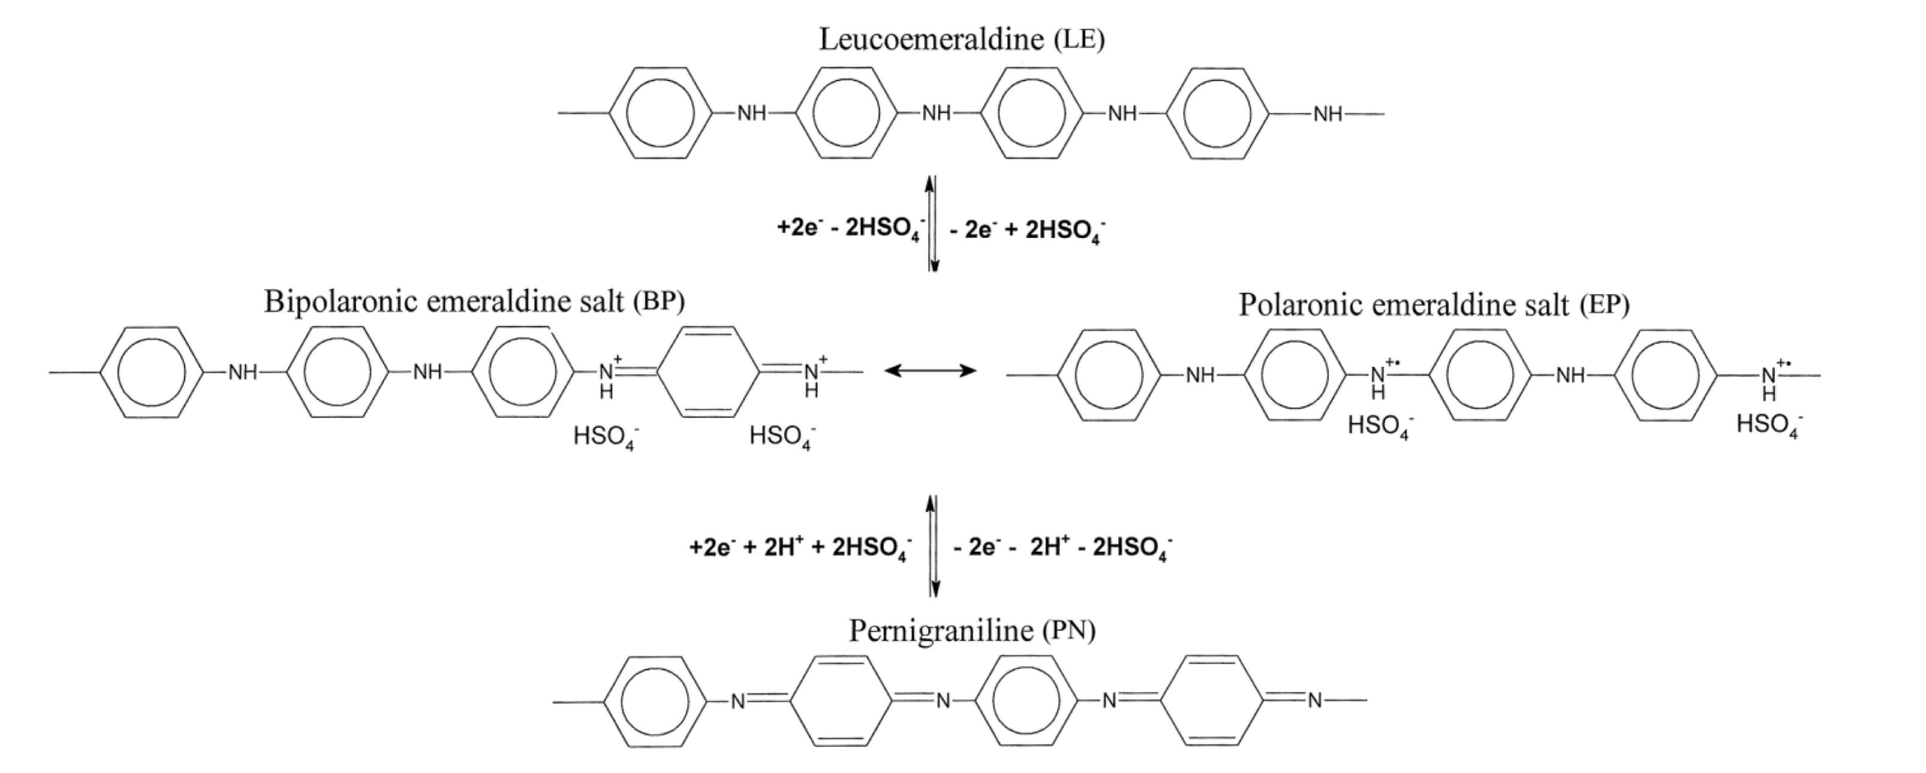
Conducting polymer - Polyaniline
Redox states of PANI
Leucoemerladine - poor conductor, fully reduced
Emeraldine - great conductor (delocalized polaron), intermediate
Pernigraniline - poor conductor, fully oxidised

Slide 3
Methodology
Electrodepositon
Potentiodynamic
CV characterization
Potentiostatic
CV characterization
UV – vis absorption spectroscopy
Over oxidation

Slide 4
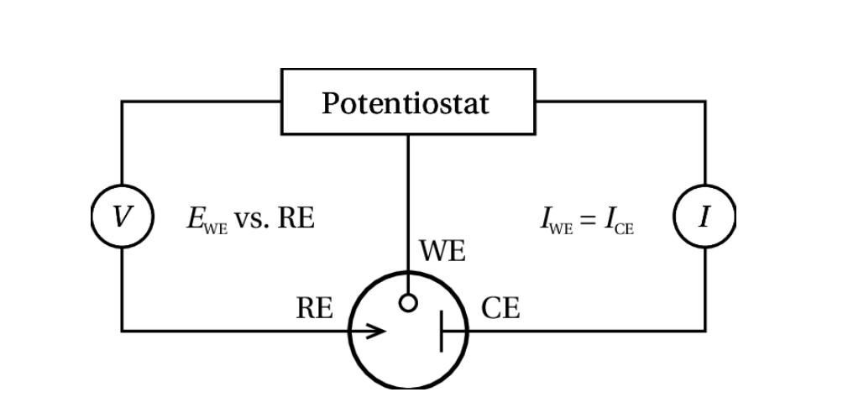
Experimental setup
Three electrode setup
WE: Transparent conducting flourine doped tin oxide electrode (FTO)
CE: Coiled platinum wire
RE: Ag/AgCl with 1M KCl filling solution
Electrolytes
Electrodepositon: H₂SO₄ + aniline
Characterization: H₂SO₄

Slide 5
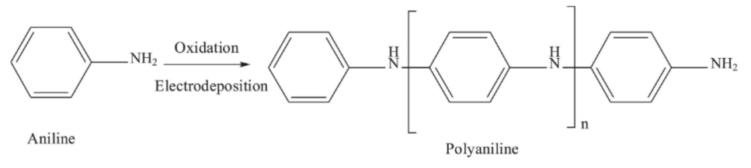
Synthesize of polyaniline
Anodic oxidation of Aniline in aqueous sulfuric acid solution
Aniline oxidizes at the negatively charge anode
Radical formation after oxidation
Polymer forms at the WE

Slide 6
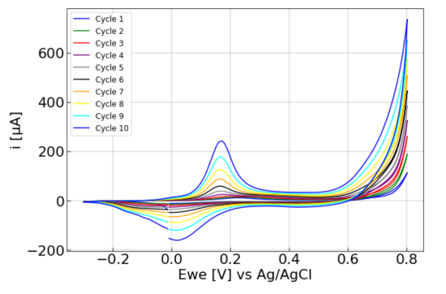
Electrodeposition of aniline
Film 1
Electrodynamically deposited through CV at 50 mV/s
Peak current increases with the number of cycles
Film 2
Electrostatically deposited through CA
Voltage fixed at:
0.75V for oxidation (300 s)
-0.3V for reduction (30 s)
Notes:
Add aniline to polyaniline, 0.8 gives polyaniline

Slide 7
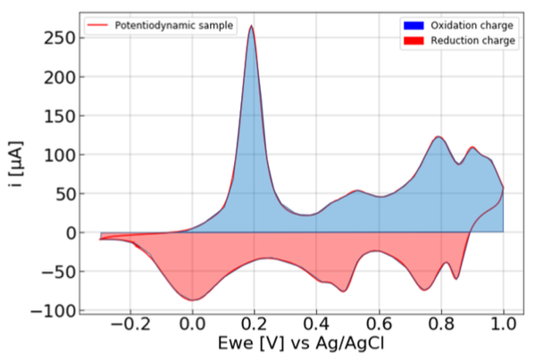
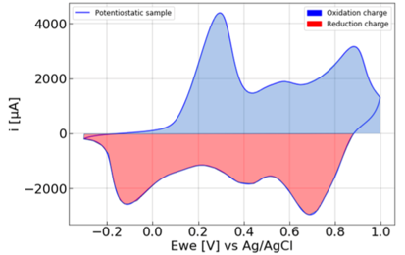
Film comparison
3 cycles 50 mV/s between −0.3V and 1.0V vs Ag/AgCl
Film 1: potentiodynamic
Film 2: potentiostatic
Film | State | Mass [µg] | Thickness [nm] | Γ [10⁻⁸ mol/cm2]
1 | Oxidation | 6.88 | 43.1 | 6.15
 | Reduction | 5.34 | 33.4 | 4.78
2 | Oxidation | 19.8 | 124 | 17.7
 | Reduction | 18.4 | 116 | 16.5
Film | Oxidation charge [C] | Reduction charge [C]
1 | 0.0143 | 0.0111
2 | 0.0411 | 0.0382

Slide 8
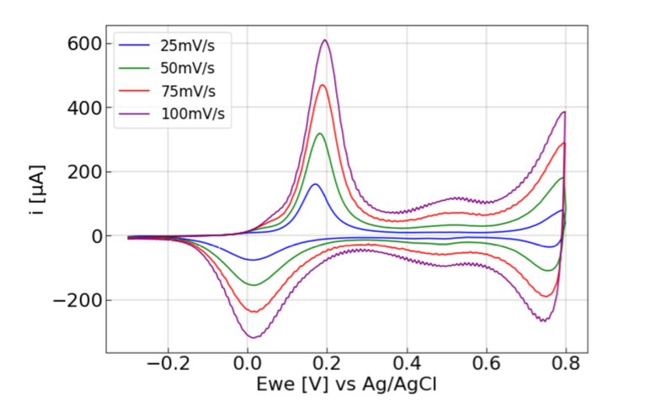
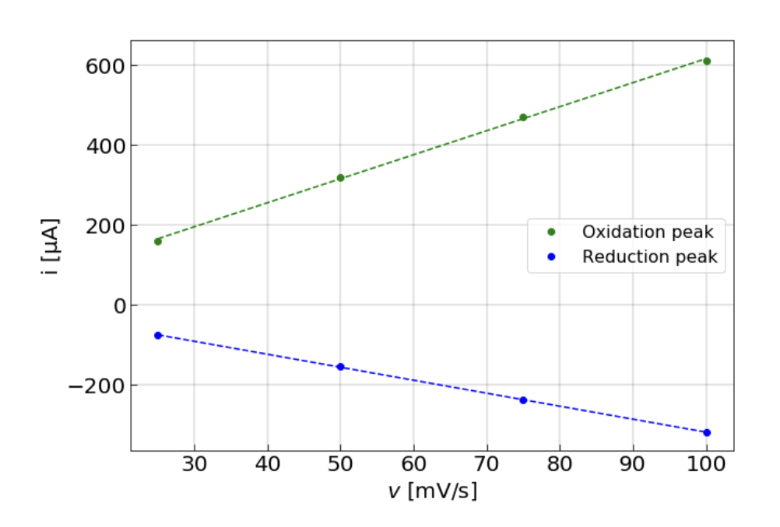
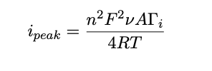
Scan rate dependence
Linear relation between peak current and scan rate
R² = 0.996
R² = 0.997
For surface confined and fully reversible species peak current is directly proportional to the scan rate:

Slide 9
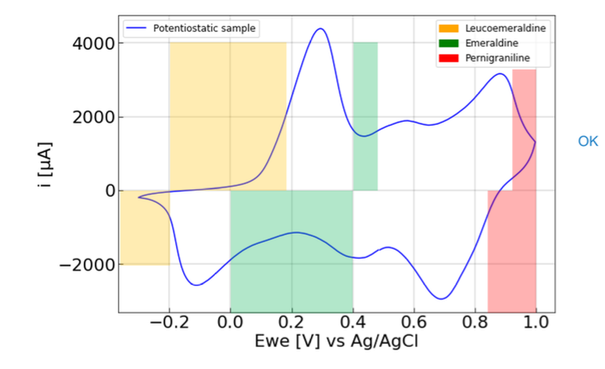
Redox states
CV at 50 mV/s to fully oxidize and fully reduce
Unexpected peak:
ortho-coupled polymers
degradation of PANI
Notes:
Rinsing of WE revealed vague colour change in droplet – shorter oligomers are soluble
Possibly due to degradation of PANI and formation of species like benzo- and hydroquinone

Slide 10
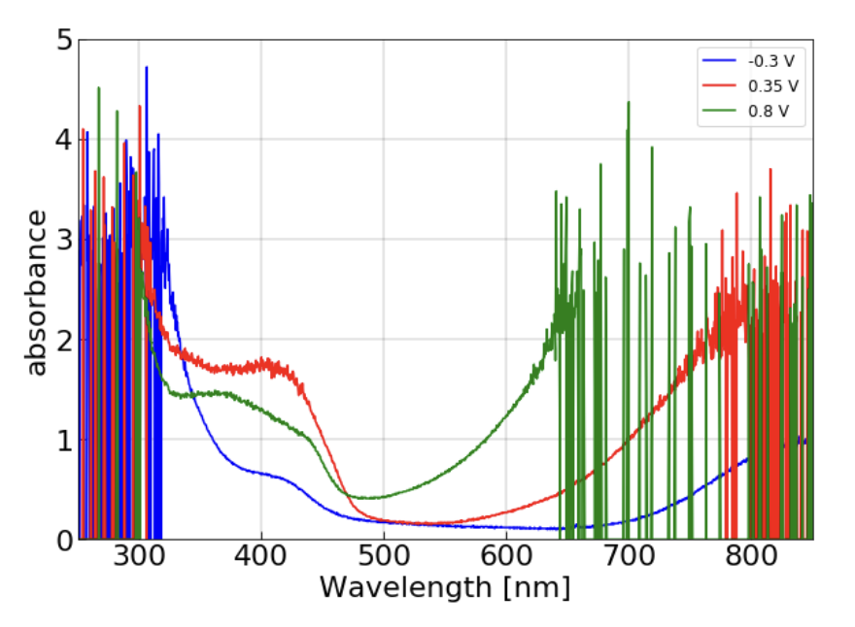
UV-vis spectroscopy
Absorption at potential holds corresponding to different redox states
Two absorption ranges:
Oxidation leads to:
Darker film
Higher absorption in the 300-400 nm range
After 600 nm peaks at different wavelength for different redox states
300 - 400 nm​
600 - 900 nm

Slide 11
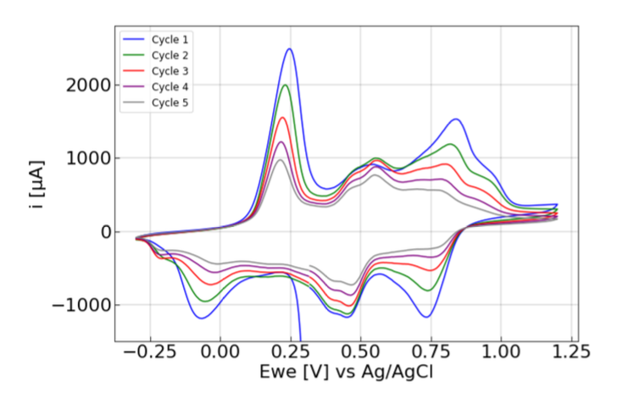
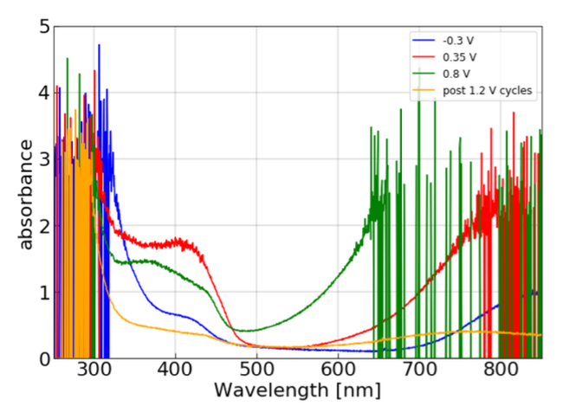
PANI at higher potentials
Absorption after CV at higher potentials and potential hold at 0.35 V
Emeraldine
Decreasing current
Less absorbance after over-oxidation

Slide 12
Conclusion
PANI is an interesting polymer to investigate as it’s easily tunable between its different redox states:
Leucoemerladine
Emeraldine
Pernigraniline
Observed a linear relation between peak current and scan rate
Absorption in two ranges (300-400 nm and 600-900 nm)
Overoxidation lead to degradation of polyaniline

Slide 13
Thank you!

