Slide 1
Problem 7
Analysis Day
Nikolas Vitaliti - s223455
Anita Pazzaglia - s222758
Matteo Galasso - s194806

Slide 2
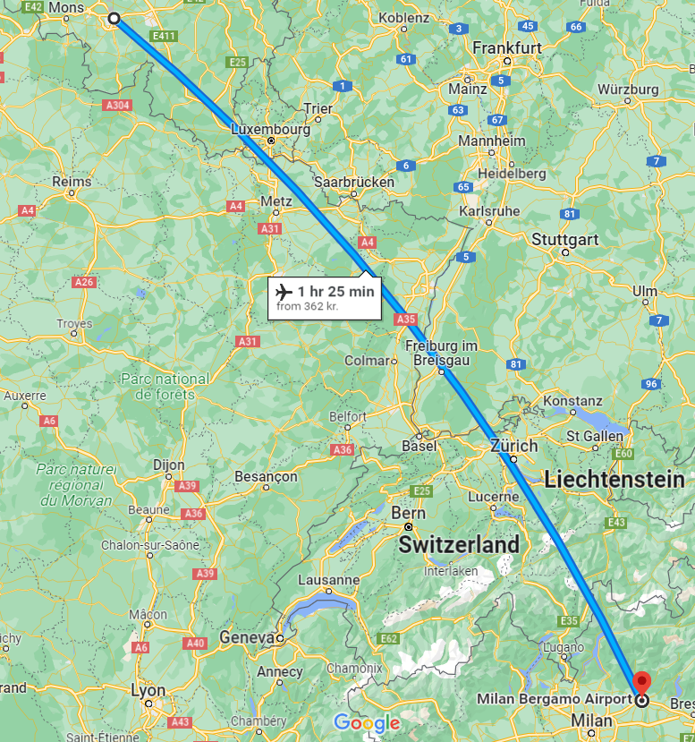
Problem Description
Company X developed a new lithium-metal battery
Its energy density is large enough to power an airplane
Demonstration: - Loaded battery in a Cessna 152 Skyhawk - The electric motor powering the shaft is connected to the battery - Flight itinerary from Milan to Brussels - Only one person on board - 1/3 of the fuel tank was full (in case of malfunctioning)
Data on energy/power density not stated by Company X
Next Project: - Power a turboprop airplane (Dash 8-400) - Short intra-European route

Slide 3
Analysis - Sources
Analysis - Assumptions
Flight distance = 700 km
Pilot weight = 80 kg
Passengers aboard DASH = 80
Fuel energy density = 12.1 kWh/kg
Battery energy density = 0.4 kWh/kg
Technical Sheet Data for: Cessna 153 Skyhawk and Dash 8-400
Cuberg’s state-of-the-art Lithium-metal battery (2022)
Given Data for the problem (traveling distance)

Slide 4
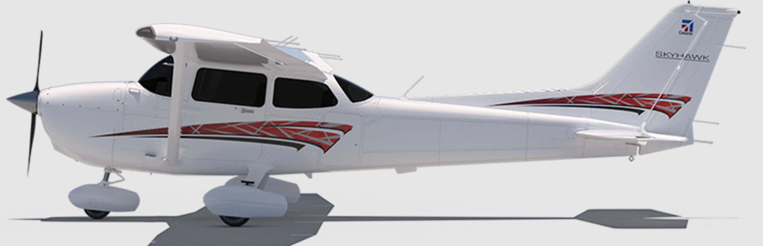
Analysis – Cessna 152 Skyhawk
(Single propeller)

Slide 5
Analysis – Cessna 152 Skyhawk
Energy consumption = 1027 kWh Estimated from the “non-electrical” version Fuel consumed = 85 kg Fuel energy density = 12.1 kWh/kg
Considering: Maximum ramp weight All available space left is used for the battery Maximum battery weight = 270 kg
For a 700 km flight: Energy Density required = 3.8 kWh/kg

Slide 6
Analysis – Cessna 152 Skyhawk
Actual Energy Density = 0.4 kWh/kg
Energy Density required = 3.8 kWh/kg (for 700 km)
That implies:
Maximum flight distance = 73 km
Maximum ramp weight = 1160 kg
To travel 700 km a battery of 2567 kg is needed

Slide 7
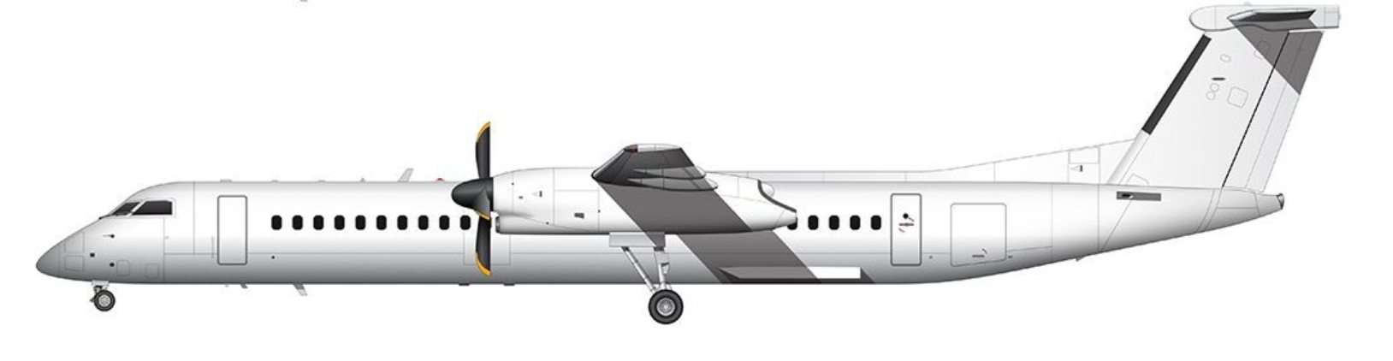
Analysis – Dash 8-400
(Double propeller)

Slide 8
Analysis – Dash 8-400
Energy consumption = 22082.47 kWh Fuel consumed = 1827.5 kg Fuel energy density = 12.1 kWh/kg Maximum battery weight = 2745.3 kg
For a 700 km flight: Energy needed = 22082.47 kWh Energy Density required = 8 kWh/kg

Slide 9
Analysis – Dash 8-400
Maximum flight distance - 35 km - 116 km (without passengers) - not enough to leave Belgium To travel 700 km the battery weight is:
- 55206 kg
- 9145.3 kg (without passengers) Maximum ramp weight = 28000 kg
Actual Energy Density = 0.4 kWh/kg
Energy Density required: - 8 kWh/kg (20 times higher) - 2.4 kWh/kg (without passengers)

Slide 10

Additional note
For the energy consumption: - Variations depending on speed weren’t considered
- Volume occupied by the battery wasn’t considered Energy needed for: - Cessna = 1027 kWh = 1 tonnes of TNT = Toast 100,000 slices of bread - Dash = 22082.47 kWh = 19 tonnes of TNT = Toast 2 millions slices of bread
Image source

Slide 11
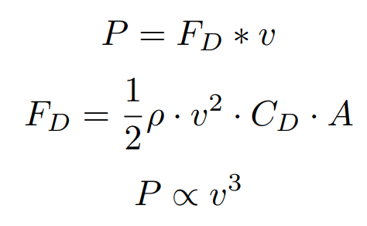
Additional Note
Relation between power and velocity:
P = power Fd = Drag force ρ = density of fuel Cd = Drag Coefficient v = flow velocity relative to the plane A = surface area (devo controllare que)

Slide 12
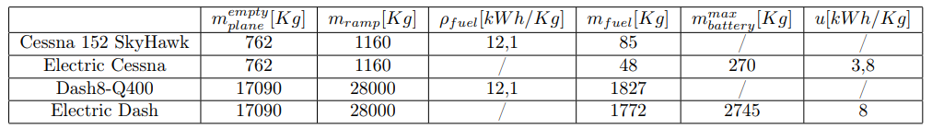
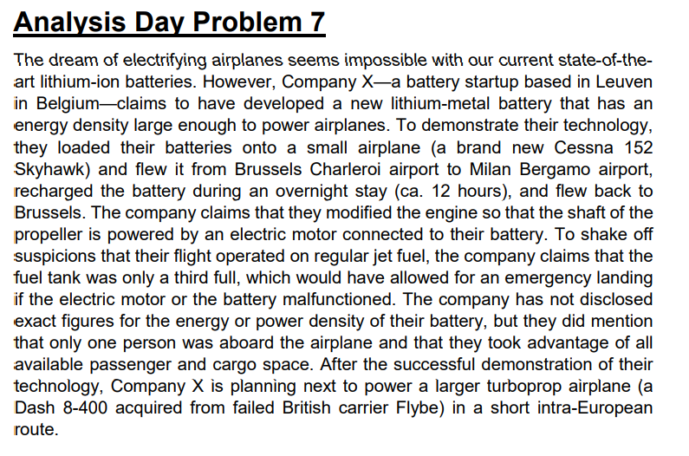
Conclusion
Electric flight only for very short distances
Not suited for commercial flight
Different solutions/technologies are required
The claim made by Company X seems to be far from any reality and there is a strong likelihood for it to be false.

Slide 13
Considerations
8% battery improvement per year: maximum improvement will be reached in 2-3 years
For a 1000 km range the battery should have 7 times more energy per kg
Up to 15 times more energy per kg for longer flights
(For reference, our Cessna has a 1100 km max. range, and we see an increase in 9.5 times more energy per kg)
“For the time being, there is no technology that allows for that much more energy storage. But suppose we do succeed in making a battery with this energy density, then what about the safety aspects? Or can this battery provide enough power to abort a landing in an emergency? There’s a lot more to it all than just energy storage.”
“We have also been talking about lithium-air for years already, potentially a much lighter technology. However, before you can apply this kind of novel technology in an aircraft, it must be 100 percent safe. And this kind of battery must last a long time and be relatively cheap to make, all of which I don’t see happening between now and 2050.”
- Joris Melkert, lecturer in aeronautical engineering at the Delft University of Technology (TU Delft, The Netherlands) -

Slide 14
Question Round!?
Electric flight only for very short distances
Not suited for commercial flight
Different solutions/technologies are required
The claim made by Company X seems to be far from any reality and there is a strong likelihood for it to be false.

Slide 15
Sources
Cessna 152 Skyhawk: https://cessna.txtav.com/en/piston/cessna-skyhawk
Dash 8-400: https://cartenav.com/wp-content/uploads/2020/10/De-Havilland-Canada-dash-8.jpg
Future of electric aviation: ‘Batteries only suitable for small-scale flights’ https://innovationorigins.com/en/future-of-electric-aviation-battery-only-suitable-for-small-scale-flights/
Cuberg's Cell Technology Reaches New Major Performance Milestone for Lithium Metal Battery Development: https://cuberg.net/news/cuberg-lithium-metal-external-cell-cycle-life-validation

