Slide 1

An AI-Based Legal Advisory System for Traffic Violation Verification Using Official Traffic Regulations
Nirapod Fine
Al Amin Hossain Nahid (22-49627-3) · Chowdhury Shakil Hasan (22-49631-3)
Rakibul Islam Akash (23-50363-1) · Abdullah Al Rafe Ayon (22-49628-3)
Department of Computer Science and Engineering · Faculty of Science and Technology · AIUB · CSE 4298 Thesis
Notes:
Introduce the team and the thesis title. Nirapod Fine is the prototype we built to check whether a Bangladeshi traffic fine receipt is legally consistent.

Slide 2
Detecting a violation is not verifying a fine
AI traffic systems detect violations, but do not confirm that the offence, cited section and fine amount are consistent with the law
A notice may carry a wrong offence, a wrong section, an excessive fine or a missed exception
Citizens have no easy way to check a notice
General legal AI can sound confident while being unsupported, so legal reasoning must be controlled
31,578
estimated road-traffic deaths in Bangladesh in 2021, 18.6 per 100,000 people (WHO)
Notes:
Existing systems stop at detection. The gap this thesis addresses is legal consistency of the notice, and reporting uncertainty rather than guessing.

Slide 3
Objectives and research questions
Objectives
Research questions
Extract fields from receipt images, PDFs and URLs
Build a structured Bangladesh offence and exception dataset
Verify offence, section, fine, repeat offence and exceptions with a deterministic rule engine
Explain results and route uncertain cases to human review
Protect data and results with hashing
RQ1 How accurately can receipt fields be extracted?
RQ2 How well can a rule engine verify consistency with the 2018 Act?
RQ3 How do extraction errors affect the final verdict?
RQ4 How can uncertain cases be sent to human review?
RQ5 How can results be protected without storing personal data on-chain?
Notes:
Seven objectives in the book; condensed here to five. The five research questions map to the evaluation stages that follow.

Slide 4
The system: AI reads, the rule engine decides
1
2
3
4
5
Upload
Extract
Confirm
Verify
Explain
Image, PDF or URL receipt
AI reads offence, amount, date, section
User checks and corrects fields
Rule engine checks law and fine limits
Status and explanation, or manual review
Probabilistic reading in steps 1 to 3, deterministic legal reasoning in steps 4 and 5. The AI never decides legal validity; its explanation is checked against the rule-engine output.
Notes:
Core design decision: separate extraction from legal reasoning. Supports Bangla, English and mixed receipts. The user confirmation step is what protects against reading errors.

Slide 5
Legal dataset and rule engine
The engine checks
42
15
Offence matching and cited section
Fine limits and tier
Repeat-offence conditions
Statutory exceptions
offence rules
exception rules
Structured from the Road Transport Act, 2018 and a selected exceptions guide. Each rule stores section, fine limits, synonyms, keywords and conditions. Dataset versions are read-only during analysis.
Possible outcomes
Valid · Fine too high · Reason mismatch · Exception possible · Exception not applicable · Needs manual review
Notes:
Stack: Next.js frontend, FastAPI backend, PostgreSQL, an external AI model for reading and wording, SHA-256 and Solidity for integrity. Rules are versioned so a result can be tied to the exact dataset.

Slide 6
Four-stage evaluation
Stage A
Stage B
Typed-field rule engine
AI receipt reading
224 manually labelled cases
56 receipt images
Stage C
Stage D
End-to-end pipeline
AI-only baseline
56 images, image to verdict
Same 56 images, no rule engine
Metrics: verdict accuracy, precision, recall, macro F1, field accuracy, section top-1 and top-3, decision quality, processing time.
Notes:
Separating the stages lets us see whether errors come from the rule engine or from reading the receipt.

Slide 7
Rule engine on typed fields (n = 224)
71.4%
0.722
100% accuracy for missing-amount, no-ceiling and below-minimum groups
Weaker on paraphrased (59.3%) and Bangla (66.7%) descriptions
Section matching: top-1 79.3%, top-3 100% on standard cases
Most errors are cautious referrals to manual review
verdict accuracy
macro F1-score
1.000
0.957
precision, fine too high
recall, manual review
95% CI for accuracy: 65.2% to 76.9%
Notes:
When facts are supplied correctly the engine is reliable and conservative. Its weak spots are language variation: paraphrased and Bangla descriptions.

Slide 8
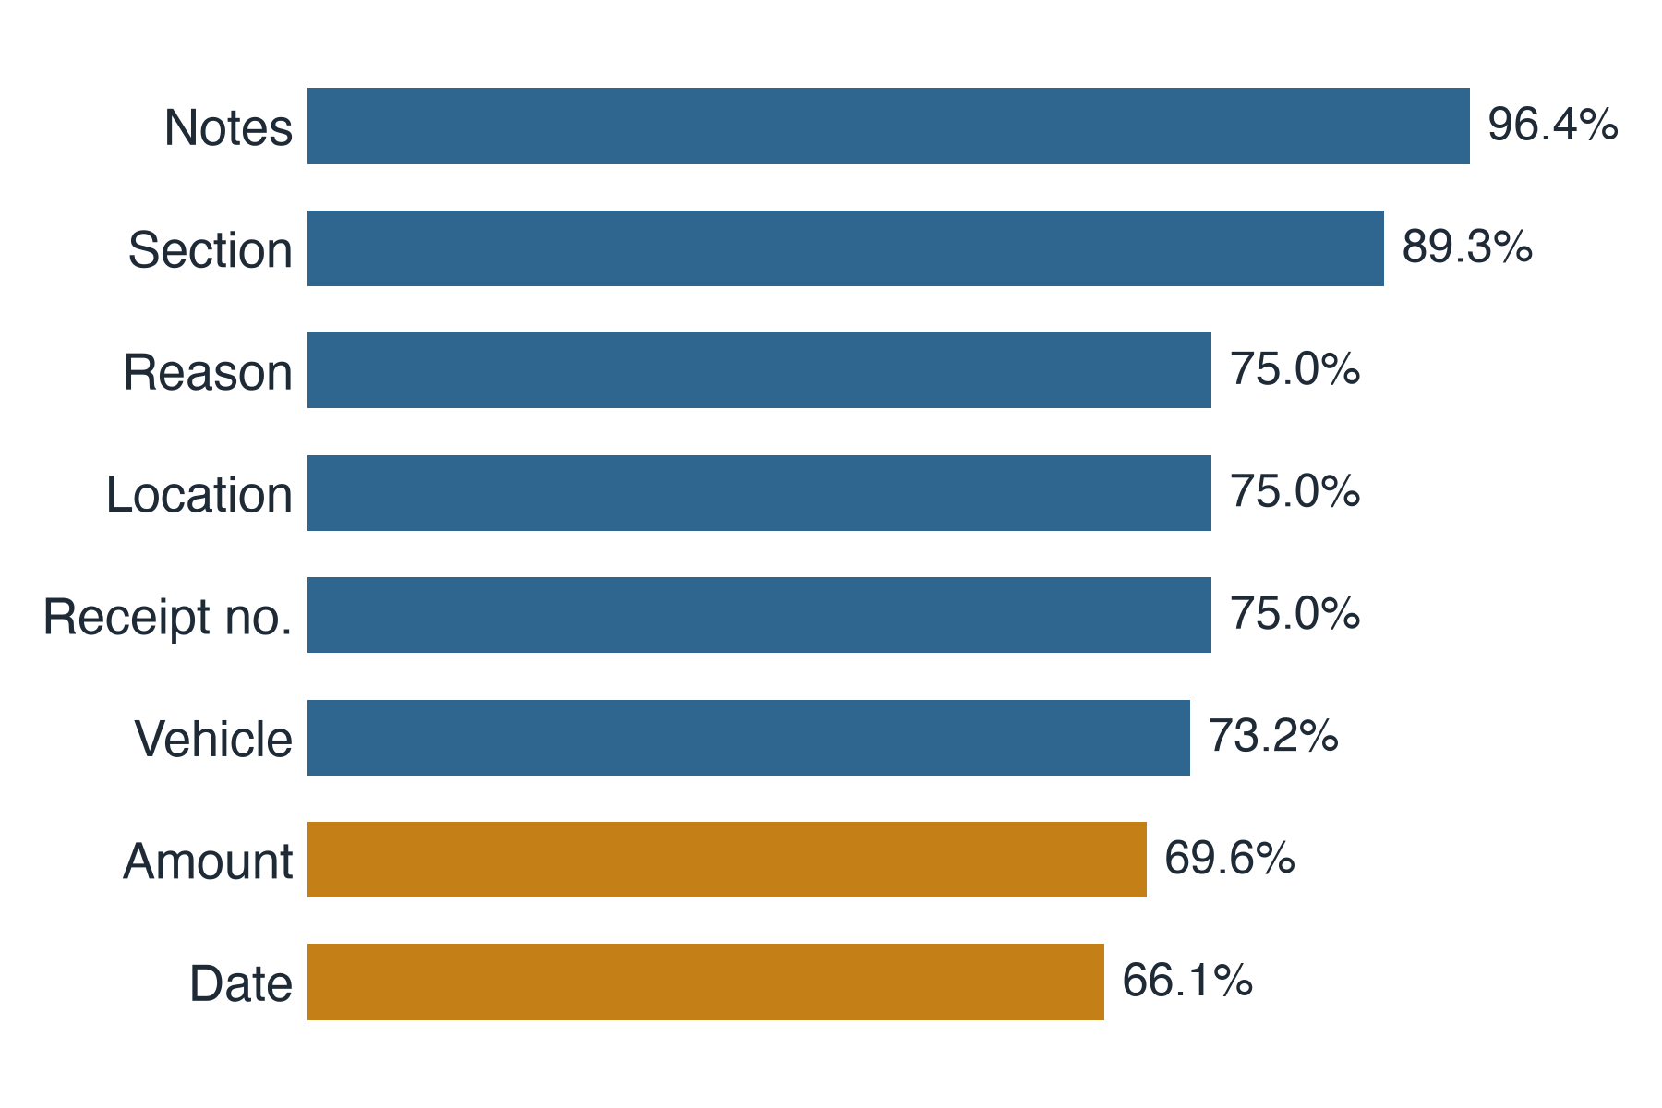
Receipt reading accuracy by field
56 / 56
images processed
7.7 s
mean time per image
Amount and date errors change the legal outcome, so user confirmation is essential.
Notes:
Notes 96.4 percent, section 89.3 percent. Amount 69.6 and date 66.1 are the weakest, and they matter most legally. That is why the user confirmation step exists.

Slide 9
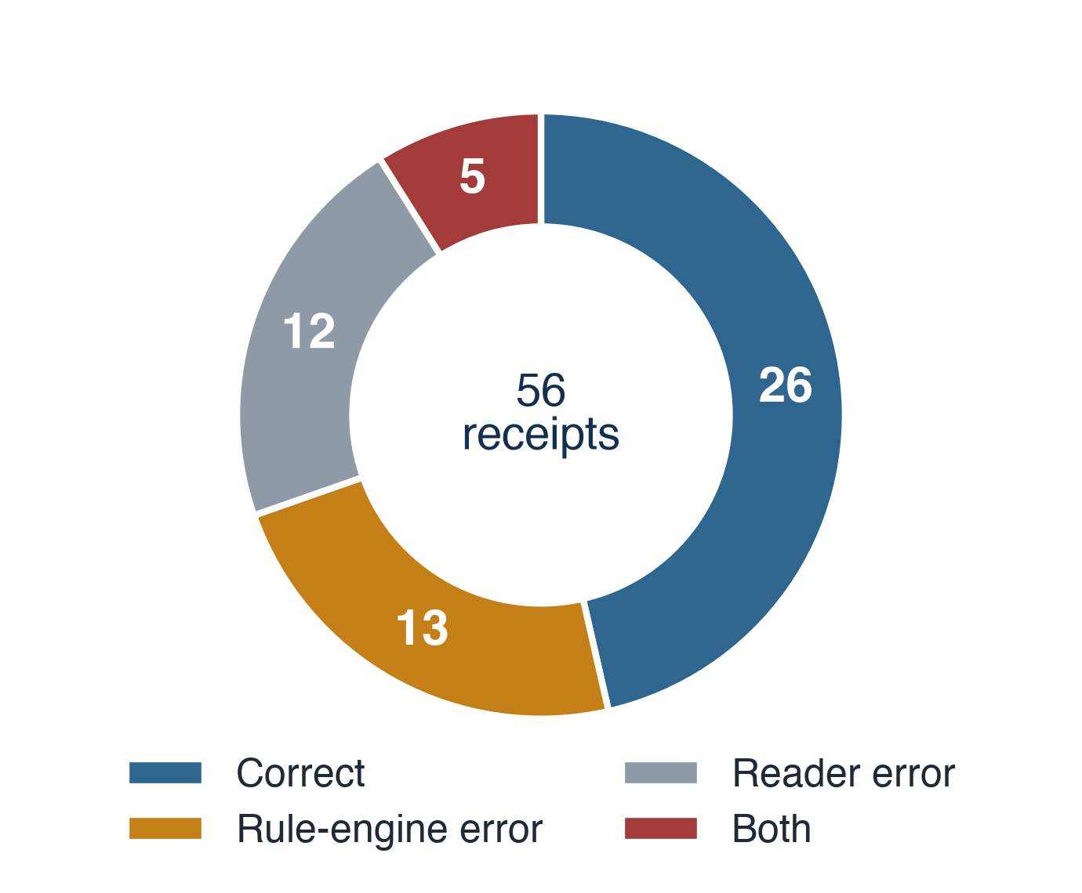
End to end: reading errors propagate
46.4%
end-to-end accuracy (95% CI 34.0 to 59.3)
26 of 56 receipts fully correct
A misread amount can turn a valid fine into "too high"; a misread section causes a section mismatch
Testing the whole pipeline matters, not the rule engine alone
Notes:
Of 56 receipts: 26 correct, 13 rule-engine errors, 12 receipt-reading errors, 5 with both. Accuracy drops from 71.4 to 46.4 because extraction errors flow into legal verification.

Slide 10
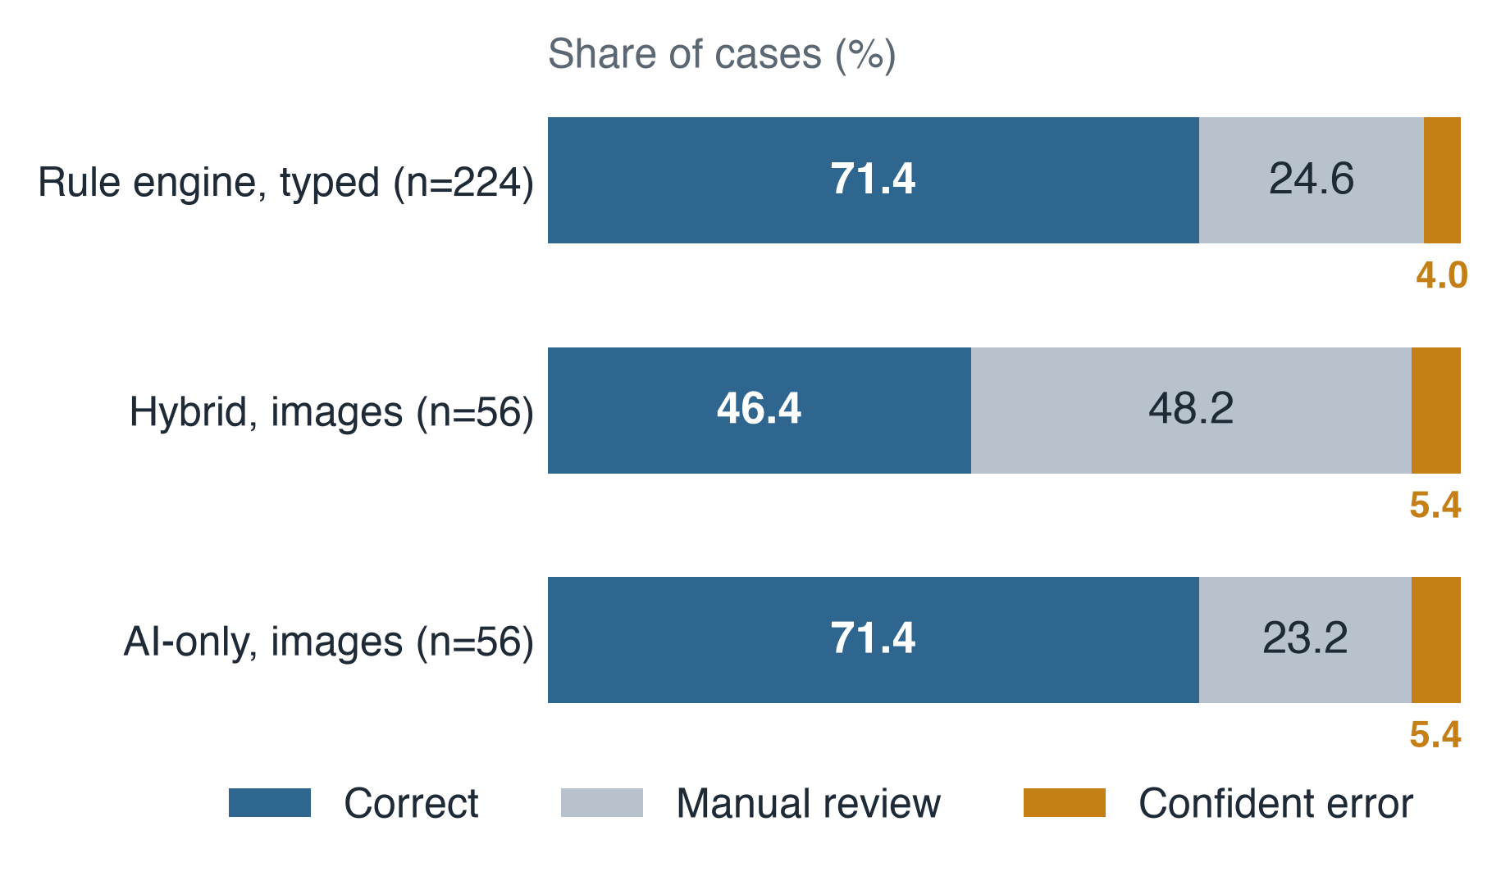
Accuracy is not the whole story
AI-only baseline had higher direct accuracy (71.4% vs 46.4%), but answers even when the receipt is incomplete
Hybrid referred 27 uncertain cases to humans
Firm-decision accuracy 88.5%, with no false approvals
A wrong automatic approval is worse than a referral
Notes:
Share of cases in percent. The hybrid is more conservative by design. For a legal support tool, an erroneous automatic approval is much worse than sending a case to a human. This is why we describe it as a verification assistant, not an autonomous decision maker.

Slide 11
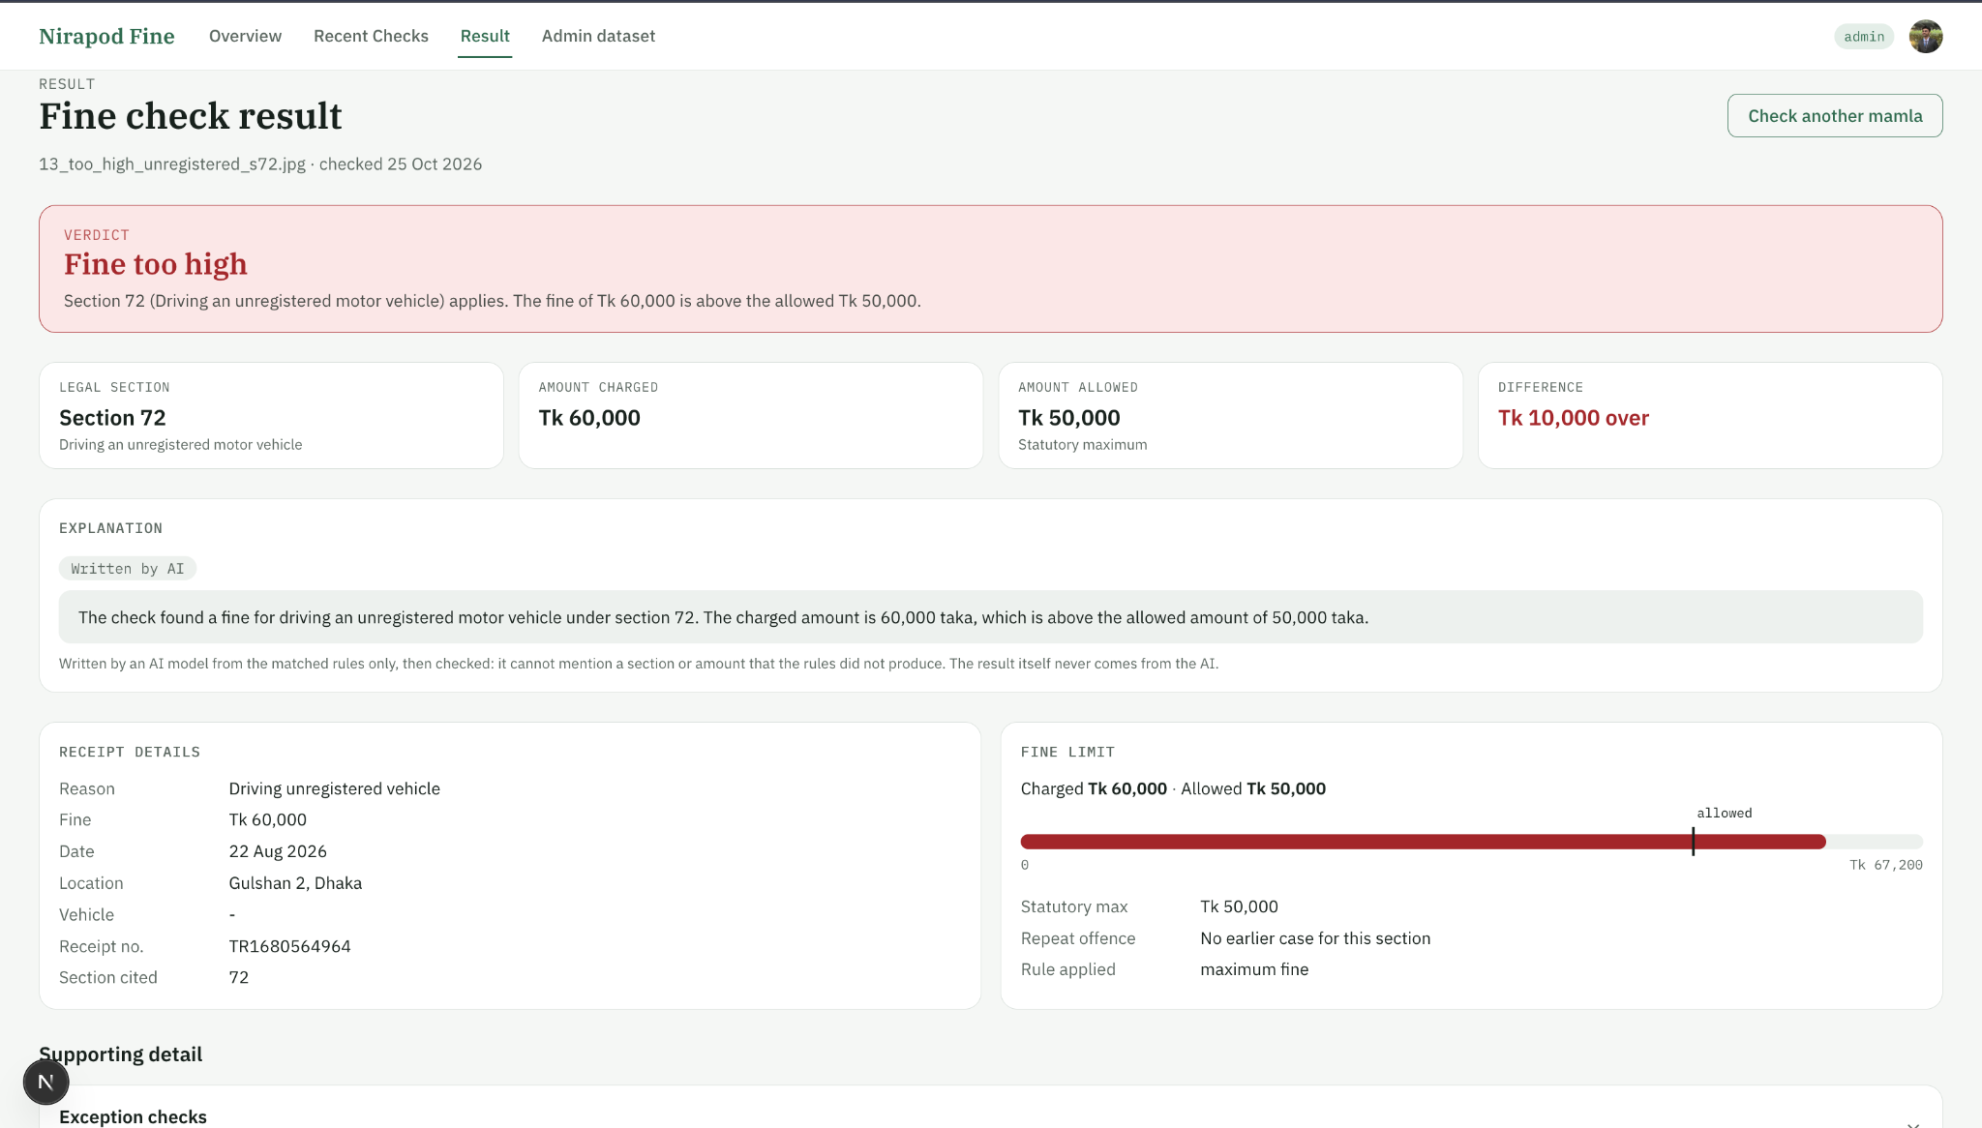
The prototype, explanations and integrity
Explanations are written from matched rules only and cannot mention a section or amount the rules did not produce
SHA-256 hashes of case, dataset and result support later integrity checks
Optional blockchain audit stores hashes only, no readable receipt or personal data
Result screen: verdict, section, allowed fine and checked explanation
Notes:
Live demo option: upload a sample receipt, review the AI-read fields, then show the verdict. Hashing detects later changes, but does not prove the original rule or input was correct.

Slide 12
Limitations and future work
Limitations
Future work
Legal scope: 2018 Act and one exceptions guide
Small evaluation set with limited receipt diversity
URL workflow built but not tested
Dates, amounts and Bangla text error-prone
Blockchain tested locally only
Add amendments and gazette updates to the dataset
Collect larger, real receipt sets
Better Bangla OCR and number recognition
Compare several AI models
User studies with drivers, officers and legal experts
Notes:
Be upfront about the limits: a decision-support tool, not a replacement for legal authority.

Slide 13
Conclusion
Separating AI reading from deterministic legal reasoning is practical and explainable.
Rule engine: 71.4% verdict accuracy. Full pipeline: 46.4%, limited by extraction.
Uncertain cases go to humans, with no false approvals on the image set.
A legal verification assistant, not an autonomous decision maker.
Thank you. Questions?
Notes:
Close with the three take-aways, then invite questions.

