Slide 1

Gym

Slide 2
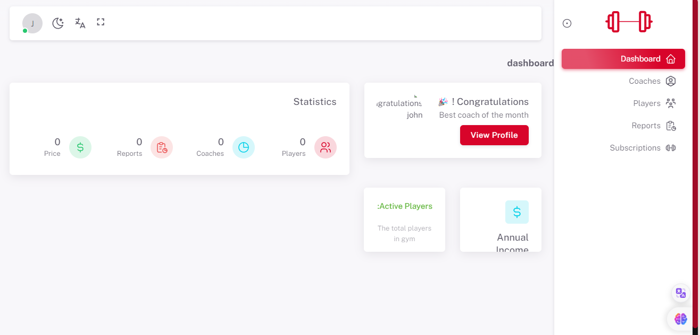
DASHBORD
There are things that need to be fixed, such as the term 'dashboard' and annual income." and Remove this symbol"$"

Slide 3
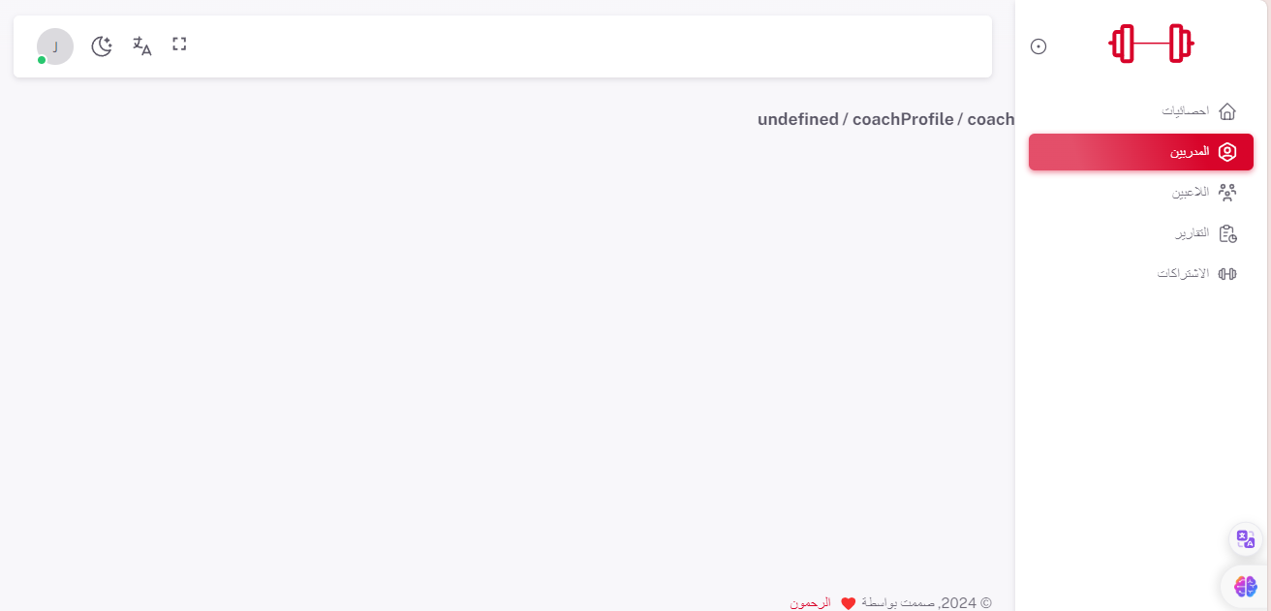
COACHES
There is no data here

Slide 4
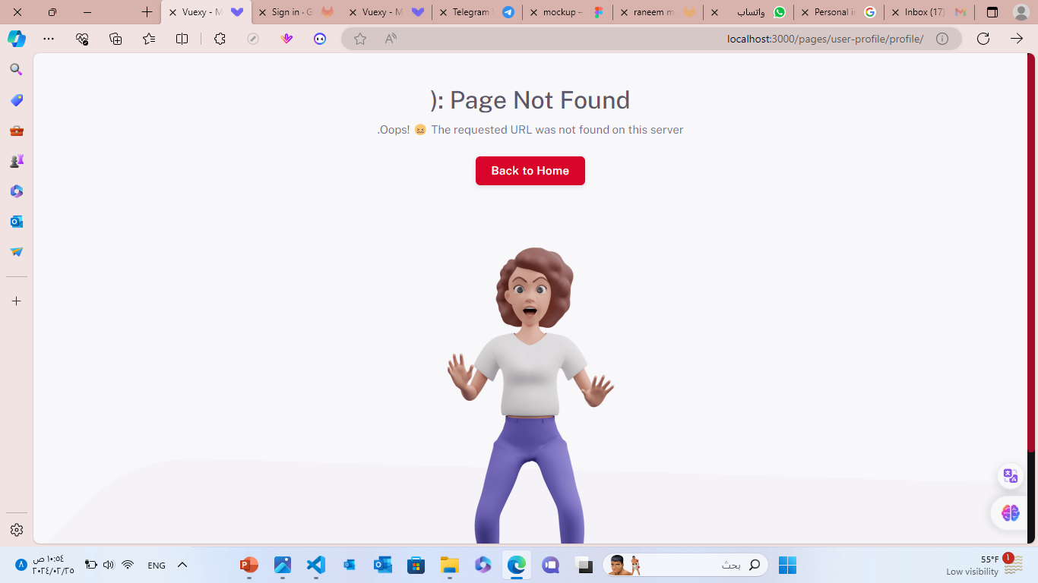
USER-PROFILE
There is no user page.

Slide 5
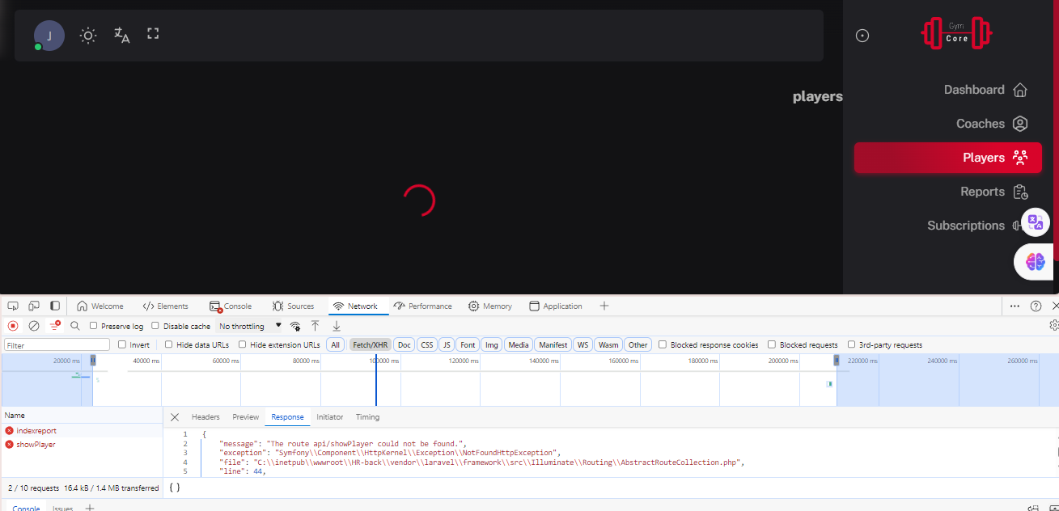
PLAYERS
There is no data here. There is no error in the inspect.

Slide 6
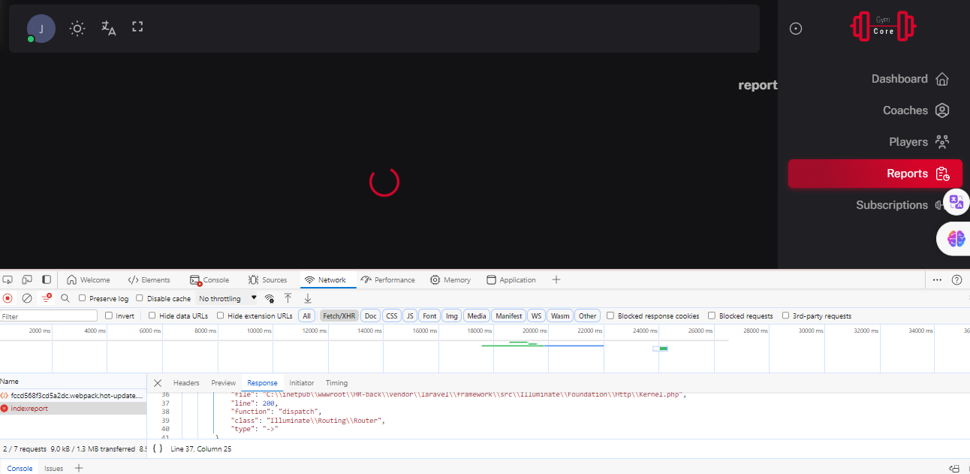
REPORTS
There is no data here. There is no error in the inspect.

Slide 7
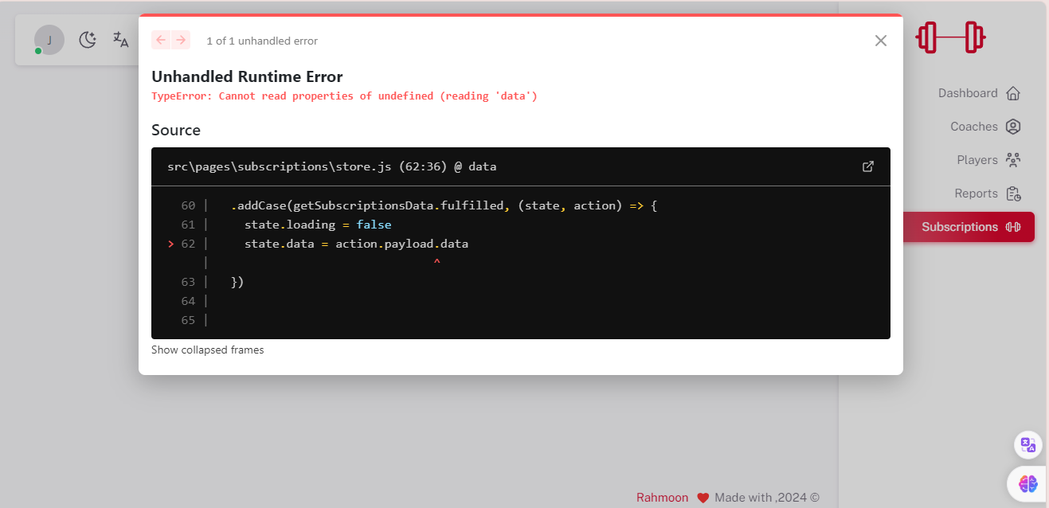
SUBSCRIPTIONS

