Slide 1

Smart 5-Story
Elevator Simulation
Presented by
Team: Abdulkader, Zakri, Fares

Slide 2
01
Objective

Slide 3
The main Objective
To design and simulate a sophisticated elevator control system using Octave/MATLAB, demonstrating the "Engineer's Logic" in real-time.

Slide 4

02
Overview

Slide 5


Overview:
GUI Simulation:
Smart Regimes:
Emergency Logic:
A fully interactive 5-story shaft visualization with real-time feedback on car position, door states, and user calls.
Time-based logic automates elevator behavior: Normal Day mode, Night Security mode, and Rush Hour optimization.
Three distinct protocols: Fire (Ground), Flood (Top), and Storm (Middle) to ensure passenger safety.

Slide 6
03
Methodology

Slide 7
Methodology
FCFS Simple
SCAN Smart
The elevator treats requests like a grocery line. If the lift is at floor 0, and requests come from 4 then 2, it travels all the way to 4, then back to 2. Highly inefficient.
The industry standard. The elevator prioritizes the nearest call in its current direction of travel. Moves 0 -> 2 -> 4. Reduces total travel distance significantly.

Slide 8
04
Findings

Slide 9
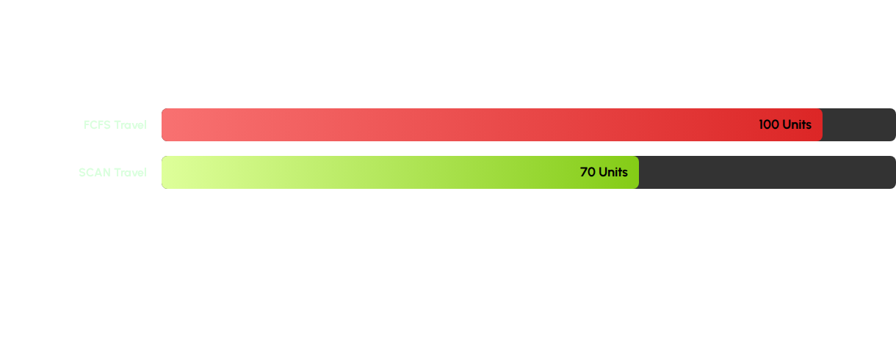



4. Findings: Efficiency Data
FCFS Travel
SCAN Travel
The SCAN algorithm demonstrated a 30% reduction in total travel distance compared to FCFS during random usage scenarios, validating the "Smart" logic implementation.

Slide 10
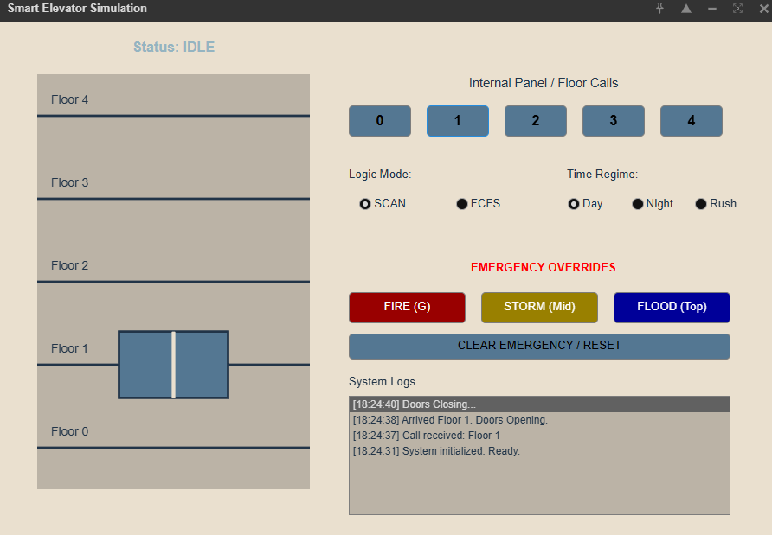
Elevator GUI

Slide 11



Challenges & Solutions
404 NOT FOUND
The "Floor Skipping" Bug
The Solution
Challenge: Due to floating-point precision errors (e.g., position = 1.99999 vs 2.0), the elevator would occasionally fail to detect it had arrived at a floor, causing it to skip stops.
Snap-to-Floor Logic: We implemented a tolerance window (arrival threshold > speed) and a "snap" function that forces the elevator's position to the exact integer value upon arrival, ensuring consistent door operations.

Slide 12


Team Contributions
Abdulkader Jalal
Lead Software Engineer. Responsible for core MATLAB architecture, GUI implementation, and the SCAN algorithm logic.
Zakri
Testing & Validation. Responsible for brainstorming emergency scenarios and black-box testing the interface.
Fares
QA & Optimization. Identified the floor-skipping bug and conducted efficiency comparison tests.

Slide 13
Thank You

