Slide 1
第四节 均差与牛顿插值公式
在插值计算中，当增加一个节点时，只需在原来的插值多项式中增加一项，原有的项不需要变
由此，既可以根据需要增加节点，也可以提高了效率

Slide 2
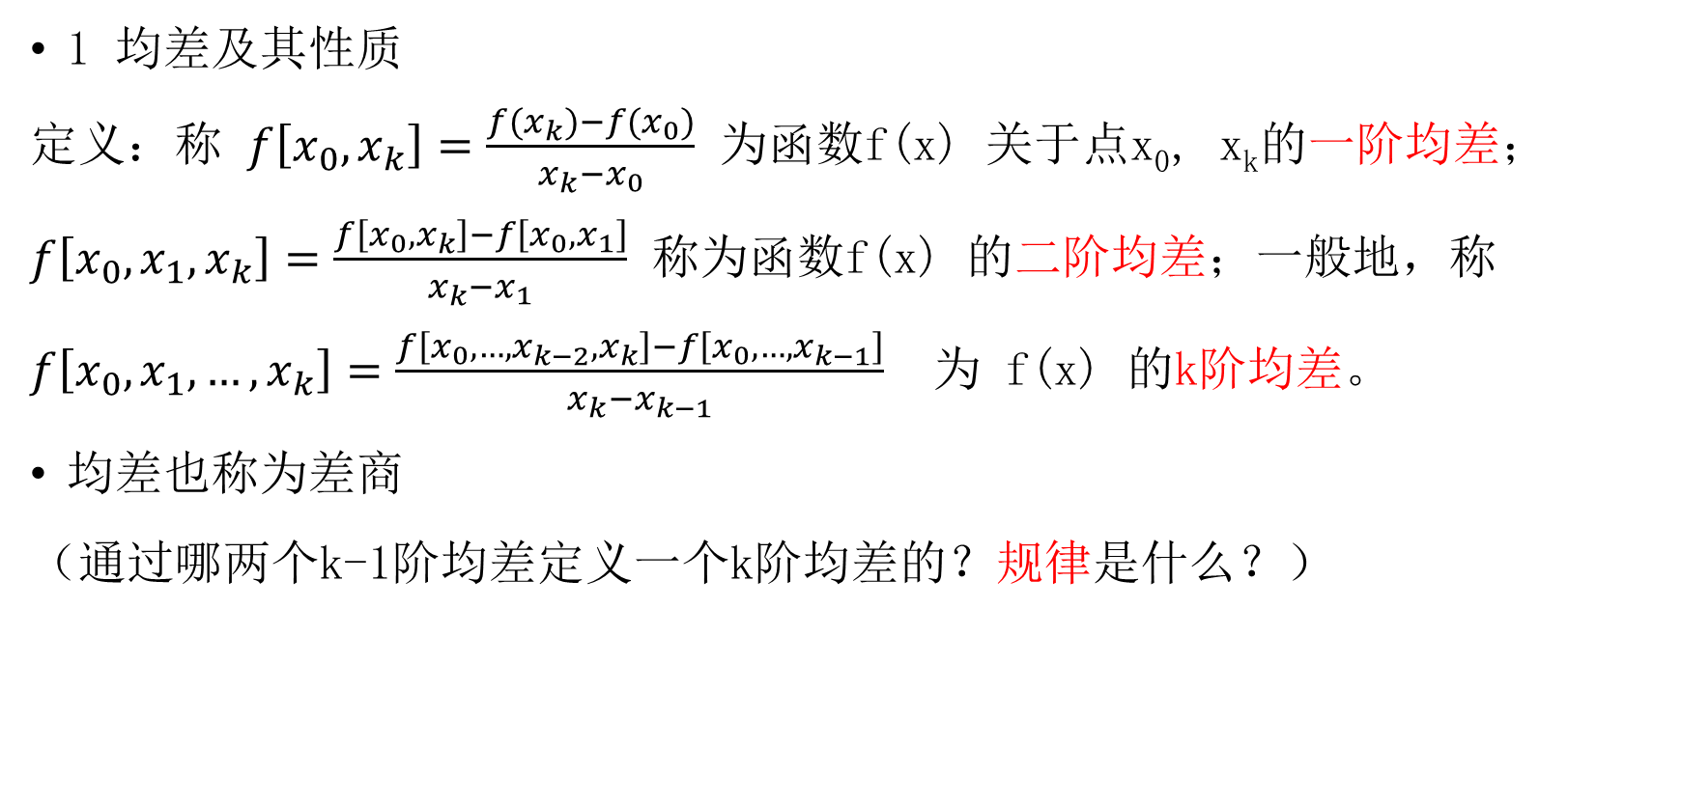
定义
1 均差及其性质
定义：称 $f\left[x_{0},x_{k}\right]=\frac{{f(x}_{k})−f(x_{0})}{x_{k}−x_{0}}$ 为函数f(x) 关于点x₀, x_{k}的一阶均差；$f\left[x_{0},x_{1},x_{k}\right]=\frac{f\left[x_{0},x_{k}\right]−f\left[x_{0},x_{1}\right]}{x_{k}−x_{1}}$ 称为函数f(x) 的二阶均差；一般地，称
$f\left[x_{0},x_{1},…,x_{k}\right]=\frac{f\left[x_{0},…,x_{k−2},x_{k}\right]−f\left[x_{0},…,x_{k−1}\right]}{x_{k}−x_{k−1}}$ 为 f(x) 的k阶均差。
均差也称为差商
（通过哪两个k-1阶均差定义一个k阶均差的？规律是什么？）

Slide 3
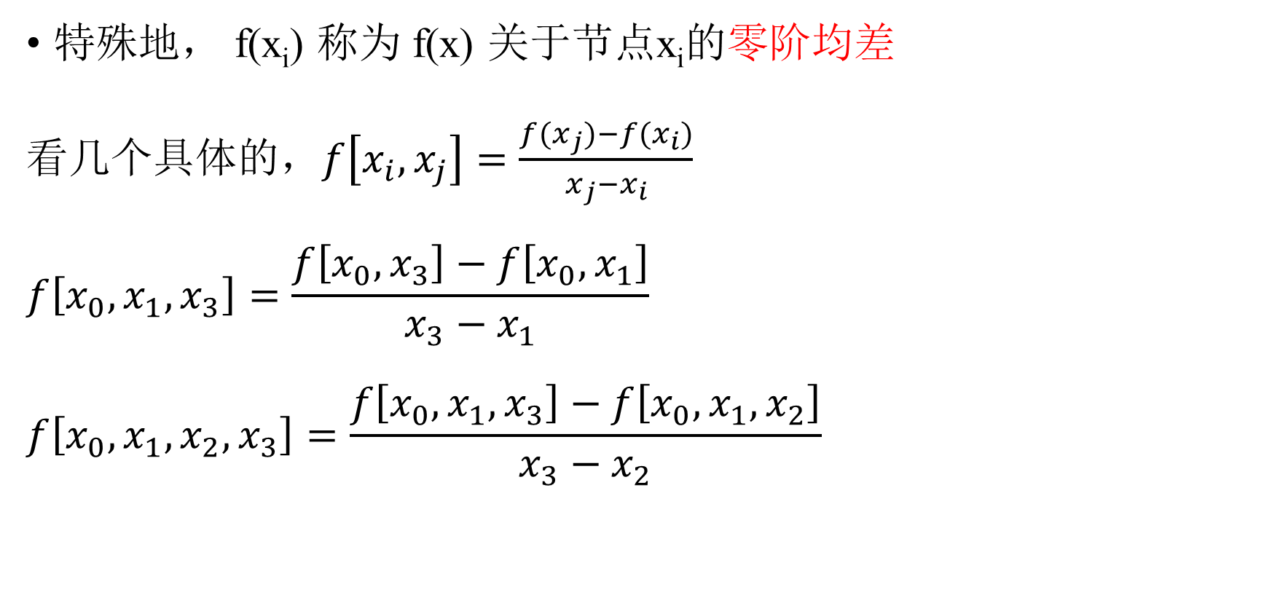
特殊地， f(x_{i}) 称为 f(x) 关于节点x_{i}的零阶均差
看几个具体的$，f\left[x_{i},x_{j}\right]=\frac{{f(x}_{j})−f(x_{i})}{x_{j}−x_{i}}$
$$f\left[x_{0},x_{1},x_{3}\right]=\frac{f\left[x_{0},x_{3}\right]−f\left[x_{0},x_{1}\right]}{x_{3}−x_{1}}$$
$$f\left[x_{0},x_{1},x_{2},x_{3}\right]=\frac{f\left[x_{0},{x_{1},x}_{3}\right]−f\left[x_{0},{x_{1},x}_{2}\right]}{x_{3}−x_{2}}$$

Slide 4
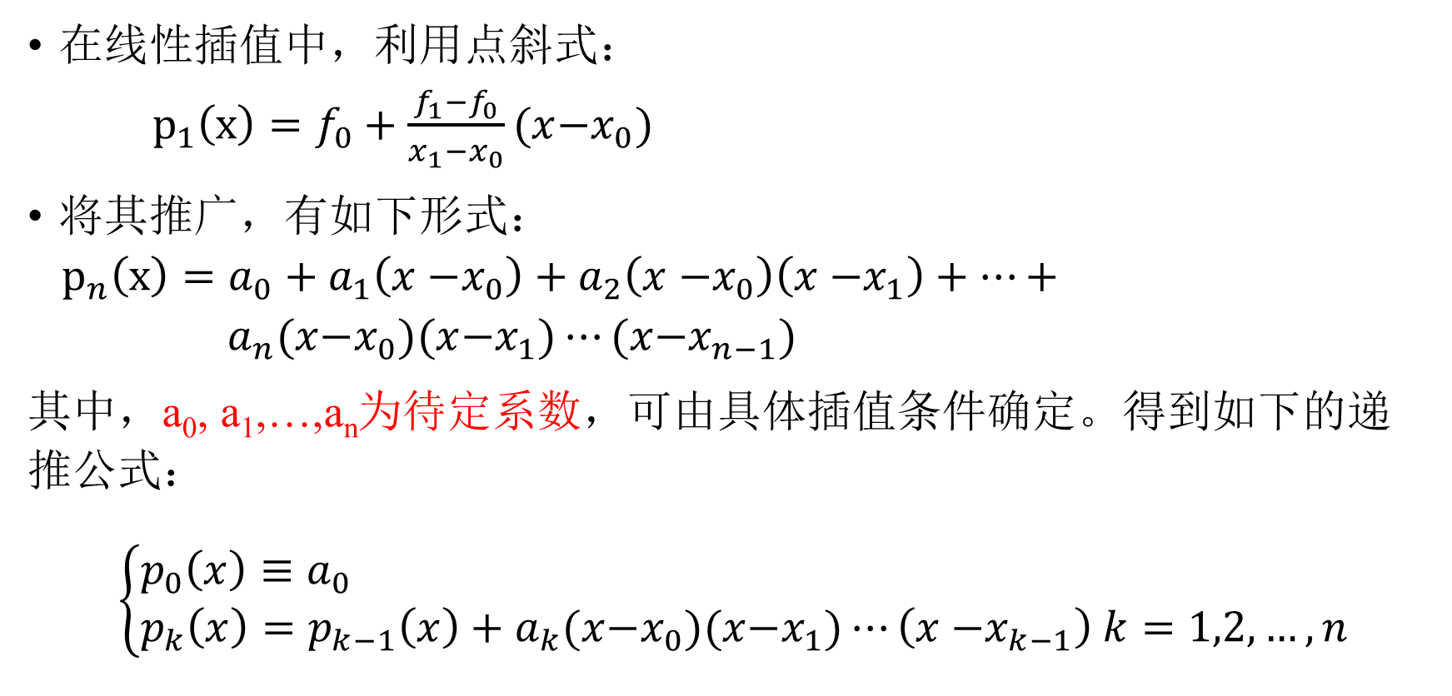
递推公式
在线性插值中，利用点斜式：
$p_{1}\left(x\right)=f_{0}+\frac{f_{1}−f_{0}}{x_{1}{−x}_{0}}(x{−x}_{0})$
将其推广，有如下形式：
$p_{n}\left(x\right)=a_{0}+a_{1}\left(x{−x}_{0}\right)+a_{2}\left(x{−x}_{0}\right)\left(x{−x}_{1}\right)+⋯+ a_{n}(x{−x}_{0})(x{−x}_{1})⋯(x{−x}_{n−1})$
其中，a₀, a₁,…,a_{n}为待定系数，可由具体插值条件确定。得到如下的递推公式：
$$\left\{\begin{aligned}&p_{0}\left(x\right)≡a_{0} \\ &p_{k}\left(x\right)=p_{k−1}\left(x\right)+a_{k}(x{−x}_{0})(x{−x}_{1})⋯\left(x{−x}_{k−1}\right) k=1,2,…,n\end{aligned}\right.$$

Slide 5
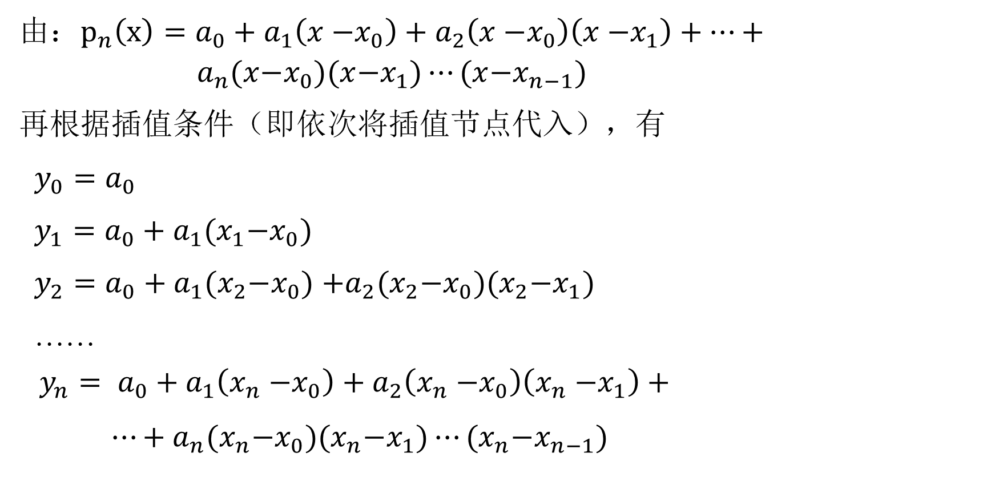
公式
由：$p_{n}\left(x\right)=a_{0}+a_{1}\left(x{−x}_{0}\right)+a_{2}\left(x{−x}_{0}\right)\left(x{−x}_{1}\right)+⋯+ a_{n}(x{−x}_{0})(x{−x}_{1})⋯(x{−x}_{n−1})$
再根据插值条件（即依次将插值节点代入），有
$y_{0}=a_{0}$
$y_{1}=a_{0}+a_{1}(x_{1}{−x}_{0})$
$y_{2}=a_{0}+a_{1}(x_{2}{−x}_{0})$ $+a_{2}(x_{2}{−x}_{0})(x_{2}{−x}_{1})$
……
$$y_{n}= a_{0}+a_{1}\left(x_{n}{−x}_{0}\right)+a_{2}\left(x_{n}{−x}_{0}\right)\left(x_{n}{−x}_{1}\right)+$$
$⋯+a_{n}(x_{n}{−x}_{0})(x_{n}{−x}_{1})⋯(x_{n}{−x}_{n−1})$

Slide 6
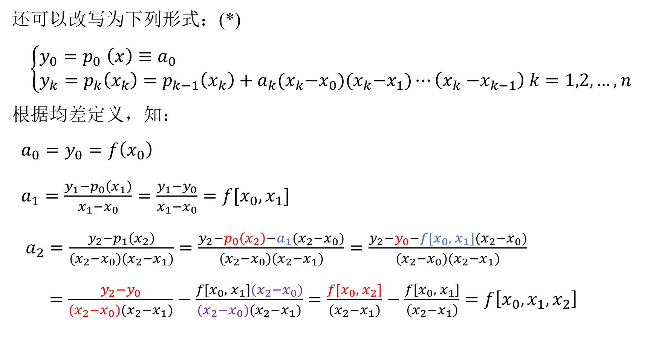
还可以改写为下列形式：(*)
$$\left\{\begin{aligned}&y_{0}{=p}_{0}\left(x\right)≡a_{0} \\ &{y_{k}=p}_{k}\left(x_{k}\right)=p_{k−1}\left(x_{k}\right)+a_{k}(x_{k}{−x}_{0})(x_{k}{−x}_{1})⋯\left(x_{k}{−x}_{k−1}\right) k=1,2,…,n\end{aligned}\right.$$
根据均差定义，知：
${a_{0}=y}_{0}=f\left(x_{0}\right)$
$a_{1}=\frac{y_{1}−p_{0}\left(x_{1}\right)}{x_{1}{−x}_{0}}=\frac{y_{1}−y_{0}}{x_{1}{−x}_{0}}=f[x_{0}, x_{1}]$
$a_{2}=\frac{y_{2}−p_{1}\left(x_{2}\right)}{(x_{2}{−x}_{0})(x_{2}{−x}_{1})}=\frac{y_{2}−p_{0}\left(x_{2}\right)−a_{1}(x_{2}{−x}_{0})}{(x_{2}{−x}_{0})(x_{2}{−x}_{1})}$ $=\frac{y_{2}−y_{0}−f[x_{0}, { x}_{1}](x_{2}{−x}_{0})}{(x_{2}{−x}_{0})(x_{2}{−x}_{1})}$
$=\frac{y_{2}−y_{0}}{(x_{2}{−x}_{0})(x_{2}{−x}_{1})}−\frac{f[x_{0},{ x}_{1}](x_{2}{−x}_{0})}{(x_{2}{−x}_{0})(x_{2}{−x}_{1})}$ $=\frac{f[x_{0},{ x}_{2}]}{(x_{2}{−x}_{1})}−\frac{f\left[x_{0}, { x}_{1}\right]}{\left(x_{2}{−x}_{1}\right)}=f\left[x_{0},x_{1},x_{2}\right]$

Slide 7
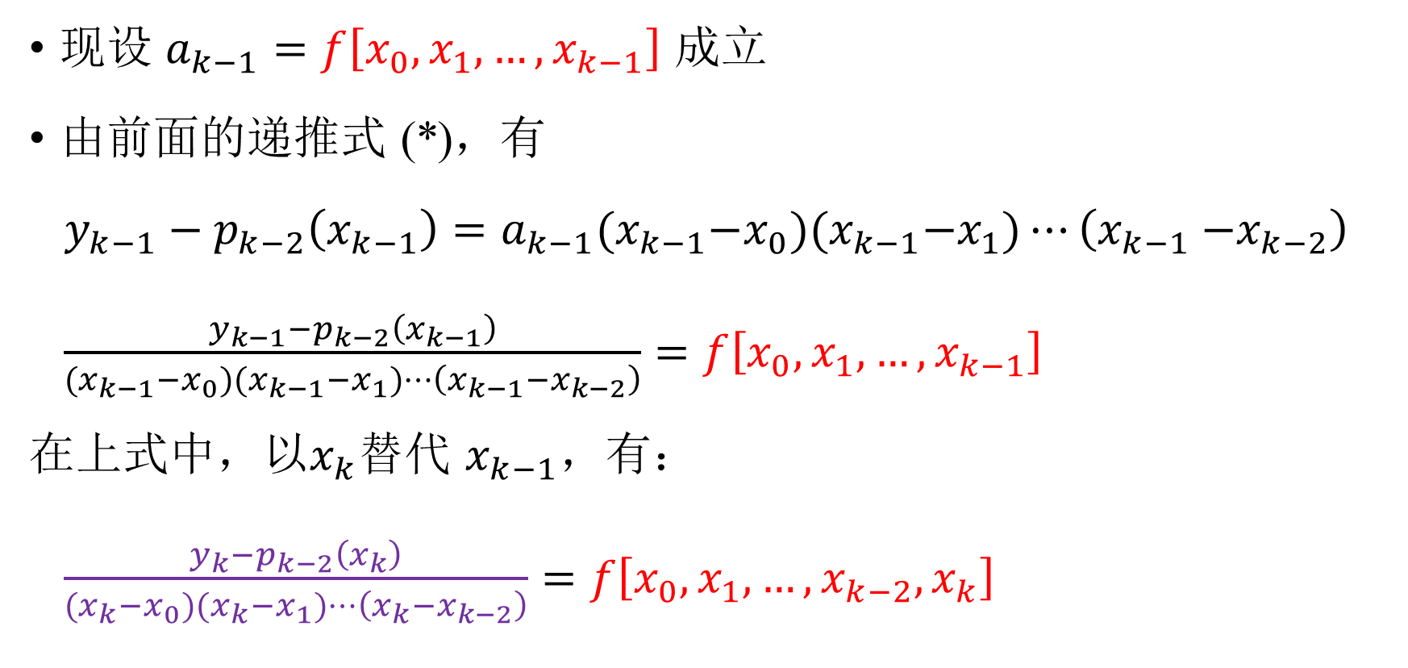
现设 $a_{k−1}=f\left[x_{0},x_{1},…,x_{k−1}\right]$ 成立
由前面的递推式 (*)，有
$y_{k−1}−p_{k−2}\left(x_{k−1}\right)=a_{k−1}(x_{k−1}{−x}_{0})(x_{k−1}{−x}_{1})⋯\left(x_{k−1}{−x}_{k−2}\right)$
$\frac{y_{k−1}−p_{k−2}\left(x_{k−1}\right)}{(x_{k−1}{−x}_{0})(x_{k−1}{−x}_{1})⋯\left(x_{k−1}{−x}_{k−2}\right)}=f\left[x_{0},x_{1},…,x_{k−1}\right]$
在上式中，以$x_{k}$替代 $x_{k−1}$，有：
$\frac{y_{k}−p_{k−2}\left(x_{k}\right)}{(x_{k}{−x}_{0})(x_{k}{−x}_{1})⋯\left(x_{k}{−x}_{k−2}\right)}=f\left[x_{0},x_{1},…,x_{k−2},x_{k}\right]$

Slide 8
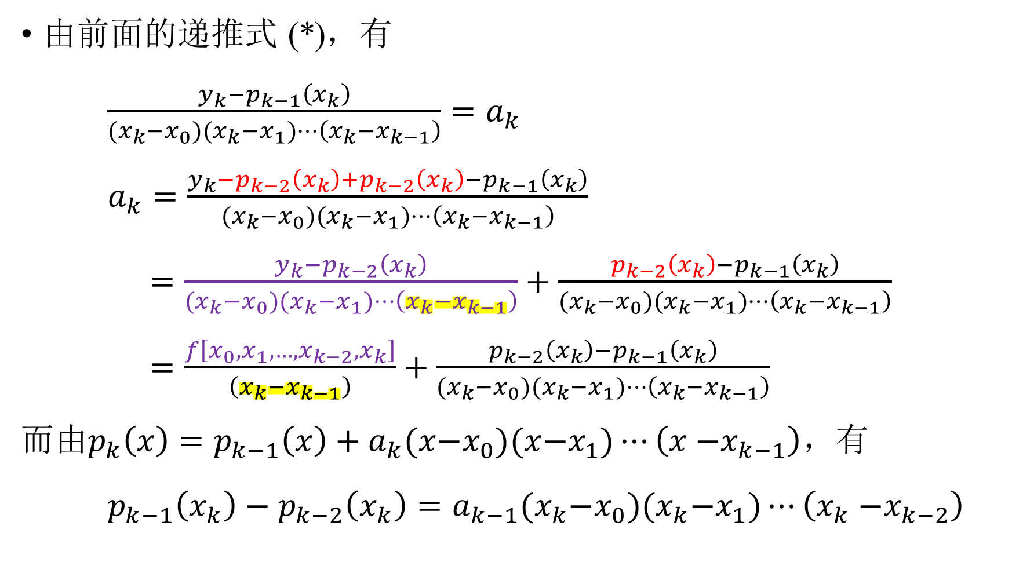
由前面的递推式 (*)，有
$\frac{y_{k}−p_{k−1}\left(x_{k}\right)}{(x_{k}{−x}_{0})(x_{k}{−x}_{1})⋯\left(x_{k}{−x}_{k−1}\right)}=a_{k}$
$a_{k}=\frac{y_{k}−p_{k−2}\left(x_{k}\right)+p_{k−2}\left(x_{k}\right)−p_{k−1}\left(x_{k}\right)}{(x_{k}{−x}_{0})(x_{k}{−x}_{1})⋯\left(x_{k}{−x}_{k−1}\right)}$
$=\frac{y_{k}−p_{k−2}\left(x_{k}\right)}{(x_{k}{−x}_{0})(x_{k}{−x}_{1})⋯\left(x_{k}{−x}_{k−1}\right)}+\frac{p_{k−2}\left(x_{k}\right)−p_{k−1}\left(x_{k}\right)}{(x_{k}{−x}_{0})(x_{k}{−x}_{1})⋯\left(x_{k}{−x}_{k−1}\right)}$
$=\frac{f\left[x_{0},x_{1},…,{x_{k−2},x}_{k}\right]}{\left(x_{k}{−x}_{k−1}\right)}+\frac{p_{k−2}\left(x_{k}\right)−p_{k−1}\left(x_{k}\right)}{(x_{k}{−x}_{0})(x_{k}{−x}_{1})⋯\left(x_{k}{−x}_{k−1}\right)}$
而由$p_{k}\left(x\right)=p_{k−1}\left(x\right)+a_{k}(x{−x}_{0})(x{−x}_{1})⋯\left(x{−x}_{k−1}\right)$，有
$p_{k−1}\left(x_{k}\right)−p_{k−2}\left(x_{k}\right)=a_{k−1}(x_{k}{−x}_{0})(x_{k}{−x}_{1})⋯\left(x_{k}{−x}_{k−2}\right)$

Slide 9
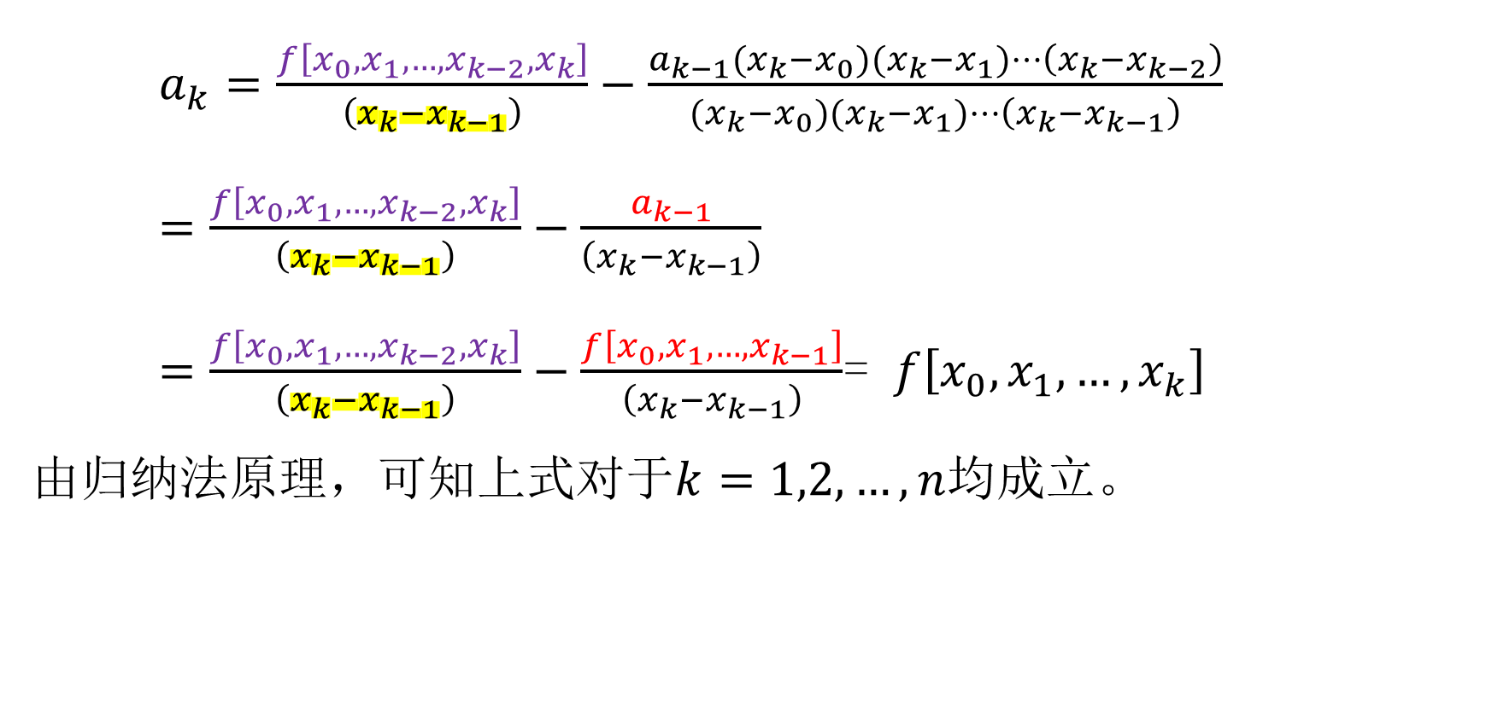
$a_{k}=\frac{f\left[x_{0},x_{1},…,{x_{k−2},x}_{k}\right]}{\left(x_{k}{−x}_{k−1}\right)}−\frac{a_{k−1}(x_{k}{−x}_{0})(x_{k}{−x}_{1})⋯\left(x_{k}{−x}_{k−2}\right)}{(x_{k}{−x}_{0})(x_{k}{−x}_{1})⋯\left(x_{k}{−x}_{k−1}\right)}$
$=\frac{f\left[x_{0},x_{1},…,{x_{k−2},x}_{k}\right]}{\left(x_{k}{−x}_{k−1}\right)}−\frac{a_{k−1}}{\left(x_{k}{−x}_{k−1}\right)}$
$=\frac{f\left[x_{0},x_{1},…,{x_{k−2},x}_{k}\right]}{\left(x_{k}{−x}_{k−1}\right)}−\frac{f\left[x_{0},x_{1},…,x_{k−1}\right]}{\left(x_{k}{−x}_{k−1}\right)}$= $f\left[x_{0},x_{1},…,x_{k}\right]$
由归纳法原理，可知上式对于$k=1,2,…,n$均成立。

Slide 10
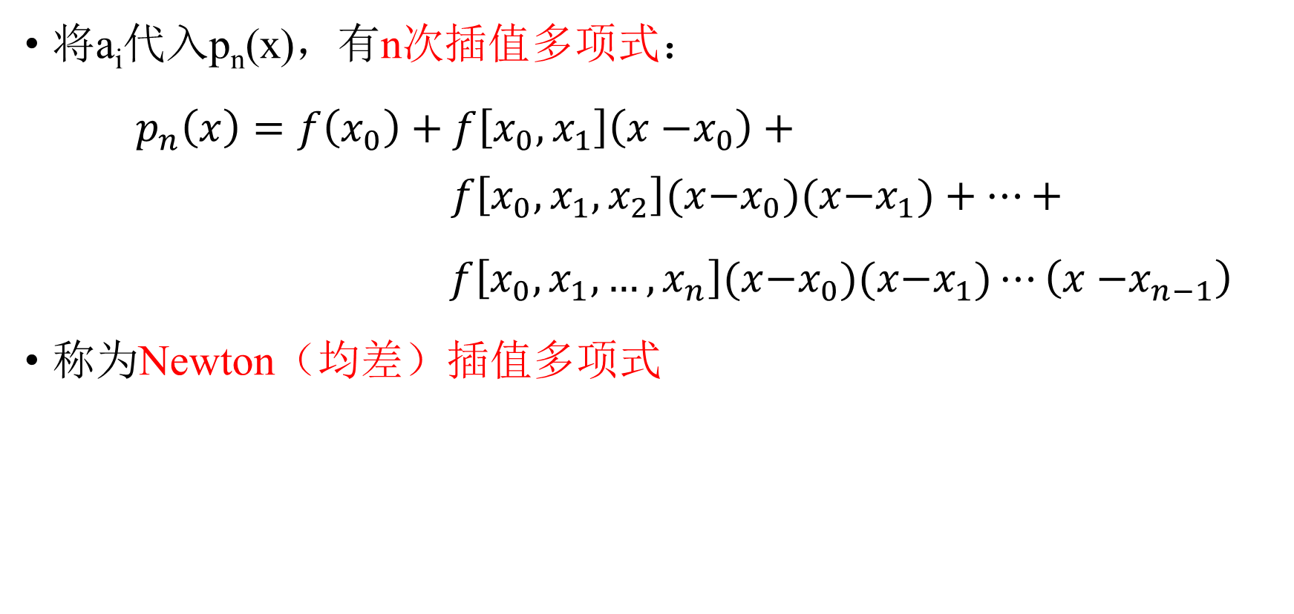
将a_{i}代入p_{n}(x)，有n次插值多项式：
$p_{n}\left(x\right)=f\left(x_{0}\right)+f\left[x_{0}, x_{1}\right]\left(x{−x}_{0}\right)+ f\left[x_{0},x_{1},x_{2}\right](x{−x}_{0})(x{−x}_{1})+⋯+$
$f\left[x_{0},x_{1},…,x_{n}\right](x{−x}_{0})(x{−x}_{1})⋯\left(x{−x}_{n−1}\right)$
称为Newton（均差）插值多项式

Slide 11
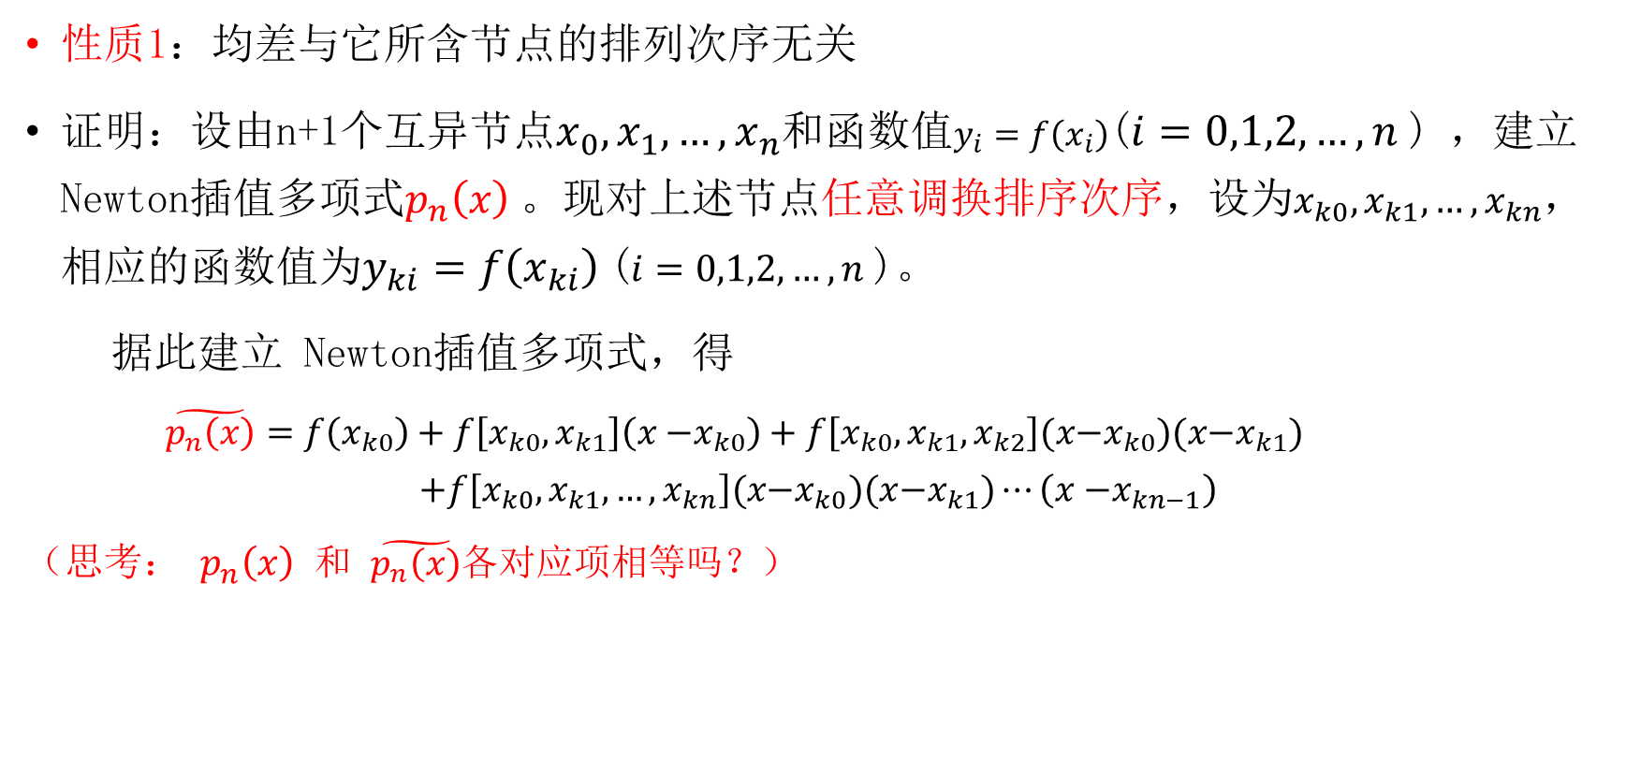
均差性质
性质1：均差与它所含节点的排列次序无关
证明：设由n+1个互异节点$x_{0},x_{1},…,x_{n}$和函数值$y_{i}=f\left(x_{i}\right)$($i=0,1,2,…,n$) ，建立Newton插值多项式$p_{n}\left(x\right)$。现对上述节点任意调换排序次序，设为$x_{k0},x_{k1},…,x_{kn}$，相应的函数值为$y_{ki}=f\left(x_{ki}\right)$($i=0,1,2,…,n$)。
据此建立 Newton插值多项式，得
$\tilde{p_{n}\left(x\right)}=f\left(x_{k0}\right)+f\left[x_{k0},x_{k1}\right]\left(x{−x}_{k0}\right)+f\left[x_{k0},x_{k1},x_{k2}\right](x{−x}_{k0})(x{−x}_{k1})$
$$+f\left[x_{k0},x_{k1},…,x_{kn}\right](x{−x}_{k0})(x{−x}_{k1})⋯\left(x{−x}_{kn−1}\right)$$
（思考： $p_{n}\left(x\right)$ 和 $\tilde{p_{n}\left(x\right)}$各对应项相等吗？）

Slide 12
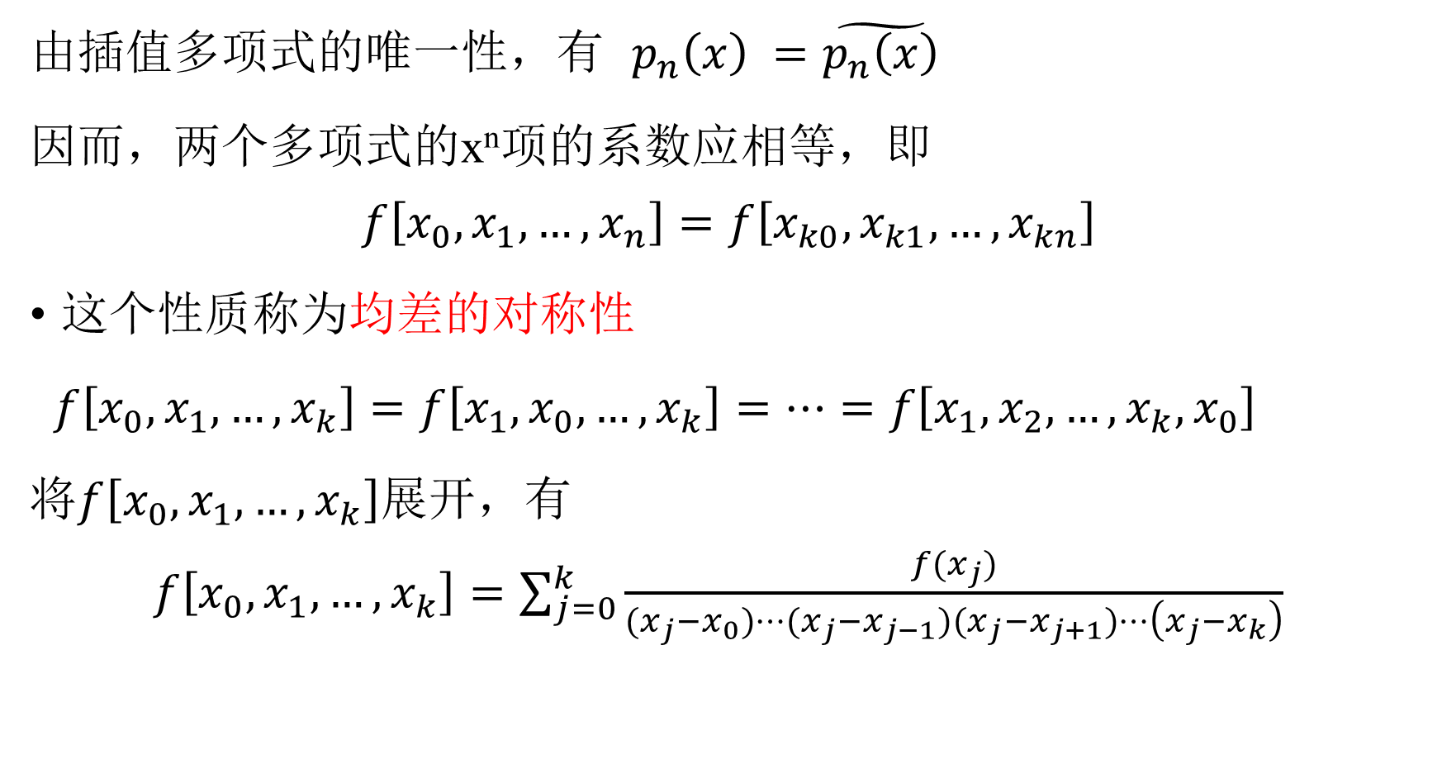
由插值多项式的唯一性，有 $p_{n}\left(x\right) =\tilde{p_{n}\left(x\right)}$
因而，两个多项式的x^{n}项的系数应相等，即
$$f\left[x_{0},x_{1},…,x_{n}\right]=f\left[x_{k0},x_{k1},…,x_{kn}\right]$$
这个性质称为均差的对称性
$f\left[x_{0},x_{1},…,x_{k}\right]=f\left[x_{1},x_{0},…,x_{k}\right]=⋯=f\left[x_{1},x_{2},…,x_{k},x_{0}\right]$
将$f\left[x_{0},x_{1},…,x_{k}\right]$展开，有
$f\left[x_{0},x_{1},…,x_{k}\right]=\sum_{j=0}^{k}{\frac{f(x_{j})}{(x_{j}{−x}_{0})⋯(x_{j}{−x}_{j−1})(x_{j}{−x}_{j+1})⋯\left(x_{j}{−x}_{k}\right)}}$

Slide 13
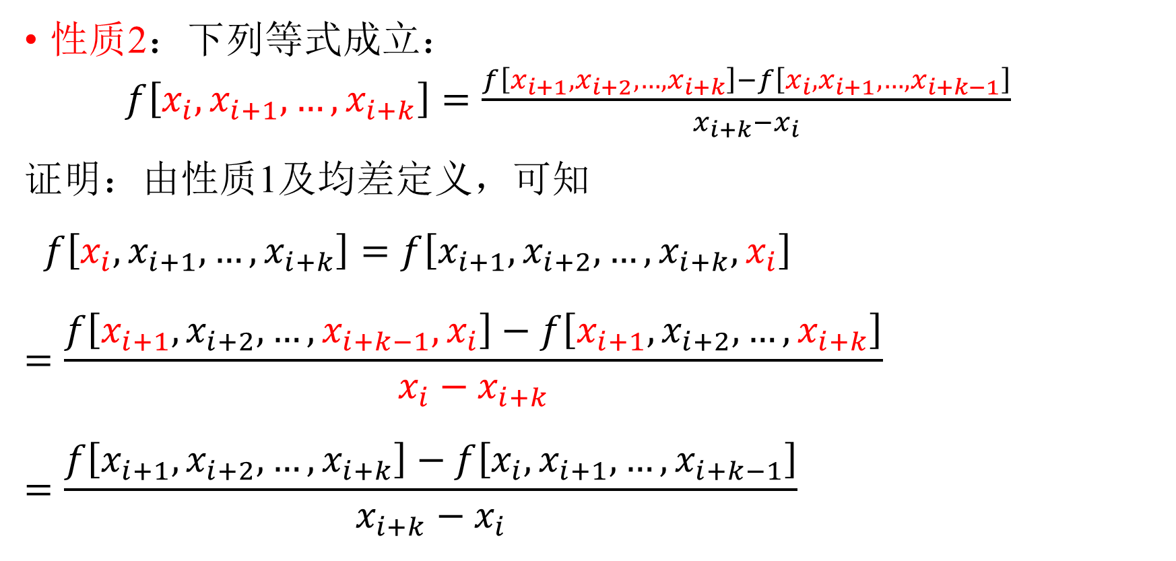
均差性质
性质2：下列等式成立：
$f\left[x_{i},x_{i+1},…,x_{i+k}\right]=\frac{f\left[x_{i+1},x_{i+2},…,x_{i+k}\right]−f\left[x_{i},x_{i+1},…,x_{i+k−1}\right]}{x_{i+k}−x_{i}}$
证明：由性质1及均差定义，可知
$f\left[x_{i},x_{i+1},…,x_{i+k}\right]=f\left[x_{i+1},x_{i+2},…,x_{i+k},x_{i}\right]$
$$=\frac{f\left[x_{i+1},x_{i+2},…,x_{i+k−1},x_{i}\right]−f\left[x_{i+1},x_{i+2},…,x_{i+k}\right]}{x_{i}−x_{i+k}}$$
$$=\frac{f\left[x_{i+1},x_{i+2},…,x_{i+k}\right]−f\left[x_{i},x_{i+1},…,x_{i+k−1}\right]}{x_{i+k}−x_{i}}$$

Slide 14
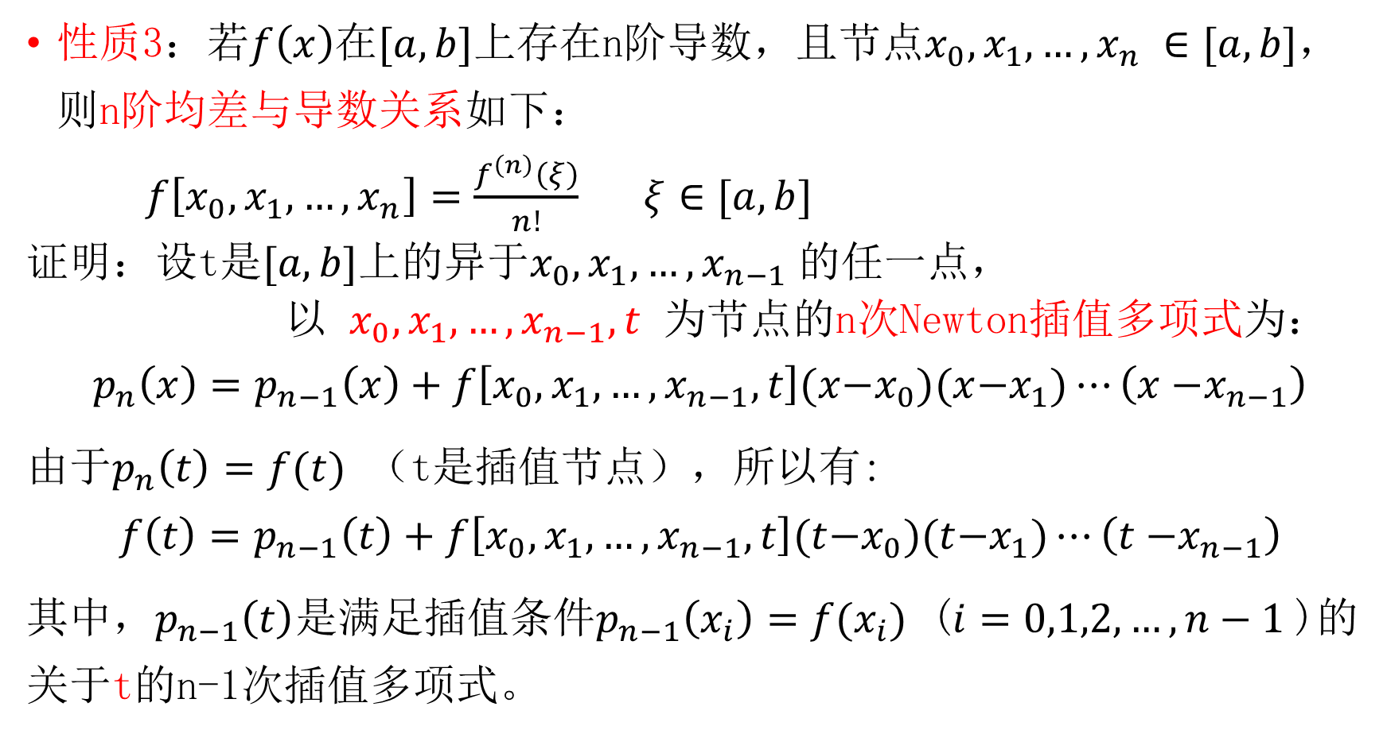
性质3：若$f\left(x\right)$在$[a,b]$上存在n阶导数，且节点$x_{0},x_{1},…,x_{n} ∈[a,b]$，则n阶均差与导数关系如下：
$f\left[x_{0},x_{1},…,x_{n}\right]=\frac{f^{\left(n\right)}\left(ξ\right)}{n!}$ $ξ∈[a,b]$
证明：设t是$[a,b]$上的异于$x_{0},x_{1},…,x_{n−1}$的任一点，
以 $x_{0},x_{1},…,x_{n−1},t$ 为节点的n次Newton插值多项式为：
$$p_{n}\left(x\right)=p_{n−1}\left(x\right)+f\left[x_{0},x_{1},…,x_{n−1},t\right](x{−x}_{0})(x{−x}_{1})⋯\left(x{−x}_{n−1}\right)$$
由于$p_{n}\left(t\right)=f(t)$ （t是插值节点），所以有:
$$f\left(t\right)=p_{n−1}\left(t\right)+f\left[x_{0},x_{1},…,x_{n−1},t\right](t{−x}_{0})(t{−x}_{1})⋯\left(t{−x}_{n−1}\right)$$
其中，$p_{n−1}\left(t\right)$是满足插值条件$p_{n−1}\left(x_{i}\right)=f(x_{i})$ ($i=0,1,2,…,n−1$)的关于t的n-1次插值多项式。

Slide 15
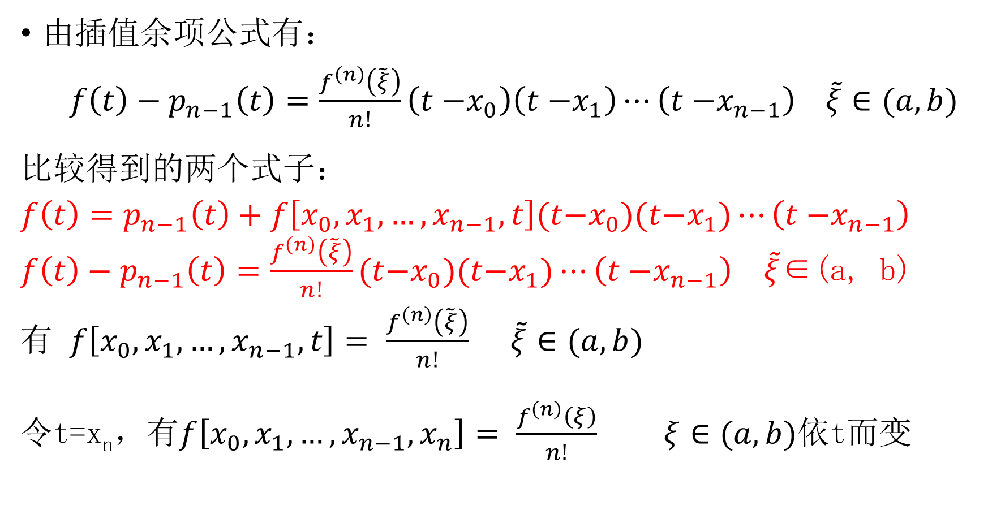
由插值余项公式有：
$f\left(t\right)−p_{n−1}\left(t\right)=\frac{f^{\left(n\right)}\left(\tilde{ξ}\right)}{n!}\left(t{−x}_{0}\right)\left(t{−x}_{1}\right)⋯\left(t{−x}_{n−1}\right) \tilde{ξ}∈(a,b)$
比较得到的两个式子：
$$f\left(t\right)=p_{n−1}\left(t\right)+f\left[x_{0},x_{1},…,x_{n−1},t\right](t{−x}_{0})(t{−x}_{1})⋯\left(t{−x}_{n−1}\right)$$
$f\left(t\right)−p_{n−1}\left(t\right)=\frac{f^{\left(n\right)}\left(\tilde{ξ}\right)}{n!}(t{−x}_{0})(t{−x}_{1})⋯\left(t{−x}_{n−1}\right)$ $\tilde{ξ}$∈(a, b)
有 $f\left[x_{0},x_{1},…,x_{n−1},t\right]=$ $\frac{f^{\left(n\right)}\left(\tilde{ξ}\right)}{n!} \tilde{ξ}∈(a,b)$
令t=x_{n}，有$f\left[x_{0},x_{1},…,x_{n−1},x_{n}\right]=$ $\frac{f^{\left(n\right)}\left(ξ\right)}{n!}$ $ξ∈(a,b)$依t而变

Slide 16
计算均差可依下表进行：
根据均差表，可计算Newton插值多项式，对角线上的各项，为Newton多项式中的各a_{i}值。
x_{k} | f(x_{k}) | 一阶均差 | 二阶均差 | 三阶均差 | 四阶均差
x₀ | f(x₀)
x₁ | f(x₁) | f[x₀, x₁]
x₂ | f(x₂) | f[x₁, x₂] | f[x₀, x₁, x₂]
x₃ | f(x₃) | f[x₂, x₃] | f[x₁, x₂, x₃] | f[x₀, x₁, x₂, x₃]
x₄ | f(x₄) | f[x₃, x₄] | f[x₂, x₃, x₄] | f[x₁, x₂, x₃, x₄] | f[x₀, x₁, x₂, x₃, x₄]
┋ | ┋ | ┋ | ┋ | ┋ | ┋

Slide 17
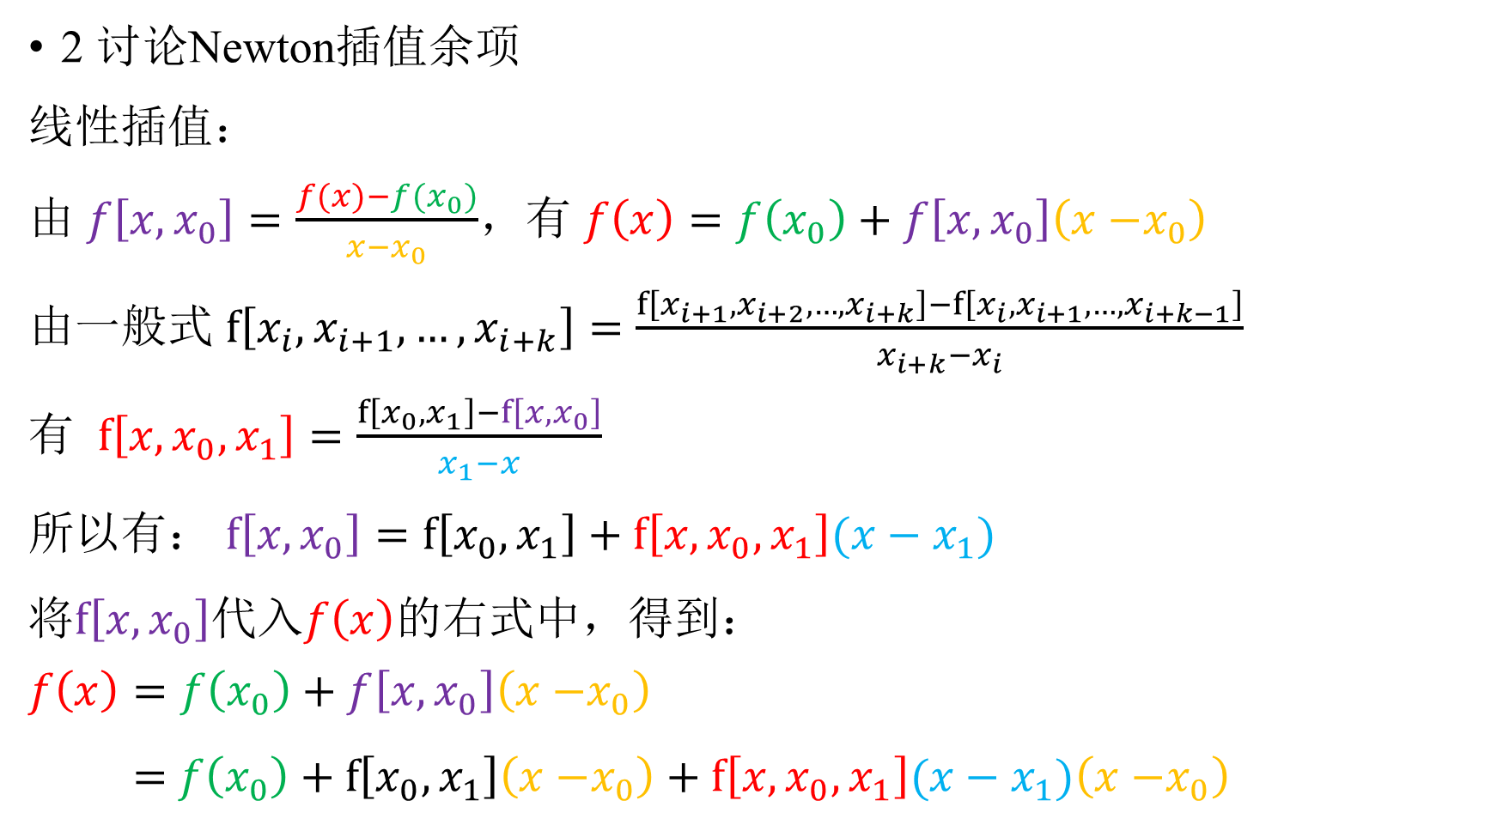
2 讨论Newton插值余项
线性插值：
由 $f\left[x,x_{0}\right]=\frac{f(x)−f(x_{0})}{x−x_{0}}$，有 $f\left(x\right)=f\left(x_{0}\right)+f\left[x, x_{0}\right]\left(x{−x}_{0}\right)$
由一般式 $f\left[x_{i},x_{i+1},…,x_{i+k}\right]=\frac{f\left[x_{i+1},x_{i+2},…,x_{i+k}\right]−f\left[x_{i},x_{i+1},…,x_{i+k−1}\right]}{x_{i+k}−x_{i}}$
有 $f\left[x,x_{0},x_{1}\right]=\frac{f\left[x_{0},x_{1}\right]−f\left[x,x_{0}\right]}{x_{1}−x}$
所以有： $f\left[x,x_{0}\right]=f\left[x_{0},x_{1}\right]+f\left[x,x_{0},x_{1}\right](x−x_{1})$
将$f\left[x,x_{0}\right]$代入$f\left(x\right)$的右式中，得到：
$$f\left(x\right)=f\left(x_{0}\right)+f\left[x, x_{0}\right]\left(x{−x}_{0}\right)$$
$=$ $f\left(x_{0}\right)+f\left[x_{0},x_{1}\right]\left(x{−x}_{0}\right)+f\left[x,x_{0},x_{1}\right](x−x_{1})\left(x{−x}_{0}\right)$

Slide 18
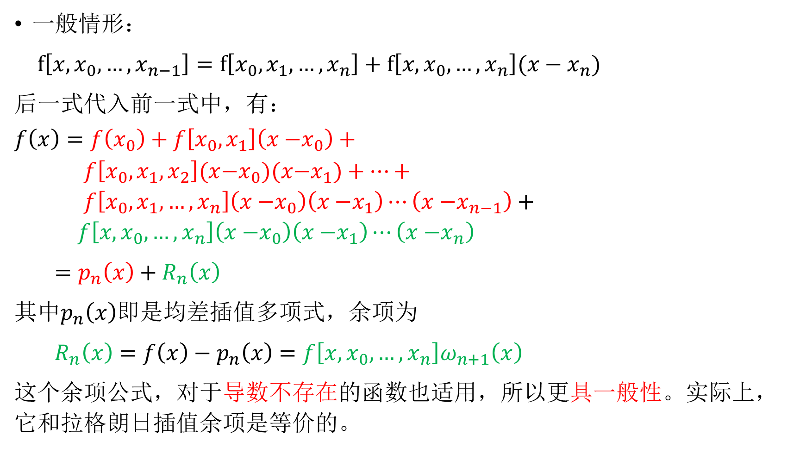
一般情形：
$f\left[x,x_{0},…,x_{n−1}\right]=f\left[x_{0},x_{1},…,x_{n}\right]+f\left[x,x_{0},…,x_{n}\right](x−x_{n})$
后一式代入前一式中，有：
$$f\left(x\right)=f\left(x_{0}\right)+f\left[x_{0}, x_{1}\right]\left(x{−x}_{0}\right)+$$
$f\left[x_{0},x_{1},x_{2}\right](x{−x}_{0})(x{−x}_{1})+⋯+$
$f\left[x_{0},x_{1},…,x_{n}\right]\left(x{−x}_{0}\right)\left(x{−x}_{1}\right)⋯\left(x{−x}_{n−1}\right)+$
$f\left[x,x_{0},…,x_{n}\right]\left(x{−x}_{0}\right)\left(x{−x}_{1}\right)⋯\left(x{−x}_{n}\right)$
$=p_{n}\left(x\right)+R_{n}\left(x\right)$
其中$p_{n}\left(x\right)$即是均差插值多项式，余项为
$R_{n}\left(x\right)=f\left(x\right)−p_{n}\left(x\right)=f\left[x,x_{0},…,x_{n}\right]ω_{n+1}\left(x\right)$
这个余项公式，对于导数不存在的函数也适用，所以更具一般性。实际上，它和拉格朗日插值余项是等价的。

Slide 19
示例
例：给出f(x)的函数表，求4次Newton插值多项式，并计算f(0.596)的近似值
构造均差表：
x_{k}(已知) | f(x_{k}) (已知) | 一阶均差 | 二阶均差 | 三阶均差 | 四阶均差 | 五阶均差
X₀ 0.4 | f(x₀) 0.41075
X₁ 0.55 | f(x₁) 0.57815 | f[x₀, x₁] 1.11600
X₂ 0.65 | f(x₂) 0.69675 | f[x₁, x₂] 1.18600 | f[x₀, x₁, x₂] 0.28000
X₃ 0.80 | f(x₃) 0.88811 | f[x₂, x₃] 1.27573 | f[x₁, x₂, x₃] | f[x₀, x₁, x₂, x₃] 0.19733
X₄ 0.90 | f(x₄) 1.02652 | f[x₃, x₄] 1.38410 | f[x₂, x₃, x₄] | f[x₁, x₂, x₃, x₄] | f[x₀, x₁, x₂, x₃, x₄] 0.03134
X₅ 1.05 | f(x₅) 1.25382 | f[x₄, x₅] 1.51533 | f[x₃, x₄, x₅] | f[x₂, x₃, x₄, x₅] | f[x₁, x₂, x₃, x₄, x₅] | f[x₀, x₁, x₂, x₃, x₄, x₅] -0.00012

Slide 20
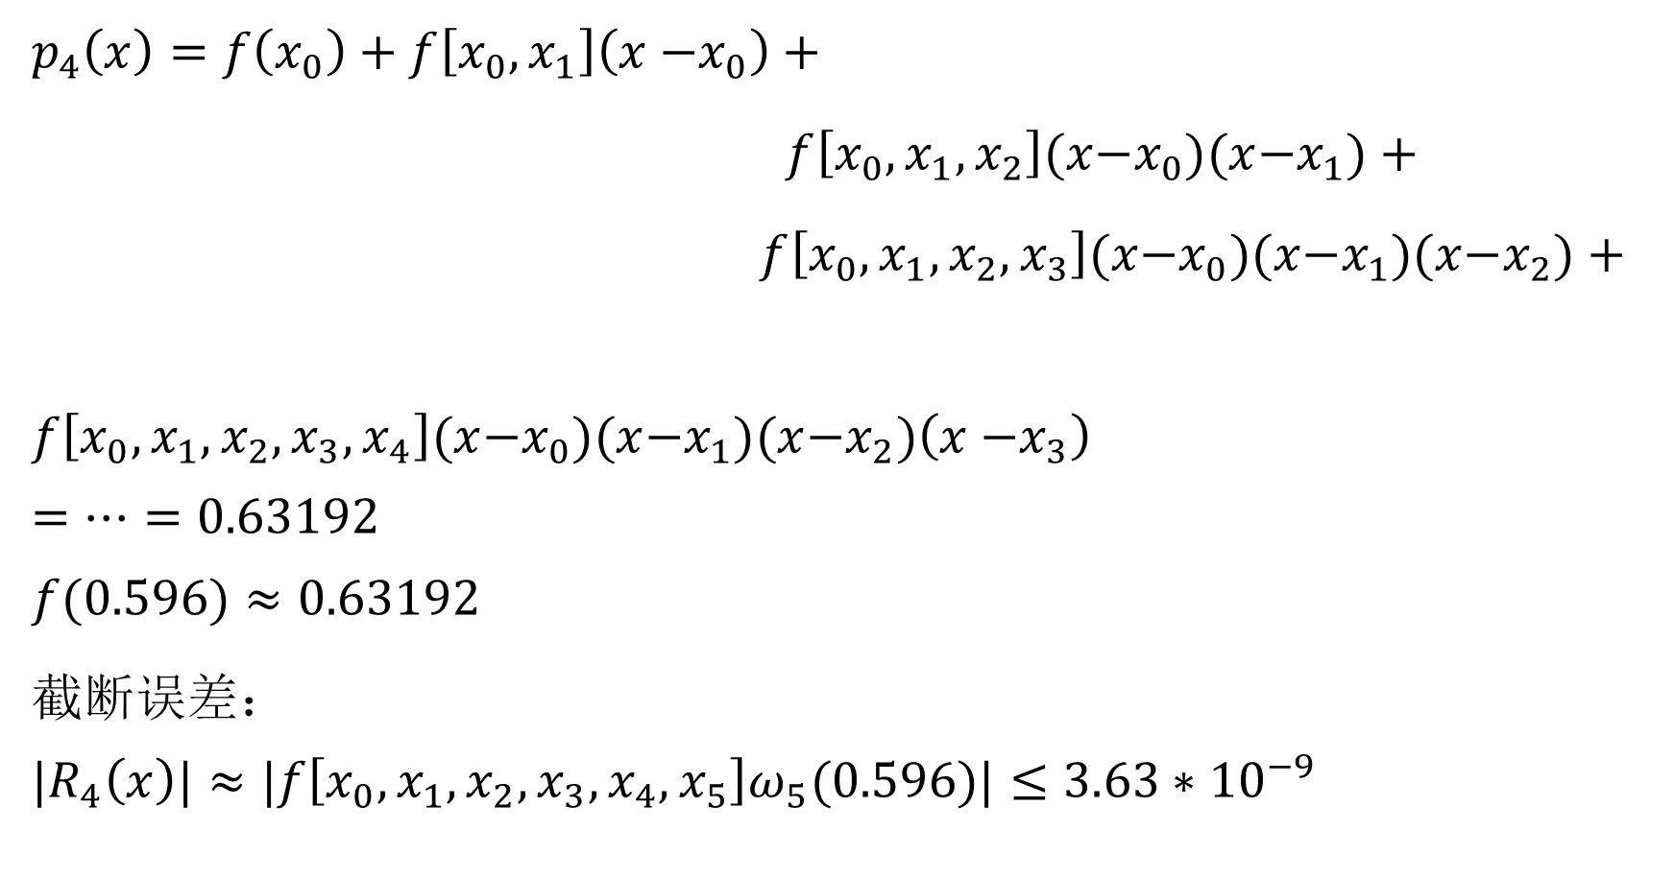
$$p_{4}\left(x\right)=f\left(x_{0}\right)+f\left[x_{0},x_{1}\right]\left(x{−x}_{0}\right)+$$
$f\left[x_{0},x_{1},x_{2}\right](x{−x}_{0})(x{−x}_{1})+$
$f\left[x_{0},x_{1},x_{2},x_{3}\right](x{−x}_{0})(x{−x}_{1})(x{−x}_{2})+$
$f\left[x_{0},x_{1},x_{2},x_{3},x_{4}\right](x{−x}_{0})(x{−x}_{1})(x{−x}_{2})\left(x{−x}_{3}\right)$
$$=⋯=0.63192$$
$$f(0.596)≈0.63192$$
截断误差：
$${|R}_{4}\left(x\right)|≈|f\left[x_{0},x_{1},x_{2},x_{3},x_{4},x_{5}\right]ω_{5}(0.596)|≤3.63∗{10}^{−9}$$

Slide 21
课后练习
例：给定数表如下：
试用二次Newton插值多项式计算f(1.5)、f(3.5) 、f(5.8)的近似值，用四次Newton插值多项式计算f(4.8)的近似值。
x | 1 | 2 | 4 | 5 | 6 | 8
f(x) | 0 | 2 | 8 | 12 | 18 | 28

Slide 22
第五节 差分与等距节点插值公式
当节点有规律分布时，比如等距分布时，插值公式可以简化，计算量也更少
1 差分及其性质
设有等距节点，x_{k}=x₀+kh k=0,1,…,n，其中，h>0，称为步长。
并已知 f_{k}=f(x_{k})

Slide 23
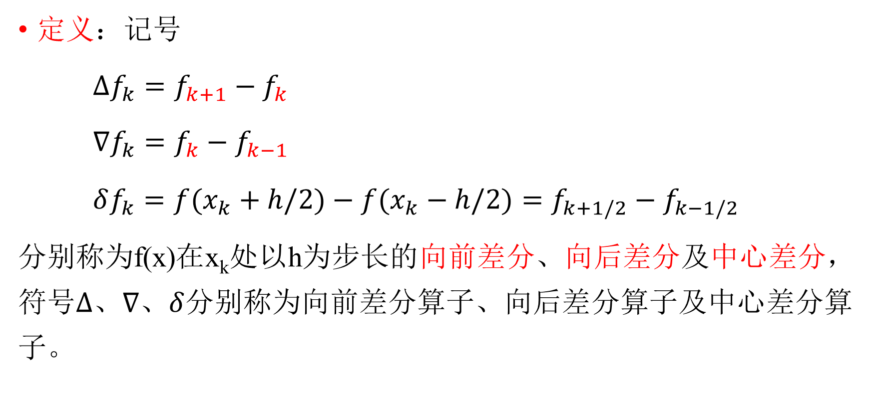
定义：记号
$∆f_{k}=f_{k+1}−f_{k}$
$∇f_{k}=f_{k}−f_{k−1}$
$δf_{k}={f(x}_{k}+h/2)−{f(x}_{k}−h/2)=f_{k+1/2}−f_{k−1/2}$
分别称为f(x)在x_{k}处以h为步长的向前差分、向后差分及中心差分，符号$∆、∇、δ$分别称为向前差分算子、向后差分算子及中心差分算子。

Slide 24

m阶差分
推广一阶差分的概念，定义二阶差分：
$∆^{2}f_{k}= ∆f_{k+1}−∆f_{k}=f_{k+2}−$2$f_{k+1}+f_{k}$
一般地，m阶差分：
$∆^{m}f_{k}= ∆^{m−1}f_{k+1}−∆^{m−1}f_{k}$
$∇^{m}f_{k}= ∇^{m−1}f_{k}−∇^{m−1}f_{k−1}$

Slide 25
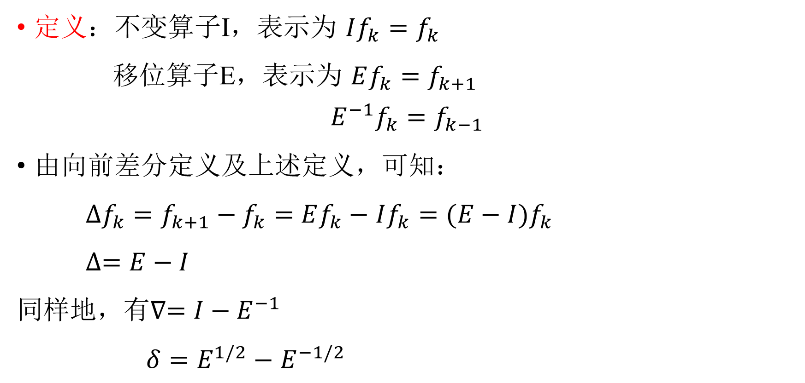
算子
定义：不变算子I，表示为 $If_{k}=f_{k}$
移位算子E，表示为 $Ef_{k}=f_{k+1}$
$$E^{−1}f_{k}=f_{k−1}$$
由向前差分定义及上述定义，可知：
$∆f_{k}=f_{k+1}−f_{k}=$ $Ef_{k}−$ $If_{k}=(E−I)f_{k}$
$∆=E−I$
同样地，有$∇=I−E^{−1}$
$δ=E^{1/2}−$ $E^{−1/2}$

Slide 26
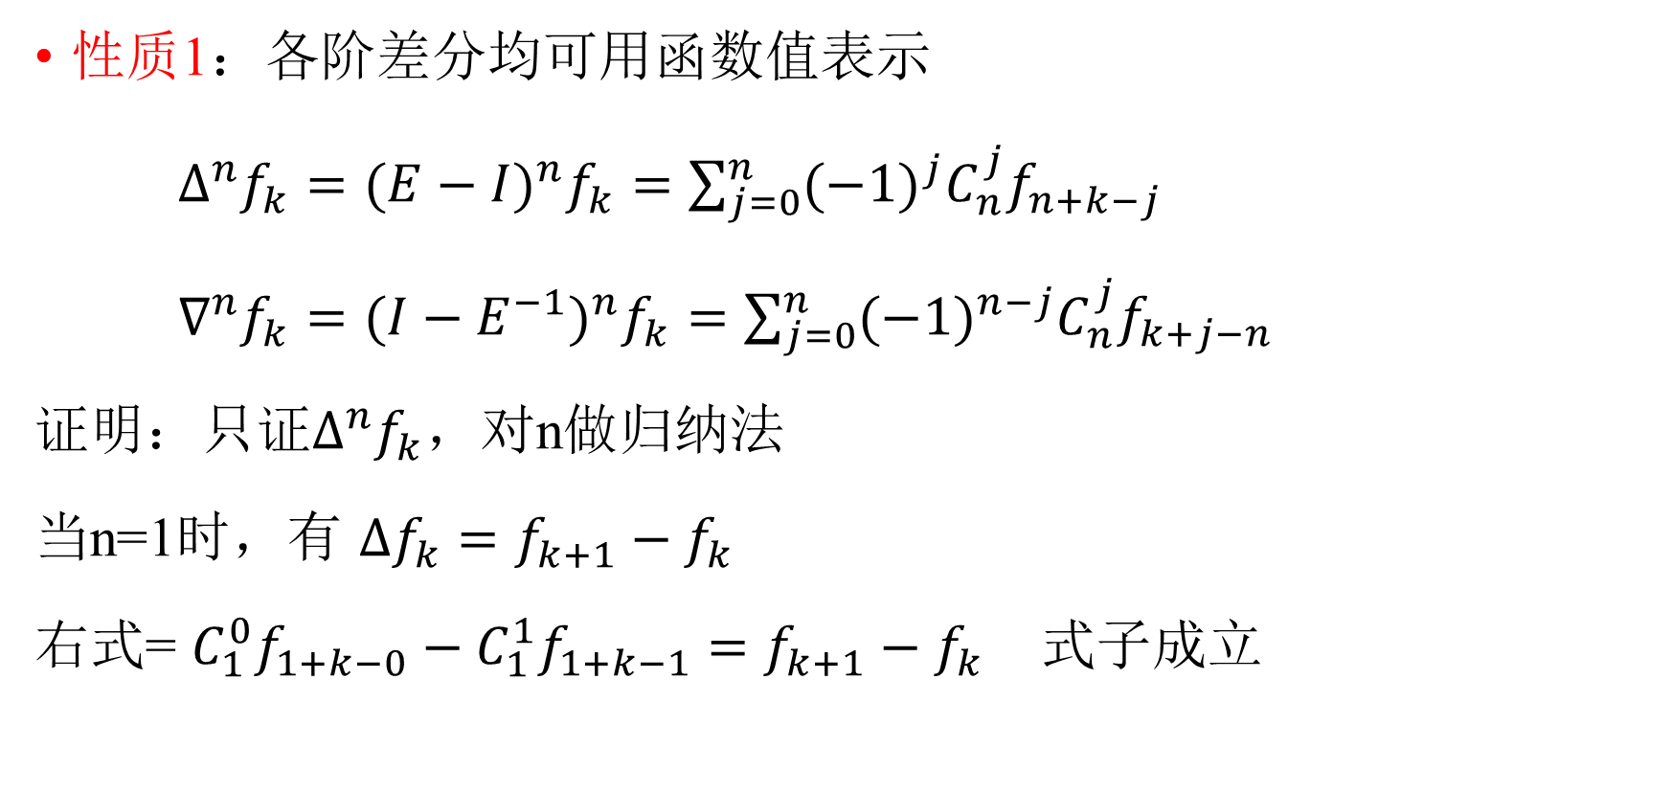
差分的性质
性质1：各阶差分均可用函数值表示
$∆^{n}f_{k}={(E−I)}^{n}f_{k}=\sum_{j=0}^{n}{{(−1)}^{j}C_{n}^{j}f_{n+k−j}}$
$∇^{n}f_{k}={(I−E^{−1})}^{n}f_{k}=\sum_{j=0}^{n}{{(−1)}^{n−j}C_{n}^{j}f_{k+j−n}}$
证明：只证$∆^{n}f_{k}$，对n做归纳法
当n=1时，有 $∆f_{k}=f_{k+1}−f_{k}$
右式= $C_{1}^{0}f_{1+k−0}−C_{1}^{1}f_{1+k−1}$ $=f_{k+1}−f_{k}$ 式子成立

Slide 27
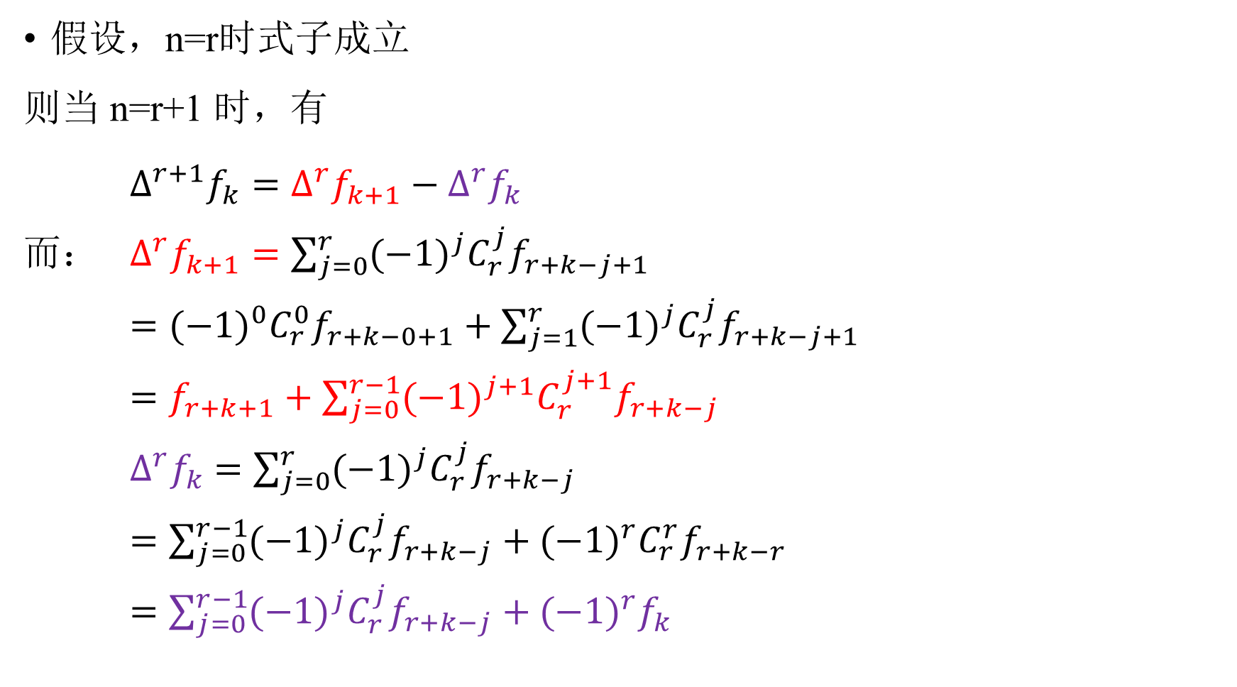
假设，n=r时式子成立
则当 n=r+1 时，有
$∆^{r+1}f_{k}= ∆^{r}f_{k+1}−∆^{r}f_{k}$
而： $∆^{r}f_{k+1}=\sum_{j=0}^{r}{{(−1)}^{j}C_{r}^{j}f_{r+k−j+1}}$
$={(−1)}^{0}C_{r}^{0}f_{r+k−0+1}+\sum_{j=1}^{r}{{(−1)}^{j}C_{r}^{j}f_{r+k−j+1}}$
$=f_{r+k+1}+\sum_{j=0}^{r−1}{{(−1)}^{j+1}C_{r}^{j+1}f_{r+k−j}}$
$∆^{r}f_{k}$ $=\sum_{j=0}^{r}{{(−1)}^{j}C_{r}^{j}f_{r+k−j}}$
$=\sum_{j=0}^{r−1}{{(−1)}^{j}C_{r}^{j}f_{r+k−j}}+{(−1)}^{r}C_{r}^{r}f_{r+k−r}$
$=\sum_{j=0}^{r−1}{{(−1)}^{j}C_{r}^{j}f_{r+k−j}}+{(−1)}^{r}f_{k}$

Slide 28
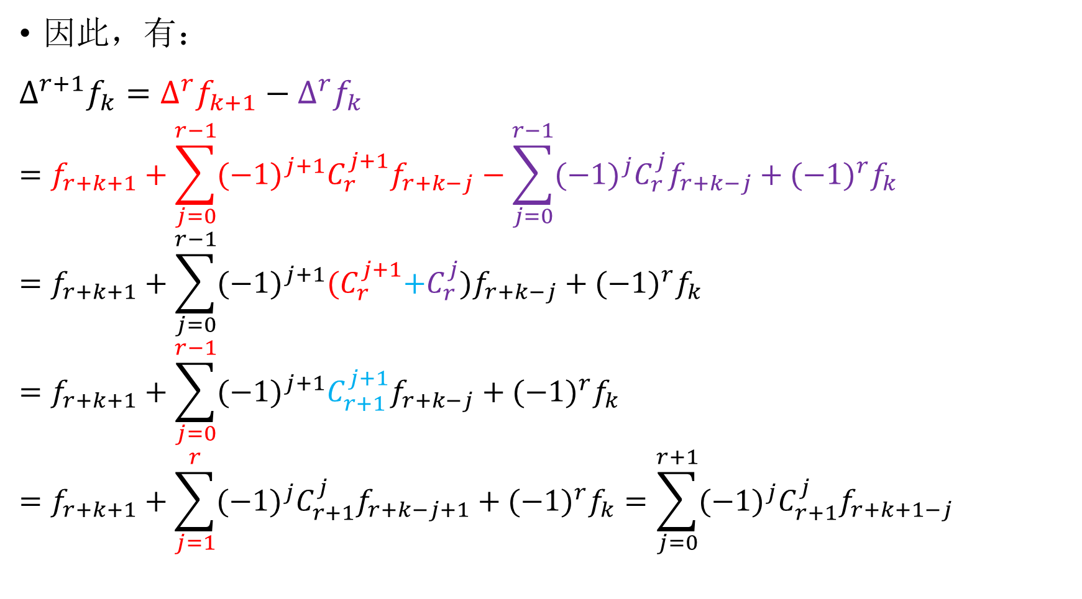
因此，有：
$$∆^{r+1}f_{k}= ∆^{r}f_{k+1}−∆^{r}f_{k}$$
$$=f_{r+k+1}+\sum_{j=0}^{r−1}{{(−1)}^{j+1}C_{r}^{j+1}f_{r+k−j}−\sum_{j=0}^{r−1}{{(−1)}^{j}C_{r}^{j}f_{r+k−j}}+{(−1)}^{r}f_{k}}$$
$$=f_{r+k+1}+\sum_{j=0}^{r−1}{{(−1)}^{j+1}{(C}_{r}^{j+1}+C_{r}^{j})f_{r+k−j}+{(−1)}^{r}f_{k}}$$
$$=f_{r+k+1}+\sum_{j=0}^{r−1}{{(−1)}^{j+1}C_{r+1}^{j+1}f_{r+k−j}+{(−1)}^{r}f_{k}}$$
$$=f_{r+k+1}+\sum_{j=1}^{r}{{(−1)}^{j}C_{r+1}^{j}f_{r+k−j+1}+{(−1)}^{r}f_{k}}=\sum_{j=0}^{r+1}{{(−1)}^{j}C_{r+1}^{j}f_{r+k+1−j}}$$
j=0
j=r+1

Slide 29

性质2：可用各阶差分表示函数值
$f_{n+k}=\sum_{j=0}^{n}{C_{n}^{j}{∆^{j}f}_{k}}$
可用归纳法证明

Slide 30

性质3：均差与差分的关系
$f\left[x_{k},x_{k+1}\right]=\frac{f_{k+1}−f_{k}}{x_{k+1}−x_{k}}=\frac{∆f_{k}}{h}$
$f\left[x_{k},x_{k+1},x_{k+2}\right]=\frac{1}{2h^{2}}∆^{2}f_{k}$
$f\left[x_{k},⋯,x_{k+m}\right]=\frac{1}{m!}\frac{1}{h^{m}}∆^{m}f_{k} (m=1,2,⋯,n)$
同理，
$f\left[x_{k},x_{k−1}⋯,x_{k−m}\right]=\frac{1}{m!}\frac{1}{h^{m}}∇^{m}f_{k}$

Slide 31

由$f\left[x_{0},x_{1},…,x_{n}\right]=\frac{f^{\left(n\right)}\left(ξ\right)}{n!}$，有
$∆^{n}f_{k}=$ ${h^{n}f}^{\left(n\right)}\left(ξ\right)$

Slide 32
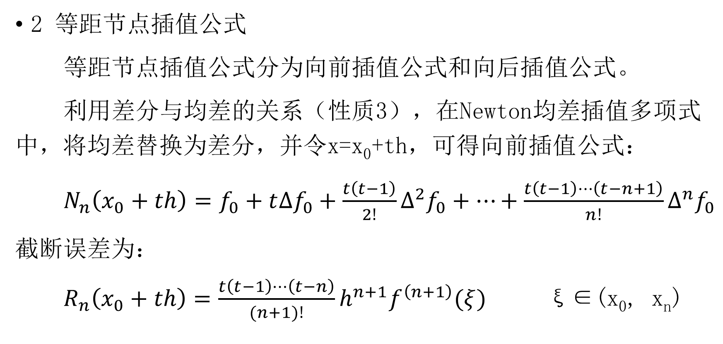
2 等距节点插值公式
等距节点插值公式分为向前插值公式和向后插值公式。
利用差分与均差的关系（性质3），在Newton均差插值多项式中，将均差替换为差分，并令x=x₀+th，可得向前插值公式：
$N_{n}\left(x_{0}+th\right)=f_{0}+t∆f_{0}+\frac{t\left(t−1\right)}{2!}∆^{2}f_{0}+⋯+\frac{t\left(t−1\right)⋯\left(t−n+1\right)}{n!}∆^{n}f_{0}$
截断误差为：
$R_{n}\left(x_{0}+th\right)=\frac{t\left(t−1\right)⋯\left(t−n\right)}{(n+1)!}h^{n+1}f^{\left(n+1\right)}(ξ)$ ξ∈(x₀, x_{n})

Slide 33
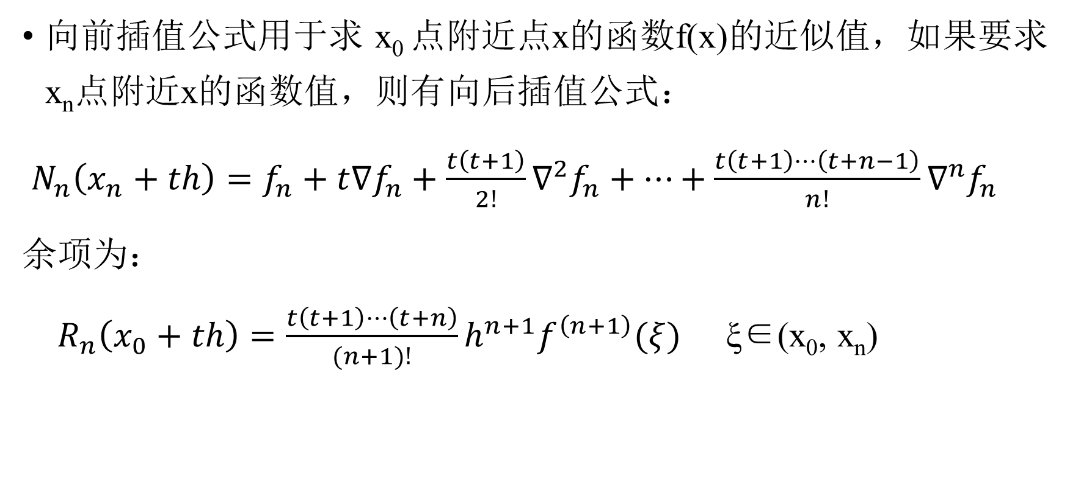
向前插值公式用于求 x₀ 点附近点x的函数f(x)的近似值，如果要求x_{n}点附近x的函数值，则有向后插值公式：
$N_{n}\left(x_{n}+th\right)=f_{n}+t∇f_{n}+\frac{t\left(t+1\right)}{2!}∇^{2}f_{n}+⋯+\frac{t\left(t+1\right)⋯\left(t+n−1\right)}{n!}∇^{n}f_{n}$
余项为：
$R_{n}\left(x_{0}+th\right)=\frac{t\left(t+1\right)⋯\left(t+n\right)}{(n+1)!}h^{n+1}f^{\left(n+1\right)}(ξ)$ ξ∈(x₀, x_{n})

Slide 34
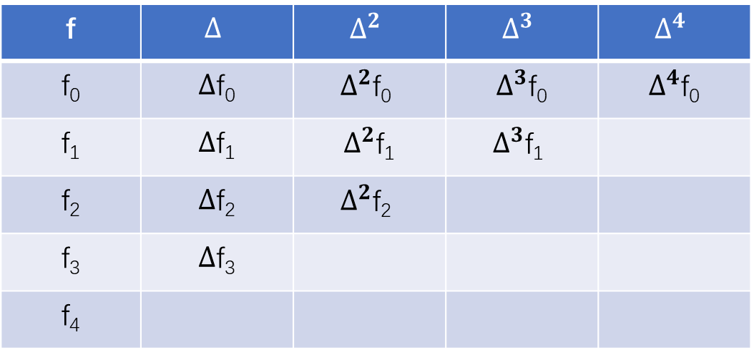

为计算x的函数近似值，用Newton差分插值公式时，需要构造向前差分表和向后差分表
向前差分表
$∆^{n}f(x_{i})= ∆^{n−1}f(x_{i+1})−∆^{n−1}f(x_{i})$
f | $$∆$$ | $$∆^{2}$$ | $$∆^{3}$$ | $$∆^{4}$$
f₀ | $∆$f₀ | $$∆^{2}\text{f}\text{0}$$ | $∆^{3}$f₀ | $∆^{4}$f₀
f₁ | $∆$f₁ | $∆^{2}$f₁ | $$∆^{3}\text{f}\text{1}$$
f₂ | $∆$f₂ | $$∆^{2}\text{f}\text{2}$$
f₃ | $∆$f₃
f₄

Slide 35
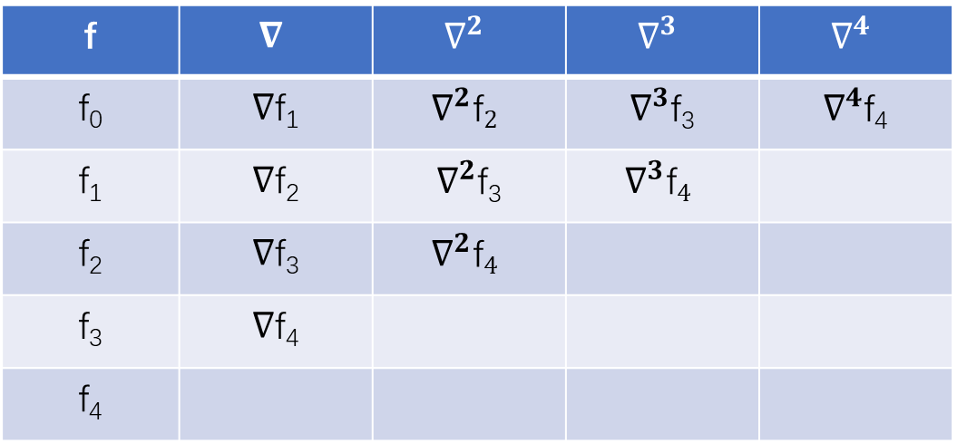

向后差分表
$∇^{n}f(x_{i})= ∇^{n−1}f(x_{i})−∇^{n−1}f(x_{i−1})$
f | $$∇$$ | $$∇^{2}$$ | $$∇^{3}$$ | $$∇^{4}$$
f₀ | $∇$f₁ | $$∇^{2}\text{f}2$$ | $∇^{3}$f₃ | $∇^{4}$f₄
f₁ | $∇$f₂ | $∇^{2}$f₃ | $$∇^{3}\text{f}4$$
f₂ | $∇$f₃ | $$∇^{2}\text{f}4$$
f₃ | $∇$f₄
f₄

Slide 36
示例
例：给定数表
(1)用三次插值多项式计算f(0.7)的近似值
(2)用二次插值多项式计算f(0.95)的近似值
解：由于是等距节点，故可用差分插值公式。
x | 0.2 | 0.4 | 0.6 | 0.8 | 1.0 | 1.2
f(x) | 21 | 25 | 23 | 20 | 21 | 24

Slide 37
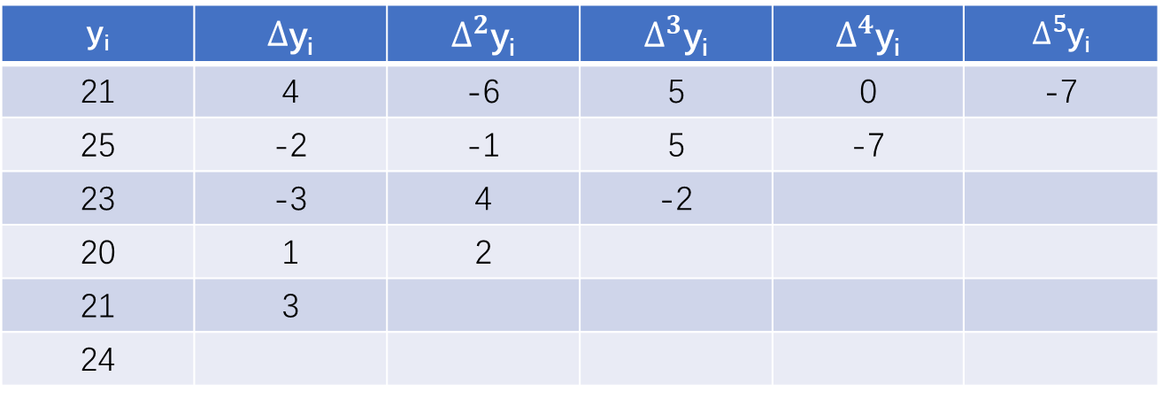
差分表如下：
(1)三次插值多项式，选四个节点：
x₁=0.4, x₂=0.6, x₃=0.8, x₄=1.0
y_{i} | $∆$y_{i} | $∆^{2}$y_{i} | $∆^{3}$y_{i} | $∆^{4}$y_{i} | $∆^{5}$y_{i}
21 | 4 | -6 | 5 | 0 | -7
25 | -2 | -1 | 5 | -7
23 | -3 | 4 | -2
20 | 1 | 2
21 | 3
24

Slide 38
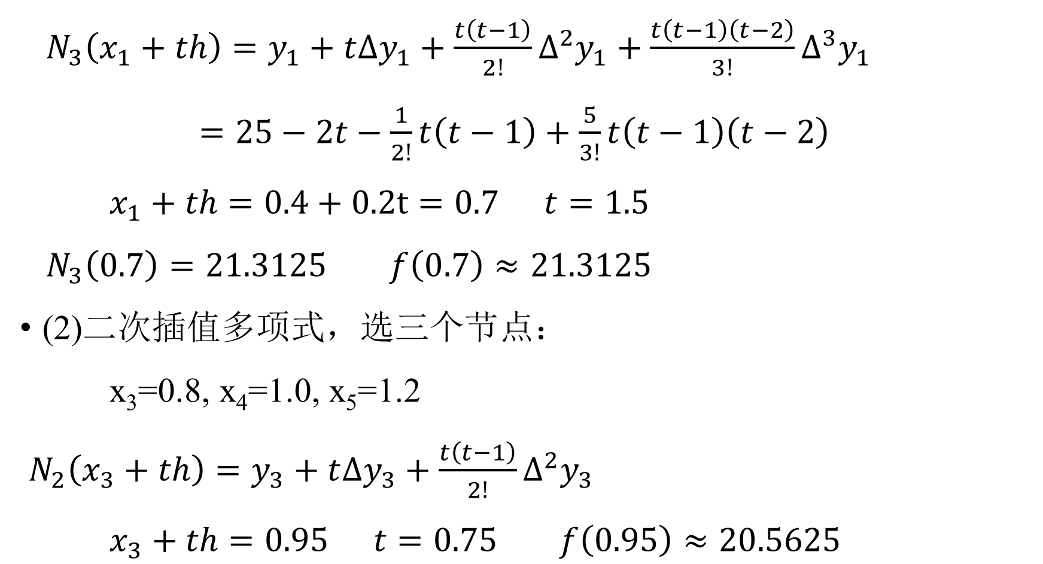
$N_{3}\left(x_{1}+th\right)=y_{1}+t∆y_{1}+\frac{t\left(t−1\right)}{2!}∆^{2}y_{1}+\frac{t\left(t−1\right)\left(t−2\right)}{3!}∆^{3}y_{1}$
$=25−2t−\frac{1}{2!}t\left(t−1\right)+\frac{5}{3!}t\left(t−1\right)\left(t−2\right)$
$x_{1}+th=0.4+0.2t=0.7$ $t=1.5$
$N_{3}\left(0.7\right)=21.3125$ $f\left(0.7\right)≈21.3125$
(2)二次插值多项式，选三个节点：
x₃=0.8, x₄=1.0, x₅=1.2
$N_{2}\left(x_{3}+th\right)=y_{3}+t∆y_{3}+\frac{t\left(t−1\right)}{2!}∆^{2}y_{3}$
$x_{3}+th=0.95$ $t=0.75$ $f\left(0.95\right)≈20.5625$

