Slide 1

Archon
Stop making students navigate the org chart.
Agentic AI Service Desk for Higher Education
KPMG ACADEMIC INNOVATION 2026
TEAM AXON ENJIN
Carlos Jerico Dela Torre · Rhandie Sales Jr. · Aidan Tiu

Slide 2




THE PROBLEM
Students are stuck in the “experience deficit.”
One issue. Many offices. No answers. Existing tools don't actually resolve anything.
Registrar
Bursar
Financial Aid
1 week
0 answers
FAQ chatbots
Ticketing systems
The runaround
Static scripts that can't touch an account-specific issue.
Still route every routine question to an overloaded human.
Misrouted between siloed offices — students self-triage and give up.
ARCHON · Axon Enjin
KPMG Academic Innovation 2026 · 2/9

Slide 3




THE SOLUTION
Cross-Department Data Orchestration & Native AI Agent
Archon reads a student's real records across departments, diagnoses the issue, and resolves it
Autonomous cross-department resolution
Zero-touch + confidence scoring
One question spans Registrar + Bursar + Financial Aid + Advising — and gets answered.
Routine tickets resolve with no human. Hard ones escalate with a full handoff packet.
Tri-lingual, by design
M365-native delivery
Fluent in Filipino, English, and Cebuano — auto-detected from how the student types.
Alerts land in Teams and Outlook — where students already are, not a 4th app.
ARCHON · Axon Enjin
KPMG Academic Innovation 2026 · 3/9

Slide 4
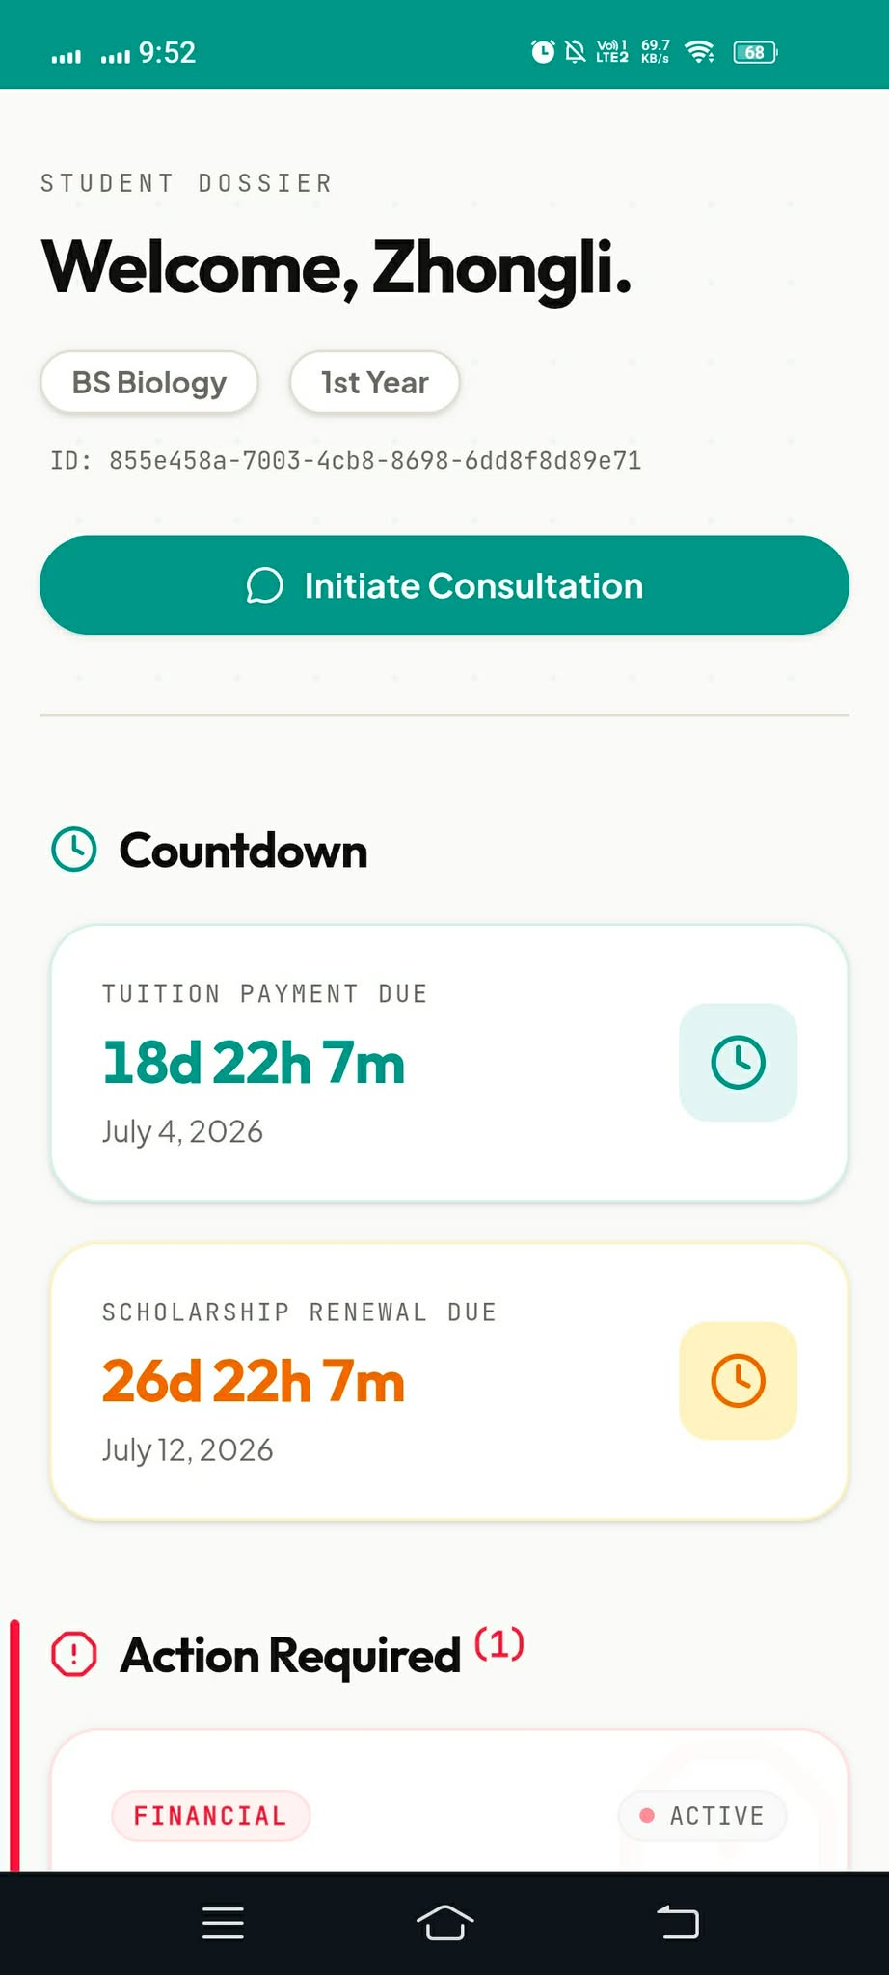
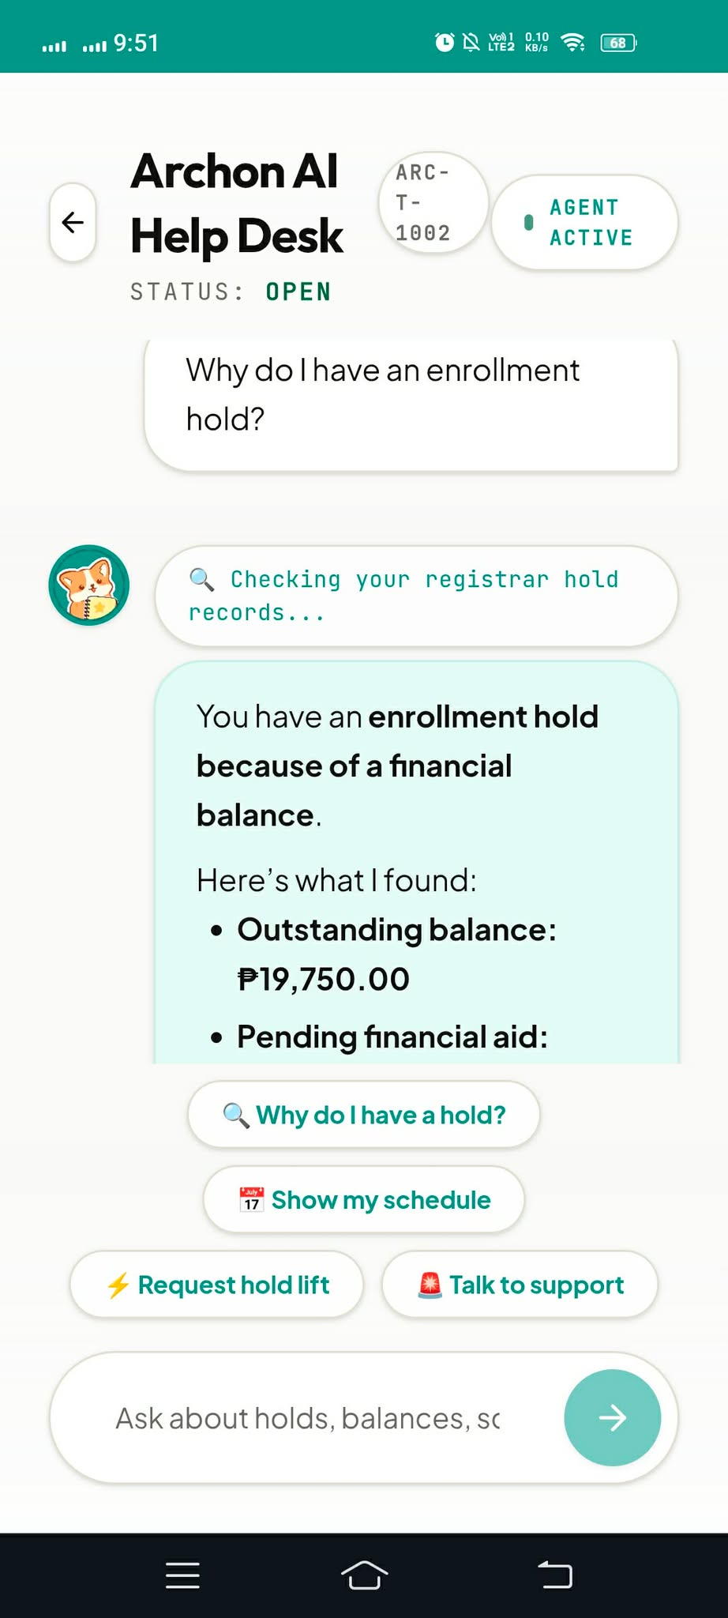


USER INTERFACE
Student’s Mobile Interface
SCORED: USER INTERFACE — 30%
Archon · Chat
Archon · Home
Mobile-first
Designed for the most common Philippine phone screen — not a desktop afterthought.
Academic Calendar
Enrollment closes · 2d
Scholarship renewal · 14d
Streams on 3G
First token in under 3 seconds, even on provincial campus connections.
Hold lifted
Deadline in 14 days
Balance ₱0.00
Aid Disbursing · 3 days
Rich status cards
Balances, holds, and deadlines render as glanceable cards
New inquiry
One-tap actions
Quick actions and consent prompts keep the friction budget near zero.
▲ wireframe — drop live screenshot
▲ wireframe — drop live screenshot
ARCHON · Axon Enjin
KPMG Academic Innovation 2026 · 4/9

Slide 5
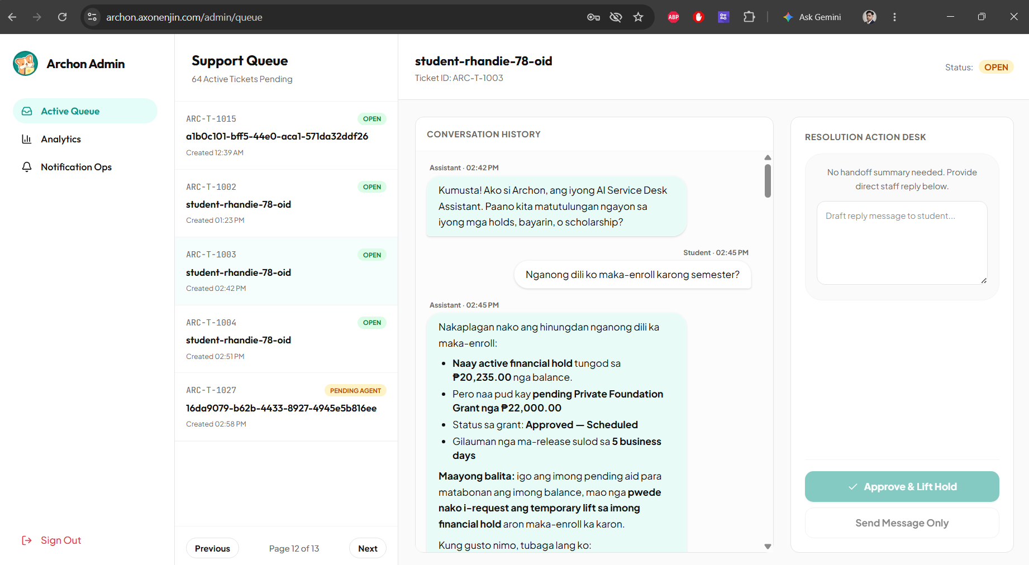


USER INTERFACE
Admin’s Desktop Interface
Students get a calm, simple chat. Staff get a power tool. Both ship from the same Next.js codebase.
Agent Dashboard
AI-suggested replies
Queue
Mara S.
Hold + aid delay
AI 0.93
Tickets
Jay R.
Balance dispute
AI 0.71
Context-preserving handoff
Handoffs
Analytics
Ana L.
Enrollment verify
AI 0.88
Admin analytics
▲ wireframe — drop live screenshot
ARCHON · Axon Enjin
KPMG Academic Innovation 2026 · 5/9

Slide 6







HOW IT WORKS
From question to resolution, autonomously.
1 · Ask
2 · Orchestrate
3 · Pull data
4 · Resolve
Student types in Filipino, English, or Cebuano.
Azure AI Foundry plans which systems to query.
Adapters read Registrar, Bursar, FA & Advising.
Synthesizes a diagnosis and acts (HITL on writes).
Zero-touch resolution
Routine tickets close instantly with target ≥30% deflection.
Human handoff
Hard cases escalate with a full context packet
+ Teams/Outlook alert.
ARCHON · Axon Enjin
KPMG Academic Innovation 2026 · 6/9

Slide 7










DATA MODEL DESIGN
One database. Isolated, expiring, searchable.
SCORED: DATA MODL DESIGN — 25%
Azure Cosmos DB · 6 containers
Isolation by design
users
conversations
/institution_id partition → multi-tenant data separation + DPA 2012 compliance.
messages
handoffs
Lifecycle built in
TTL: messages & handoffs 90d (data minimization);
university cache 5 min (fresh + cheap).
policy_embeddings
cache_university_data
Recall in the same store
Vector search over policy_embeddings powers RAG
no bolt-on vector DB.
Partition key /institution_id on every container
Graceful degradation
Mock-adapter fallback keeps the app running when a university API is down.
ARCHON · Axon Enjin
KPMG Academic Innovation 2026 · 7/9

Slide 8




INTEGRATIONS
Native to the tools students already use.
No new account. No new app. Archon plugs into the university's existing Microsoft 365 tenant.
IDENTITY
AI
DATA
DELIVERY
Microsoft Entra ID
Azure AI Foundry
Azure Cosmos DB
Microsoft Graph
Single sign-on (OIDC) with the student's existing university account.
GPT-4o for reasoning + Phi-4 for low-cost intent routing.
NoSQL records + native vector search in one serverless store.
Calendar panel, Teams adaptive cards & Outlook digests.
Shipped on Next.js 16 · full-stack monolith deployed on Vercel (Serverless + Edge)
ARCHON · Axon Enjin
KPMG Academic Innovation 2026 · 8/9

Slide 9


THE PAYOFF
From cost center to resolution engine.
₱104 → ₱22
≥30%
24/7
cost per ticket
tickets resolved
always on
≈79% lower
zero-touch
3 languages
Try Archon
Scan to open the live app on your phone.
Team Axon Enjin
Dela Torre · Sales Jr. · Tiu
link your Vercel URL

