Slide 1
Safety Helmet Detection By: Vlad Medves, Iosif Balasca, Igor Bolek C17719031 C17719309 C17487376

Slide 2
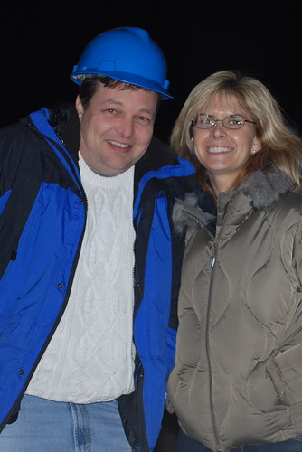
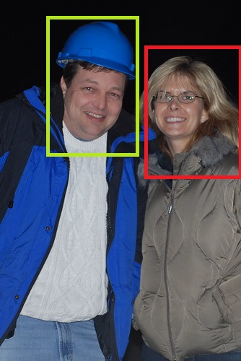
Objective
Detect people wearing a safety helmet on construction site.

Slide 3
DEMO

Slide 4
Challenges
Human Detection / Face Detection
Helmet Recognition
Classification of whether a person is wearing a helmet or not

Slide 5
Human Detection
First of all we thought of using Haar Cascade
Haar Feature Selection
Creating Integral Images
Adaboost Training
Cascading Classifier
Many types of Haar Cascade tested:
Upper body
Face detection
Smile detection

Slide 6
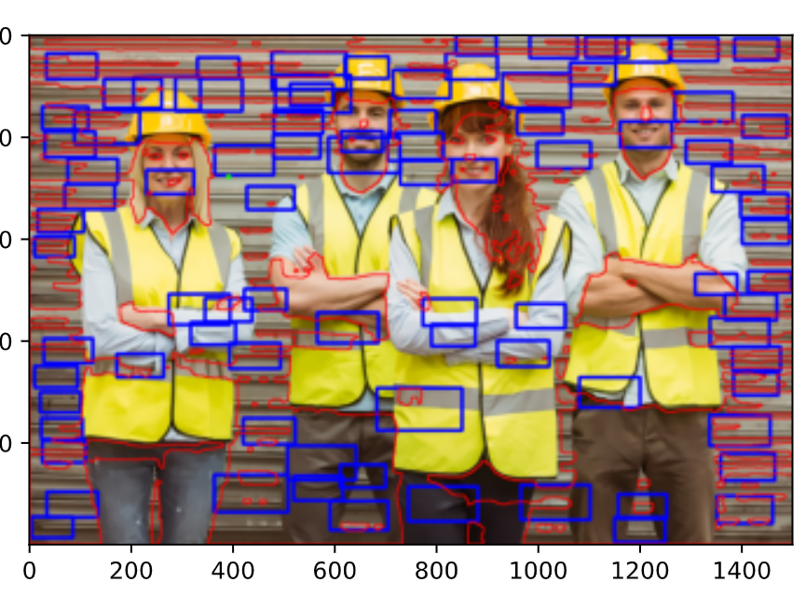
Haar Cascade in python
casc_path = "haarcascade_upperbody.xml"
upperbody_cascade = cv2.CascadeClassifier(cv2.data.haarcascades + casc_path)
bodies = upperbody_cascade.detectMultiScale(I_gray,1.05,3)
Conclusion:
None of them were working

Slide 7
Skin Detection Steps
preProcess the image
getSkinMask
getFaces returns the bounding box of all detected faces

Slide 8
Pre Process
In the preProcess we actually smooth the image using fastNlMeansDenoising

Slide 9
Skin Mask Detection
We define a class called SkinDetector and we call the function findSkin
In the function we do a color segmentation in order to return just the skin
We use watershed in order to separate the background from the foreground

Slide 10
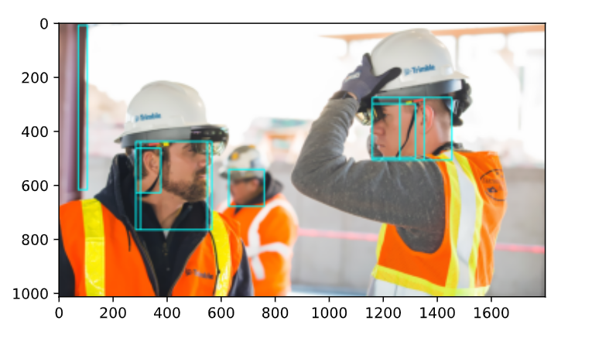
From Skin Detection to Face Detection
First we find the contours of the skin mask
We order or the contours by area and we consider just the ones that until 5 times smaller than the first

Slide 11
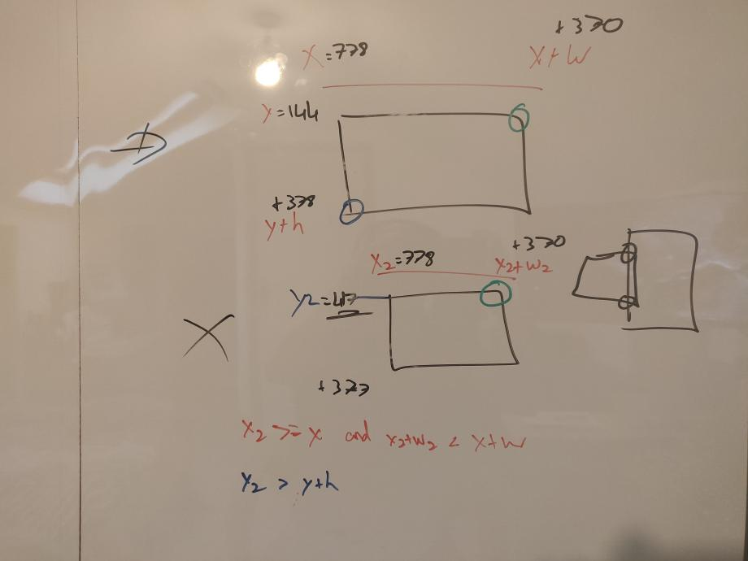
Problems with Face Detection
We need to clean the data:
Merge the touching rectangles
Clean rectangles inside rectangles
Delete the ones that are under the head level

Slide 12
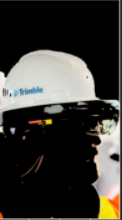

Helmet Detection
During the Face Detection we extend the square containing the face in order to contain the helmet (x2)
Use a mask
Calculate the percentage of predefined helmet HSV value to find the percentage

Slide 13
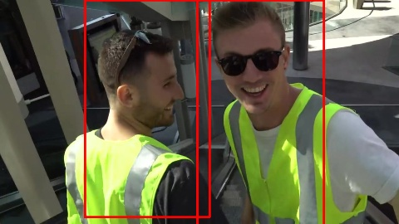
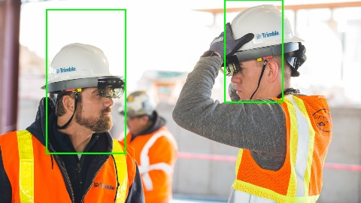
End Results: Positive

Slide 14
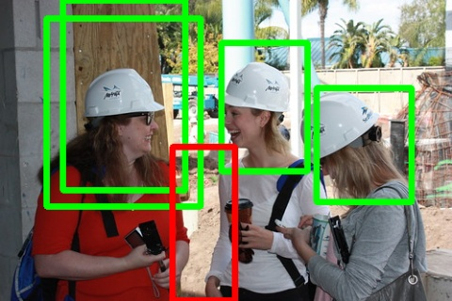
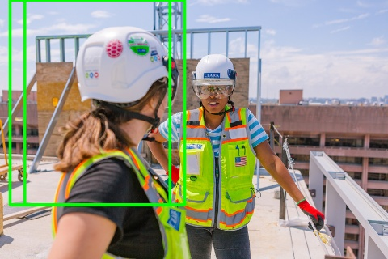
End Results: Partial

Slide 15
Questions

