Slide 1
Mask Detection
B10615040 陳洛翔 Axot

Slide 2
Table of contents
Introduction
Mask Face Classifier Training
Tracker
Analysis
Final Demo

Slide 3
Introduction
Objective
Flow chart
Model we used

Slide 4
Objective
In this COVID-19 Era, we want to…
Collect the people’s’ information while they get into/out a place, then we can do some analysis.
People’s’ information contains
Wearing mask or not
Age
Gender
Timstamp

Slide 5
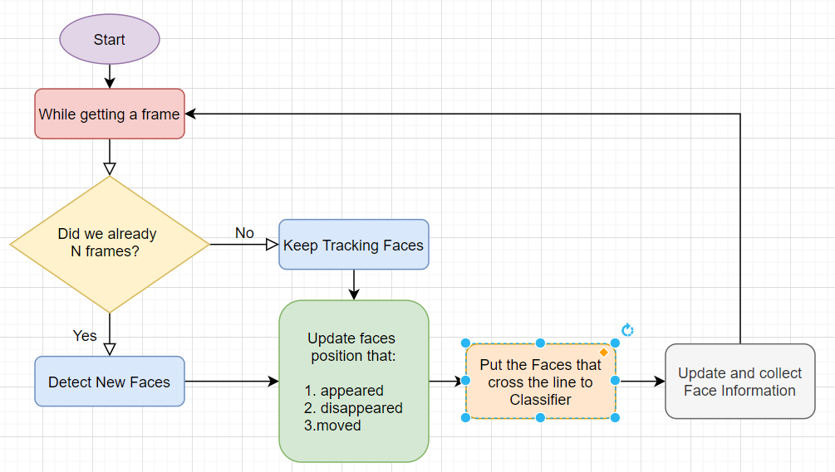
Flow Chart

Slide 6
Model we used
Detection
Openvino pretrained model: face-detection-adas-0001
Classifier
Openvino pretrained model: age-gender-recognition-retail-0013
Self-trained model: MaskFaceClassifier

Slide 7
Mask Face Classifier Training
Data source
Model Structure
Training Result
Feature Map

Slide 8
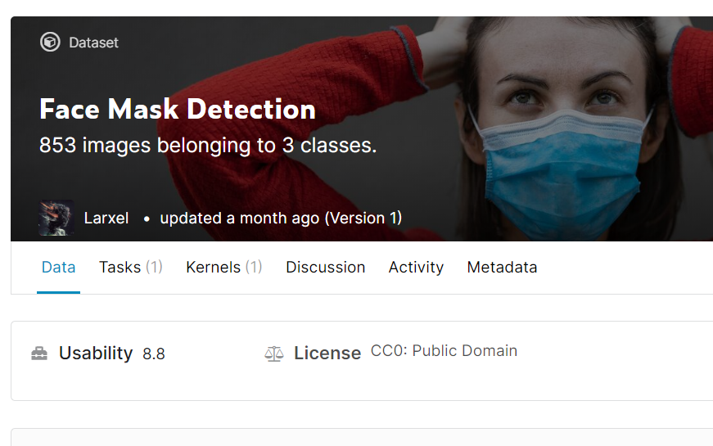
Data source
https://www.kaggle.com/andrewmvd/face-mask-detection
Then we can get 716 with and without mask face

Slide 9
Model Structure

Slide 10
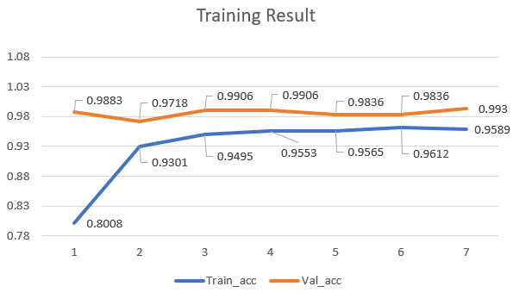
Training Result
Train acc: 0.9589
Val acc: 0.9930

Slide 11
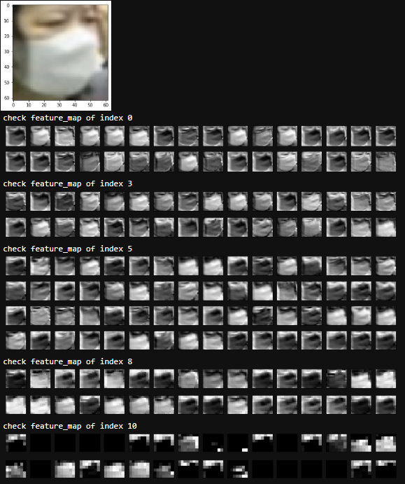
Feature map

Slide 12
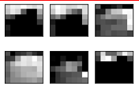
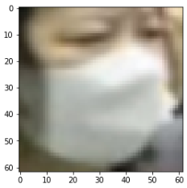
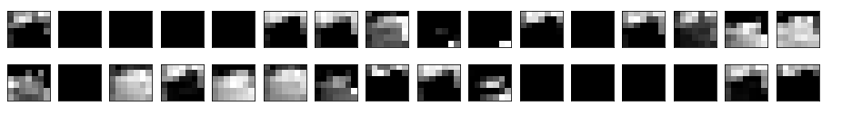
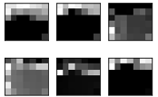
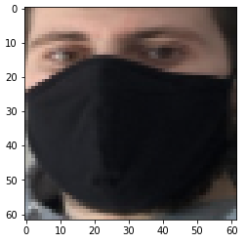
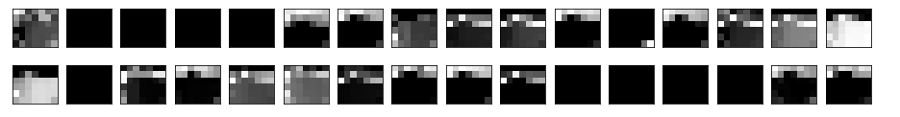
Feature map

Slide 13
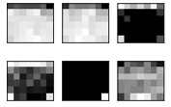
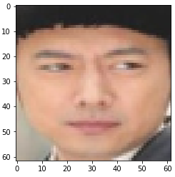
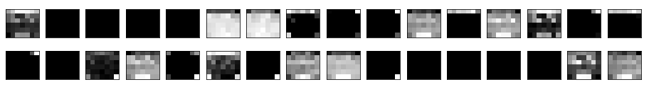
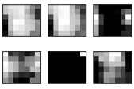
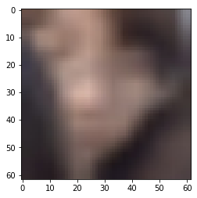
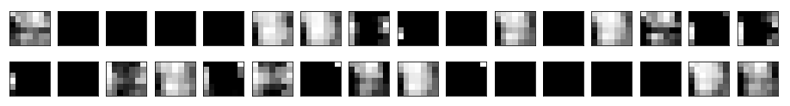
Feature map

Slide 14
Tracker
Detector and dlib.correlation_tracker
Pyimagesearch - CentroidTracker

Slide 15
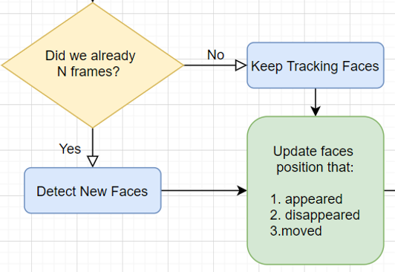
Detector and dlib.correlation_tracker

Slide 16
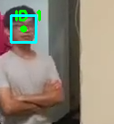
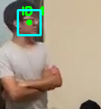
Detector and dlib.correlation_tracker
Every N Frames, Detector refreshs/tells correlation_tracker that where the faces actually are.
Then correlation_tracker keep tracking the faces by the correlation of a sequence of frames

Slide 17
Pyimagesearch - CentroidTracker

Slide 18
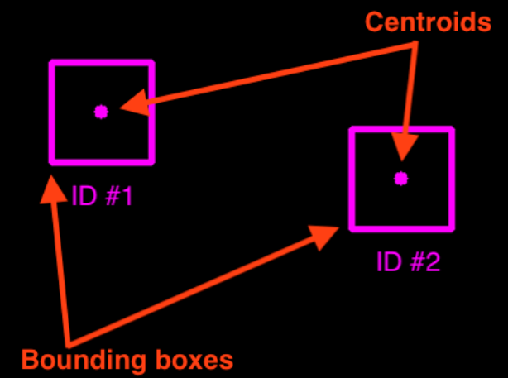
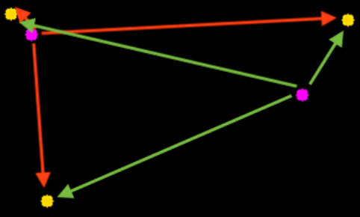
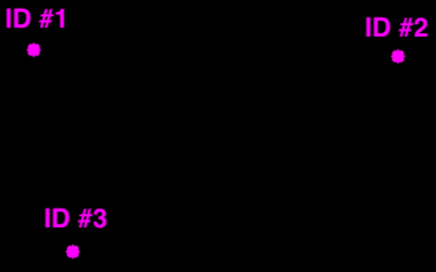
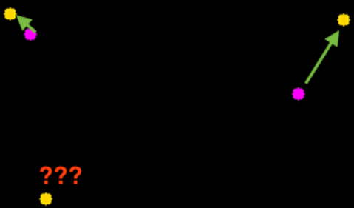
Pyimagesearch - CentroidTracker
1.
2.
4.
3.

Slide 19
Analysis
Data we get
What we analysis

Slide 20
Data we collect
timestamp
wearning_mask
gender
age

Slide 21
What we analysis

Slide 22
Final Demo

