Slide 1
Masked Face Detection?
B10615040 陳洛翔 Axot
B10530301 許書豪 Jack
M10815822 Hoan

Slide 2
Table of contents
Introduction
Mask Face Classifier Training
Tracker
Analysis/Visualization
Demo

Slide 3
Introduction
Objective
GUI
Flow chart
Model we used

Slide 4
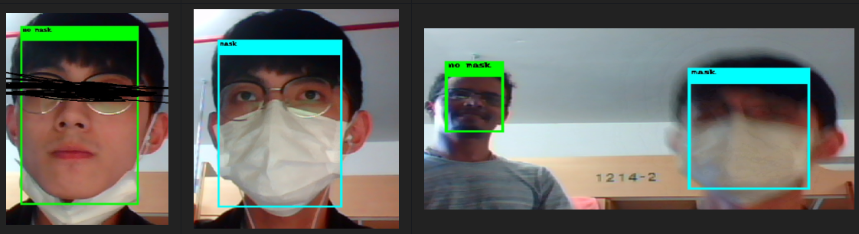
Objective
Our idea was to do something for this COVID-19 Era, creating a safe environment as we prepare for open facilities again, help people and their families free form harm , so then we want to do something that have more value and can have more extension.

Slide 5
Objective
So we did….
Collect the people’s’ information while they get into/out a place e.g. convenience store, school, etc. And then we can do some analysis.
With this analytic enables facility owners to know who enters their building with or without a required mask.
People’s’ information contains
Wearing mask or not
Age
Gender
Timestamp

Slide 6
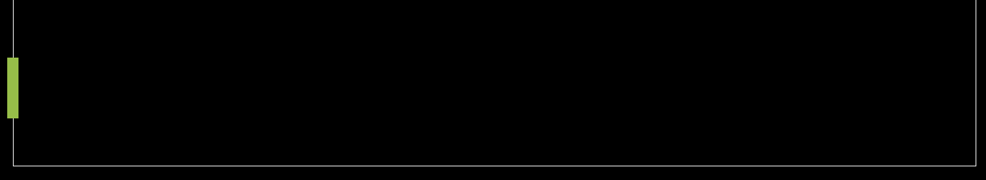
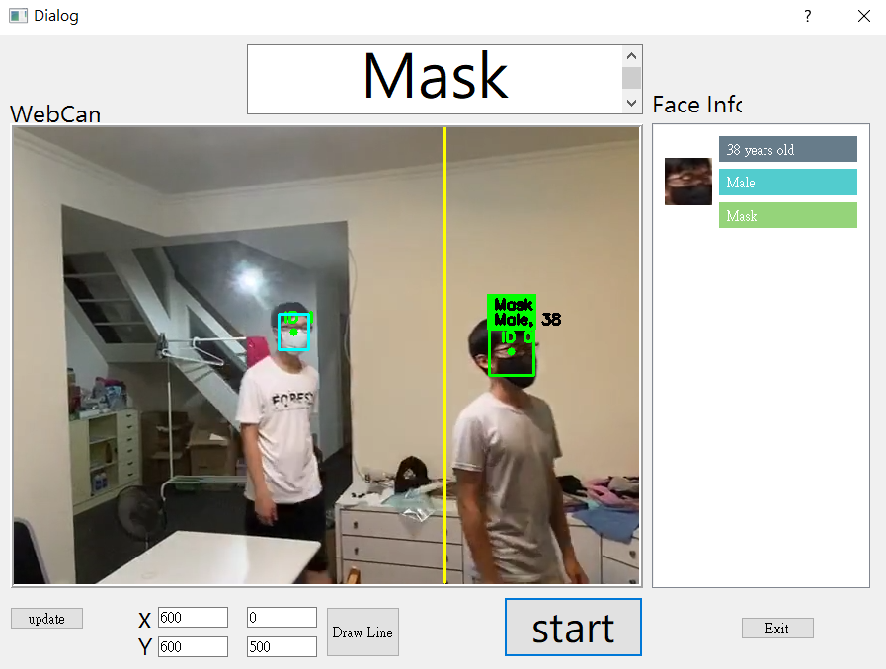
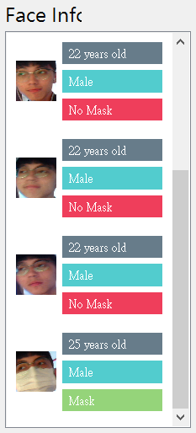
GUI

Slide 7
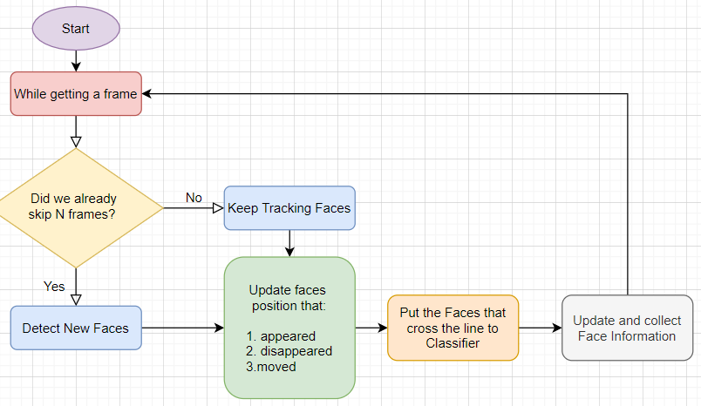
Flow Chart

Slide 8
Model we used
Detection
Openvino pretrained model: face-detection-adas-0001
Classifier
Openvino pretrained model: age-gender-recognition-retail-0013
Model we trained: MaskFaceClassifier

Slide 9
Mask Face Classifier Training
Data source
Model Structure
Training Result
Feature Map

Slide 10
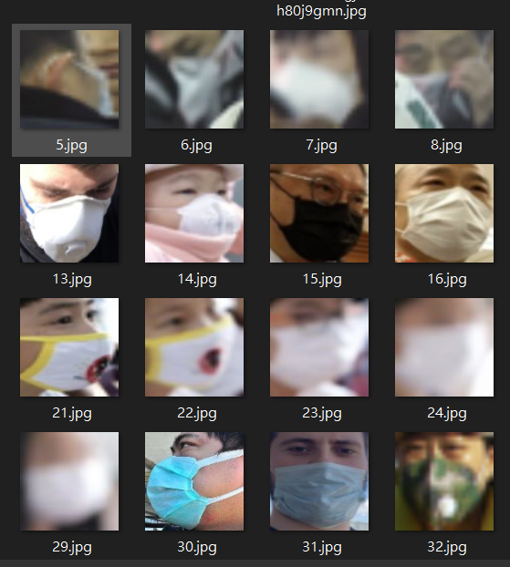
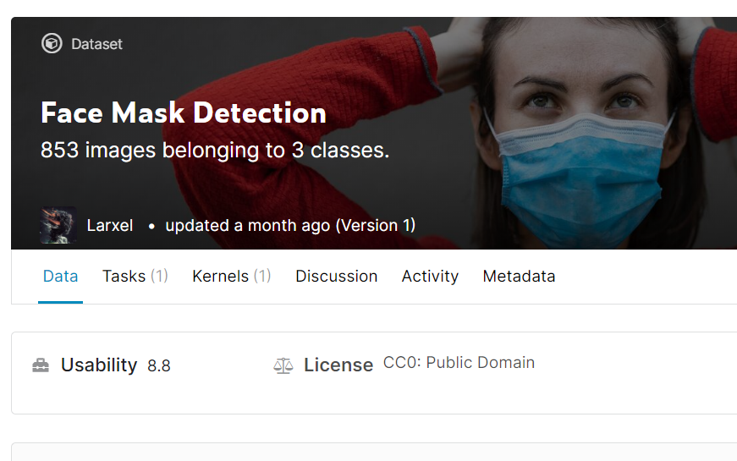
Data source
https://www.kaggle.com/andrewmvd/face-mask-detection
Then we can get 716 with and without mask face

Slide 11
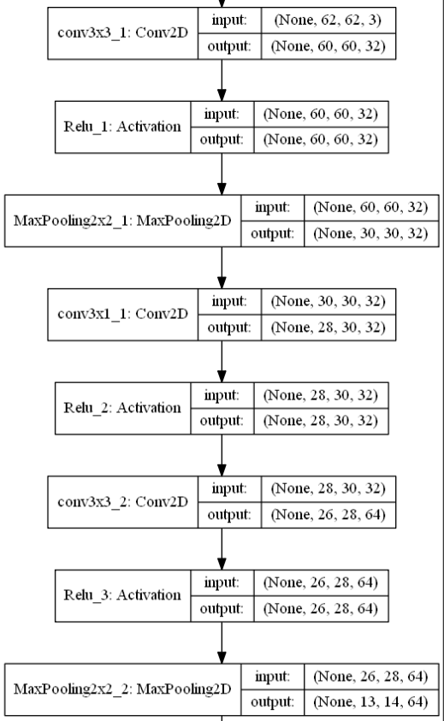
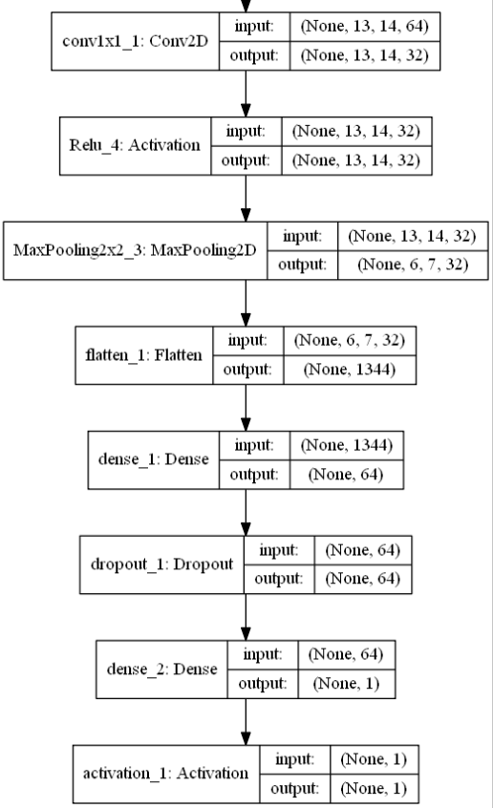
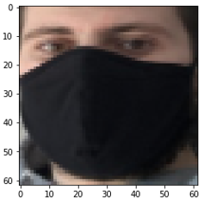
Model Structure
Total params:110,721

Slide 12
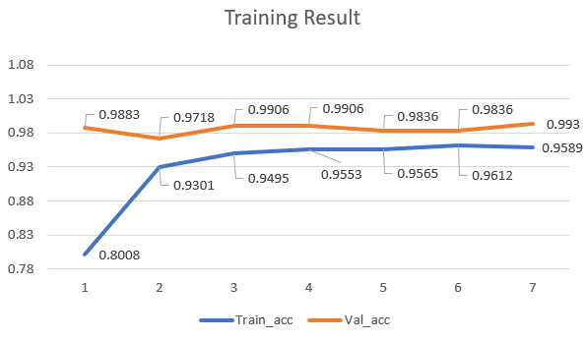
Training Result
Train acc: 0.9589
Val acc: 0.9930
Total training time: less than 1 min!

Slide 13
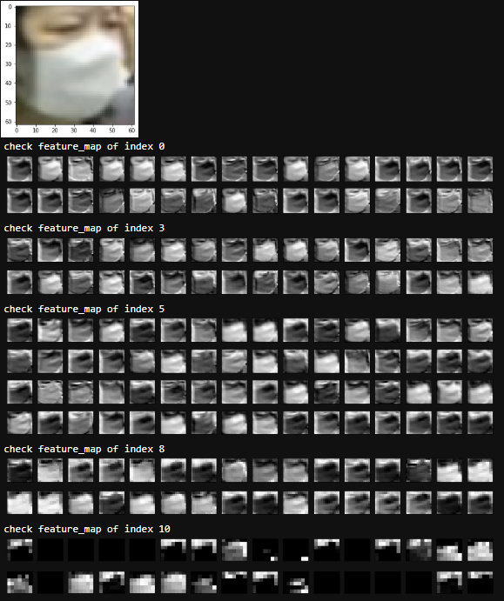
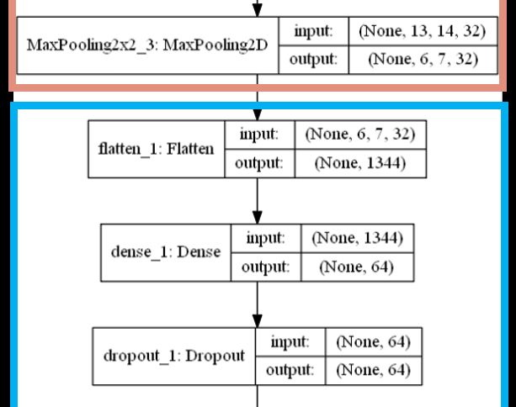
Feature map

Slide 14
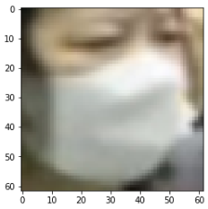
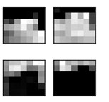
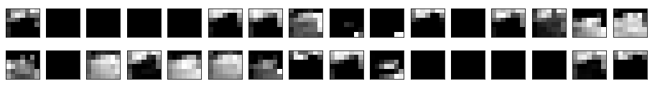
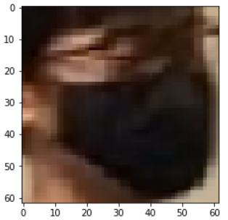
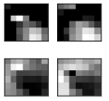
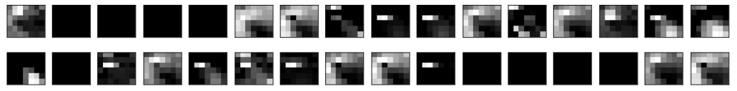
Feature map

Slide 15
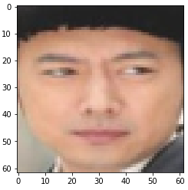
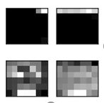
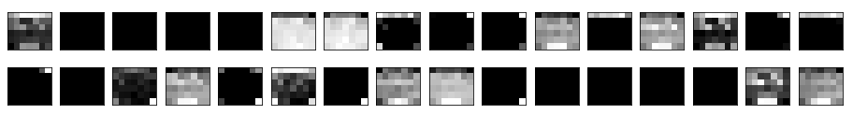
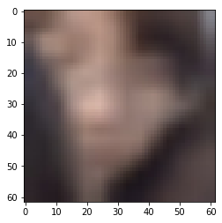
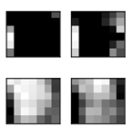
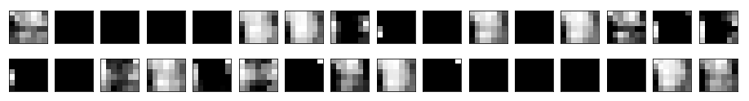
Feature map

Slide 16
Tracker
Pros and Cons
Detector and dlib.correlation_tracker
Pyimagesearch – CentroidTracker
Performance

Slide 17
Pros and Cons
Pros:
Have higher speed.
Detection is more computation expensive than tracker. (And we only have cpu.)
Cons:
Have lower accuracy.
Tracker track the face by correlation of image

Slide 18
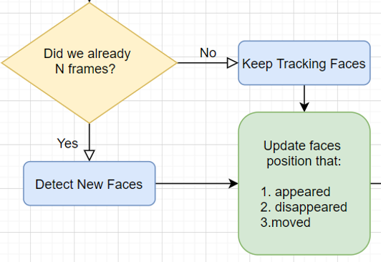
Detector and dlib.correlation_tracker

Slide 19
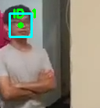
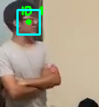
Detector and dlib.correlation_tracker
Every N Frames, Detector refreshs/tells correlation_tracker that where the faces actually are.
Then correlation_tracker keep tracking the faces by the correlation of a sequence of frames

Slide 20
Pyimagesearch - CentroidTracker
Based on the track result (bounding box) from Detector and CorrelationTracker, CentroidTracker decide to new an objects , delete objects and track objects

Slide 21
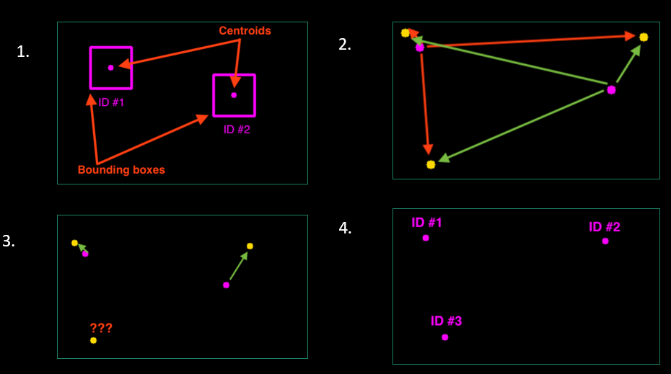
Pyimagesearch - CentroidTracker

Slide 22
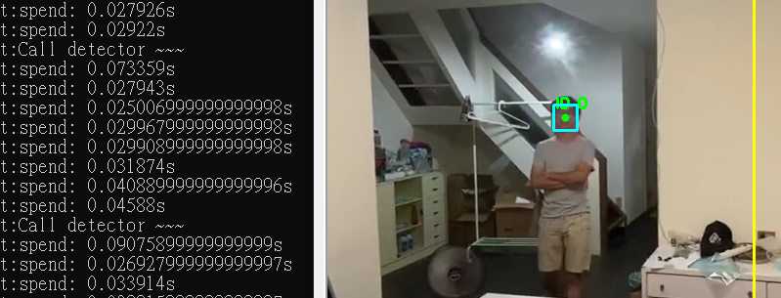
Performance
If we only have one face
- Detector:
0.070 ~ 0.09s per frame
- Correlation Tracker:
0.025 ~ 0.04s per frame
Tracker is three times faster than Detector !

Slide 23
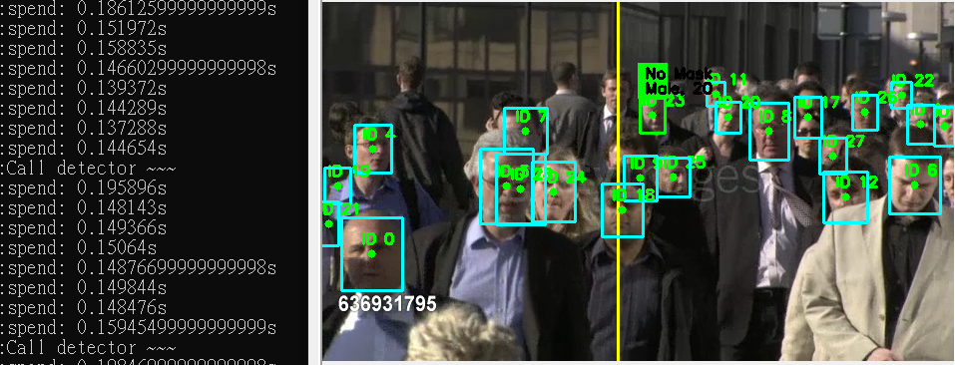
If we have lots of face
- Detector:
0.18 ~ 0.19s per frame
- Correlation Tracker:
0.14 ~ 0.16s per frame
The affect is not that obvious.
Performance

Slide 24
Analysis/Visualization
Data we collected
What can we Analyze/Visualize?

Slide 25
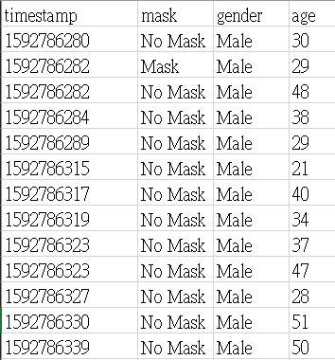
Data we collected
timestamp
mask
gender
age

Slide 26
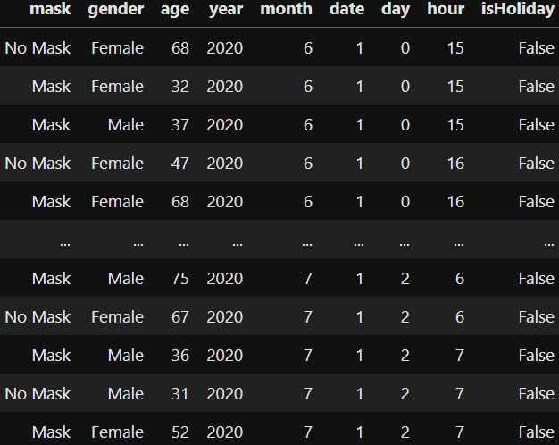
What can we Analyze/Visualize
Relationship between mask and (age, gender)
Distribution of gender, age, (gender, age)
People flow (by gender) (by age)
In the month distributed by “date”
Relationship with “isHoliday”
Stats for each hour
………..
Combine all these stuff above
If we are in a big building, then we can stats for each area in the building.
Lots of work!

Slide 27
Demo

Slide 28
End
https://github.com/AxotZero/NTUST--MaskFaceDetection

