Slide 1








Open-Traffic
Event-Log
API-Gateway
Filebeat
per GW
Memcached
Multiple
Kibana
Dashboards
API-Gateway
Filebeat
per GW
Logstash
Multiple
Elasticsearch
Multiple
API-Gateway
Filebeat
per GW
Lookup
API-Builder
Multiple
API-Manager
API-Gateway
Traffic Monitor
API-Gateway OPSDB

Slide 2

Create and Install a
Custom Setup Helm-Chart
Managing custom resources
Setup your myvalues.yaml based on the values.yaml
Install or Upgrade the solution
axway-elk-setup
│ .helmignore
│ Chart.yaml
│ values.yaml
│
├───charts
└───templates
api-builder-config-files.yaml
api-builder-secret.yaml
elasticsearch-certificate.yaml
pv-volumes.yaml
_helpers.tpl
elasticsearch:
resources:
requests:
cpu: "500m"
limits:
cpu: "500m"
volumeClaimTemplate:
accessModes: [ "ReadWriteOnce" ]
resources:
requests:
storage: 1Gi
logstash:
secretMounts:
- name: myCustomCA
secretName: apim4elastic-elastic-ca
path: /usr/share/logstash/config/certificates
subPath: myElasticsearchCa.crt
apibuilder4elastic:
envFrom:
- configMapRef:
name: axway-elk-apim4elastic-apibuilder4elastic-config
- secretRef:
name: api-builder-secrets
helm install -n apim-elk -f myvalues.yaml \
axway-elk apim4elastic-3.0.0.tgz
Custom K8S Resources
Customized deployment
helm upgrade -n apim-elk -f myvalues.yaml \
axway-elk apim4elastic-3.0.0.tgz

Slide 3
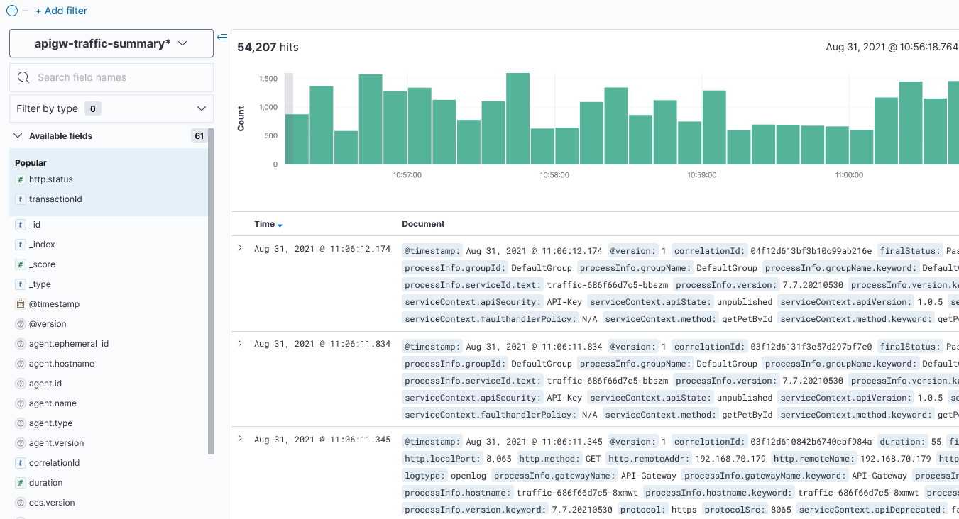
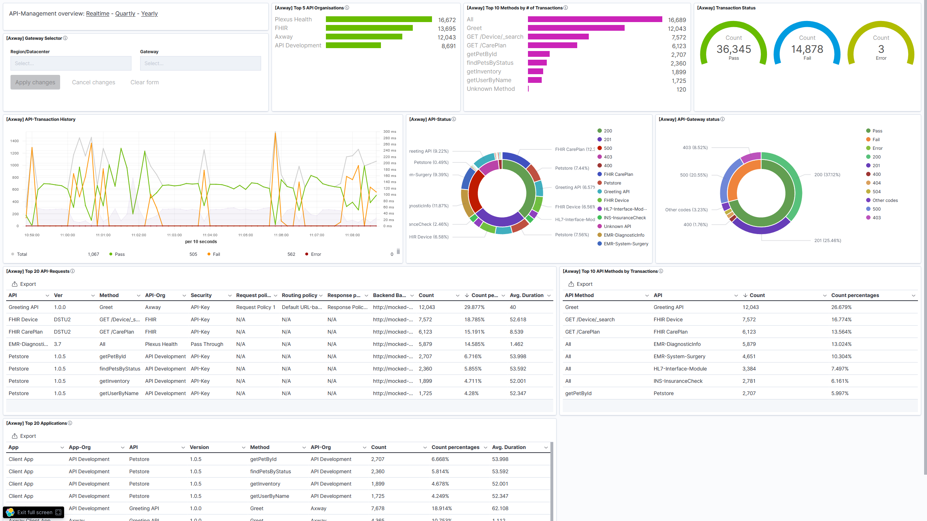
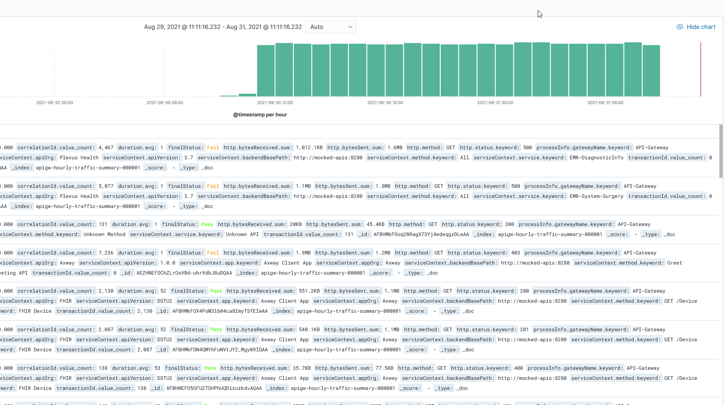
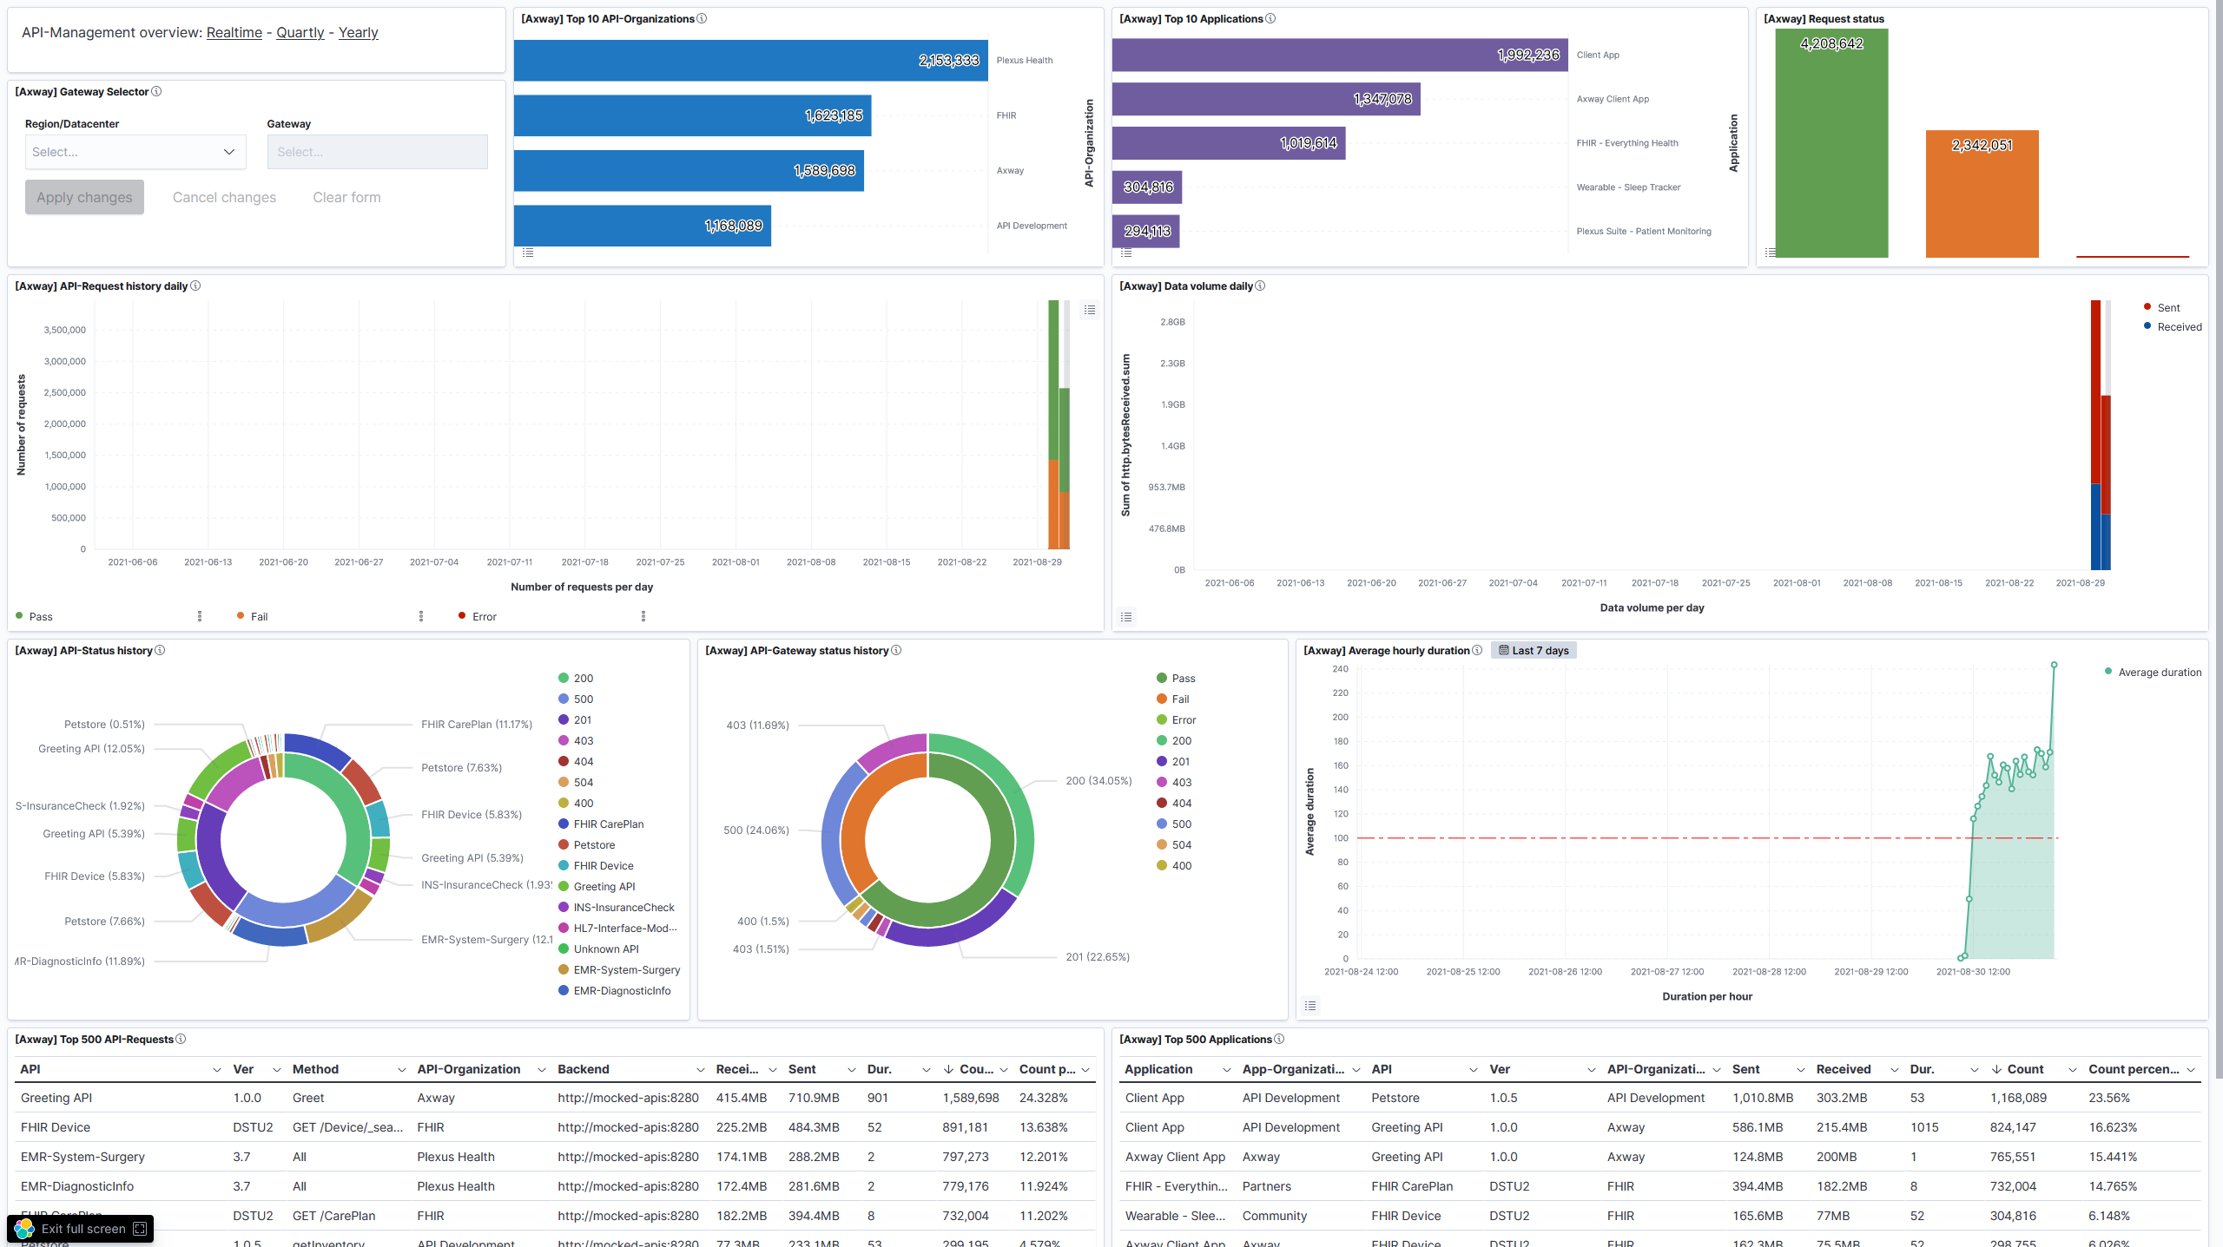
Raw-Data index
Real-Time Dashboard
Transformation Hourly buckets Delay of 3 hours.
Quarterly- or Yearly-Dashboard
Hourly-Data index

