Slide 1








Open-Traffic
Event-Log
API-Gateway
Filebeat
per GW
Memcached
Multiple
Kibana
Dashboards
API-Gateway
Filebeat
per GW
Logstash
Multiple
Elasticsearch
Multiple
API-Gateway
Filebeat
per GW
Lookup
API-Builder
Multiple
API-Manager
API-Gateway
Traffic Monitor
API-Gateway OPSDB

Slide 2

Create and Install a
Custom Setup Helm-Chart
Managing custom resources
Setup your myvalues.yaml based on the values.yaml
Install or Upgrade the solution
axway-elk-setup
│ .helmignore
│ Chart.yaml
│ values.yaml
│
├───charts
└───templates
api-builder-config-files.yaml
api-builder-secret.yaml
elasticsearch-certificate.yaml
pv-volumes.yaml
_helpers.tpl
elasticsearch:
resources:
requests:
cpu: "500m"
limits:
cpu: "500m"
volumeClaimTemplate:
accessModes: [ "ReadWriteOnce" ]
resources:
requests:
storage: 1Gi
logstash:
secretMounts:
- name: myCustomCA
secretName: apim4elastic-elastic-ca
path: /usr/share/logstash/config/certificates
subPath: myElasticsearchCa.crt
apibuilder4elastic:
envFrom:
- configMapRef:
name: axway-elk-apim4elastic-apibuilder4elastic-config
- secretRef:
name: api-builder-secrets
helm install -n apim-elk -f myvalues.yaml \
axway-elk apim4elastic-3.0.0.tgz
Custom K8S Resources
Customized deployment
helm upgrade -n apim-elk -f myvalues.yaml \
axway-elk apim4elastic-3.0.0.tgz

Slide 3
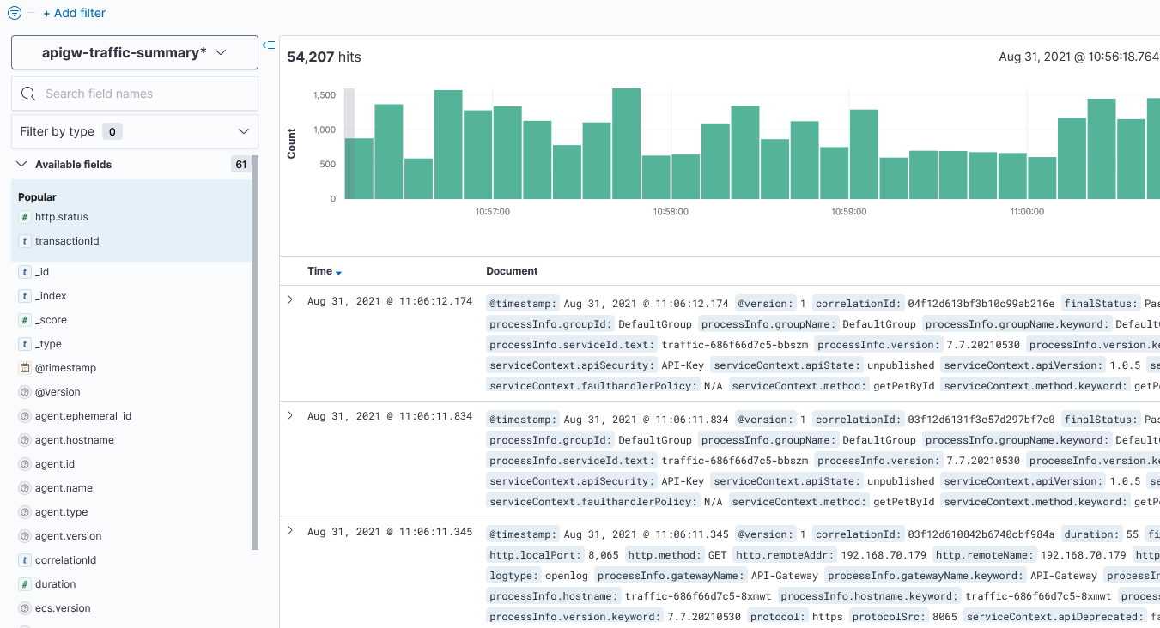
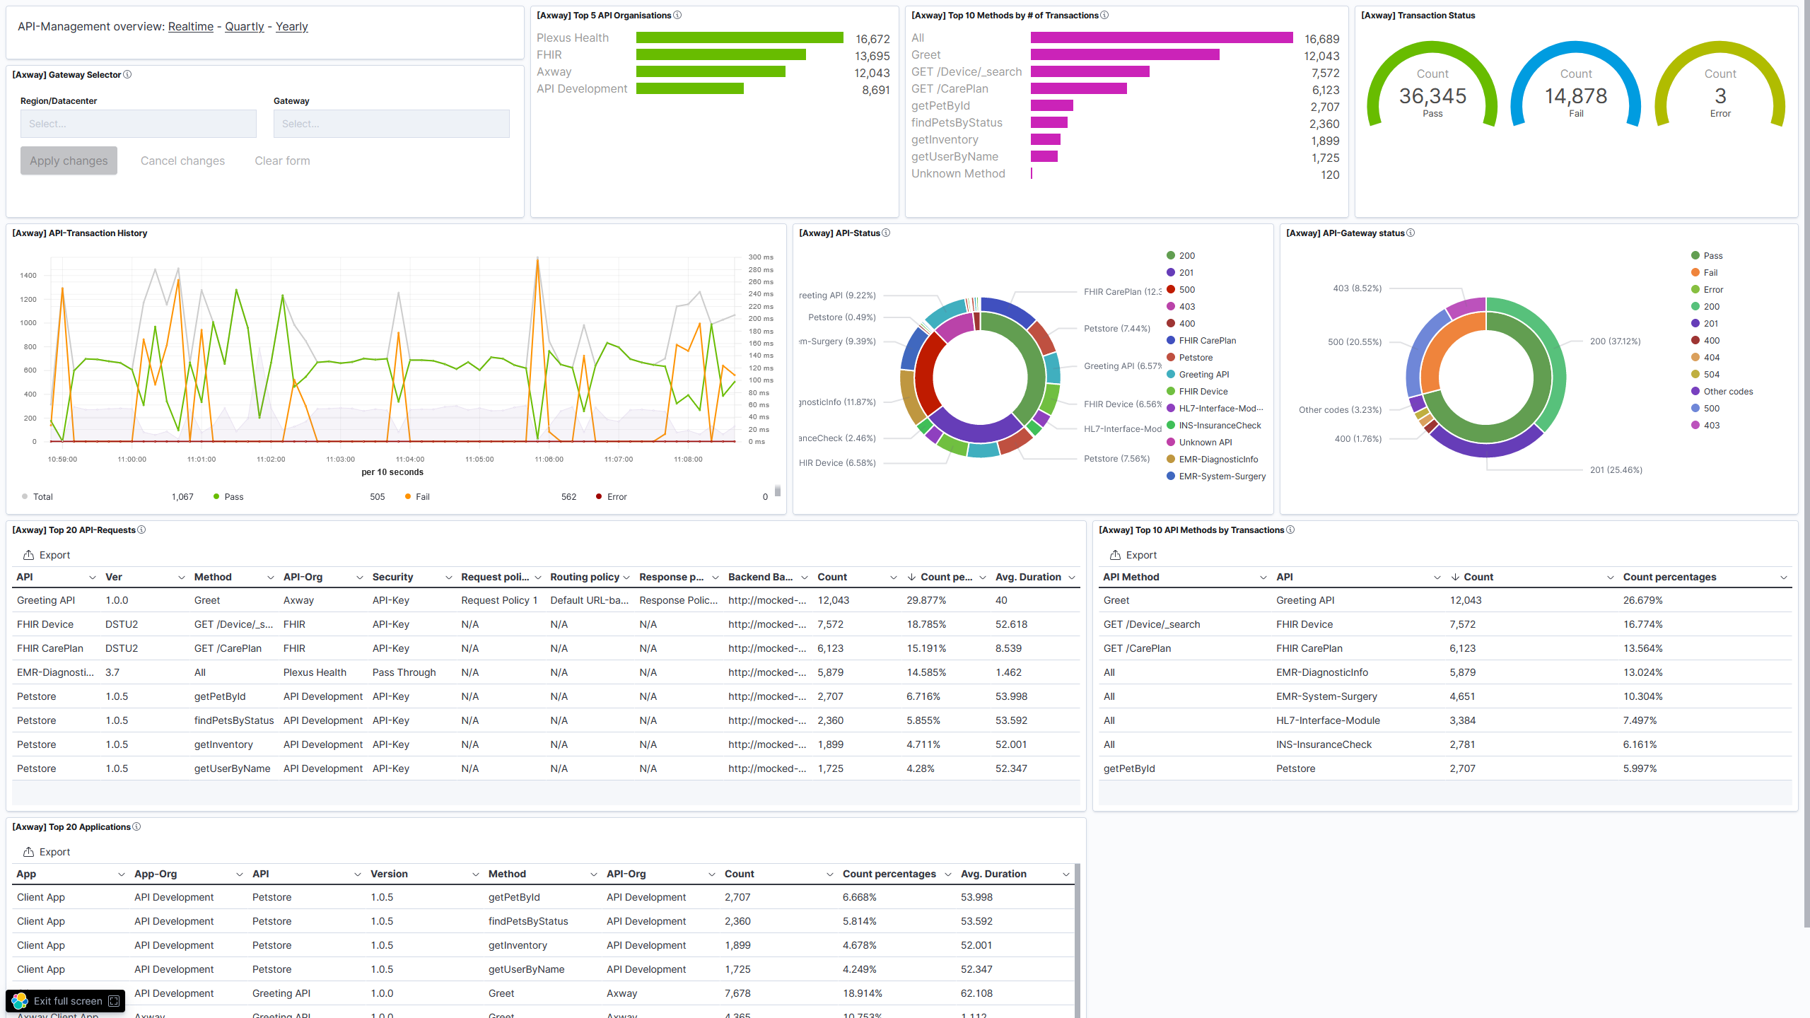
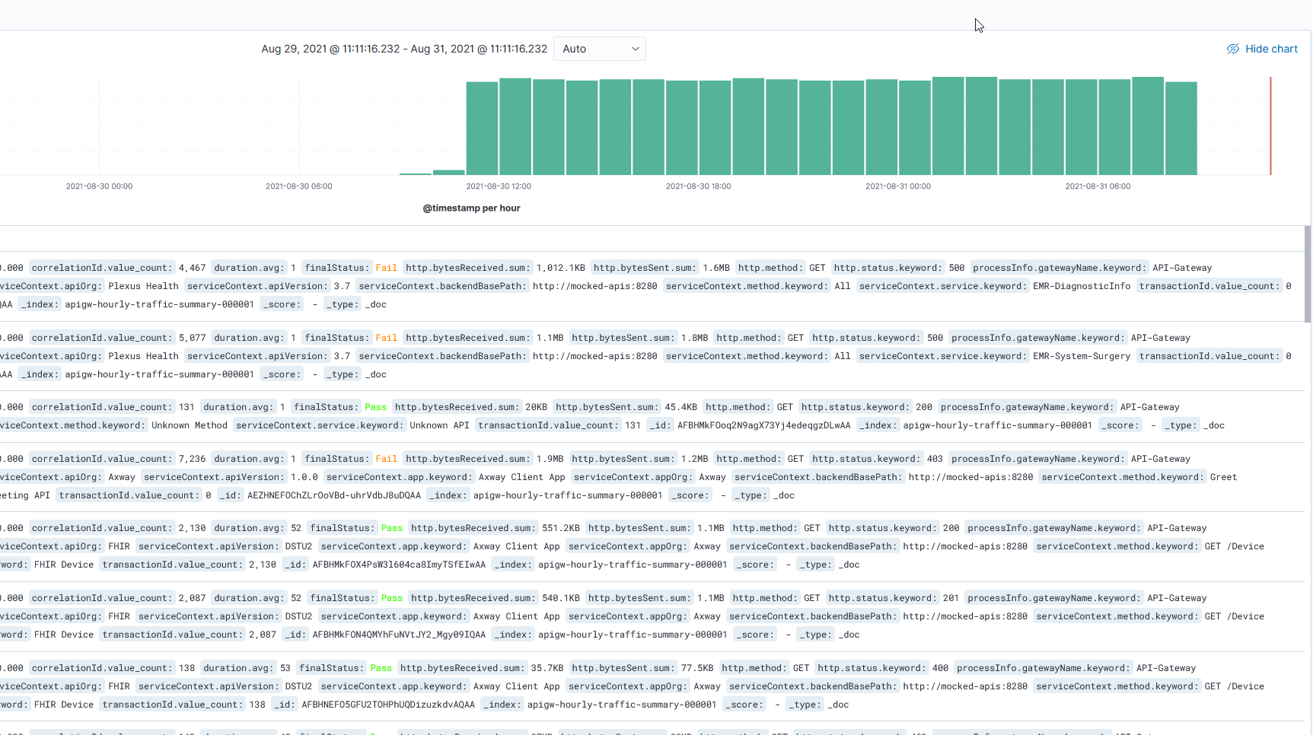
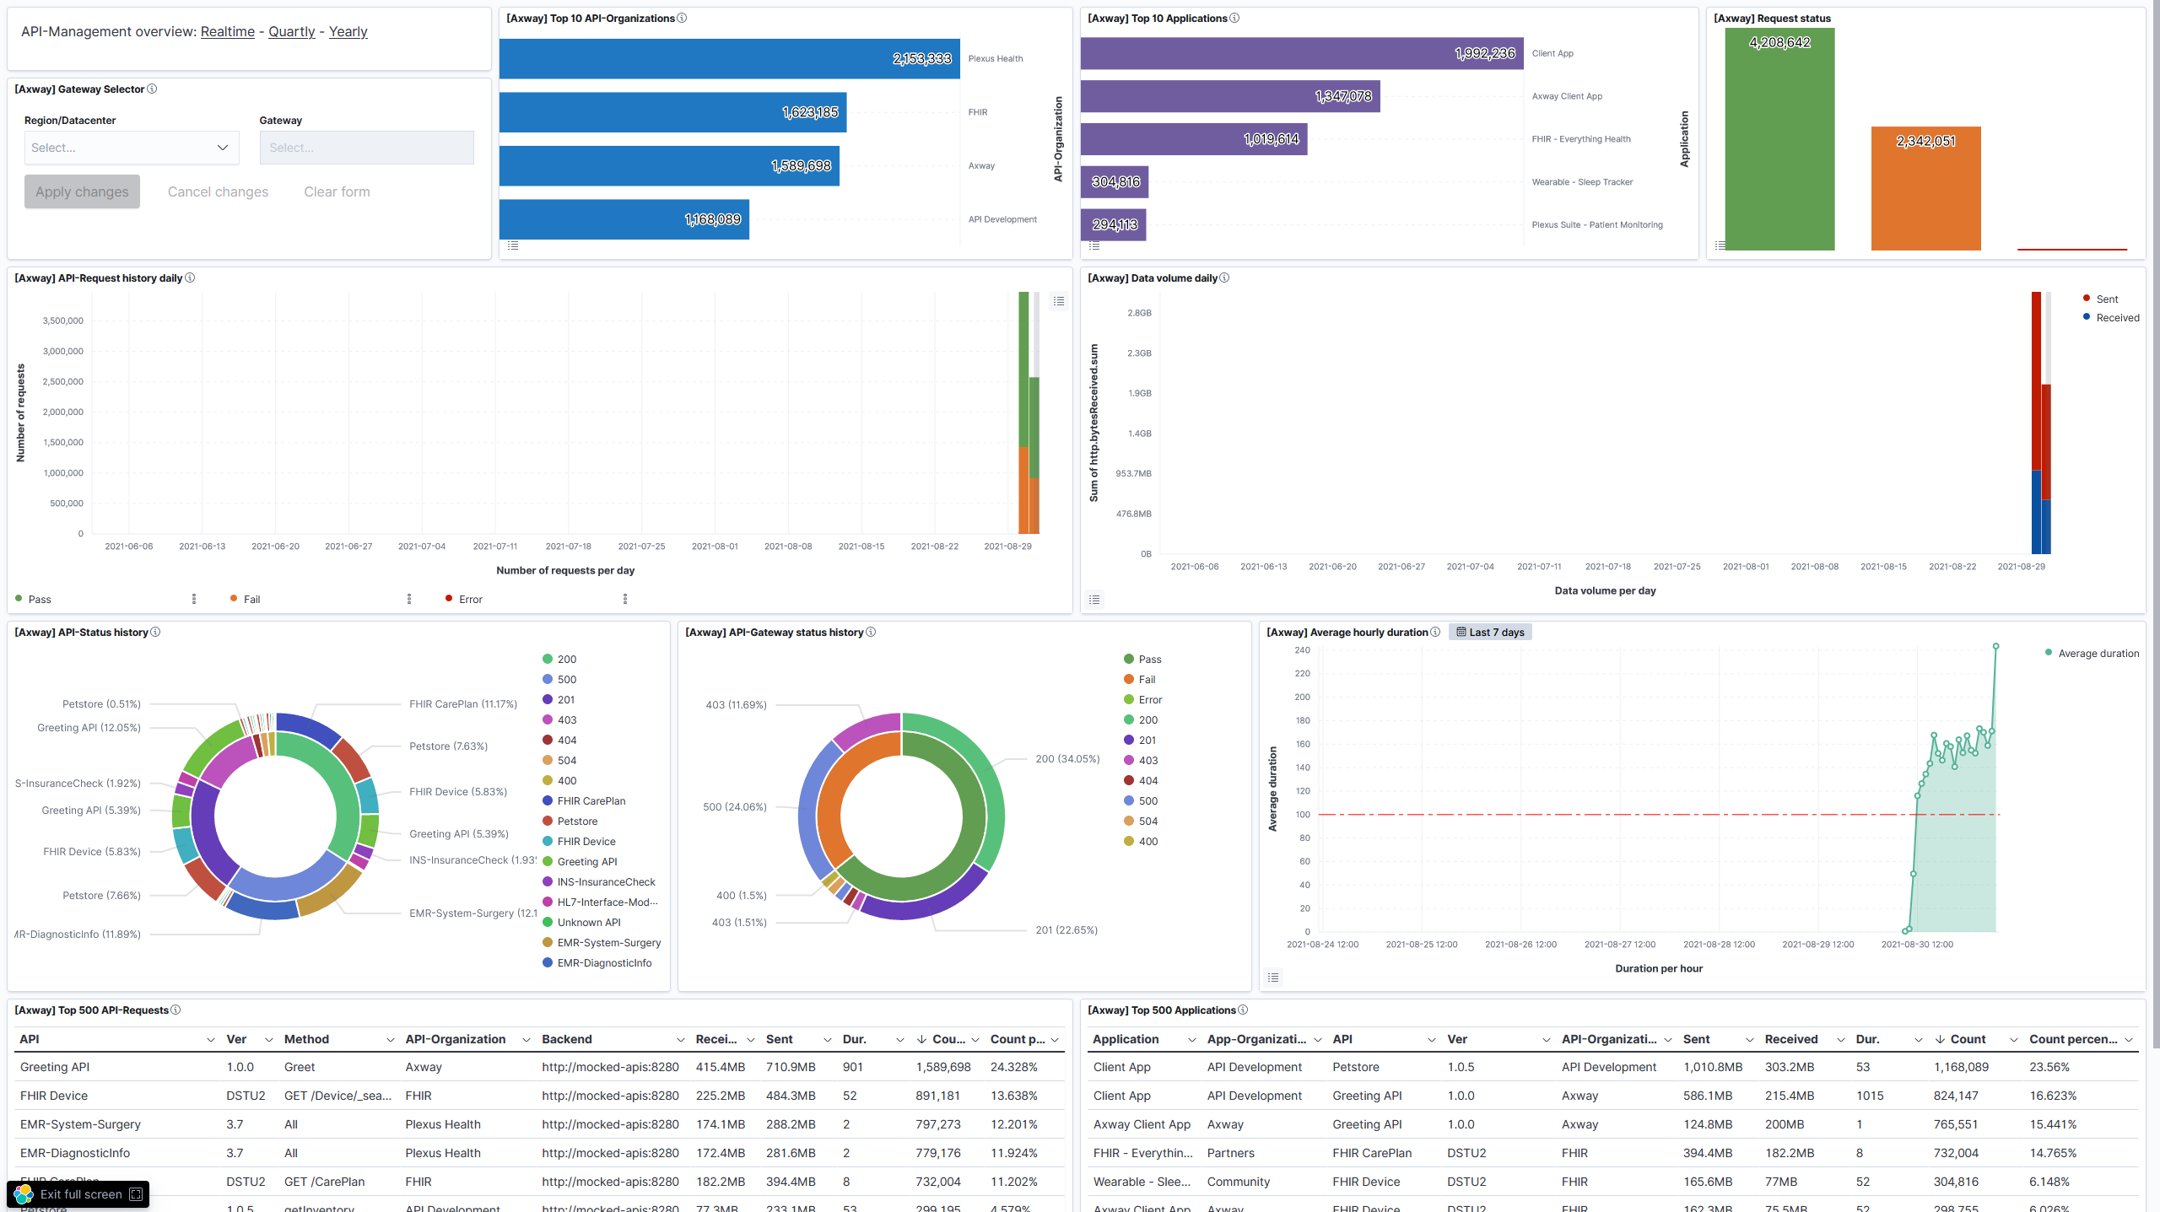
Raw-Data index
Real-Time Dashboard
Transformation Hourly buckets Delay of 3 hours.
Quarterly- or Yearly-Dashboard
Hourly-Data index

Slide 4
The rollover criteria in the Hot-Phase define when an index is rolled over. If one of the defined rollover criteria is met, a new index is created and the old one starts its lifecycle via Warm, Cold and Delete.
Depending on the amount of data in your environment, an index will be rolled over sooner or later.
Rollover date
Period after rollover until data is deleted
An index moves to the next phase when the rollover date is a specified time ago. Please note, that the solution is configured so that an index enters the Warm phase immediately after rollover.
Use the retentionPeriod parameter in the retention period config to control this section. The solution breaks down the specified days between the Cold- and Delete-Phase respectively.

Slide 5
