Slide 1









Developer
Bitbucket / GitHub
Jenkins
Organization Folder
API-Management
Project 1
API 1
+ API-Config & Jenkinsfile
API 1 Workflow
API 1
API 2
+ API-Config & Jenkinsfile
API 2 Workflow
API 2
Project 2
API 3
+ API-Config & Jenkinsfile
API 3 Workflow
API 3
API 4
+ API-Config & Jenkinsfile
API 4 Workflow
API 4
Project 3
API 5
+ API-Config & Jenkinsfile
API 5 Workflow
API 5
API 6
+ API-Config & Jenkinsfile

Slide 2
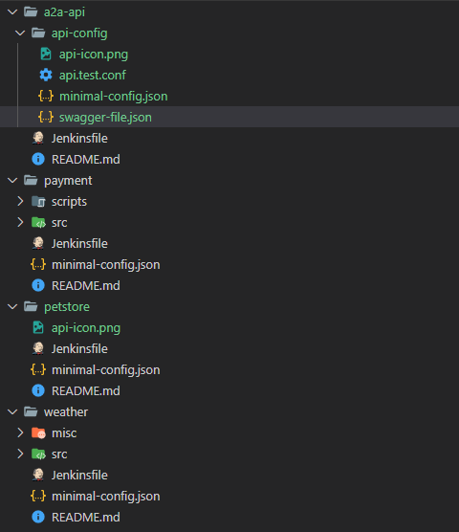
Project with dedicated folder for the API-Configuration
Very likely a project may also contain sources, tools, etc.
Or a project just containing the API-Definition. For instance when registering a Cloud-Service-API.

Slide 3
