Slide 1
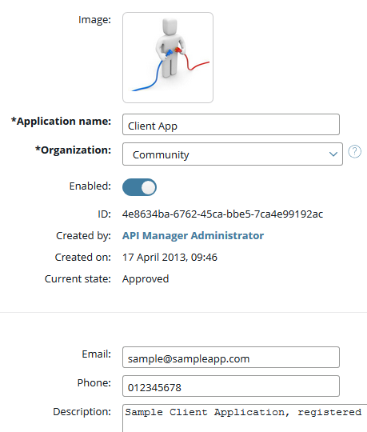
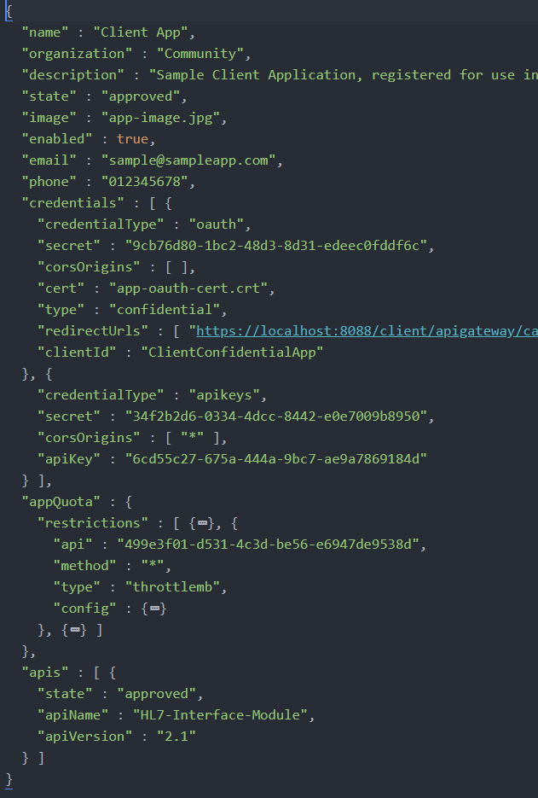


Slide 2

API-Management CLI

Slide 3
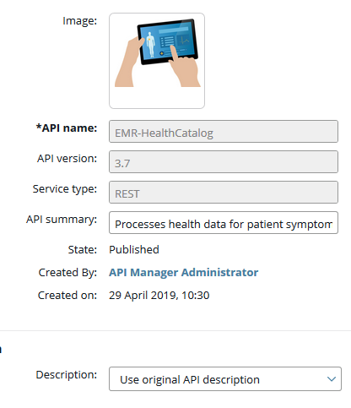
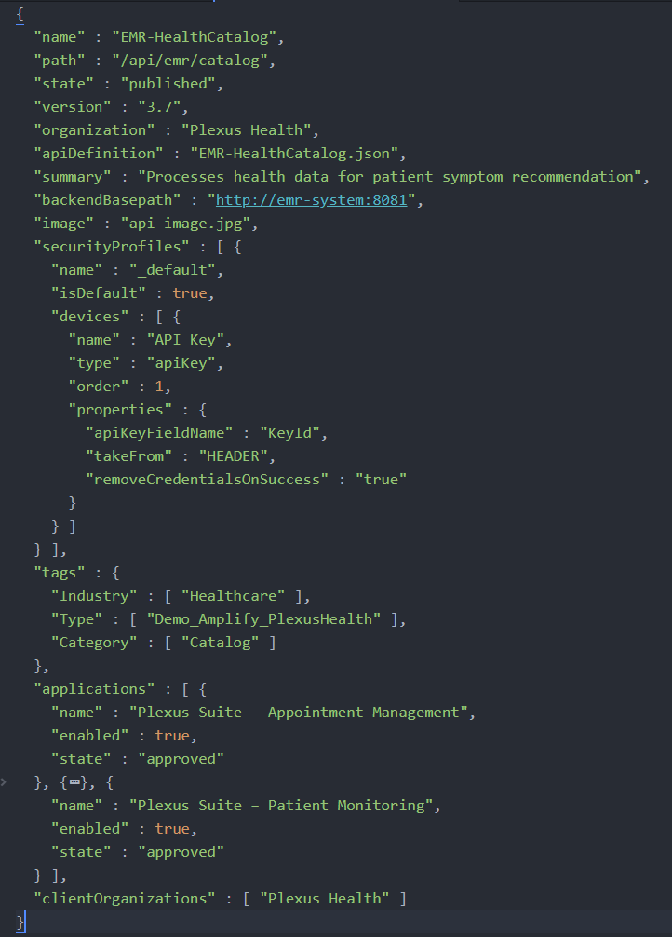

Slide 4
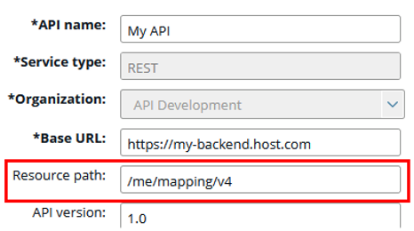
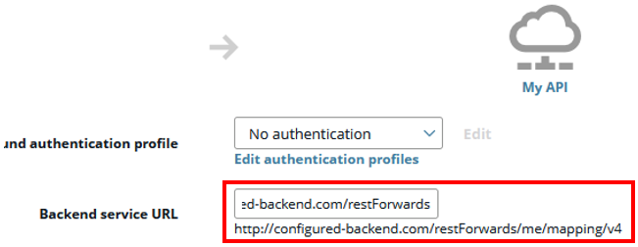


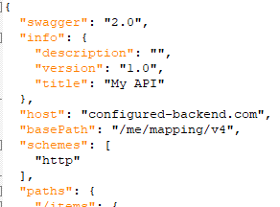
Backend API
Frontend API Inbound
Frontend API Outbound
Export
API-Config File
API-Specification
Only when using the toggle useFEAPIDefinition
host, basePath and schemes is adjusted according to the API-Backend

