Slide 1
Axway API-Management
Automate your APIs with Jenkins

Slide 2


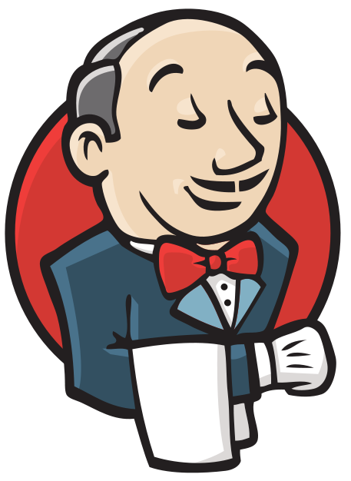






Developer
Bitbucket / GitHub
Jenkins
Organization Folder
API-Management
Team/Owner
Project 1
API 1
+ API-Config & Jenkinsfile
API 1 Workflow
API 1
API 2
+ API-Config & Jenkinsfile
API 2 Workflow
API 2
Project 2
API 3
+ API-Config & Jenkinsfile
API 3 Workflow
API 3
API 4
+ API-Config & Jenkinsfile
API 4 Workflow
API 4
Project 3
API 5
+ API-Config & Jenkinsfile
API 5 Workflow
API 5
API 6
+ API-Config & Jenkinsfile

Slide 3
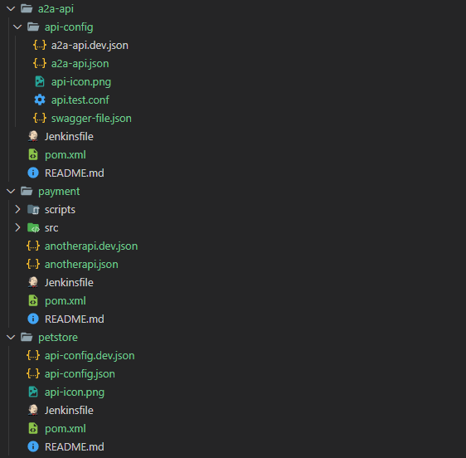
Project with dedicated folder for the API-Configuration
The pom.xml is used by the Jenkins-Pipeline to create the package and call Swagger-Promote
Very likely a project may also contain sources, tools, etc.
The Jenkinsfile is used to dynamically create the Jenkins-Pipeline, that is using Maven.
Or projects contain only the API-Definition. For instance when registering a Cloud-Service-API.

Slide 4
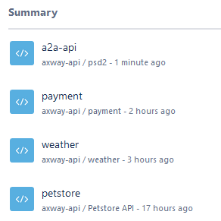
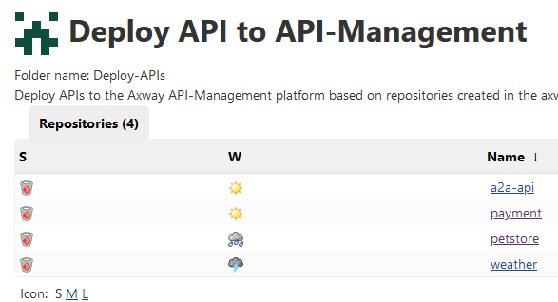

Slide 5
Stoplight & Axway API-Management
A pipeline based integration

Slide 6





- Stage DEV -
- TST, PROD, … -
Version Control Bitbucket / GitHub
Jenkins
Development pipeline
SNAPSHOT Repository
Jenkins
Release pipeline
RELEASE Repository
API 1 API-Config & Jenkinsfile
pom.xml
Create SNAPSHOT package
API1-V1.0-SNAPSHOT
Create & Publish
release
API1-V1.0
Deploy package to DEV-Stage
Stage: DEV
API-Management
Developer decides when to create release package
API-Design
api-import CLI Design, Test, … Repeat
OpenAPI Code-Generator

Slide 7
- Stage TST, PROD, … -
Jenkins
Release workflow
RELEASE Repository
Version Control Bitbucket / GitHub
Create & Publish
release
API1-V1.0
List of Production APIs A folder-structure for every API each with a POM
Jenkins
Deploy pipeline
Stage: PROD
API-Management
Deploy API1-V1.0 Release

Slide 8
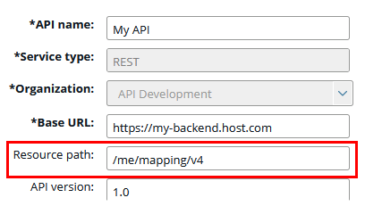
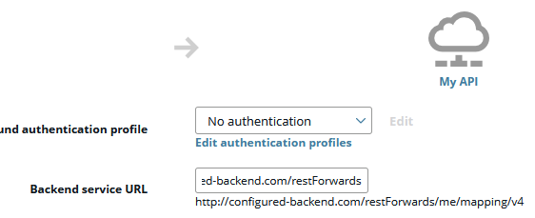
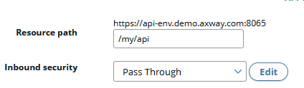
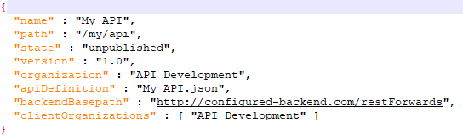
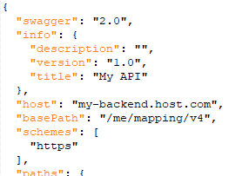
When using Flag: -useFEAPIDefinition
Backend API
Frontend API Inbound
Frontend API Outbound
Export
API-Config file
API-Specification

Slide 9
