Slide 1
OAuth PKCE Flow
3rd Party Autorisation server (e.g. Keycloak, AzureAD, …)
An extension to the Autorisation code flow
Token exchange
Including
Code-Verifier
Login & Autorisation
Axway API-Management
Backend expecting Oauth-Access-Token from 3rd Party Autorization server
User (Resource-Owner)
Client (User-Agent)
Redirect
API-Call
OAuth-Access token
Callback
Including the Code-Challenge

Slide 2
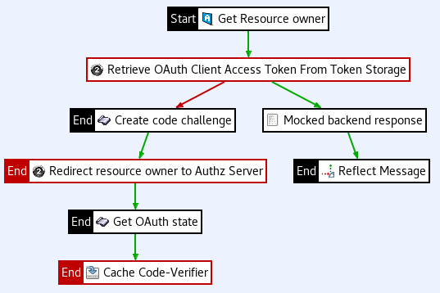
Get the resource owner. e.g. a Cookie, ID-Token, etc.
Set attribute: authentication.subject.id
Get the resource owner. e.g. a Cookie, ID-Token, etc.
Set attribute: authentication.subject.id
Try to get the token for the resource owner from the Token-Store
Create the Code-Verifier and Code-Challenge for the PKCE-Flow
Redirect the resource owner to the AuthZ-Server. This includes the Code-Challenge & Method
Make the backend call using the retrieved Token
Get the Oauth-State from Redirect Location header
Cache the Code-Verifier using the Oauth-State

Slide 3
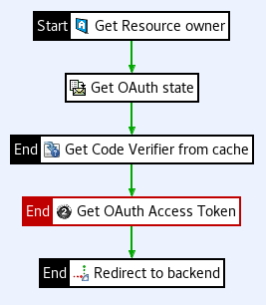
The resource owner must be known as the token is stored on behalf of the resource owner
Get the returned OAuth state from Query-Parameters
Use the OAuth-State to lookup the Code-Verifier
Exchange the Autorization-Code to get the Access-Token
Token is stored. For convinience redirect the user to the requested resource.

Slide 4
