Slide 1
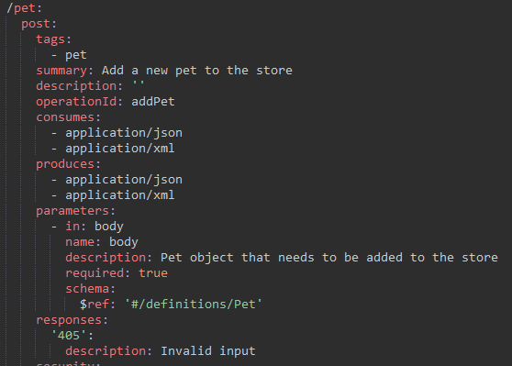
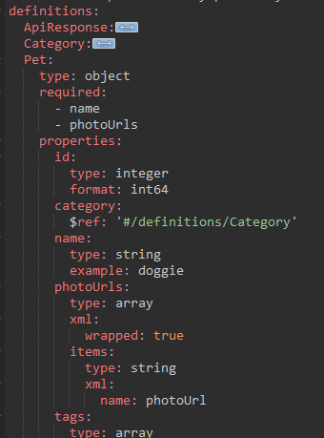
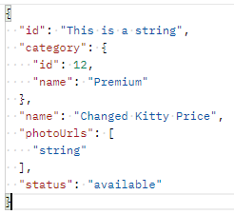
API-Path (e.g. ${api.method.path})
HTTP-Verb (e.g. ${http.request.verb}
Invalid request
The schema to check

