Slide 1
Unit 4 – Assignment 2
Anas Farhan
40208262

Slide 2
Contents-
Computational thinking
Principles of computer programming
Principles of software design

Slide 3
Principles of software design

Slide 4

Principles of software design
Definition of principles of software design:
Set of guidelines and rules to help the developer to make a good design of the system.
Types of software design:
SRP – single responsibility principle
DRY – Don't repeat yourself
KISS – keep it simple stupid
YAGNI – you ain't gonna need it

Slide 5
SRP(single responsibility principle)
Definition - A SRP is a programming principle that says a module should only have the responsibility of handling one actor only, meaning should only having and executing one action at a time. From google.
Example: The welcome() function lets us only to start the program, it cannot execute another function except for starting the program.

Slide 6
DRY(don't repeat yourself)
Definition - A DRY is not make sure that the program's pieces of code repeats itself over and over too many times to avoid redundancy. From Google.
Example: A While() Will make sure that the program will not have to repeat itself by setting the loop to however many times the programmer wants it to be, this saves the programmer from having to repeat that specific code again and again.

Slide 7
KISS(keep it simple, stupid)
Should make the design of the program as simple as possible, and not over complicate the program to the point that it does not make sense and errors start to occur. From Google.

Slide 8
YAGNI(you ain't gonna need it )
Identifying the important features while ignoring the rest, the key features that make the program better and do more than other relevant but less features.

Slide 9
Computational thinking

Slide 10
Computational Thinking
Definition of Computational Thinking:
This is a Problem-solving step which is to analyse and then solve the problem.
Types of computational thinking techniques:
Abstraction
Algorithm
Decomposition
Pattern Recognition

Slide 11
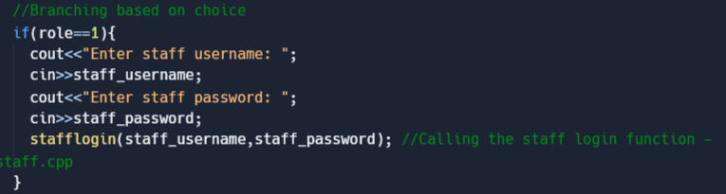
Abstraction
Abstraction – this part focuses on only the info that is important and leaves out the info that is not important.
Important info:
Staff_username / staff_password
Unimportant info:
Student_username / student_password

Slide 12
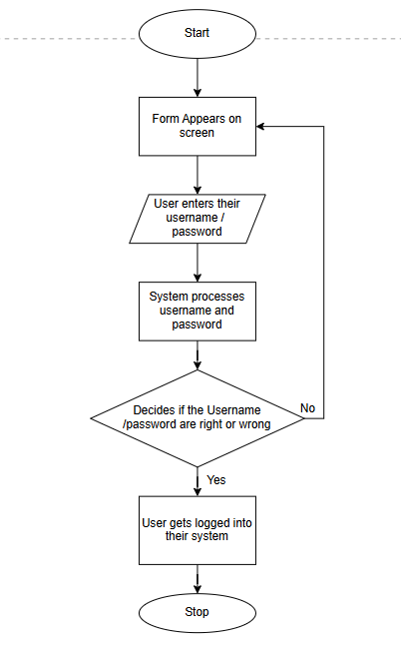
Algorithm
Algorithm - making a solution for the problem which is going to be a step-by-step solution, this can be by a flowchart or a pseudocode.
GET users username and password
IF the username and password both are valid THEN
SHOW login status as successful
ELSE
SHOW login status as Failed
ENDIF

Slide 13
Decomposition
Breaking down big and hard parts of a problem or a system into smaller and more easier parts to manage.
Decomposition happens by cutting the problem up into smaller sub-problems, this is done by putting the problem from one big problem into four small problem, the four problems meaning each file of the code, and each file of code has small functions to divide itself even further.

Slide 14
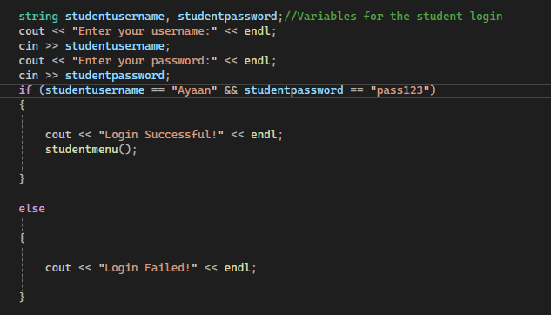
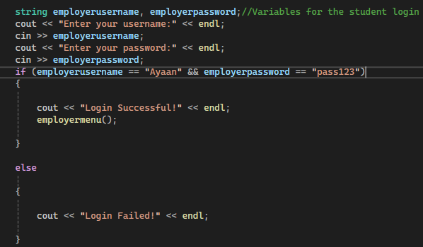
Pattern recognition
Pattern recognition – is to look for similarities on top of and in the problem.

Slide 15
Principles of computer programming

Slide 16
Principles of computer programming
Types of principles of computer programming:
Variable Declaration
Input and Output
Comments
Selection Statements
Integration
Modularity
Structure and Class
Vectors and lists

Slide 17
Principles of computer programming
C++:
Made by Bjarne Stroustrup
Made at Bell Labs
Originally called: C with class
Made in 1985
A high-level programming language
Python:
Made by Guido van Rossum
Made in 1991
Used for software development
Named after a comedy group called Monty Python
A high-level language

Slide 18
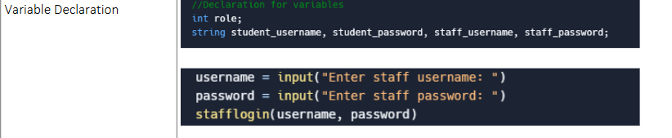
Variable Declaration
Similarities': Both python and C++ ask the for username and the password
Differences: in C++ you must write the variables in the datatype whereas in Python you do not .

Slide 19
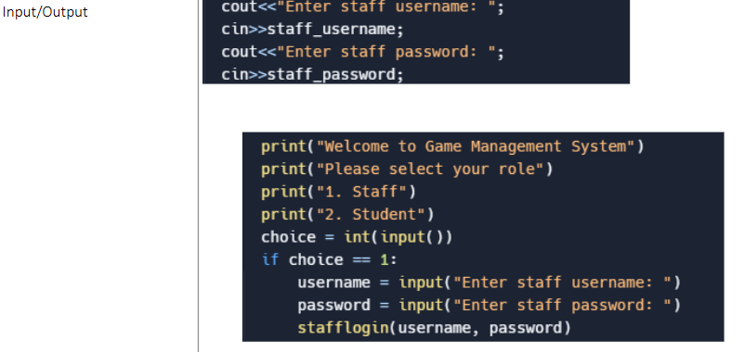
Input / Output
Similarities: in C++ "cout" and in python "print" have the same functions that is to display and output Whatever the coder writes.
Difference: The message of the output, in python is put in brackets

Slide 20
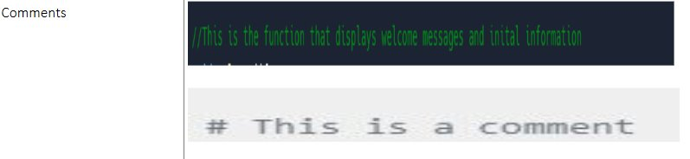
Comments
Similarities: In both python and C++, the comment is never going to be displayed in the output, so it will only be seen on the code.
Differences: in python all comments start with a hashtag whereas in C++ they start with a double slash

Slide 21
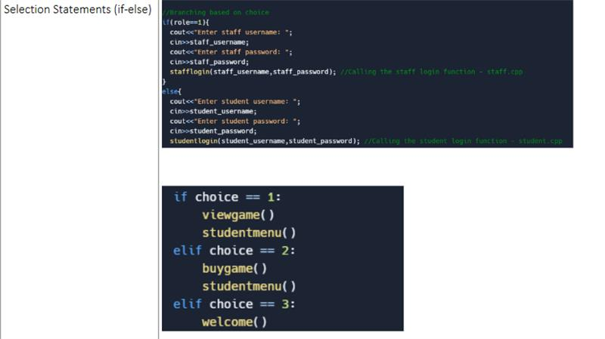
Selection statements
Similarities: Both python and c++ have an if and else statements, which starts with the if statements and ends with the else statement.
Differences: Python does not have an elif statement whereas C++ does have this statement in the middle of the if and else statements.

Slide 22
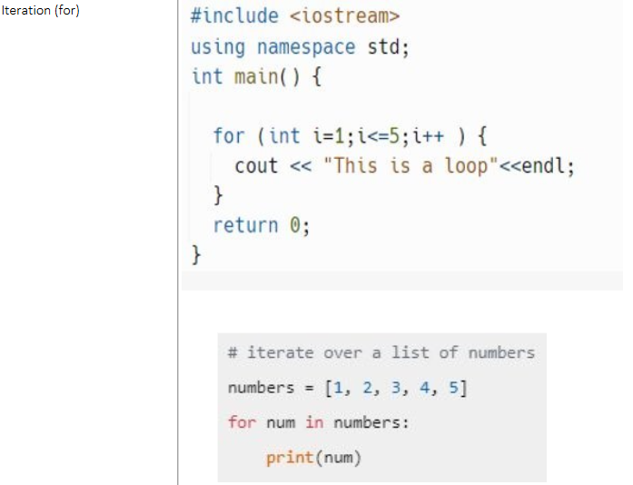
Iteration
similarities: both Python and C++ have got output statements after the for loop.
Differences: In C++, the for loop is written in brackets whereas in python the for loop is written without brackets and has a colon on the end but C++ doesn’t have any colon at the all the code

Slide 23
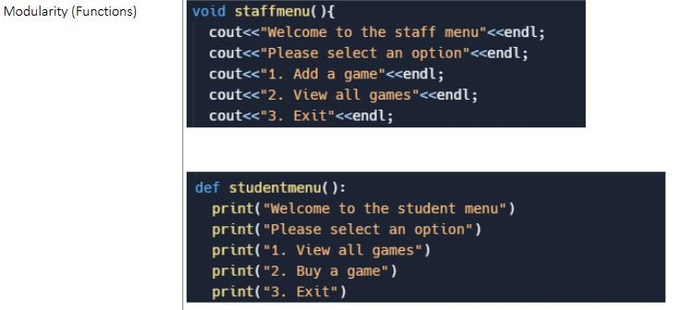
Modularity
Similarities: In both the C++ and Python both the functions do the same exact things, which is to select an option.
Differences: the names of those functions which do the same things are different name, in python it is called def and in C++ it is called void.

Slide 24
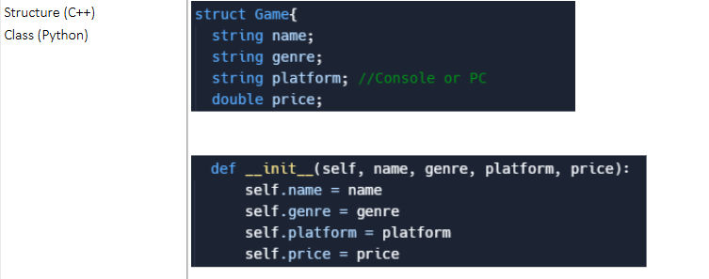
Structure and class
Similarities: Both the C++ struct and Python class are used to group related information about a game, like its name, genre, platform, and price.
Differences: The C++ struct only defines the data, while the Python class includes an __init__ method to automatically set the data when a new game object is created.

Slide 25
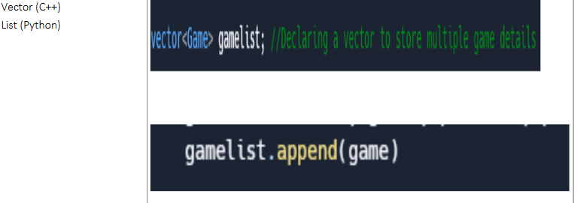
Vector and lists
Similarities: Both C++ and Python store games in a list. You create a vector<game> in C++ and add games with gamelist.append(game) in Python. Both let you keep and add games easily.
Differences: C++ vectors need you to specify the type (game), so all items are the same type. Python lists can hold anything but here you add games with append(). C++ is faster but more complex, Python is simpler and manages memory for you.

