Slide 1
Electronic Circuit Design Technology
Week-1
BJT Amplifiers

Slide 2
Instructor: Anwar Ali
PhD: Electronic and Communication Engineering, Politecnico di Torino, Italy
MS: Electronic Engineering, Politecnico di Torino, Italy
BS: Electronic Engineering, NED UET Karachi
Currently Working as Associate Professor in the School of Information Sciences and Technology, ZSTU Hangzhou, China
Office: Building # 25, Room # 1003

Slide 3
Today’s Lecture Highlights
BJT (Bipolar Junction Transistor) as Amplifier
DC Analysis (To check your know-how about BJT from previous courses)
AC or small signal analysis
Small signal models
Hybrid-π and T-Models
Common Emitter Amplifier Analysis
Common Emitter Amplifier LTSpice Simulations to find Gain, Phase and Frequency

Slide 4
Bipolar Junction Transistor (BJT)
BJT invented in 1948 at the Bell Telephone Laboratories
It brought great revolution in electronics and information technology
Enjoyed nearly three decades as the device of choice
MOSFET became a serious competitor to the BJT in 1980s
BJT is still has wide applications in
  Severe environmental conditions (High Temperature and humidity)
  High power rating
  Popular in discrete-circuit design
  Base region is very rigid (High radiations withstanding capability, use in space applications)

Slide 5
Difference between BJT and FET
BJT (Bipolar Junction Transistor)
Bipolar device (current flow due to both types of carriers i.e. holes and electrons)
Current controlled device
Use in low frequency applications
Relatively Large size (use in discrete circuits)
High power rating
FET (Filed Effect Transistor)
Unipolar device (Current flow due to one type of charge carriers i.e. electrons or holes
Voltage controlled device
Use in high frequency applications
Very small size (use in integrated circuits)
Low power rating

Slide 6
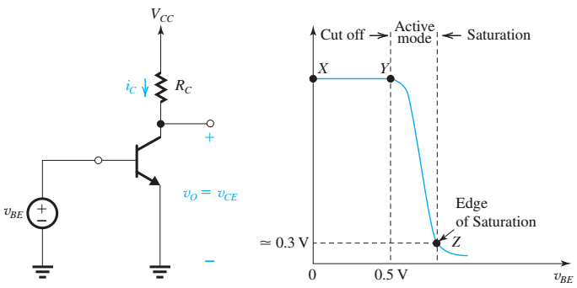
BJT Applications
BJT is used as a
  Switch or as an
  Amplifier
BJT has three regions of operation (explained on next slide)
  Cut off
  Active
  Saturation
As a Switch, BJT is operated in
  Cut off and
  Saturation region
As an Amplifier, BJT is operated
  Active region

Slide 7
BJT as Amplifier
Active mode
Voltage controlled current source amplifier
VBE control IC
Transconductance amplifier (output current is controlled by input voltage)
Always interested in voltage amplification
Pass this signal through a resistor and get output voltage

Slide 8
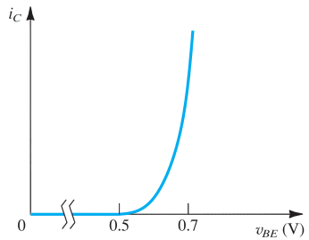
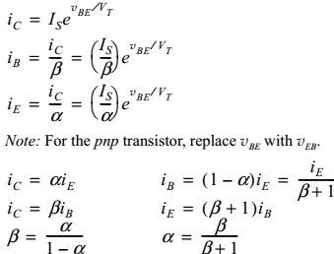

Simple BJT amplifier

Slide 9
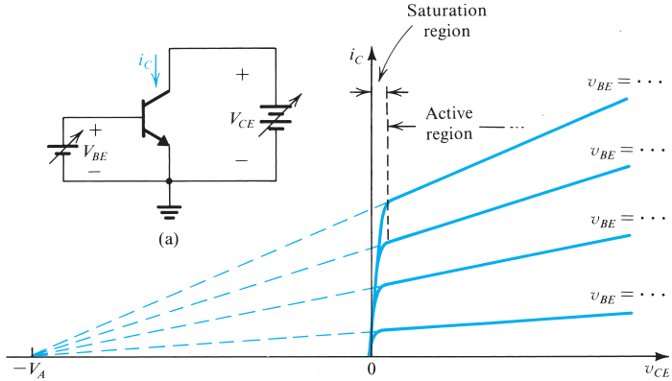
characteristics of the BJT

Slide 10
Voltage transfer characteristic (VTC)
  This curve is nonlinear
  Linear amplification can be obtained by using the technique of biasing the BJT

Slide 11
Voltage transfer characteristic (VTC)
Voltage transfer characteristic (VTC) is used to have insight into the operation of an amplifier circuit This is simply a plot of the output voltage versus the input voltage.
Observe that for lower than about 0.5 V, the transistor is cut off
As VBE rises, the transistor turns on and VCE decreases. Initially VBE is still high, the BJT will be operating in the active mode.
This continues as is increased until it reaches a value that results in becoming lower than by 0.4 volt or so (point Z on the VTC).
For greater than that at point Z, the transistor operates in the saturation region and decreases very slowly.

Slide 12
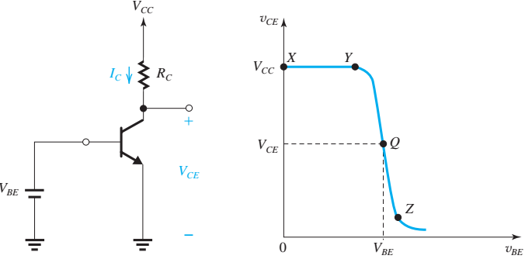


Biasing the BJT to Obtain Linear Amplification
Point Q is known as the bias point or the dc operating point or quiescent point
Transistor operating at Q will have a collector current
And collector voltage at Q point is

Slide 13
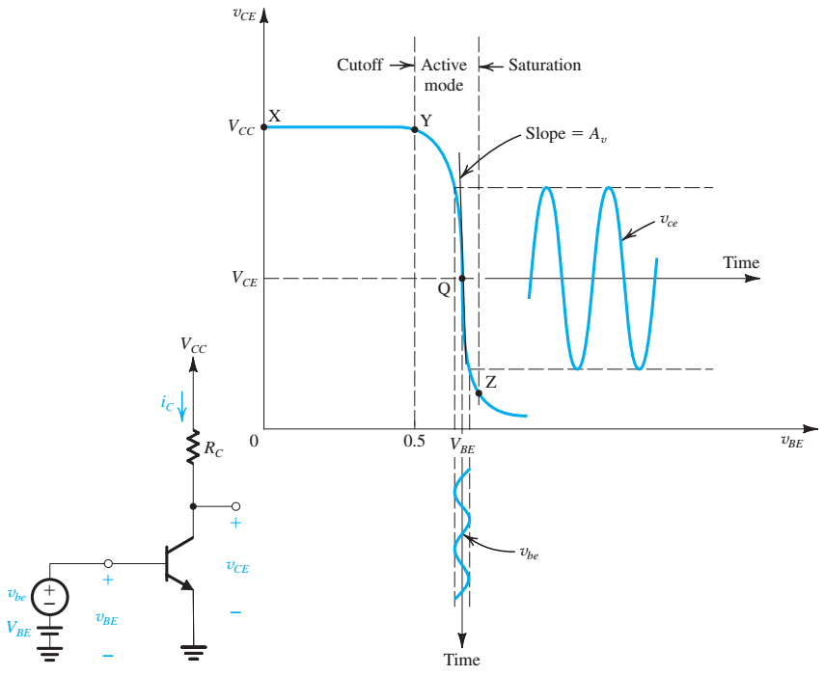


Apply signal of interest on VTC

Slide 14
In this case, Vbe is a sine wave of small amplitude, small enough to restrict the instantaneous operating point to almost linear segment of the VTC around the bias point Q.
Shorter the segment the greater the linearity achieved and closer to an ideal sine wave the signal component at the output
This is the technique to obtain linear amplification from a non-linear BJT

Slide 15
DC biasing and DC analysis of BJT
Before proceeding to Amplifiers lets check your level about DC analysis of BJT Amplifier Circuits…!!!

Slide 16
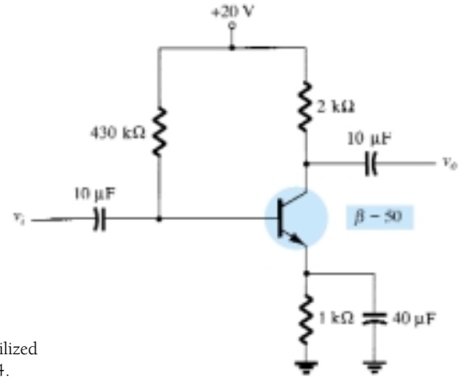
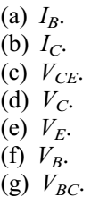
DC Analysis of a BJT circuit
(FIXED-BIAS CIRCUIT )

Slide 17
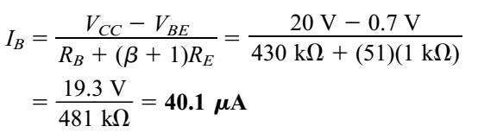
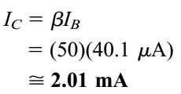
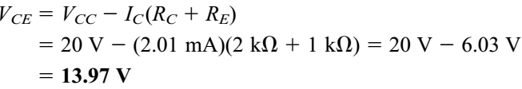
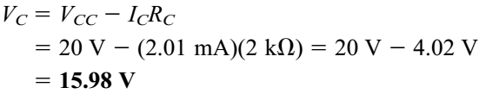
Solution…1

Slide 18
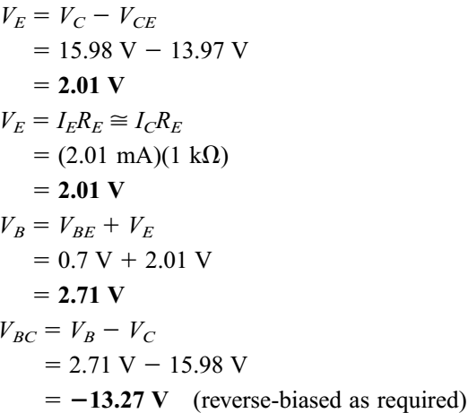
Solution…2

Slide 19
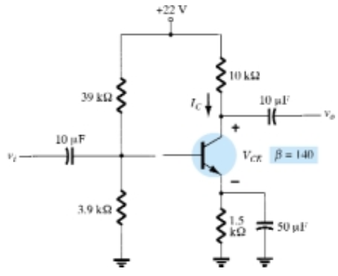
DC Analysis of a BJT circuit
(Voltage Divider Biasing )

Slide 20
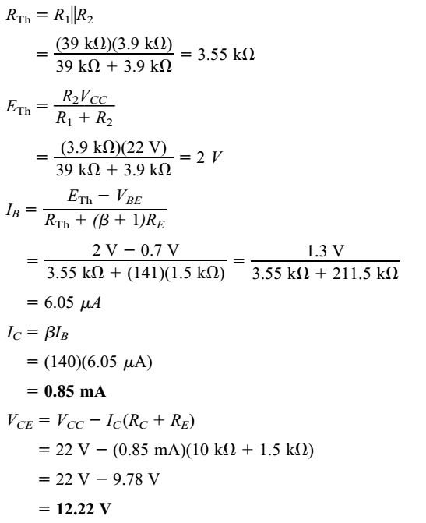
Solution

Slide 21


The Small-Signal Voltage Gain
If the input signal “Vbe" is kept small, the output “Vce" will be nearly proportional to “Vbe”
The constant of proportionality being the slope of the almost-linear segment of the VTC around Q.
This is the voltage gain of the amplifier and value is determined by evaluating the slope of the tangent to the VTC at the bias point Q.

Slide 22
Voltage Gain Equation
Two Observations from Voltage gain equation
The gain is negative, which signifies that the amplifier is inverting: that is, there is a 180◦ phase shift between the input and the output.
The gain is proportional to the collector bias current Ic and to the load resistance Rc

Slide 23




Theoretical maximum gain is obtained by operating by operating BJT at the edge of saturation

Slide 24

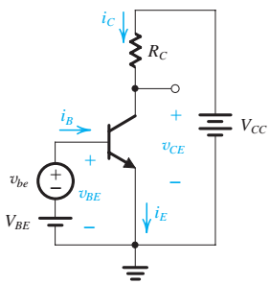
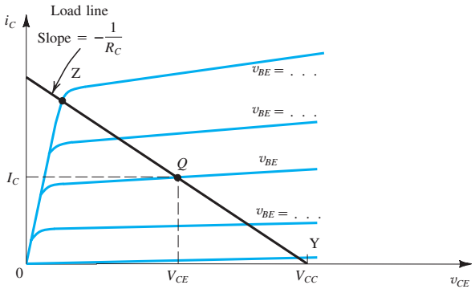
Determining the VTC by Graphical Analysis

Slide 25
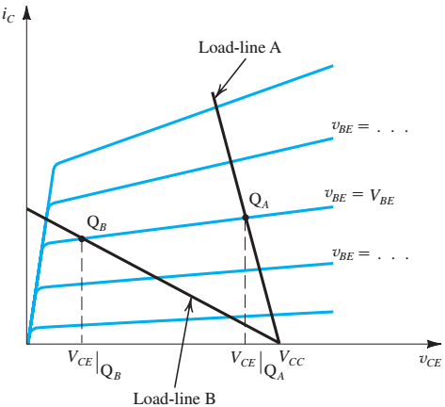
Locating the Bias Point Q
QA load line results in the positive peaks of the Signal being clipped off.
The BJT will turn off for the part of each cycle near the positive peak called circuit not having sufficient "headroom."
Point QB is too close to the boundary of the
saturation region, severely limiting the
allowable negative signal swing.
Exceeding this limit would result in the
transistor entering the saturation region
for part of each cycle near the negative
peaks, resulting In a distorted output
signal called circuit not having sufficient
"legroom."

Slide 26
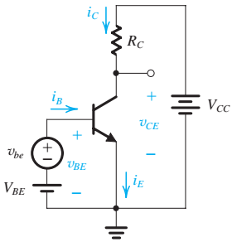
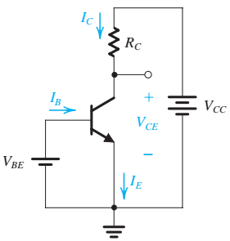








Small-Signal Operation and Models
The input signal to be amplified is represented by the voltage source vbe that is superimposed on VBE

Slide 27

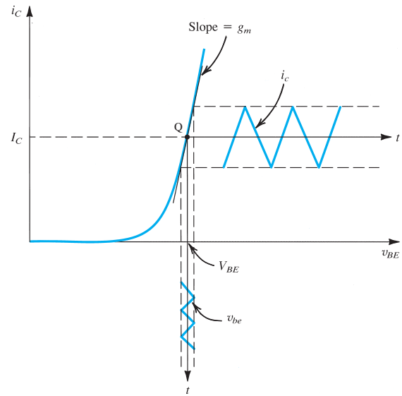




The Collector Current and the Transconductance
Transconductance of the BJT is
directly proportional to the collector
bias current IC
gm is the slope of the ic versus Vbe
curve at the bias point Q

Slide 28



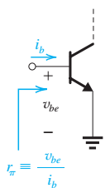




The Base Current and the Input Resistance at the Base

Slide 29









The Emitter Current and the Input Resistance at the Emitter

Slide 30
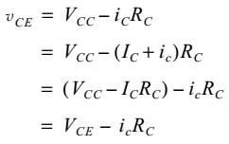



Voltage Gain

Slide 31
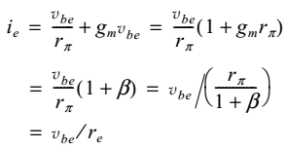

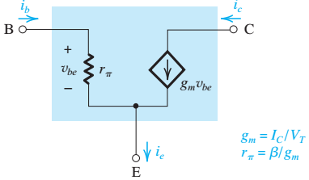
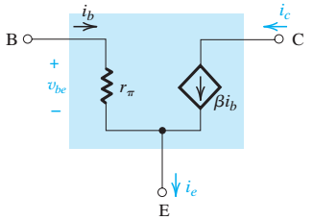
The Hybrid-π Model

Slide 32
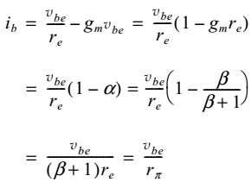
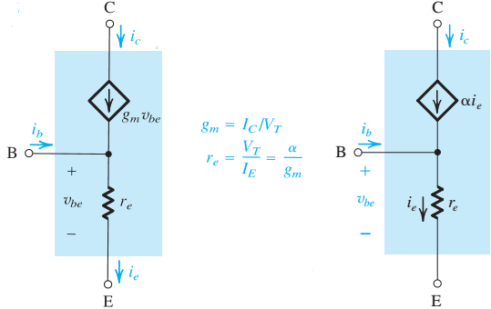

The T Model
Although the hybrid-π model can be usedto carry out small-signal analysis of any transistor circuit, there are situations in which an alternative model, is much more convenient.
This model, called the T model, is shown in two versions

Slide 33
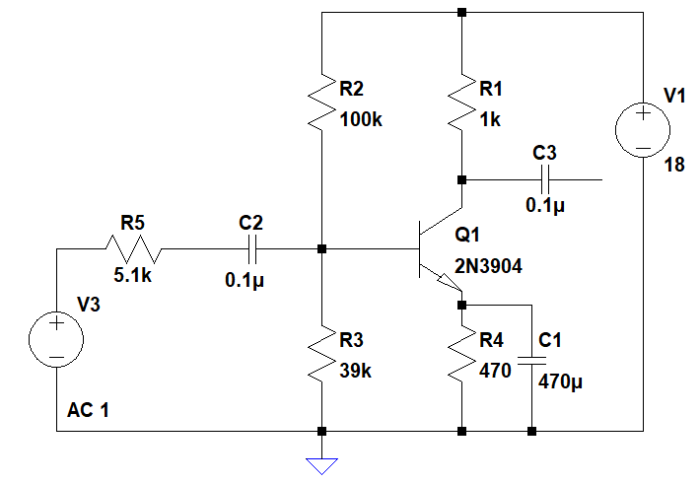
Common Emitter Amplifier

Slide 34
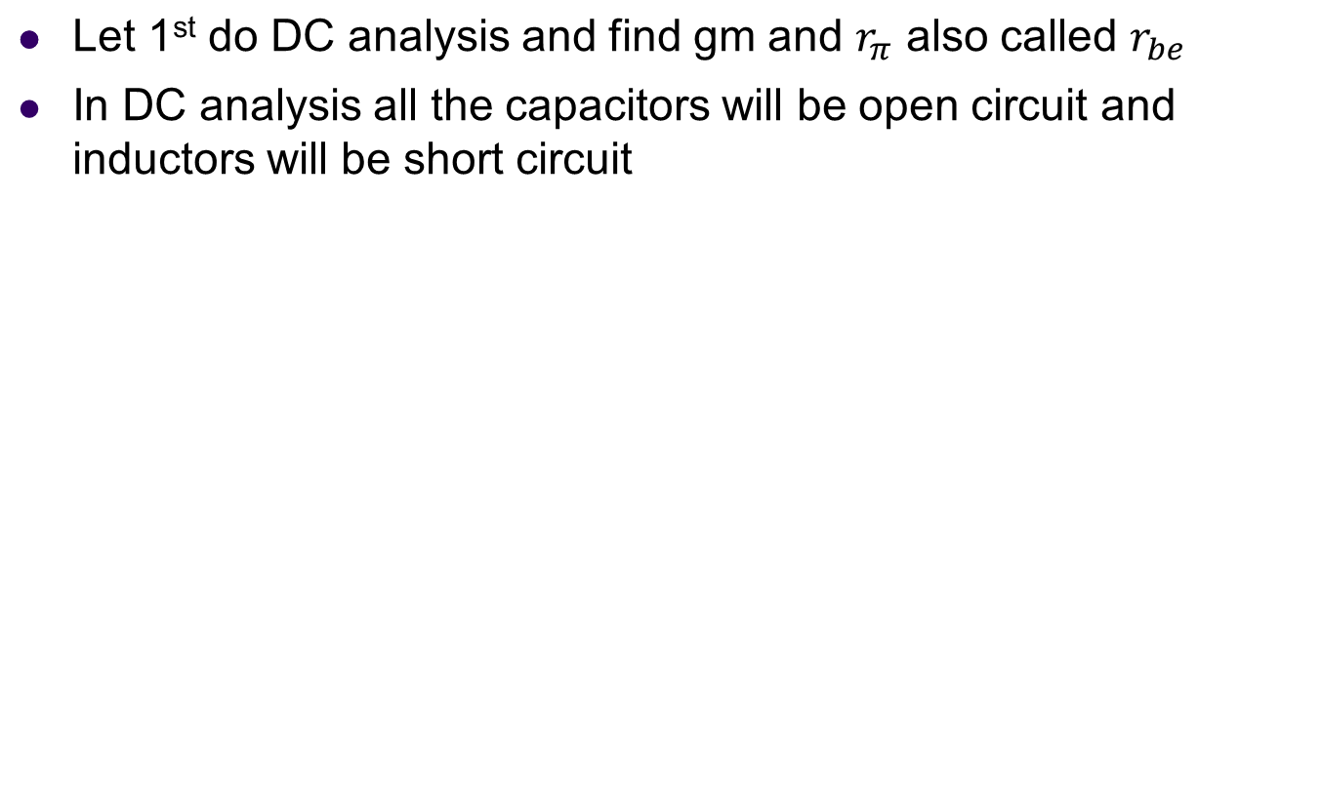
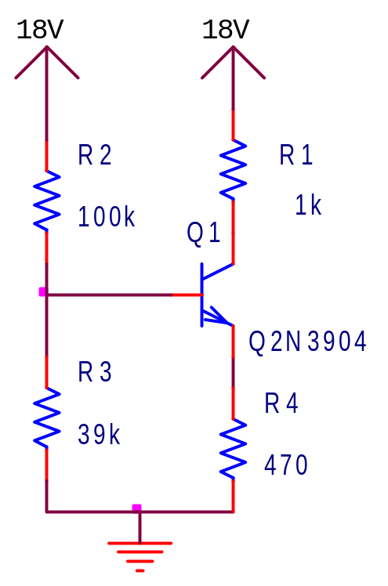
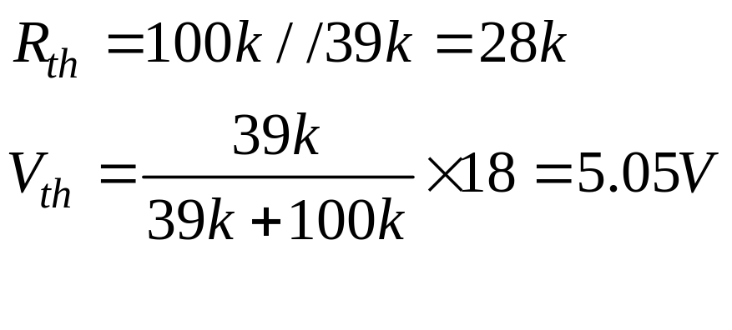
DC Analysis

Slide 35
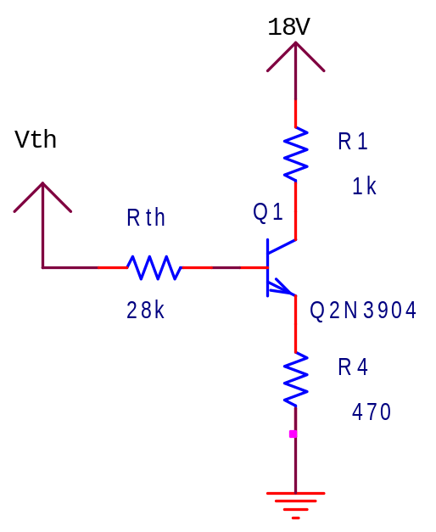

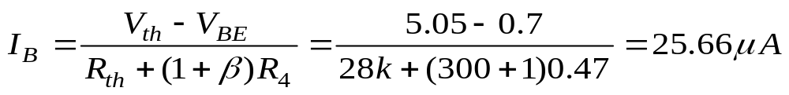
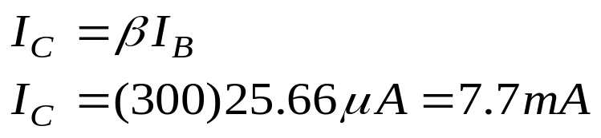
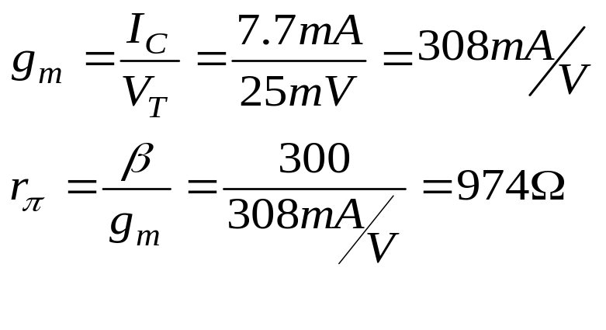
Apply KVL on the base emitter loop

Slide 36
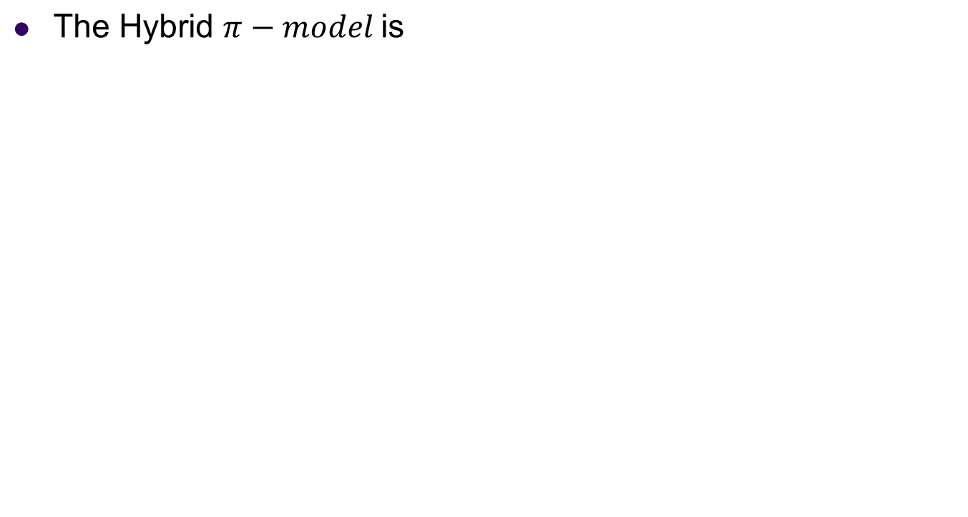
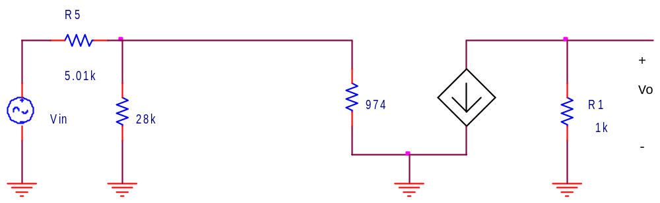
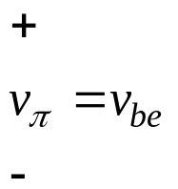

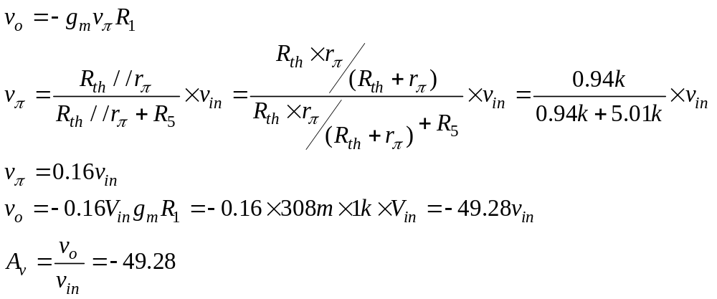

Slide 37
LTSpice Simulations of the Common Emitter Amplifier

Slide 38
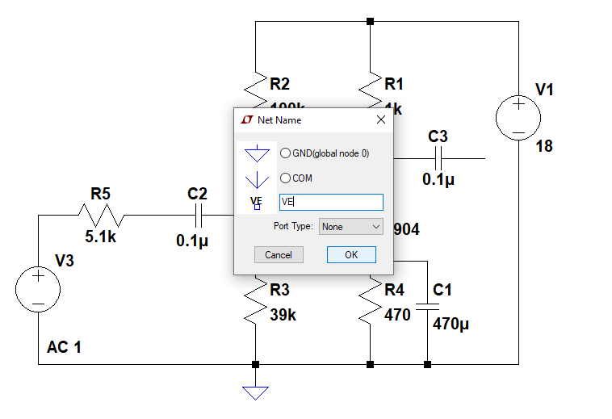
1-DC Analysis: Label NET

Slide 39
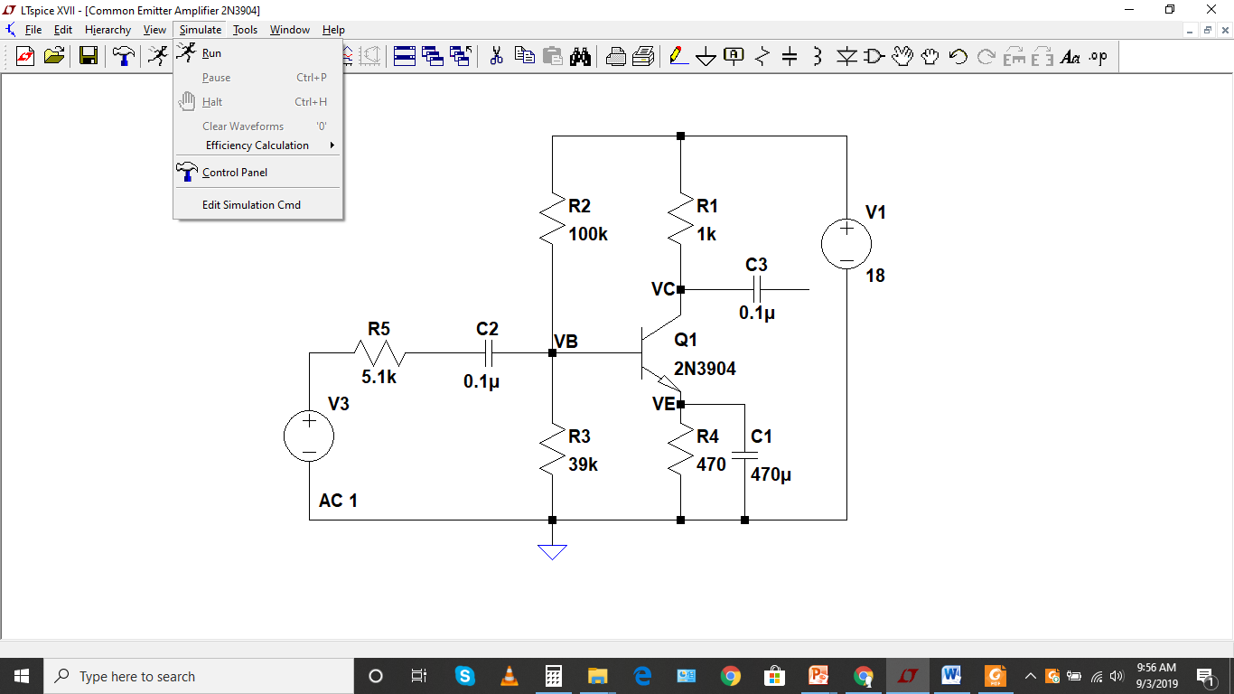
2-DC Analysis

Slide 40
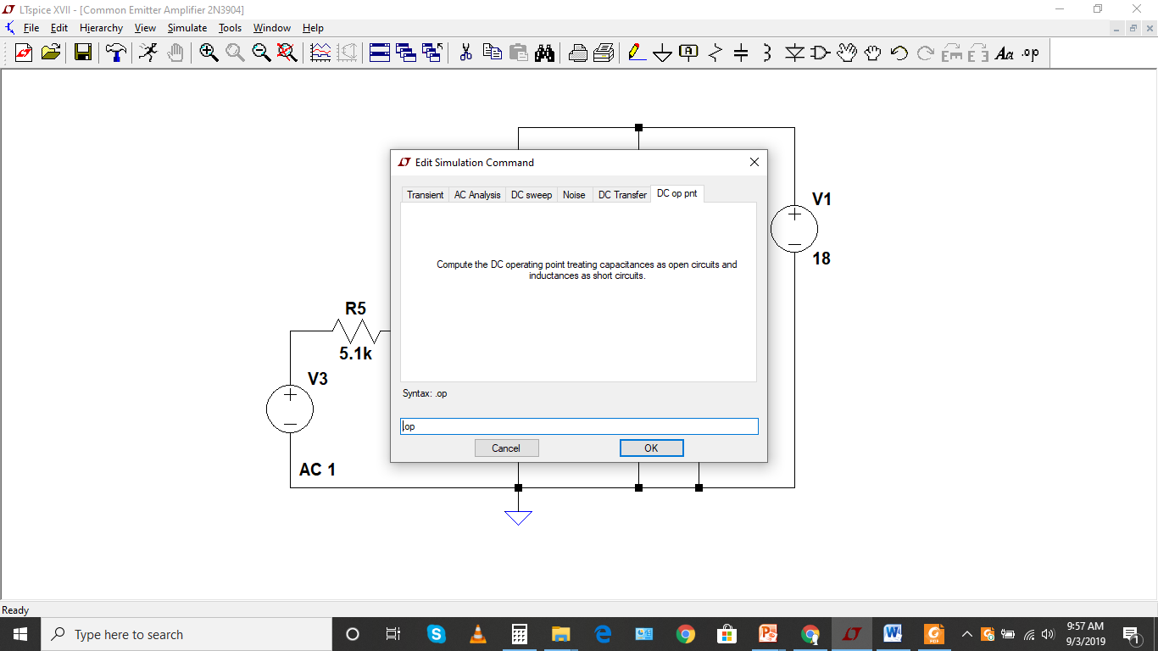
3-DC Analysis

Slide 41
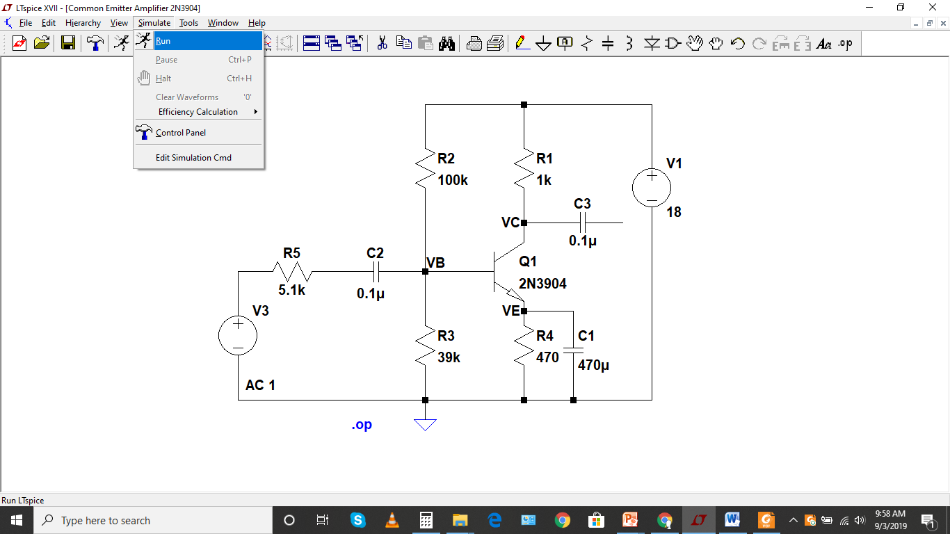
4-DC Analysis

Slide 42
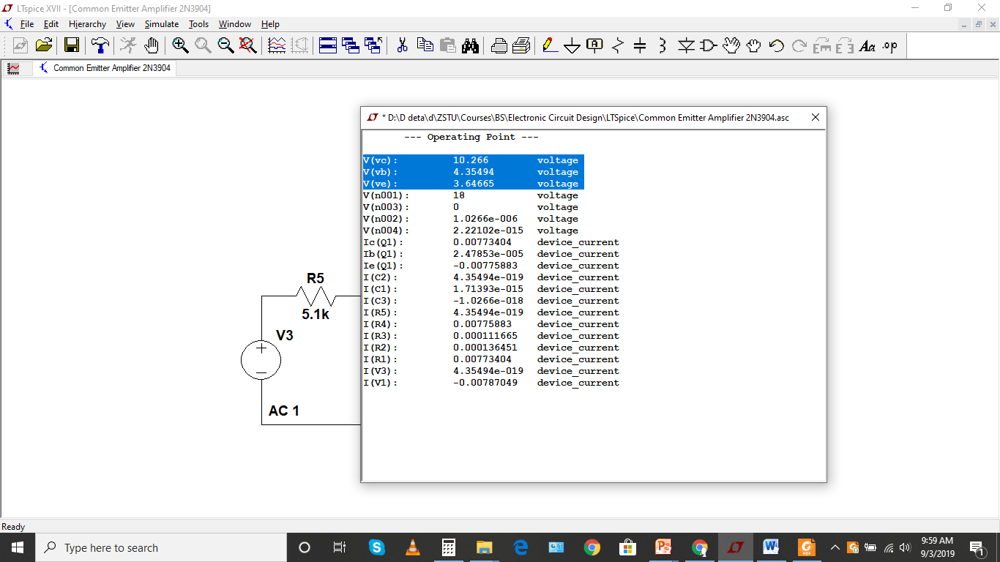
5-DC Analysis

Slide 43
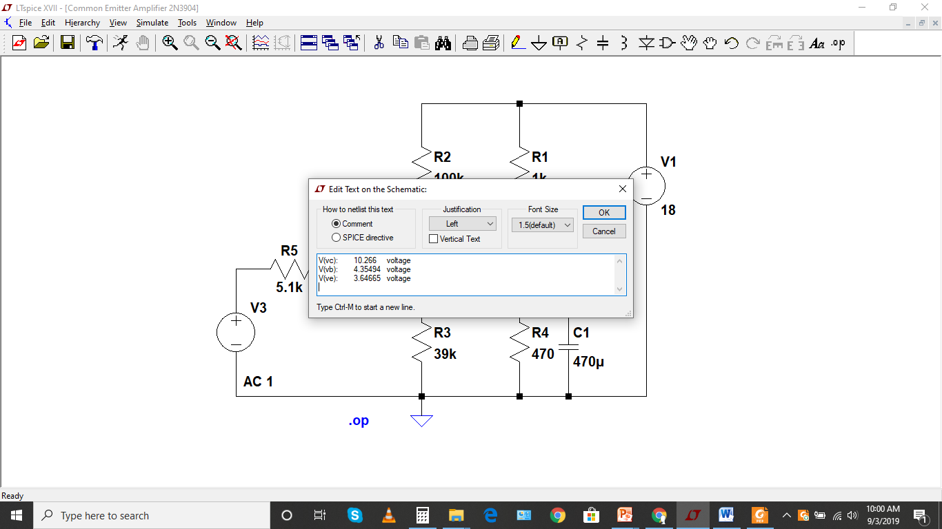
6-DC Analysis

Slide 44
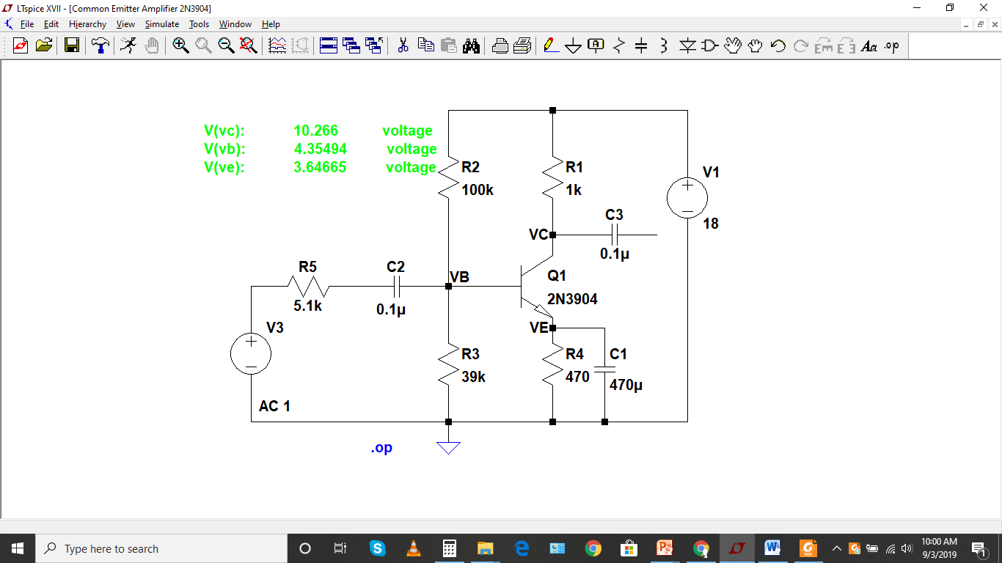
7-DC Analysis

Slide 45
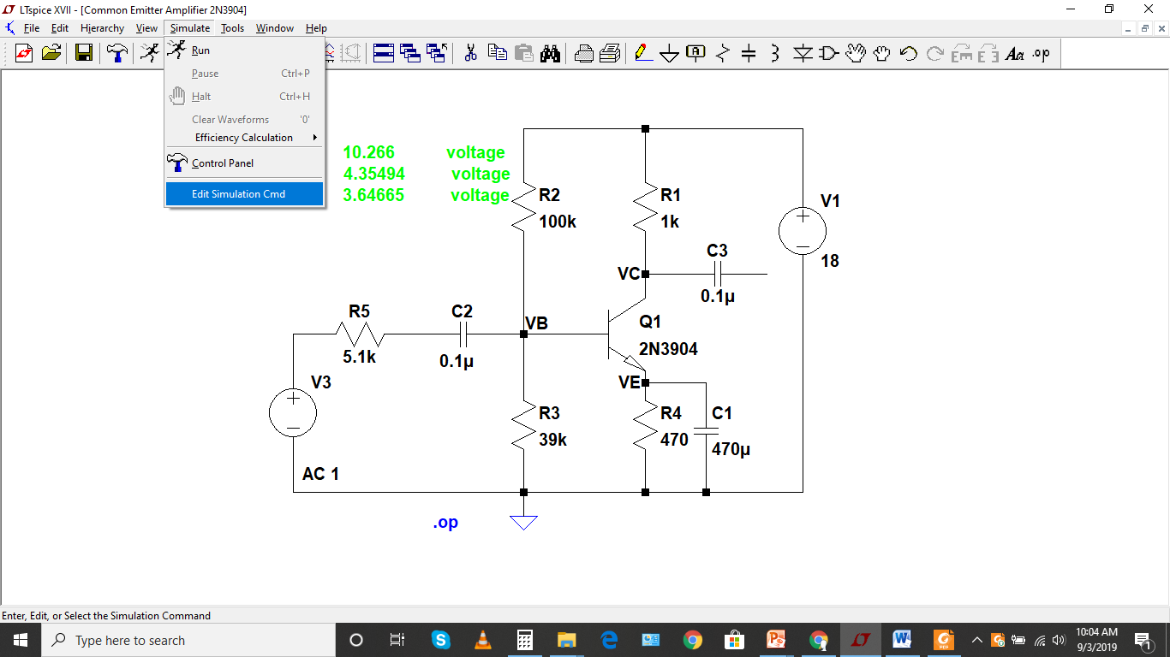
1-AC analysis

Slide 46
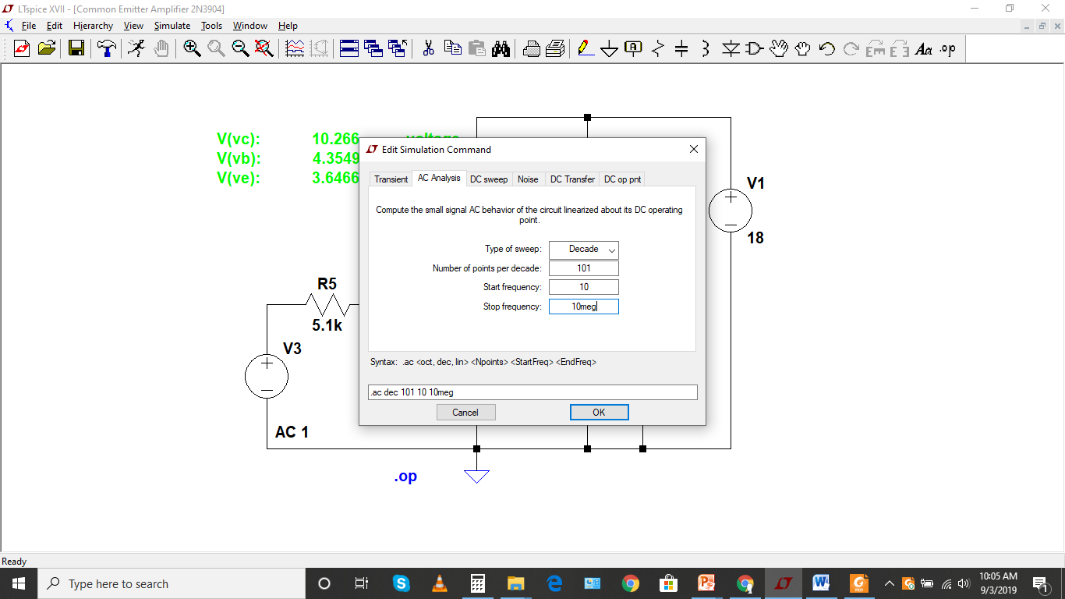
2-AC analysis

Slide 47
3-AC analysis
For the AC analysis, we are interested in GAIN, Frequency and phase shift
GAIN may be in V/V or in dB
The gain is Vo/Vin and as Vin is 1V so the gain will be Vo

Slide 48
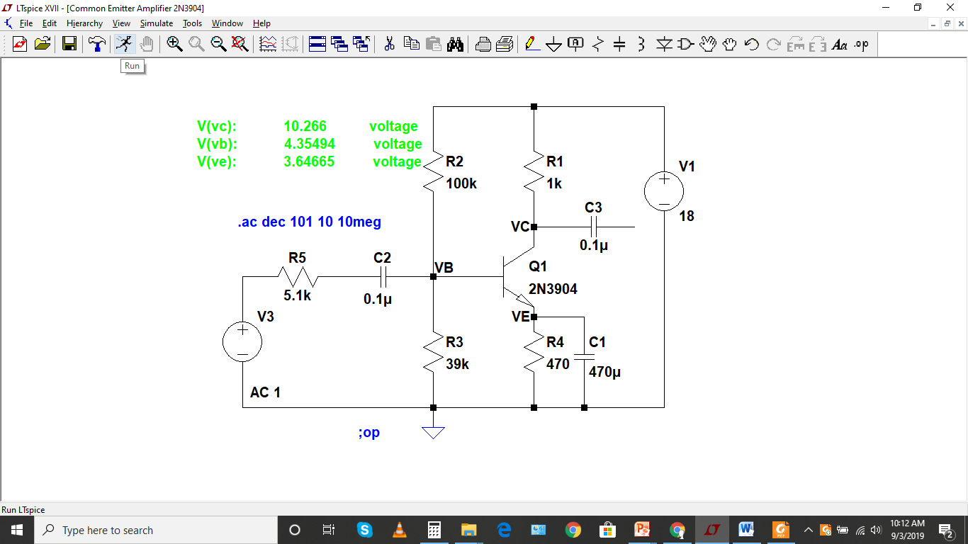
4-AC analysis

Slide 49

5-AC analysis

Slide 50

6-AC analysis

Slide 51

7-AC analysis

Slide 52

8-AC analysis

Slide 53

9-AC analysis

Slide 54

10-AC analysis

Slide 55

11-AC analysis

Slide 56

12-AC analysis

Slide 57

13-AC analysis

Slide 58

14-AC analysis

Slide 59

15-AC analysis

Slide 60
16-AC analysis
Gain = 44.64V/V
Frequency = 10.06kHz
Phase Shift = -180
Gain (dB) = 32.99dB
Now let get low and high frequencies at 3db gain
Low Frequency Gain = 29.97dB at 272.35Hz
High Frequency Gain = 29.92 dB at 298.43kHz

Slide 61

17-AC analysis

Slide 62

18-AC analysis

