Slide 1
Operational Amplifier

Slide 2
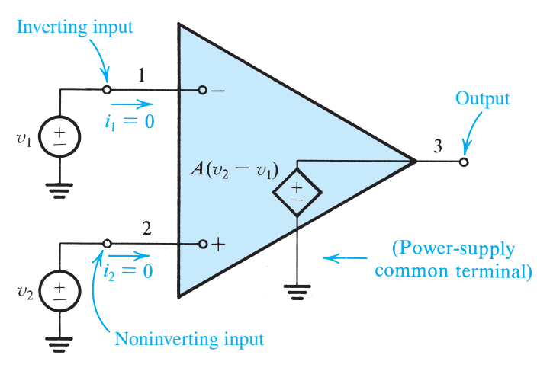
Operational Amplifier
Common-mode rejection
Open-loop gain is infinite
Infinite input resistance
Virtual Short Circuit: means that whatever voltage is at 2 will atomatically appear at 1 because of the infinite gain A
Negative feedback
Positive feedback

Slide 3
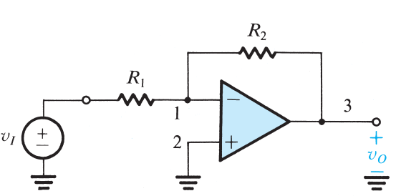
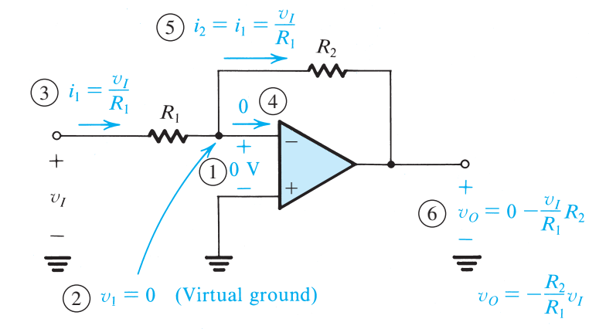

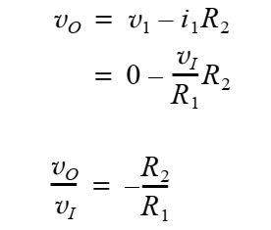
Inverting closed-loop configuration

Slide 4
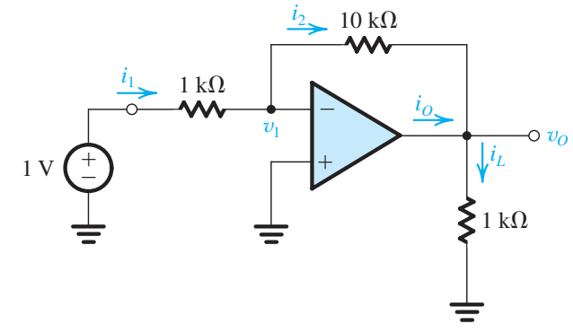

Slide 5
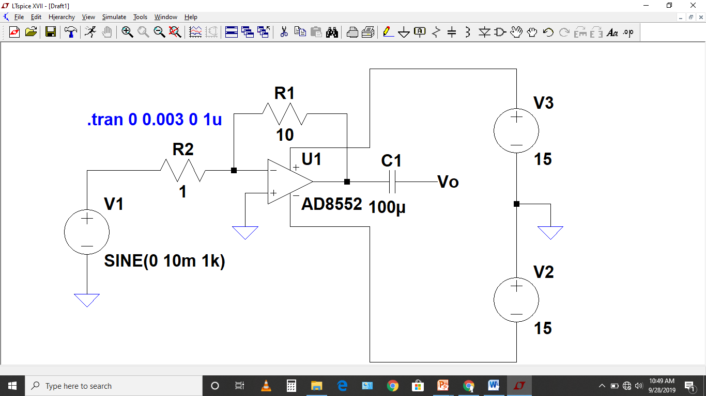
Inverting OpAmp Simulations Gain=-

Slide 6
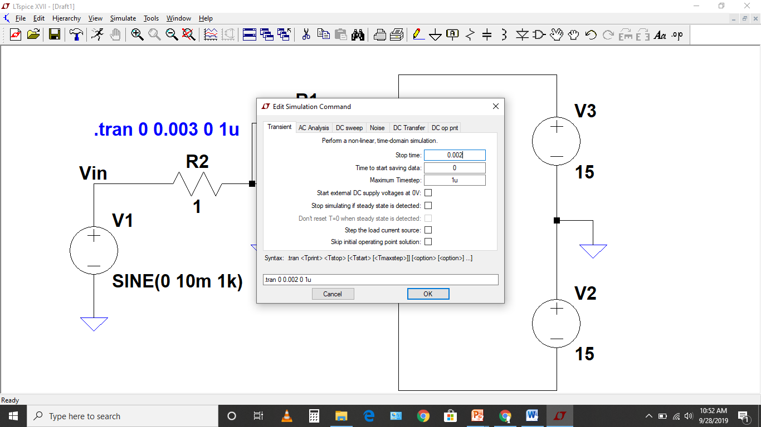
Transient Simulations

Slide 7
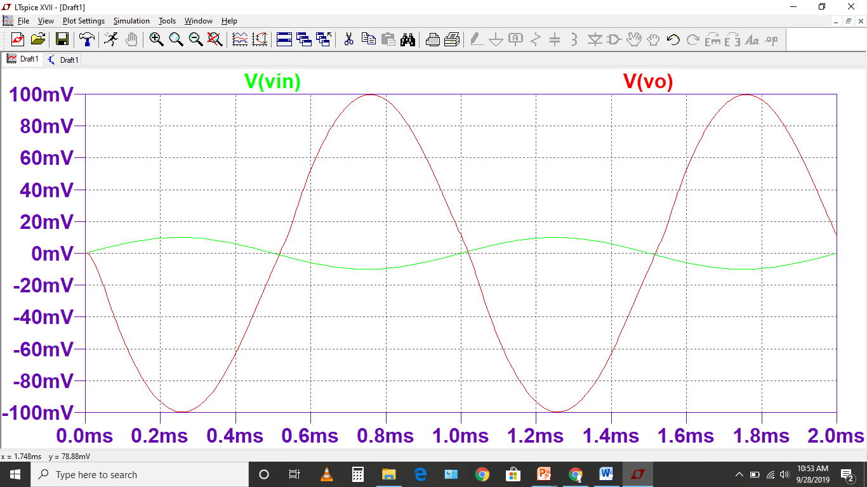
Input (Vin) and Inverting Output (Vo) 180˚out of phase with gain=10 input is 10mV and output is 100mV

Slide 8
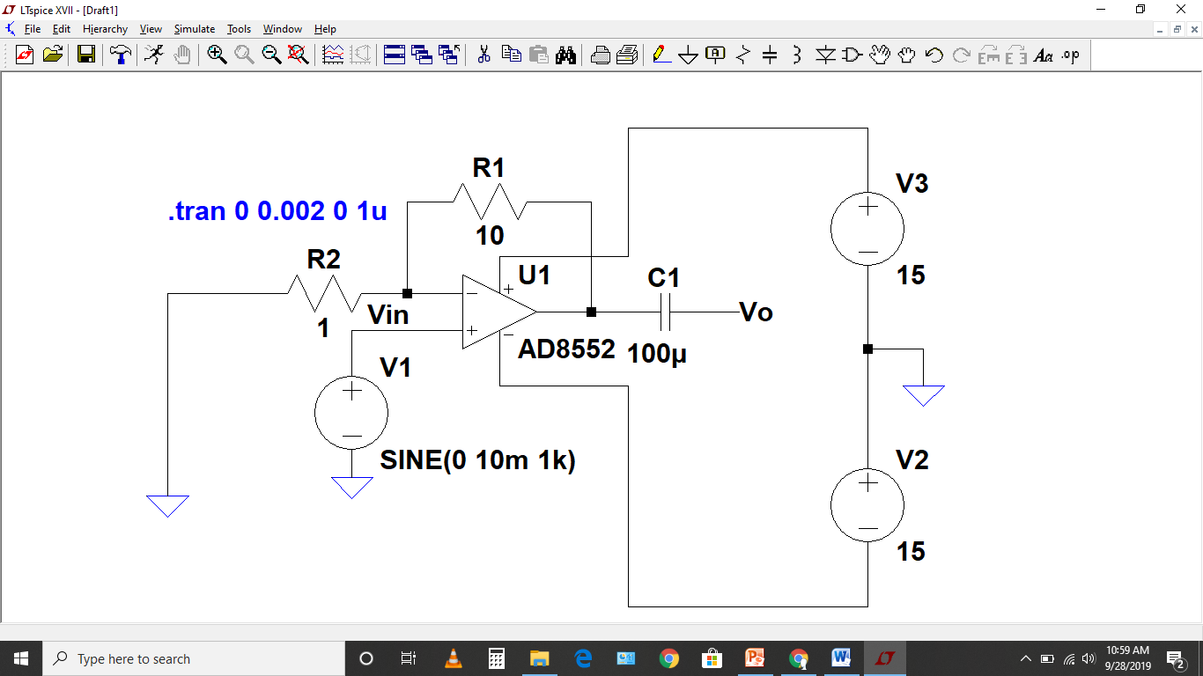
Non-inverting OpAmp Simulations Gain=

Slide 9
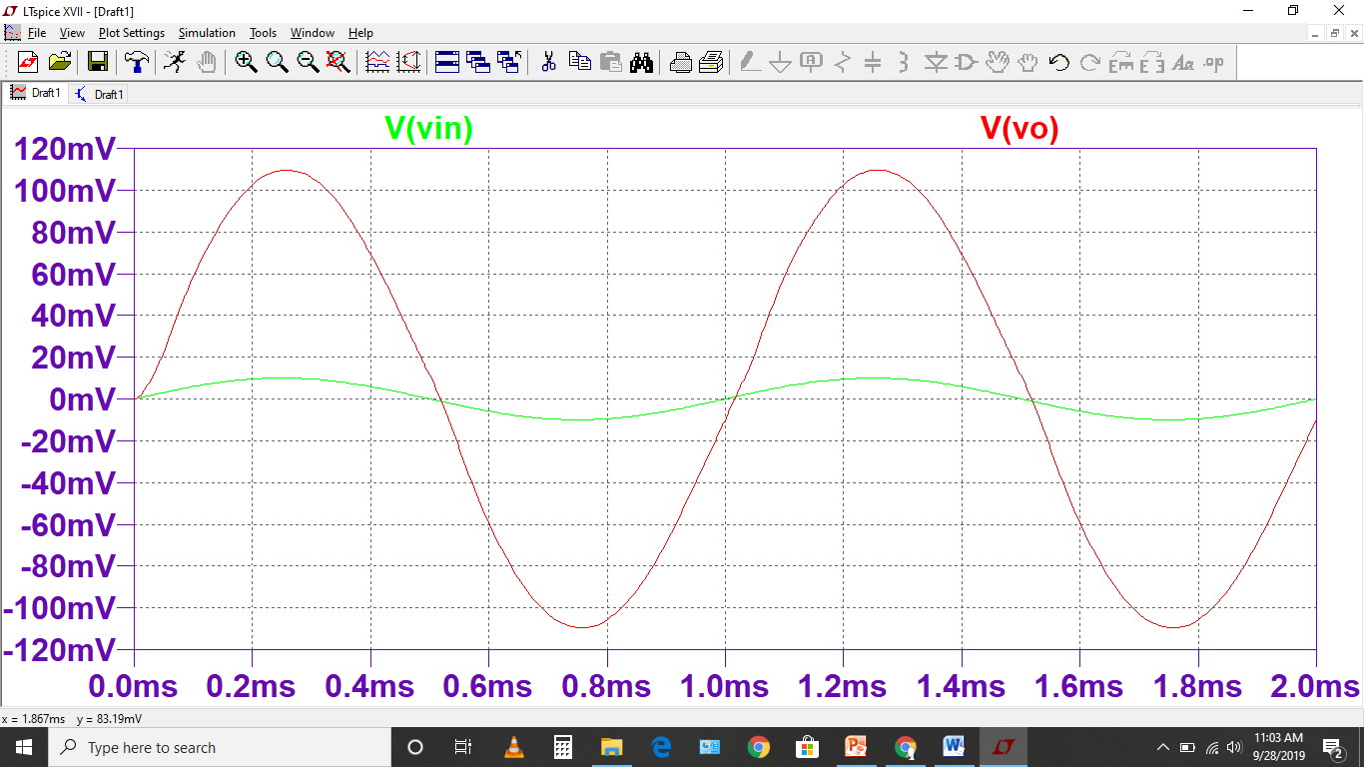
Input (Vin) and Output (Vo) are in phase, gain=11 Input is 10mV and output is 110mV

Slide 10
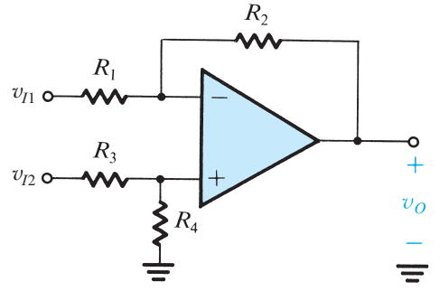
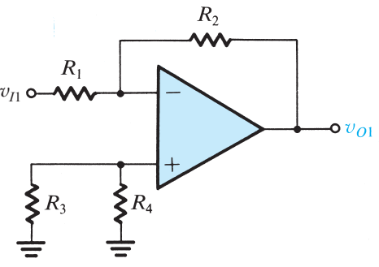
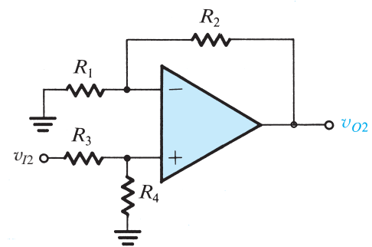
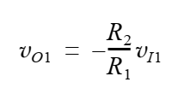
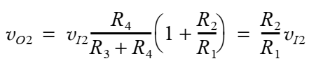
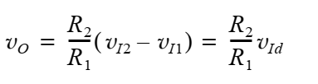


Difference Amplifier
Apply superposition principle

Slide 11
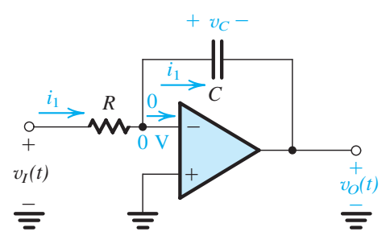
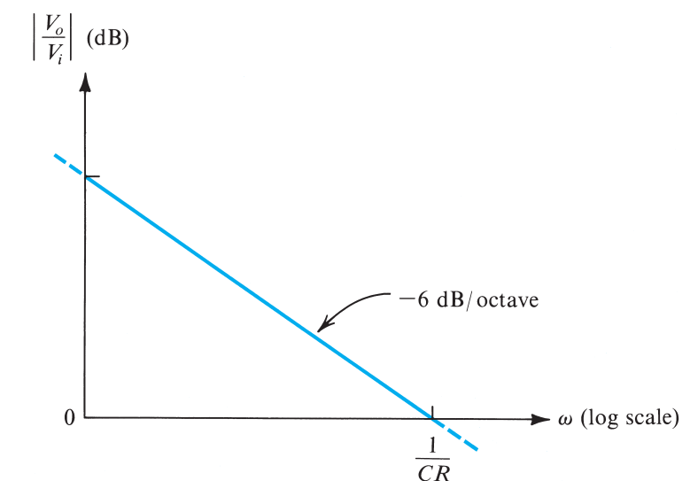
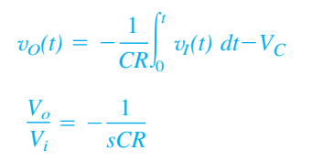
Op-Amp Integrator

Slide 12
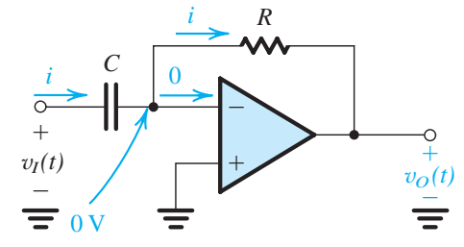
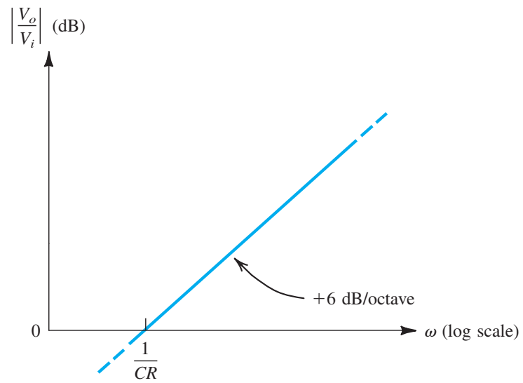
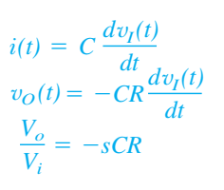
Op-Amp Diffrentiator

Slide 13
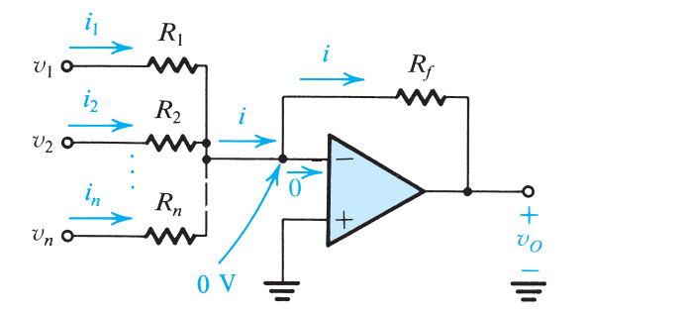


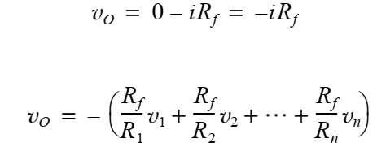

Slide 14
Difference Operational Amplifier

Slide 15
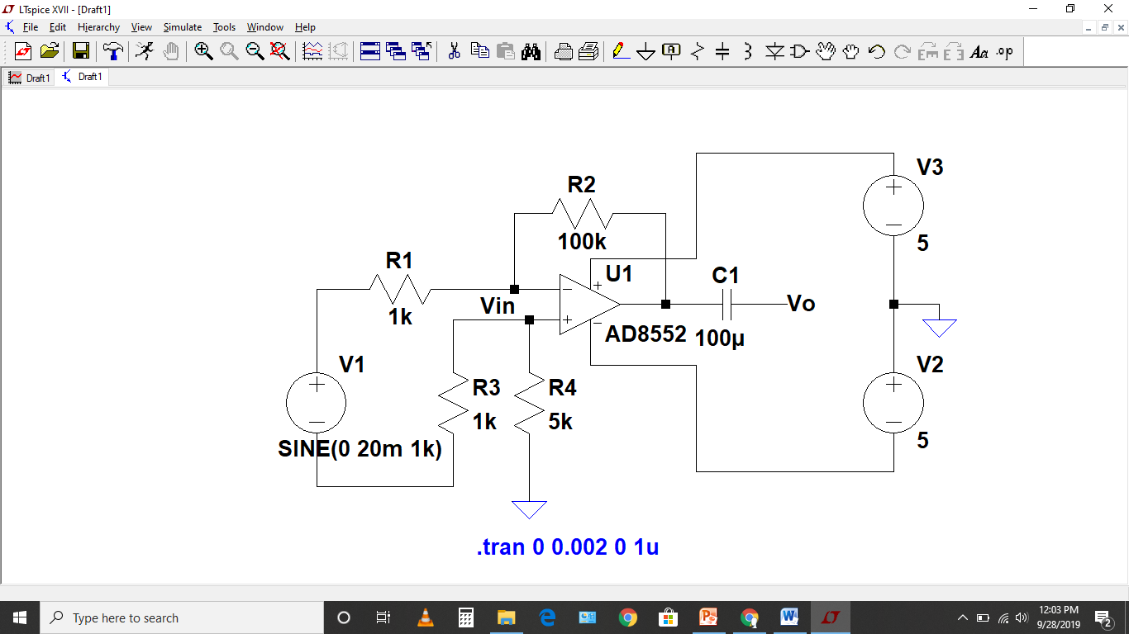
Differential OpAmp Simulations Applying differential input

Slide 16
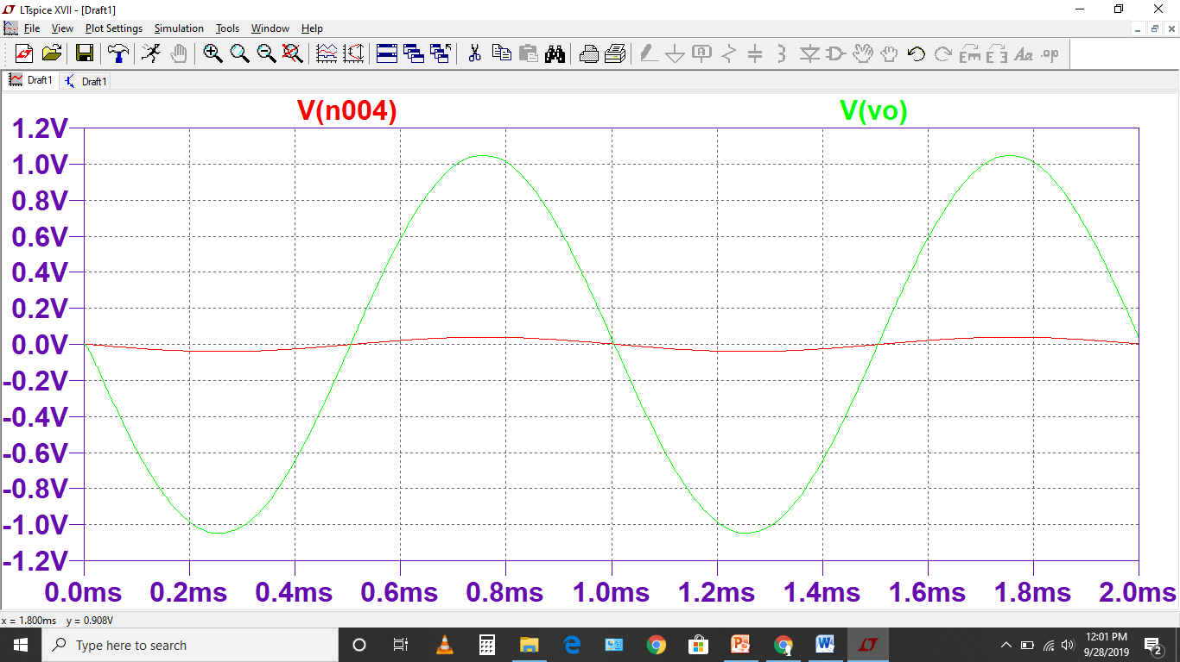
Input and output are in phase Theoretical gain can be calculated using equation No. 2.19

Slide 17
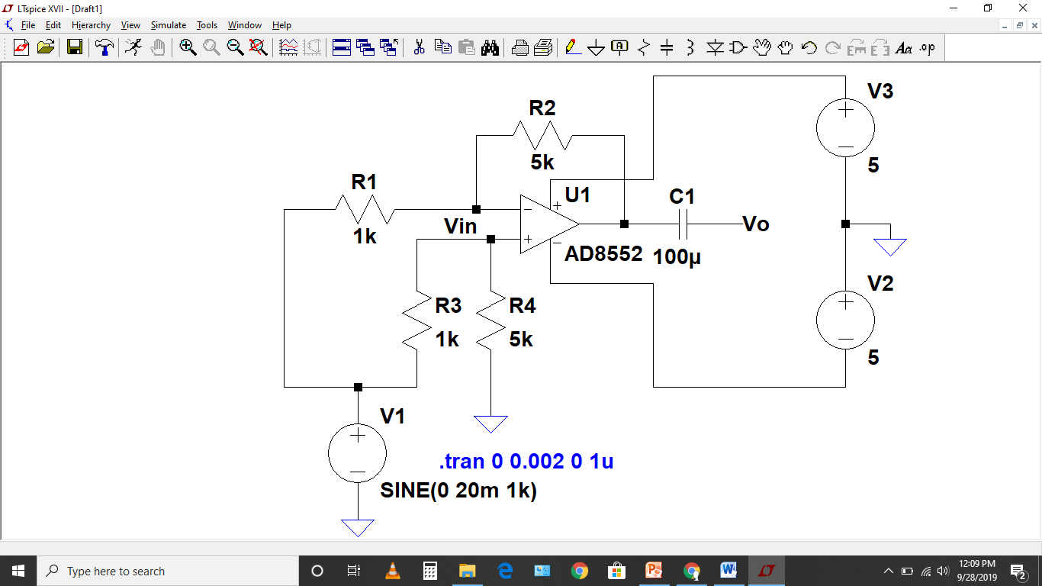
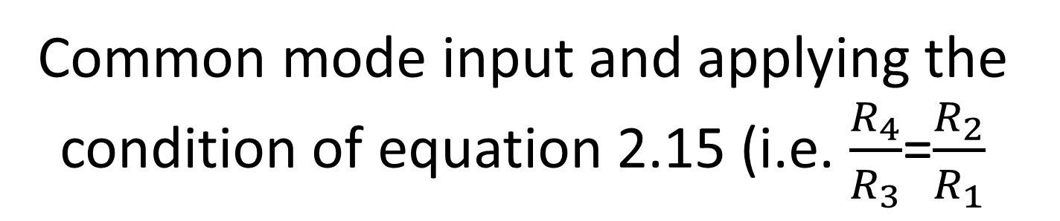
Common mode input and applying the condition of equation 2.15 (i.e. $\frac{R_{4}}{R_{3}}$=$\frac{R_{2}}{R_{1}}$

Slide 18
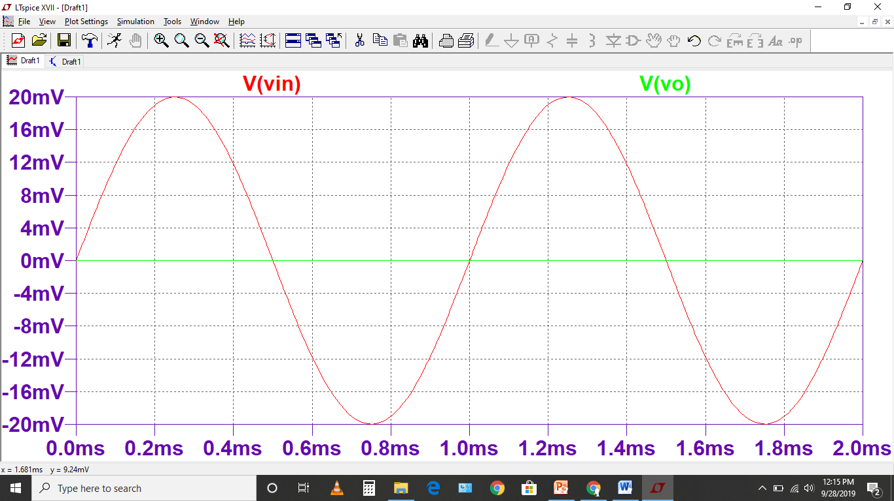
Output is zero because of the common mode rejection of the differential Opamp

