Slide 1
DC-DC Converters Simulations

Slide 2
Contents
Content
Boost Converter
Buck Converter
Synchronous Buck Converter
Book: “Power Electronics”, Daniel W. Hart, Mc-Graw Hill

Slide 3
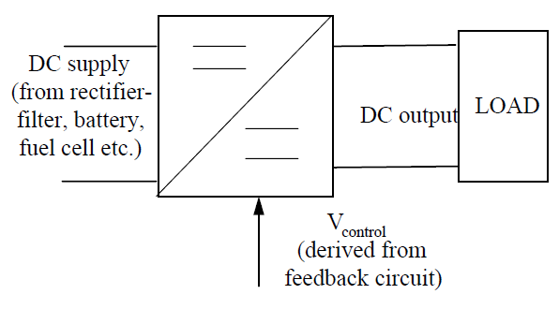
Converters
Converting the unregulated DC input to a controlled DC output with a desired voltage level
General block diagram:
APPLICATIONS:
Switched-mode power supply (SMPS), DC motor control, battery chargers, Renewabal Energy Systems

Slide 4
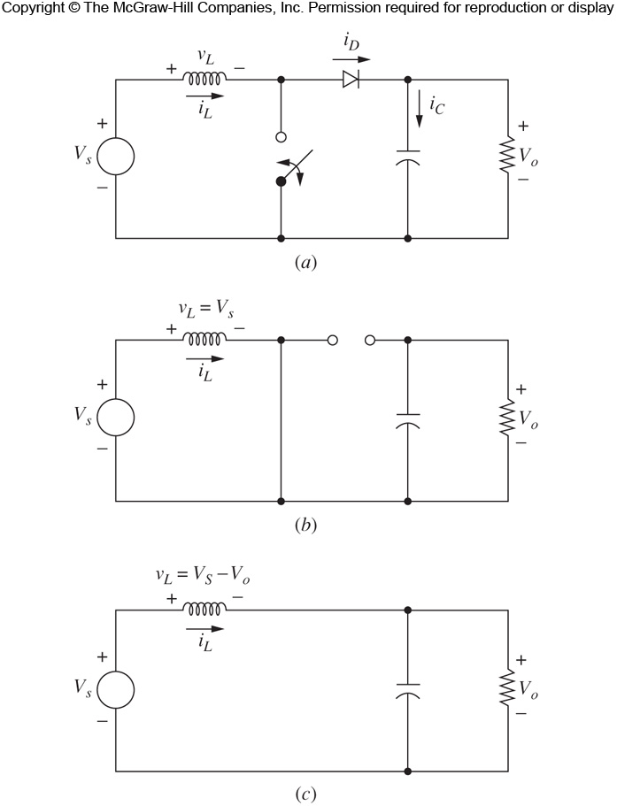
Boost (Step-up) Converter
Boost converter produces output voltage that is greater or equal to the input voltage.
Circuit
The dynamic (changing) element is switch, therefore two states of operation
1. Switch closed, diode OFF
2. Switch open, diode ON

Slide 5
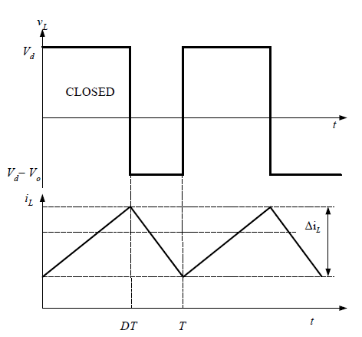
Boost Converter
Switch closed, diode OFF

Slide 6
Boost Converter
Switch open, diode ON

Slide 7
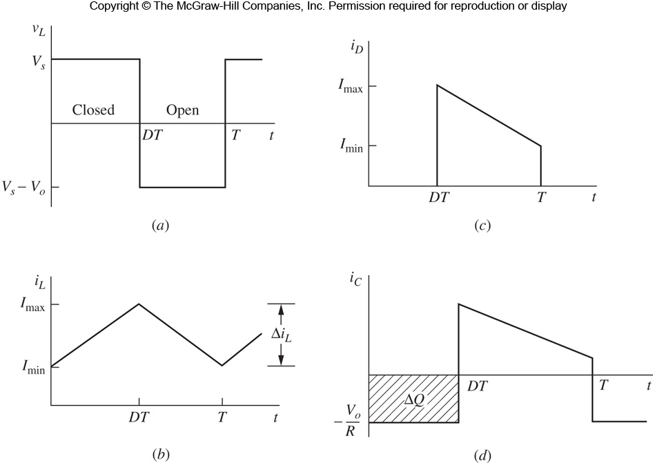
Boost Converter
Steady-state Operation
Boost converter produces output voltage that is greater or equal to the input voltage.
Alternative explanation:
when switch is closed, diode is reversed. Thus output is isolated. The input supplies energy to inductor.
When switch is opened, the output stage receives energy from the input as well as from the inductor. Hence output is large.
Output voltage is maintained constant by virtue of large C.

Slide 8
Boost Converter
Output Voltage Ripple

Slide 9
Boost Converter
Average, Max & Min Inductor Current

Slide 10
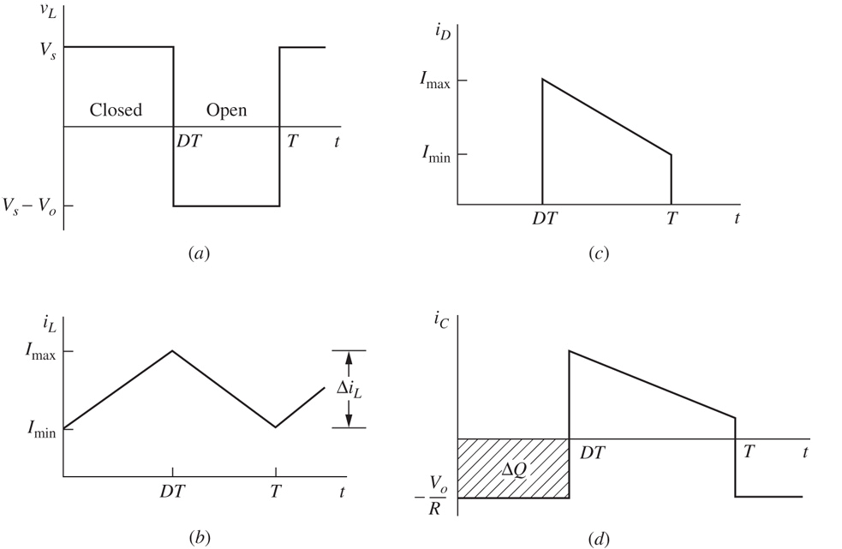
Boost Converter
Waveforms
Inductor voltage
Diode current
Inductor current
Capacitor current

Slide 11
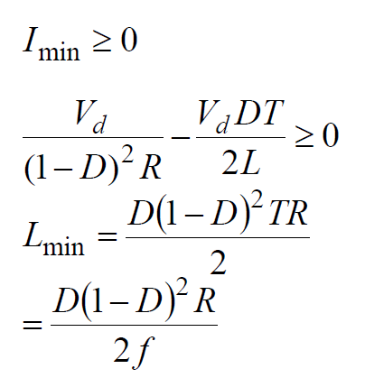
Boost Converter
For continuous operation,

Slide 12


Boost Converter Design
Design a boost converter that will have an output of 30 V from a 12-V source. Design for continuous inductor current and an output ripple voltage of less than one percent. The load is a resistance of 50 . Assume ideal components for this design.
Find D

Slide 13

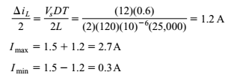

Boost Converter Design

Slide 14
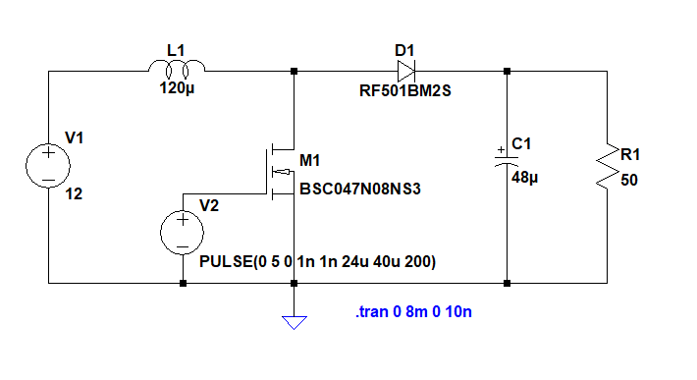
Boost Converter LTSpice Simulations

Slide 15
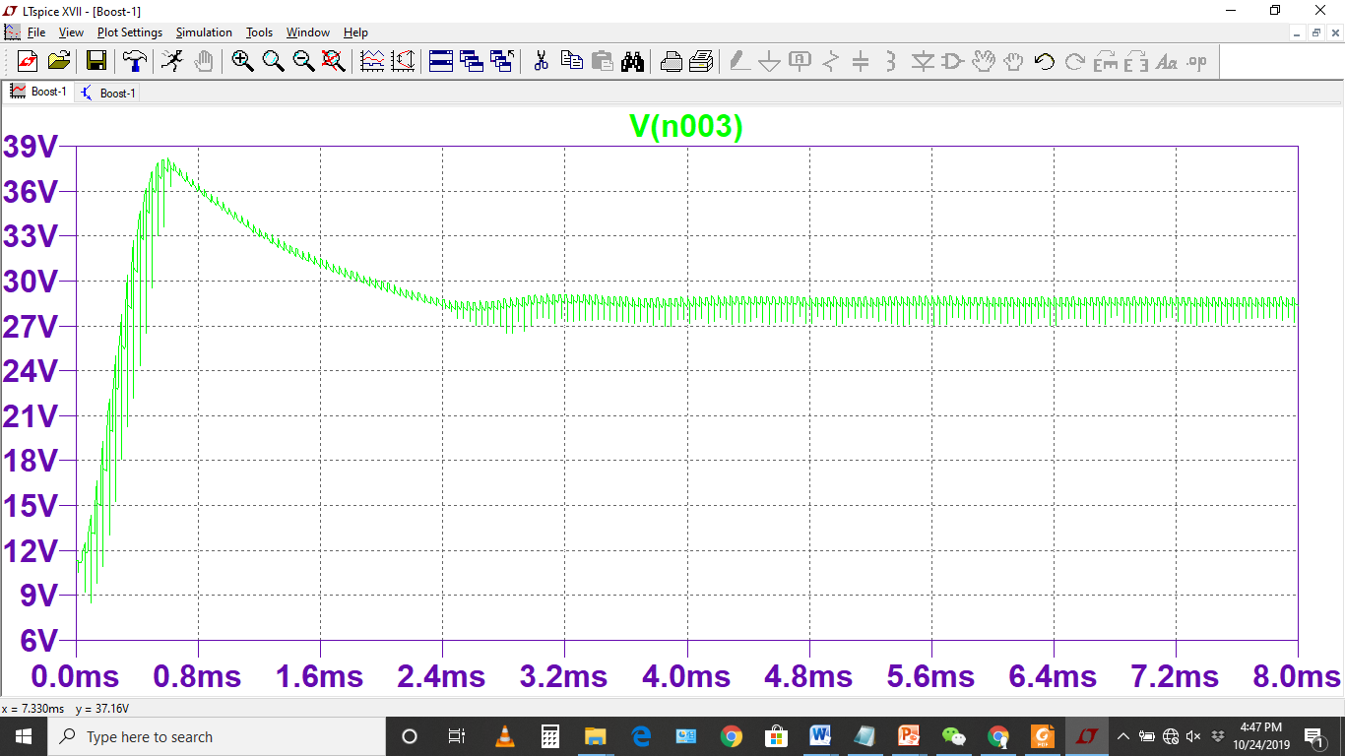
Output Voltage

Slide 16
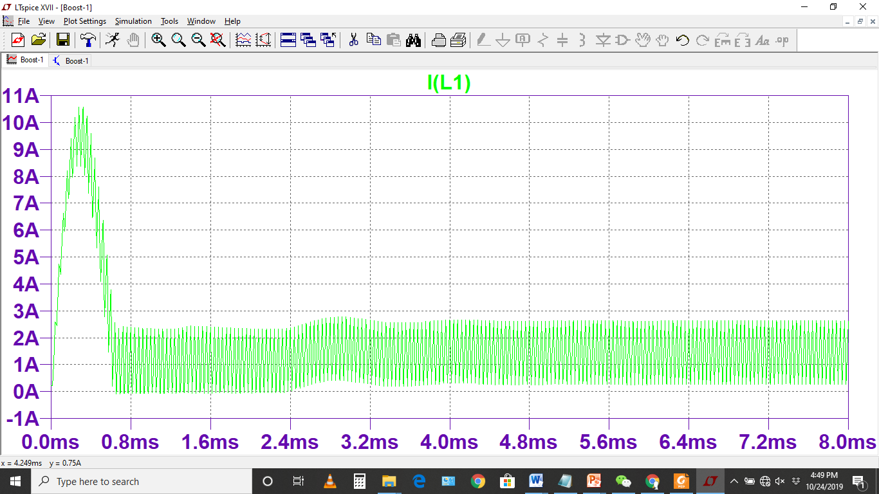
Inductor current

Slide 17
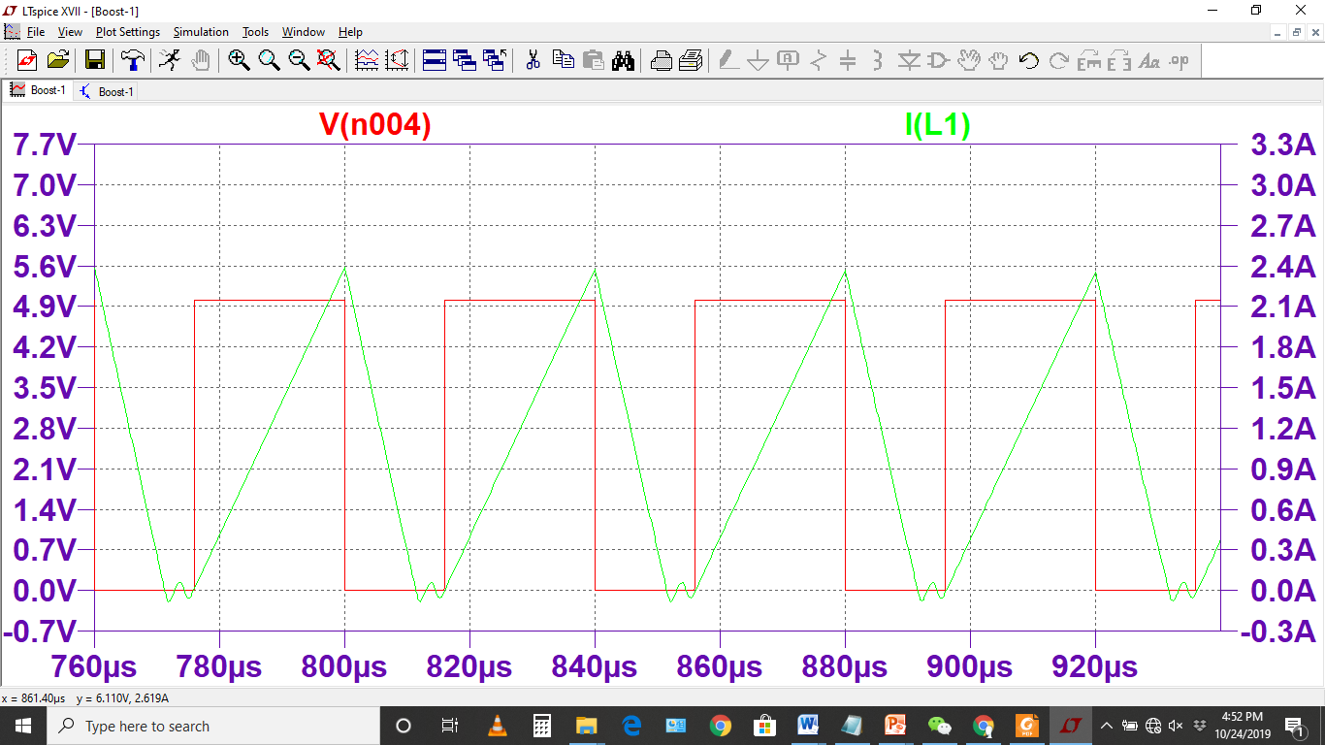
Close look of Inductor current with Switching Signal

Slide 18
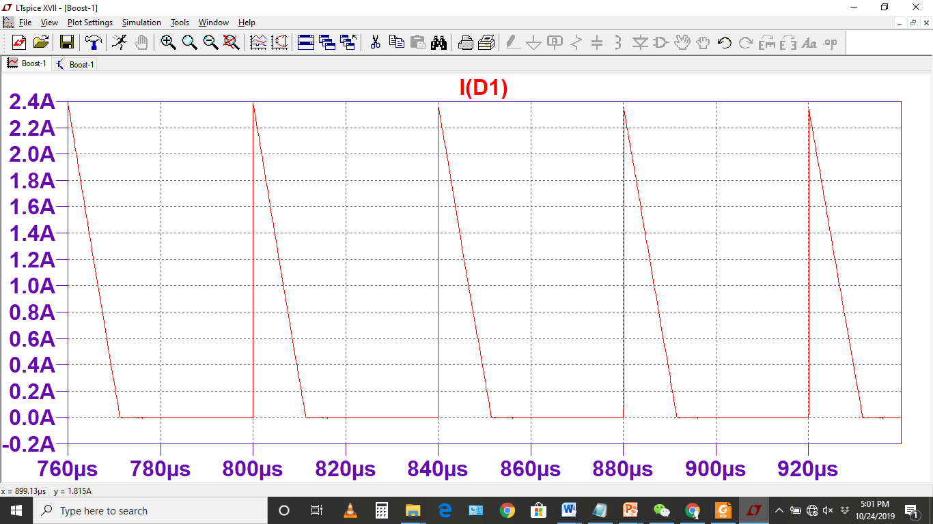
Diode current

Slide 19
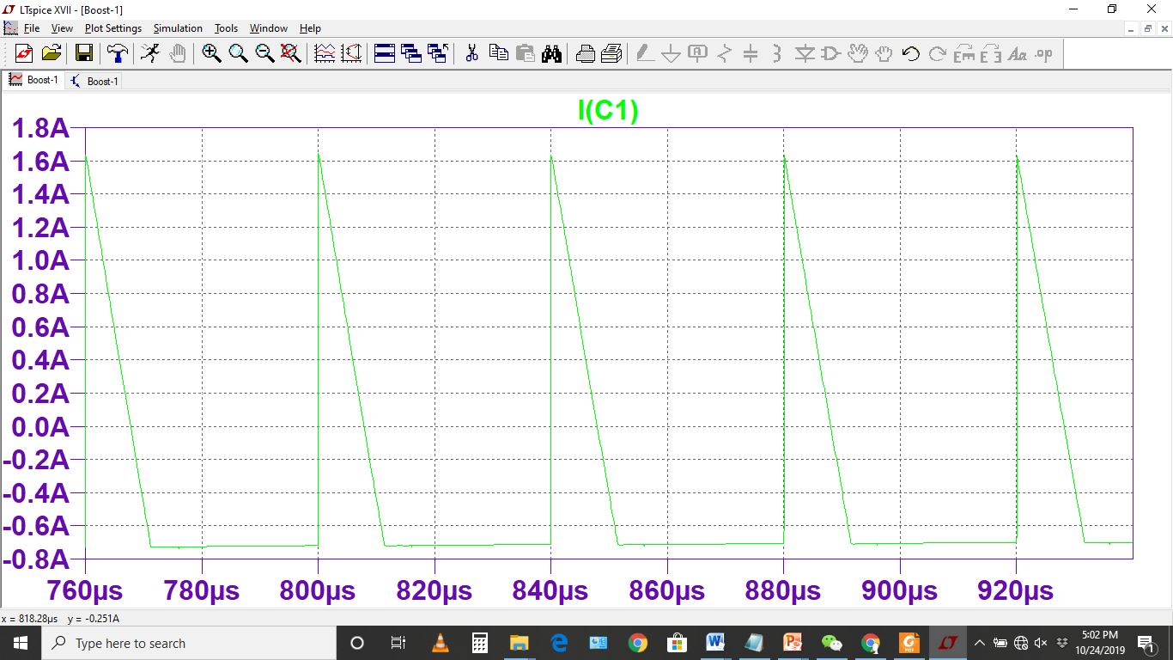
Capacitor Current

Slide 20
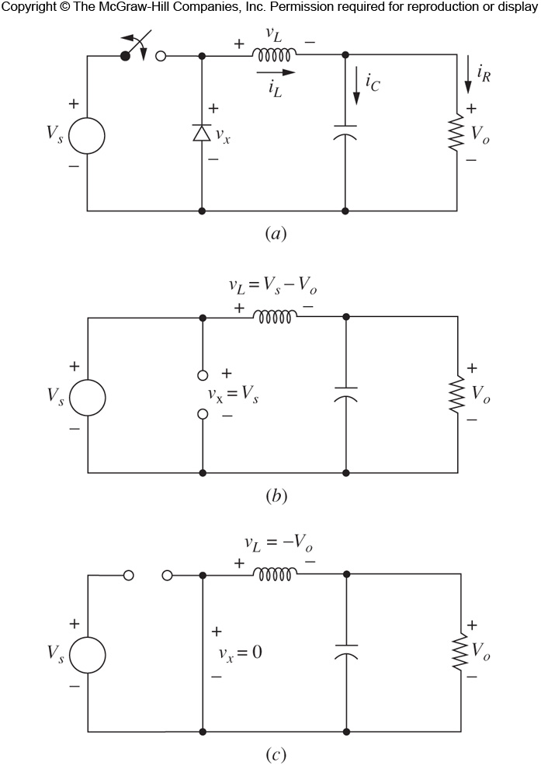
Buck Converter
Buck converter produces an output voltage that is lesser or equal to the input voltage.
Circuit
The dynamic (changing) element is switch, therefore two states of operation
1. Switch closed, diode OFF
2. Switch open, diode ON

Slide 21
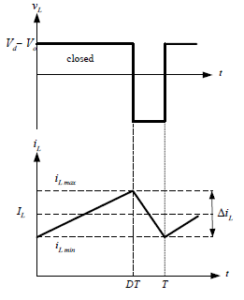
Buck Converter: Switch Close
Switch closed, diode off

Slide 22
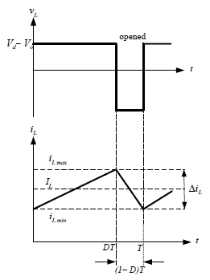
Buck Converter: Switch Close
Switch closed, diode ON

Slide 23
Buck Converter
Steady-state Operation
Steady-state operation requires that iL at the end of switching cycle is the same at the beginning of next cycle.
The change of iL over one period is zero, i.e:

Slide 24
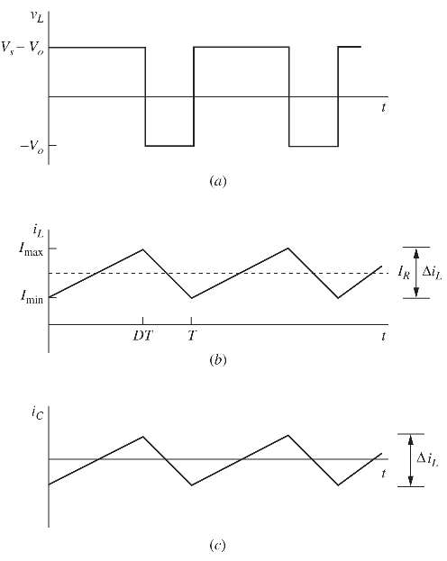
Waveforms
Inductor
voltage
Inductor
current
Capacitor
current

Slide 25
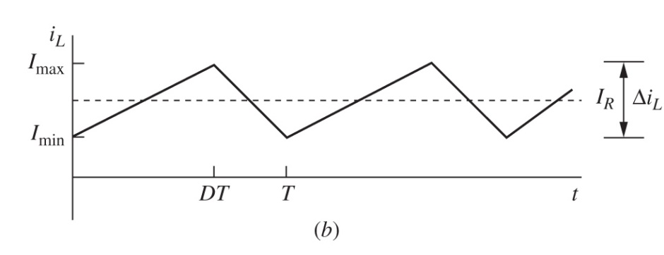
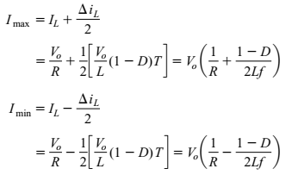
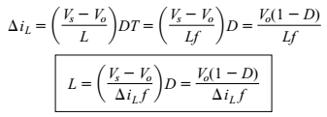


Buck Converter
Inductor Value
To determine the value of inductance for a specified peak-to-peak inductor current for continuous-current operation:

Slide 26
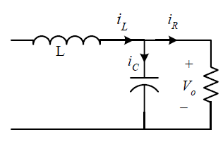

Buck Converter

Slide 27
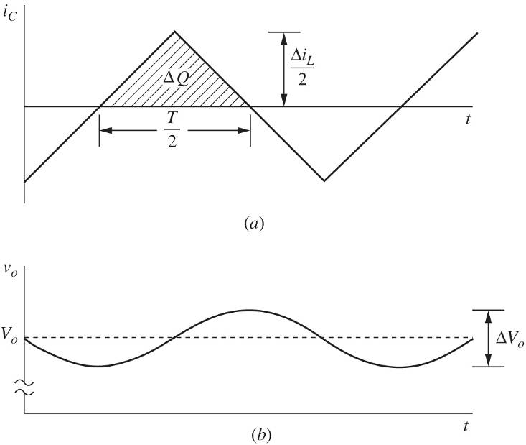
Buck Converter
Output Voltage Ripple

Slide 28
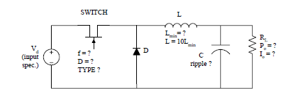
Design: Buck Converter
Calculate D to obtain required output voltage.
Select a particular switching frequency:
preferably >20KHz for negligible acoustic noise
higher fs results in smaller L, but higher device losses. Thus lowering efficiency and larger heat sink. Also C is reduced.
Possible devices: MOSFET, IGBT and BJT. Low power MOSFET can reach MHz range.

Slide 29
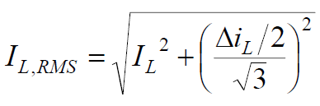
Design: Buck Converter
Determine L_{min}: Increase L_{min} by about 10 times to ensure full continuous mode.
Calculate C for ripple factor requirement.
Capacitor ratings:
must withstand peak output voltage
must carry required RMS current. Note RMS current for triangular w/f is Ip/3, where Ip is the peak capacitor current given by ΔiL/2
Wire size consideration:
Normally rated in RMS. But i_{L} is known as peak. RMS value for i_{L} is given as:

Slide 30
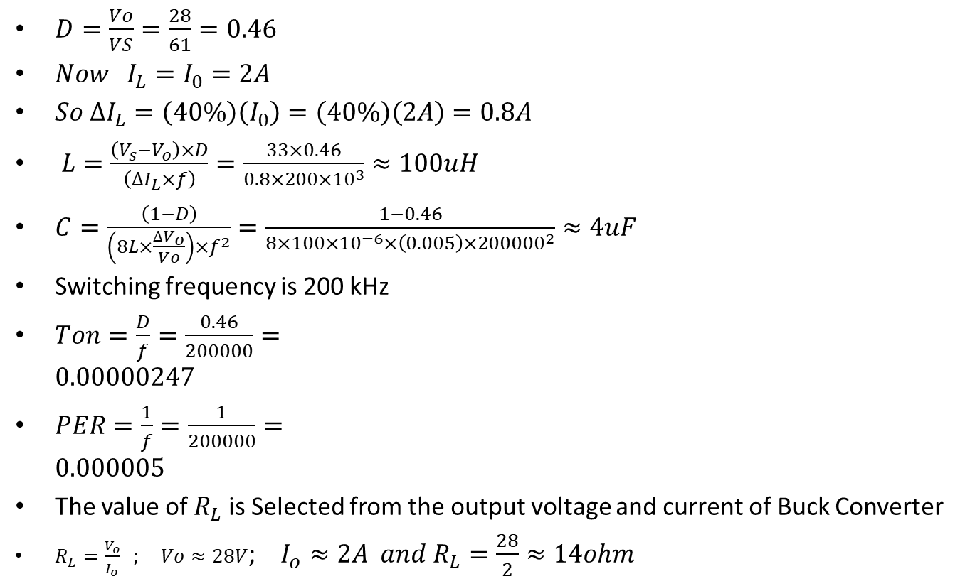
Buck Converter Design
Design a converter Vin = 61V and Vout = 28V, Load Current is 2A, inductor current variation is 40% of load current and operating frequency is 200kHz
$D=\frac{Vo}{VS}=\frac{28}{61}=0.46$
$Now I_{L}=I_{0}=2A$
$So ∆I_{L}=\left(40\%\right)\left(I_{0}\right)=\left(40\%\right)\left(2A\right)=0.8A$
$L=\frac{\left(V_{s}−V_{o}\right)×D}{\left(∆I_{L}×f\right)}=\frac{33×0.46}{0.8×200×{10}^{3}}≈100uH$
$C=\frac{\left(1−D\right)}{\left(8L×\frac{∆V_{o}}{Vo}\right)×f^{2}}=\frac{1−0.46}{8×100×{10}^{−6}×\left(0.005\right)×{200000}^{2}}≈4uF$
Switching frequency is 200 kHz
$Ton=\frac{D}{f}=\frac{0.46}{200000}=0.00000247$
$PER=\frac{1}{f}=\frac{1}{200000}=0.000005$
The value of $R_{L}$ is Selected from the output voltage and current of Buck Converter
$R_{L}=\frac{V_{o}}{I_{o}} ; Vo≈28V$; $I_{o}≈2A and R_{L}=\frac{28}{2}≈14ohm$

Slide 31
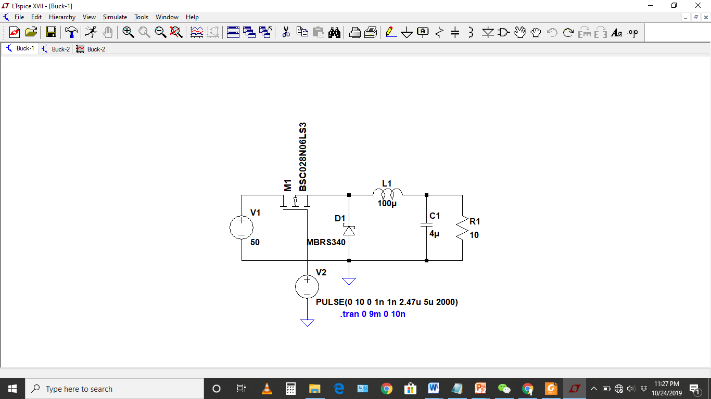
Problem

Slide 32
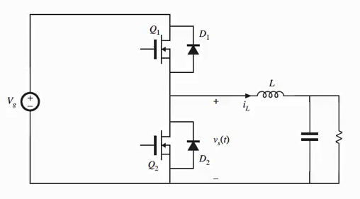
Synchronous Buck Converter Design

Slide 33
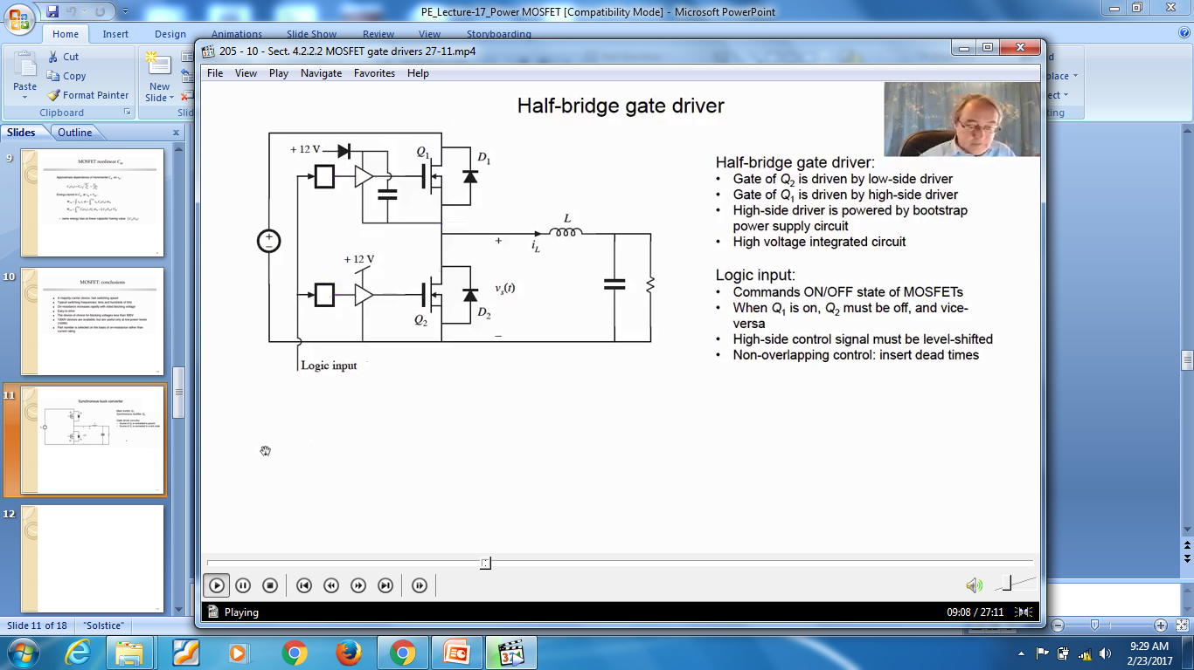
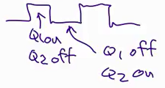

Slide 34
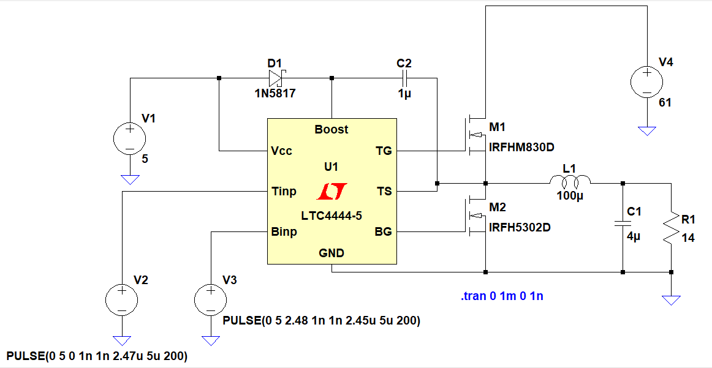
LTSpice Simulations

Slide 35
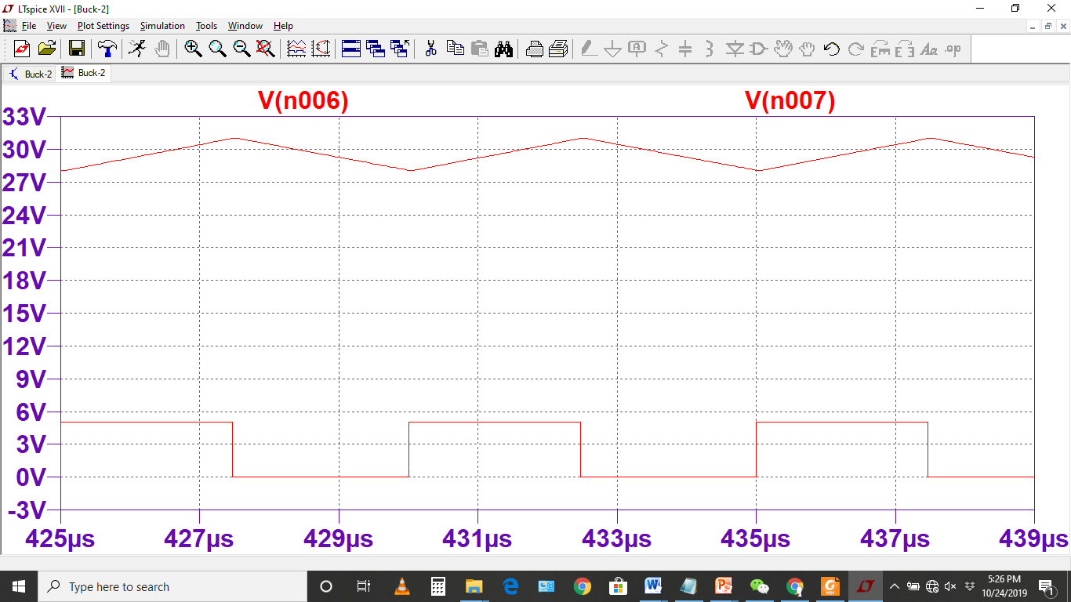
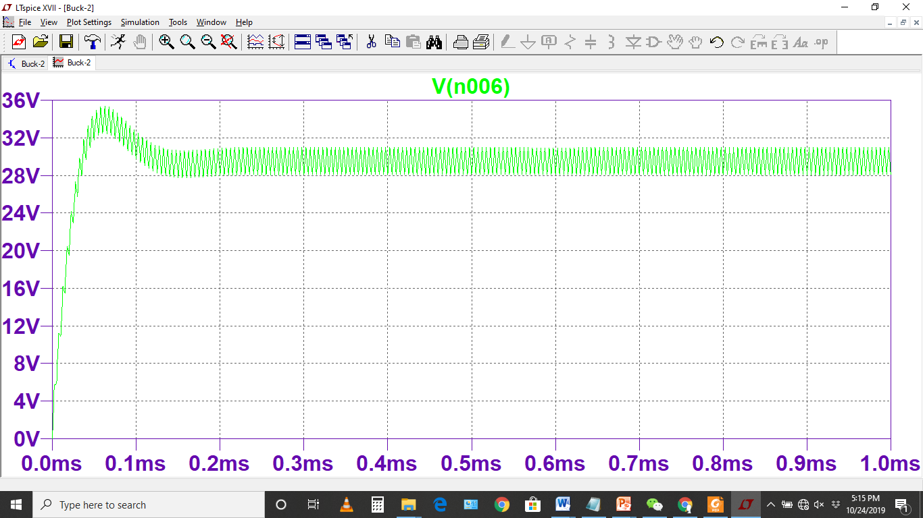
Output Voltage

Slide 36
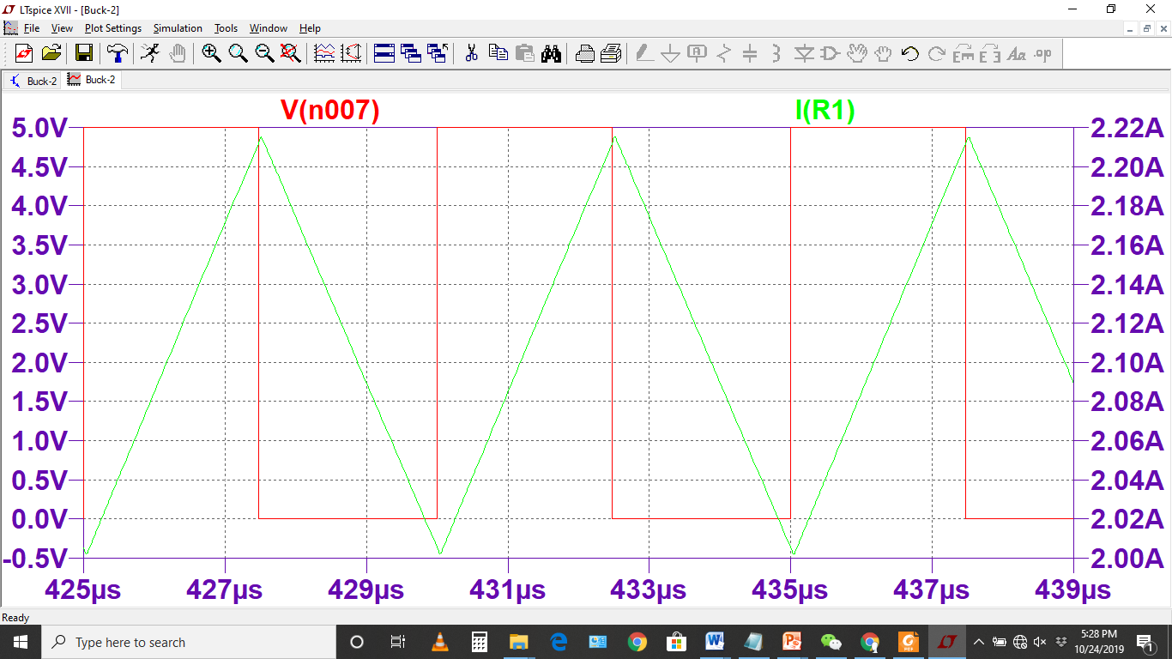
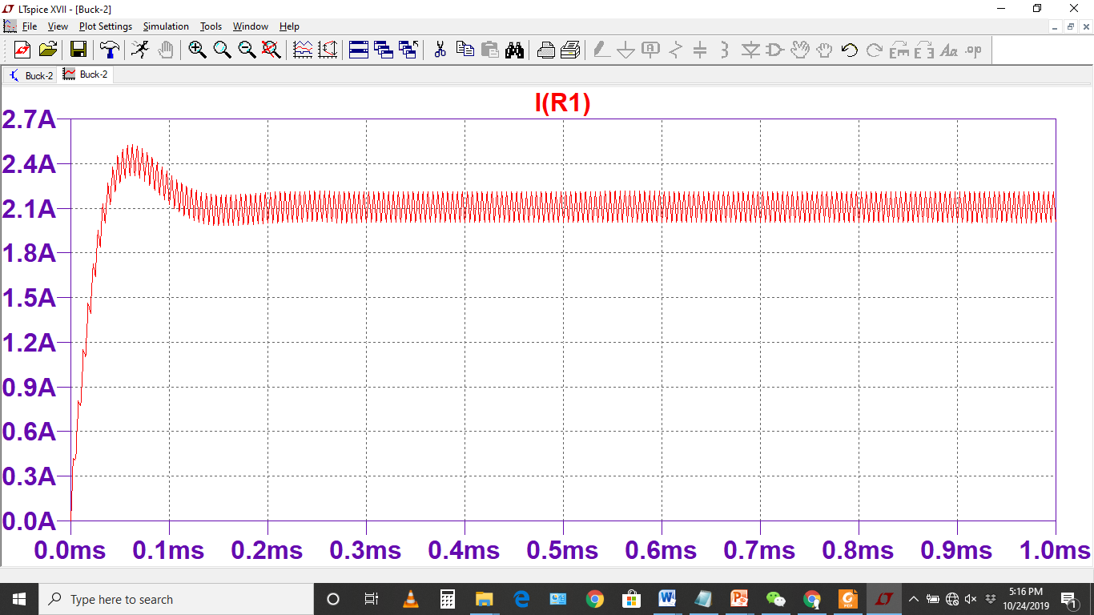
Output Current

Slide 37
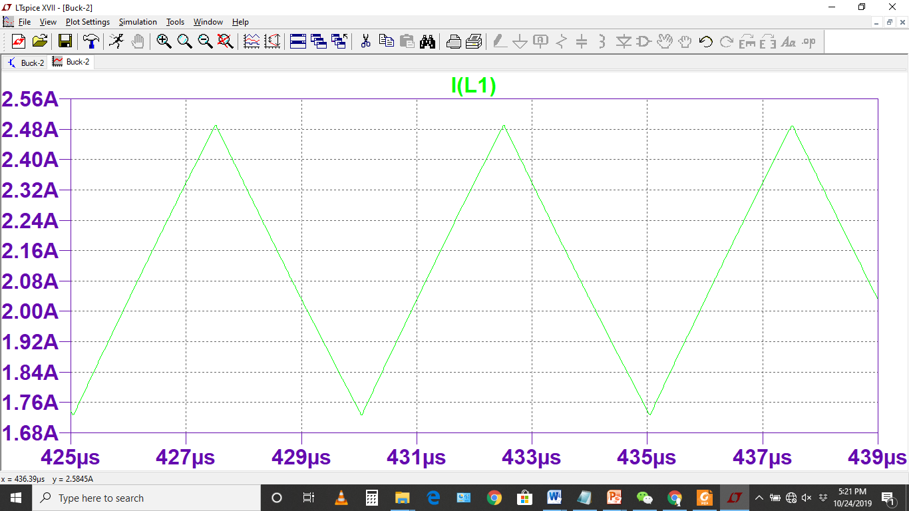
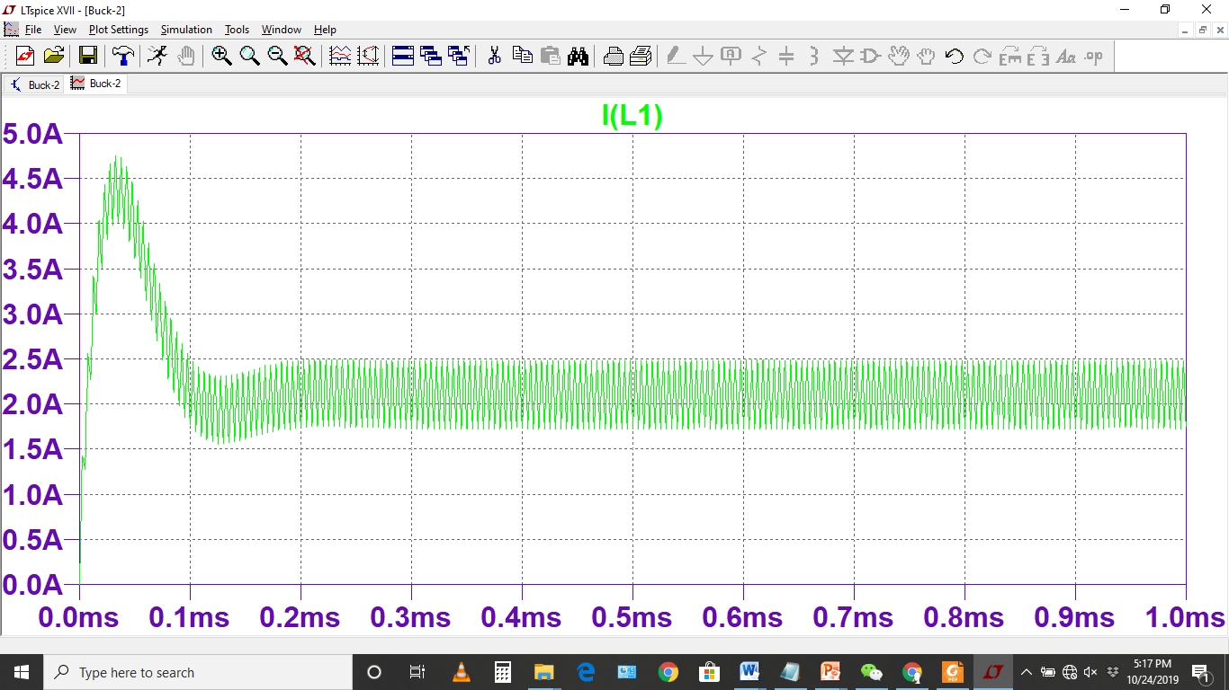
Inductor Current

Slide 38
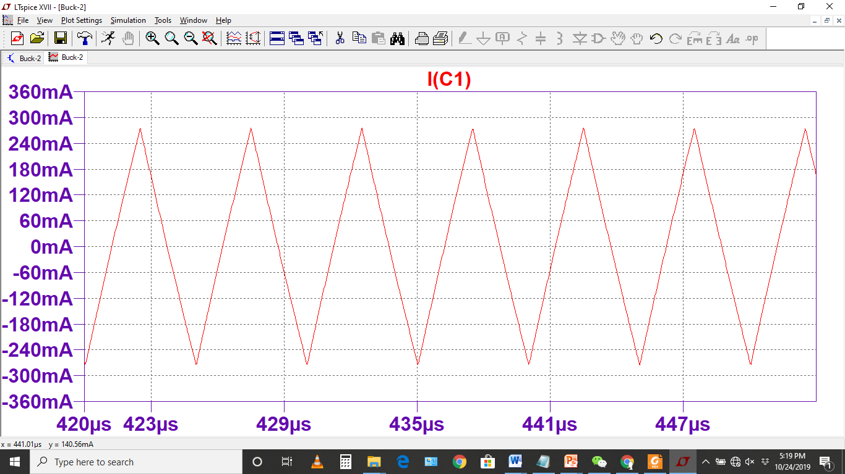
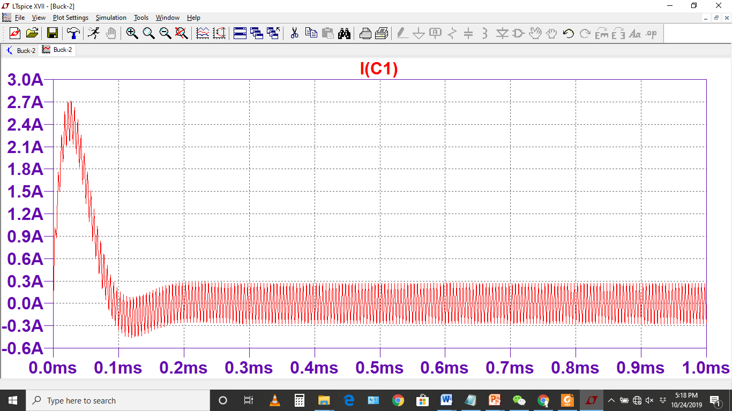
Capacitor Current

