Slide 1

PHASE 3 · PROGRESS PRESENTATION
InCraft
The Art of Intelligent Inventory
Web-based inventory & sales management · Flask, MySQL, Pandas, Matplotlib
By :- Ayush Anand
UID :- 24BCD10053

Slide 2
A
PROGRESS CHECK
Progress Relative to the Initial Plan
WE ARE HERE
✓
✓
3
4
5
Planning &
Requirements
Design &
Setup
Core
Development
Testing &
Refinement
Deployment
& Demo
✓
Completed So Far
◑
In Progress / On Track
Dashboard displaying live counts from MySQL
Inventory module: add, edit, delete, search & filter products
Sales module: transactions with automatic stock deduction
Core schema: products, categories, sales, sale items, stock movements
Data import / export (Pandas validation pipeline)
Analytics module — Pandas metrics + Matplotlib charts
Activity history & stock-movement logging
UI polish and responsive layout pass
Status shown is a typical example — mark each item against your team's real progress.
InCraft — The Art of Intelligent Inventory
2

Slide 3
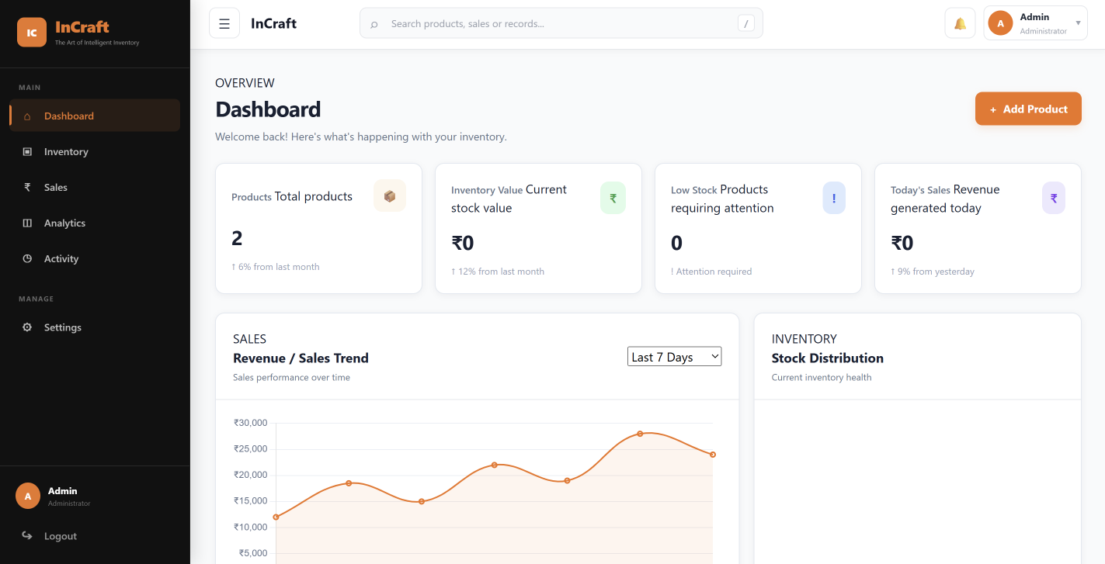
B
PROTOTYPE SNAPSHOT
Preliminary Results & Prototype
What's Working End-to-End
✓
Sale flow: select product → check stock → deduct → log stock movement
✓
Dashboard reads live counts and totals from MySQL
✓
CSV import prototype: upload → Pandas validation → preview
✓
First Matplotlib charts generated from real query results
Swap the numbers, chart data & "what's working" list for your actual build.
InCraft — The Art of Intelligent Inventory
3

Slide 4
C
APPROACH EVOLUTION
Methodology Refinement
Initial Approach
Refined Approach
Single Flask app with logic written directly inside route handlers
Manual, per-field validation repeated in each form
Stock updates handled inline within the sale route
Analytics values computed fresh on every page request
Modular Flask blueprints per module: inventory, sales, reports, analytics
Centralized Pandas validation layer, reused by forms and file import
Dedicated stock-movement service logging type, quantity & timestamp
Pre-aggregated analytics queries, cached before Matplotlib renders
Illustrative before/after — replace with your team's own methodology shift.
InCraft — The Art of Intelligent Inventory
4

Slide 5
D
PROBLEM SOLVING
Challenges Encountered & Solutions
!
CHALLENGE
✓
SOLUTION
Keeping stock accurate when one sale covers several products at once
Introduced a dedicated Sale Items structure so each line item deducts stock independently and atomically
!
CHALLENGE
✓
SOLUTION
Imported CSV/Excel files often had missing columns, blanks, or duplicate SKUs
Built a Pandas validation pipeline with a preview step before anything is committed to MySQL
!
CHALLENGE
✓
SOLUTION
Analytics needed to reflect real activity, not stale or hardcoded numbers
Charts now pull directly from MySQL at request time, with Pandas aggregating before Matplotlib renders
Example challenges based on the project plan — swap in what your team actually hit.
InCraft — The Art of Intelligent Inventory
5

Slide 6
Thank You

