Slide 1
PRESENTATION ON ANIME STORE
Presented By:
Ayush Pakhrin Tamang
Robina Shahi

Slide 2
Acknowledgement
We would like to express our deepest appreciation towards EVEREST COLLEGE BCA department who provided us the opportunity to do this project. We would like to show our humble gratitude to Mr. SANTU DEULA whose contribution in stimulating suggestions and encouragement, helped us to coordinate our project.

Slide 3
Topics to be discussed
Introduction
Problem Statement
Objectives
Development methodology
Requirement analysis
Recommendation Algorithm
Class and object diagram
Activity diagram
Implementation tools
Limitation
Conclusion

Slide 4
1.Introduction
Anime Store
Anime Store is an e-commerce platform where users are able to make purchase of merchs and cosplay dresses of their favourite anime
Anime is a style of Japanese film and television animation, typically aimed at adults as well as children
Anime store is related to those Japanese film which sell fanbased merch and dresses.

Slide 5
continue…
The system consist of two users:
Admin users:
Admin are the one to manage CRUD operation in database of customer as well as products.
Customer users:
Users are the one who can purchase and view products from the store.

Slide 6
2.Problem Statement
Limited product availability
Copyright problems
Limited community Interaction
Limited content categorization

Slide 7
3.Objectives
To promote E-commerce in Nepal.
To increase anime enthusiasts and fandom.
To provide premium and limited anime products

Slide 8
4.Development methodology
Waterfall methodology
A traditional project management method known as the "waterfall methodology" is characterized by sequential and linear phases, where each phase is finished before moving on to the next. It is suitable for projects with clearly defined requirements and little scope for change because it places an emphasis on careful planning, documentation, and a structured progression of tasks.

Slide 9
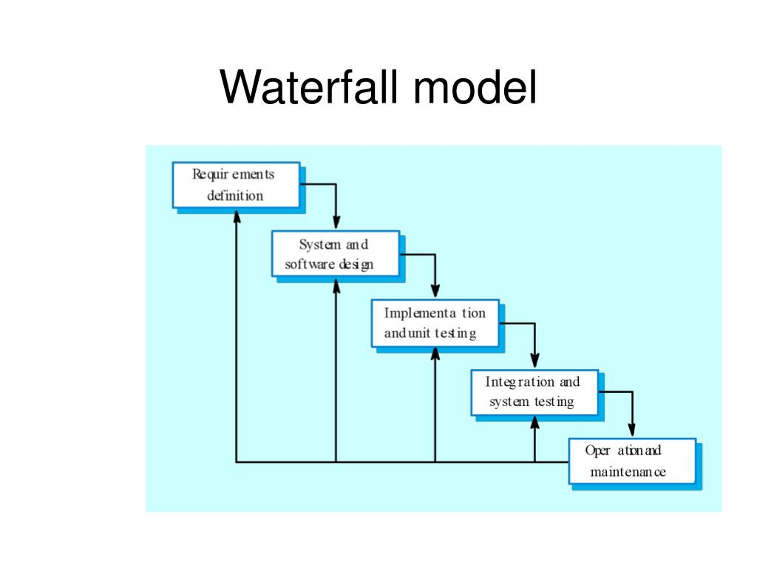
Continue..

Slide 10
5.Requirement analysis
Functional requirement
Non functional requirement
User
Allow customer to purchase
Allow customer to register and login
Allow customer to view details
Admin
Allow admin to insert products and categories
Allow admin to modify the product details.
Allow admin to view all users
Reliability
Security
Scalability
Portability

Slide 11
6.Recommendation Algorithm
Product Recommendation Algorithm:
Product recommendation algorithms are designed to suggest products to users based on their preferences, behaviors, and characteristics. These algorithms are widely used in e-commerce, streaming services, and various other applications to enhance user experience and drive engagement.
Our System will allow users to buy a products and product recommendation algorithm
Will recommend the products users usually search and buys from the website. It provides users to easily access the products.

Slide 12
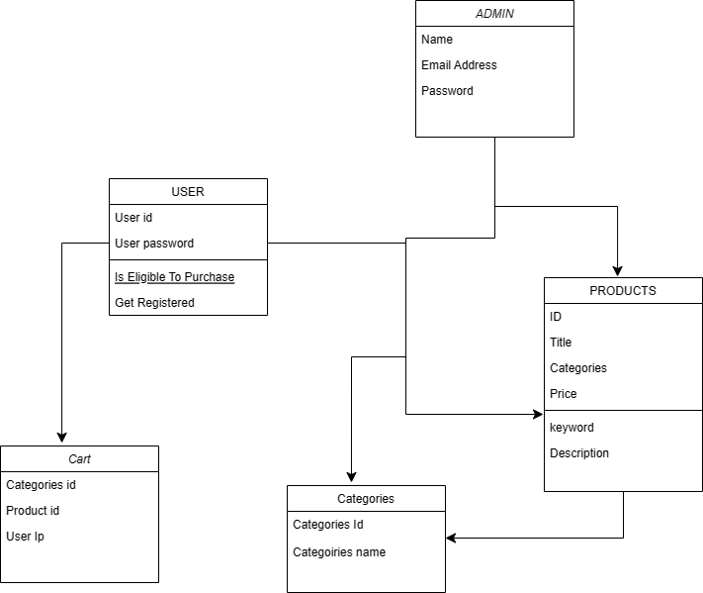
7.Class and object diagram

Slide 13
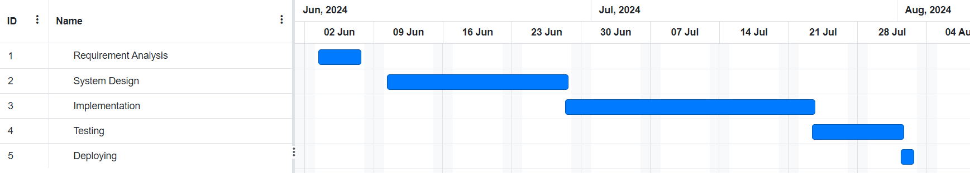
8.Activity diagram

Slide 14
9.Implementation tools
HTML
CSS
JAVASCRIPT
PHP
MYSQL
APACHE SERVER

Slide 15
10.Limitations
Our system consists of following limitations:
Our system cannot manage stocks.
In our system, user cannot leave comment or review about the product.

Slide 16
11.Conclusion
In conclusion,
The development and maintenance of an anime
E-commerce website present an exciting opportunity to engage and connect with a vibrant and passionate community of anime enthusiasts. The project creates a website offering them not only a place to shop but also a community to connect with and celebrate their shared love for anime.

Slide 17
THANK YOU !!!

