Slide 1
IBM University Engagement Project Submission
“Exploring the Power of Agentic AI with IBM Granite and LangFlow”

Slide 2

Project Tile – CareWatch AI – Agentic Chronic Disease Monitoring System
Domain of Project – Healthcare / AI-Powered Chronic Disease Management
Student Name | Recent Passport Photo | Email ID | Mobile number [WhatsApp]
Ayisha Muhammed |  | ayishamuhammed2005@gmail.com | 9074282974

Slide 3
Problem Statement -
Problem Statement : AI Agent for Chronic Disease Monitoring
The Challenge
Millions worldwide suffer from chronic conditions—diabetes, hypertension, and heart disease. Managing them requires continuous monitoring, timely interventions, and personalized care guidance. Health data from wearables and EHRs is siloed and hard to interpret. Without an intelligent, autonomous monitoring system, patients miss warning signs and face avoidable hospitalizations.
The Objective
Build an AI-powered Chronic Disease Monitoring Agent that delivers real-time health monitoring, predictive alerts, and personalized care guidance for individuals, families, and health professionals. The solution should:
Real-Time Health Monitoring – Continuously analyze wearable data (glucose, BP, heart rate) and flag anomalies against patient baselines.
RAG-Based Medical Knowledge – Retrieve WHO/ICMR guidelines and clinical protocols to ground all AI responses in trusted data.
Predictive Risk Alerts – Predict deterioration events 24–48 hours ahead using time-series pattern detection.
Dual-Mode Reporting – Generate plain-language alerts for patients and structured clinical summaries for doctors.
Multi-Agent Architecture –
Ingestion Agent (streams wearable + EHR data)
Analysis Agent (anomaly detection + trend analysis)
RAG Knowledge Agent (retrieves clinical guidelines)
Alert & Recommendation Agent (generates patient & doctor summaries)
Longitudinal Dashboard – Visualize longitudinal health trends, risk scores, and medication adherence over time.

Slide 4
Technology Used
Tech Stack (Mandatory)
Use any one of the following approaches:
LangFlow + IBM watsonx.ai + Granite Models
IBM Cloud Agentic Lab with IBM Granite Models
Replicate with LangChain + RAG + IBM Granite Models
I used LangFlow + IBM watsonx.ai + Granite Models

Slide 5
Proposed Solution -
Proposed Solution: CareWatch AI – Chronic Disease Monitoring Agent
The proposed solution is a multi-agent AI-powered Chronic Disease Monitoring System built using LangChain + CrewAI, IBM watsonx.ai, and IBM Granite Models to provide real-time chronic disease monitoring, predictive alerts, and personalized care guidance. The system addresses the critical gap in continuous patient monitoring through an intelligent, modular multi-agent architecture.
At its core, the solution uses a Retrieval-Augmented Generation (RAG) pipeline retrieves verified clinical guidelines from WHO, ICMR, and medical journals. This data is embedded into a vector database (ChromaDB), enabling context-aware responses grounded in trusted medical knowledge using Granite models.
The system consists of four specialized agents:
Ingestion Agent ingests and normalizes real-time streams from simulated wearables (glucose, BP, heart rate, SpO2).
Analysis Agent performs anomaly detection using statistical thresholds and ML models, flagging deviations from patient baselines.
RAG Knowledge Agent queries clinical databases to provide evidence-based explanations and care protocols for detected conditions.
Alert & Recommendation Agent generates dual-mode outputs: plain-language summaries for patients and structured clinical reports for doctors, with urgency triage.
The solution includes a React-based monitoring dashboard that visualizes longitudinal health trends, risk scores, and medication adherence. Built with FastAPI + React for scalable deployment.
LangChain + CrewAI orchestrates multi-agent workflows, while IBM watsonx.ai handles model deployment, embeddings, and AI governance. IBM Granite powers clinical reasoning, summarization, and alert generation.
Overall, this solution delivers an end-to-end intelligent chronic care platform that enables proactive patient management, reduces hospital admissions, and bridges the gap between patients and providers.

Slide 6
LangChain / CrewAI Components Used -
1) Health Data Ingestion Node – Accepts simulated wearable streams (glucose, BP, heart rate) and patient profile inputs via REST API.
2) IBM watsonx AI Agent - Orchestrates all agents via CrewAI; routes health data to the Analysis Agent and triggers RAG lookups using IBM Granite.
3) IBM Granite Model - granite-3-2-8b-instruct → Powers clinical reasoning, alert generation, and patient report summarization
4) Alert & Report Output -Delivers dual-mode outputs: patient-friendly plain-language alerts and structured clinical summaries for doctors.
5) ChromaDB Vector Store - Stores embeddings of clinical guidelines (WHO, ICMR) for RAG retrieval; enables semantic search on medical protocols.
6) FastAPI Backend + React Dashboard - Exposes agent pipeline via REST API; visualizes longitudinal health trends and risk scores in real time.

Slide 7
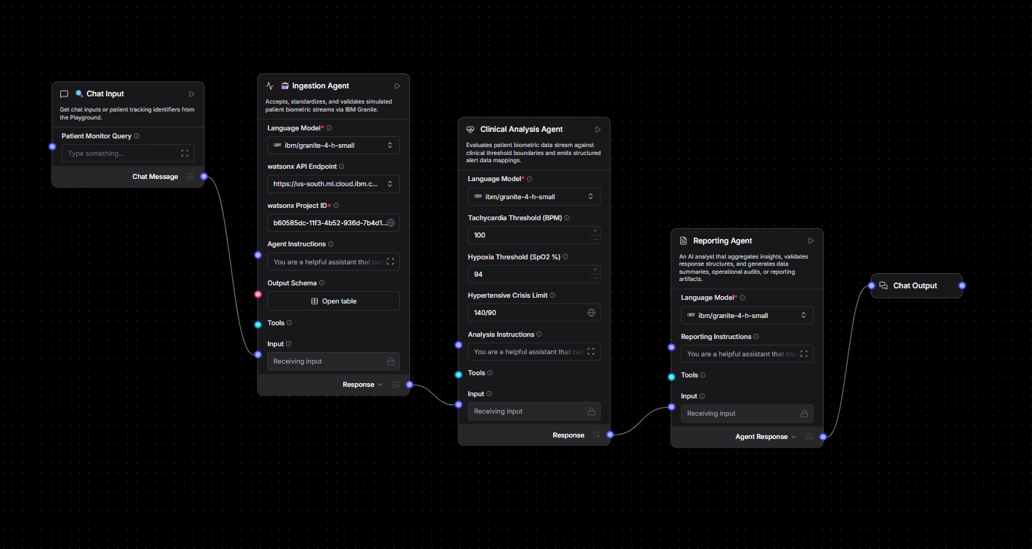
Langflow workflow -

Slide 8
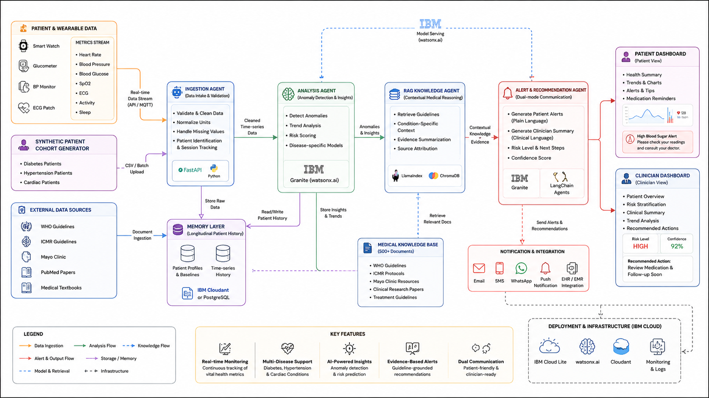
Architecture blueprint

Slide 9

Role of Agentic AI in the solution
Role of Agentic AI in CareWatch
Agentic AI enables CareWatch to function as a proactive, autonomous health guardian rather than a passive data logger. Using IBM watsonx.ai and IBM Granite models, it coordinates four specialized agents that collectively monitor, analyze, and respond to patient health events in real time.
Each agent owns a distinct responsibility—ingesting wearable streams, detecting anomalies, retrieving clinical evidence, and generating alerts—while sharing a common memory layer for longitudinal context. This multi-agent approach enables the system to reason across days and weeks of patient history, not just individual events.
Agentic AI also brings temporal context awareness, understanding each patient's medical history, medication schedule, and condition-specific baselines to personalize every alert. It supports real-time adaptation, updating risk models as new vitals arrive and learning from clinician feedback over time.
The inter-agent communication pattern means a spike in glucose can automatically trigger a RAG lookup for diabetic protocols, which then informs the alert content—all without human intervention.
Overall, Agentic AI transforms CareWatch from a static dashboard into a dynamic, intelligent care coordinator—acting like a 24/7 clinical copilot that catches what doctors miss and empowers patients to take control of their chronic conditions.

Slide 10
Technology Used
LangChain + CrewAI platform – For building multi-agent pipelines; CrewAI defines agent roles, tasks, and inter-agent communication
IBM Granite model - for eg – ibm/granite-3-2-8b-instruct – Powers clinical NLU, anomaly explanation, and alert generation
IBM Cloud – Hosts the entire CareWatch stack. Provides scalable compute, managed databases, and HIPAA-compliant security posture suitable for healthcare workloads.
RAG– RAG to retrieve verified clinical guidelines before generating patient or doctor responses, reducing hallucination risk in a high-stakes medical context.
IBM Watsonx.ai - Model deployment, text embeddings (for RAG), and AI governance ensuring explainability of clinical recommendations
Vector Database (ChromaDB) – Stores embeddings of 500+ medical guidelines; enables sub-100ms semantic retrieval for RAG

Slide 11
Novelty and Uniqueness
CareWatch stands out by combining Agentic AI, RAG-grounded medical knowledge, and predictive analytics into a healthcare-grade chronic disease platform.
Multi-Agent Architecture – Four agents with distinct roles (Ingestion, Analysis, Knowledge, Alert) coordinate autonomously, enabling robust and parallelized health monitoring
Clinically Grounded RAG – Every AI response is grounded in verified sources (WHO, ICMR, Mayo Clinic), critically reducing hallucination risk in a medical context
Longitudinal Patient Memory – The system reasons across weeks of health history, not just the latest reading, enabling trend-based risk assessment
Predictive Early Warning – Detects deterioration patterns 24–48 hours before critical events, enabling proactive intervention rather than reactive treatment
Dual-Mode Output – Generates patient-friendly plain language alerts AND structured clinical summaries for doctors—bridging the communication gap
Disease-Specific Intelligence – Separate knowledge bases for diabetes, hypertension, and cardiac conditions ensure domain-accurate recommendations
Scalable & Enterprise-Ready – Deployed on IBM watsonx.ai with IBM Granite models, with built-in AI governance and explainability for every clinical recommendation
This makes CareWatch a production-grade, explainable AI health platform—not just a monitoring dashboard, but an intelligent clinical partner.

Slide 12
Git Hub Link
Github URL – https://github.com/Ay-sha-07/CareWatchAI.git 1) app.json file
2) yourproblemstatement.pdf file
3) your projectpresntation.pptx file
4)other files
are included in the github repository.

Slide 13
Future Scope
1. Real Wearable Device Integration –
Replace synthetic data streams with live integration to FDA-approved devices (Apple Watch, Dexcom CGM, Omron BP monitors) via Bluetooth/HL7 FHIR APIs. This would enable true real-world deployment with clinically validated sensor data.
2.EHR Integration & Hospital Deployment –
Connect CareWatch to hospital Electronic Health Records (EPIC, OpenMRS) to incorporate lab results, medications, and clinical notes into the monitoring pipeline. This would enable full clinical-grade deployment in a hospital or telemedicine setting.
·
·
·

Slide 14


