Slide 1
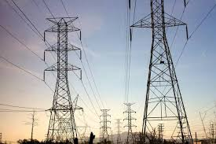
Time Series Analysis and Forecasting of Electricity Consumption Data Ayooluwa Adedipe
Stutern Graduate Accelerator, Cohort 07
Data Science/Machine Learning Track

Slide 2
About Me
I am Ayooluwa Adedipe, a graduate of Chemical Engineering whose interest in Data Science/ Machine Learning was triggered by my final year research on Non Linear Model Predictive Control with an Extended Kalman Filter for real time parameter/disturbance estimation and model updates.
The most fascinating aspect of this course for me has been Time Series Analysis. The reason for this is because it ties in with my previous research work and I realize that output prediction is majorly carrying out forecasting on time series data (states and controlled variables) from process plants.

Slide 3
About Me (contd.)
Most importantly, I realized the usefulness of Time Series Analysis in forecasting of both electricity generation and consumption which is a significant motivation for me in choosing Chemical Engineering and now Machine Learning
Apart from the technical skills, my biggest lesson from the Stutern Graduate Accelerator course is to think outside the box and try to build solutions as quickly as possible. Learning in tech should be less theory focused and more about getting things done and scaling. I hope to adopt this in all my endeavors, going forward.

Slide 4
Problem Statement
In the supply chain that begins with electricity generation, runs through distribution and ends with consumption by the end user, there are often energy losses and inefficiencies (Rahman et al., 2016)
These energy losses are even more expensive in a country like Nigeria where not enough electricity is being generated in the first place.
To increase efficiency, it is important to be able to forecast the energy demand in each area to a fairly accurate degree. This will help in scheduling distribution and preventing oversupply to some areas while underserving others.

Slide 5
ToolBox
The programming language used for this project is Python with coding done in the Jupyter Notebook environment
Regular libraries for Data Science and Machine learning such as Pandas, Numpy, Matplotlib, Seaborn, and Scikit learn were used
Useful Libraries for Time Series Analysis such as statsmodels and sarimax were also used

Slide 6
Research Process/Approach
Ideally, local electricity consumption data would have been the best for a project of this nature.
Due to time constraints for the completion of the course, gathering data locally was not feasible.
To improvise, data from Kaggle London smart meters electricity consumption was used. Suggestions for local implementation are provided in the next steps section
Exploratory Data Analysis was carried out to identify various properties of the data. Also, moving average techniques and exponential smoothing was used to identify the overall trend in the data.

Slide 7
Research Process/Approach
While the customer data was already classified based on the Acorn classification, a clustering technique was also used to classify the customers based on location ID. Forecasting can be done for these separate clusters to help with scheduling electricity distribution
Finally, the forecasting itself was carried out using a Seasonal ARIMA model, the Facebook prophet forecasting algorithm, and a Long Short Term Memory model

Slide 8
Findings/Results
The use of the Location clusters and Acorn classification as exogenous parameters improved the performance of the SARIMAX model with lower Mean Absolute Error and Mean Absolute Percentage Error
No exog: MAE: 0.5785 MAPE: 5.2672
location_cluster alone: MAE: 0.5786 MAPE: 5.2679
arcon_numbers alone: MAE: 0.5704 MAPE: 5.1858
arcon_numbers and location_cluster: MAE: 0.5697 MAPE: 5.1782

Slide 9
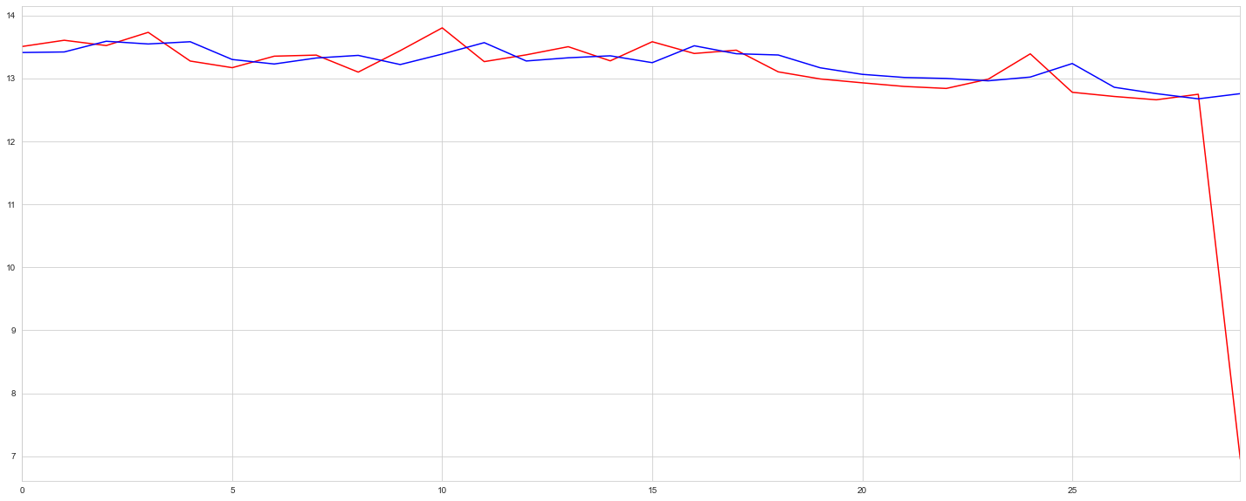
Findings/Results (Contd.)
For the LSTM, carrying out forecasting on the supervised data itself gave a lower Root Mean Square Error than when the engineered features were included. The network could learn on its own.

Slide 10
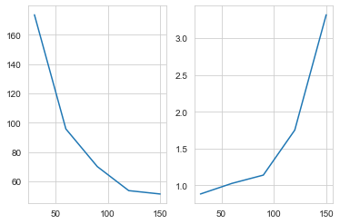
Findings/Results (Contd.)
Fb Prophet is a good candidate for forecasting but may require some more tuning as the MAE and MAPE change with the prediction horizon as shown below

Slide 11
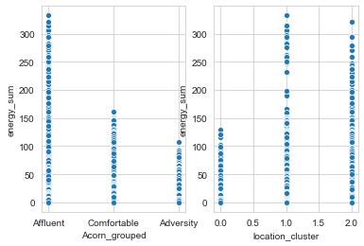
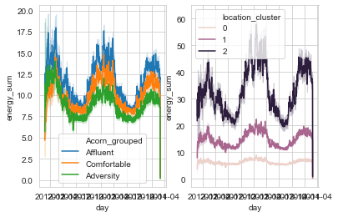
Findings/Results (Contd.)
Electricity usage is dependent on factors like temperature, economic status (as indicated by geographical location) as well as having seasonal effects i.e, it depends on the time of the year (more visualizations in the attaced Jupyter notebook)

Slide 12
Stakeholder benefits
Electricity Distribution Companies (Discos) can build this into their systems to schedule distribution over periods of time ( a day, a week or even a month)
Insights from the Exploratory Data Analysis can help with deciding peak periods, most profitable customers, and location with the highest electricity needs
The forecasting system can be built as backend for a mobile app through which customers can check a forecast of how much electricity they would be consuming the next month and generate an estimated bill. This can be used to create a standard tariff package such as paying 6 months in advance, which will be beneficial to both customer and DisCo

Slide 13
Next Steps
Most importantly, applying these analyses and techniques to Nigerian electricity consumption data would be an important task to carry out.
As previously mentioned, deploying these forecasts to production is another step that has to be worked on.

Slide 14
Contact Info
ayooluwaadedipe@gmail.com
+2347060951036

Slide 15
References
https://www.kaggle.com/data-exploration-smart-meters-london
Hai-xiang ZHAO and Frédéric MAGOULÈS, Feature Selection for Predicting Building Energy Consumption Based on Statistical Learning Method
Mohammad Naimur Rahman, Amir Esmailpour, Junhui Zhao: Machine Learning with Big Data An Efficient Electricity Generation Forecasting System
I. Koprinska, M. Rana, V.G. Agelidis, Correlation and instance based feature selection for electricity load forecasting, Knowledge-Based Systems (2015), doi: http://dx.doi.org/10.1016/j.knosys. 2015.02.017
Li Guo, Jinhao Chen, Fukui Wu & Manran Wang (2018) An electric power generation forecasting method using support vector machine, Systems Science & Control Engineering, 6:3, 191-199, DOI: 10.1080/21642583.2018.1544947 https://doi.org/10.1080/21642583.2018.1544947

Slide 16
References
https://towardsdatascience.com/the-complete-guide-to-time-series-analysis-and-forecasting-70d476bfe775
https://www.kaggle.com/jeanmidev/smart-meters-in-london
https://www.kaggle.com/hsankesara/time-series-forecasting-using-seasonal-arima
https://www.kaggle.com/rheajgurung/energy-consumption-forecast

