Slide 1

Who will Donate?

Slide 2
Introduction
The challenge here is to draw insights from previous donor history and make predictions based on that to identify the most likely donors to reach out to.
Identifying individuals most likely to donate will help save the time and resources required to do the actual work of caring for the less privileged

Slide 3
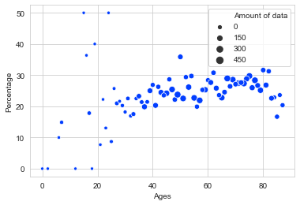
Insights (based on percentage of givers compared to non-donors in the dataset)
Age
People aged 50 had the highest significant contributions (35% donated)
The next highest (significant) donors were those aged 80 and 82 with 31% of them donating
Insufficient data to estimate younger people’s contribution.
Based on available data, middle aged(50) and elderly people(80-82) should be targeted in donation requests

Slide 4
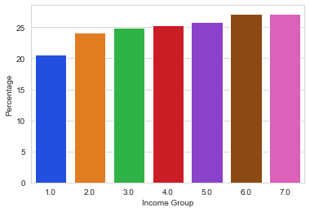
Insights(contd.)
Income Group
Expectedly, there were higher donor percentages from the top income groups.
In making donation requests, people in income groups 5 and above should be given priority

Slide 5
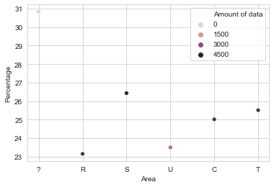
Insights (contd.)
Location
Among respondents, suburban dwellers had the highest percentage donation (26.5%)
There isn’t sufficient data about urban dwellers(less than1500 data points)

Slide 6
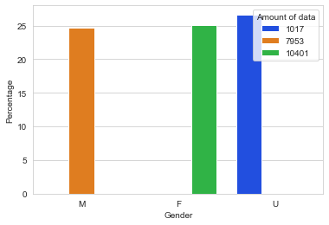
Insights (contd.)
Gender
Gender does not seem to be a significant factor in determining whether a given respondent would donate or not.

Slide 7
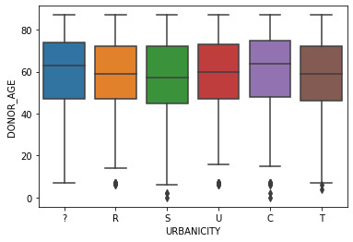
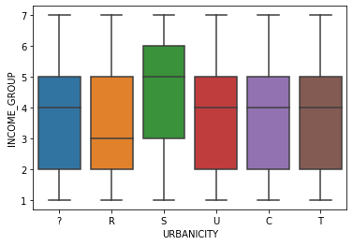
Missing Data and Null Values
Columns with a high amount of missing data were left out of the analysis (Target D- 75%. Wealth Rating: 45.48%)
Income Group and Donor Age had 22.67% and 24.75% null values respectively
The null values were filled with mode and mean based on Metropolis

Slide 8
Data Preparation
Removal of collinear features (Months since first gift and Average file gift)
Removal of observations with Age 0
Applying Log transformation to columns with high skew
Removal of Gender category A present in training set but not prediction test
Undersampling to balance the data

Slide 9
Prediction
Performance Metric: The positive recall (TP/FN+TP) was chosen for measuring performance since we need to identify donors.
A Decision Tree Classifier provided the highest recall and was trained on the training data then applied to the prospective donors data, generating a list of 516 control numbers identifying the most likely donors to reach out to

Slide 10
Summary and Recommendations
The data collection system has to be improved to fix the following
High number of null values in dataset (an example is the provision of options or drop down menus rather than asking respondents to fill data manually)
Collecting uniform data across categories (significant examples: age and metropolis) to properly represent the population and provide a balanced data set

Slide 11
Further Work
To adopt this system for regular use at the charity, an ML pipeline can be built to integrate the whole data cleaning, feature engineering and prediction process.
Training a deep neural network and selecting the right hyperparameters to learn the data and make more accurate predictions
Collect enough data to develop a time series framework for this data and investigate the donation pattern among respondents based on time (e.g. When are the peak months where people are most likely to donate)

