Slide 1

Donor Prediction Challenge
Who is likely to donate to charity?

Slide 2
Introduction
The challenge here is to draw insights from previous donor history and make predictions based on that to identify the most likely donors to reach out to.
Being able to identify the individuals with the highest potential to donate will save the charity organization time, money and efforts

Slide 3
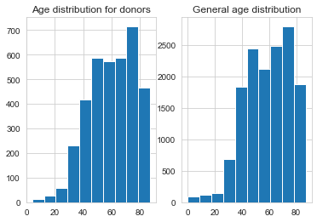
Insights
Age
Most of the people who donated in the past were between the ages of 70 and 80. Promotional efforts should be targeted at this age group

Slide 4
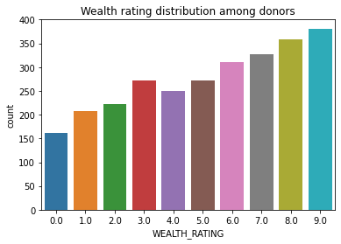
Insights(contd.)
Wealth Rating
As expected, people with higher wealth rating are more likely to give. Therefore, promotional efforts should be targeted at the more wealthy people

Slide 5
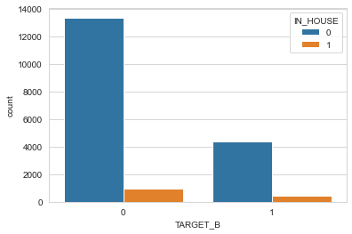
Insights(contd.)
Inhouse donations
It appears, there’s little contribution among workers within the charity. There should be a focus on donation among staff as this with set a precedent for other people.

Slide 6
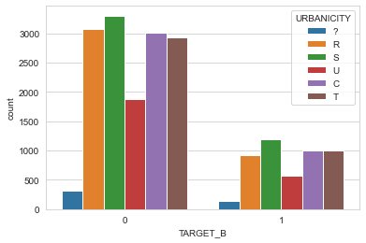
Insights (contd.)
Location
It appears from the data graph that there’s comparatively little data about people in Urban area. There is a good chance that urban dwellers will be willing to donate, so more efforts should be made to reach out to people in these areas

Slide 7
Prospects to Contact
867 individuals are predicted to be likely to donate to the charity and they are identified by their controlled number as given by the list_of_likely_donors series in the prediction python notebook file.

